Slide 1

11: Genetic Programming
COMP704: Machine Learning

Slide 2
Evolutionary algorithms (EAs) Revision from Lecture 7
Inspired by biological evolution
A family of population-based search algorithms
Fittest individuals are used to produce new individuals via mutation and crossover
Genotype: search space representation
Phenotype: solution space representation

Slide 3
Basic evolutionary algorithm Revision from Lecture 7
Initialise population
Evaluate fitness of population
No
Done?
Select parents for next generation
Yes
End
Breed offspring to form new population

Slide 4
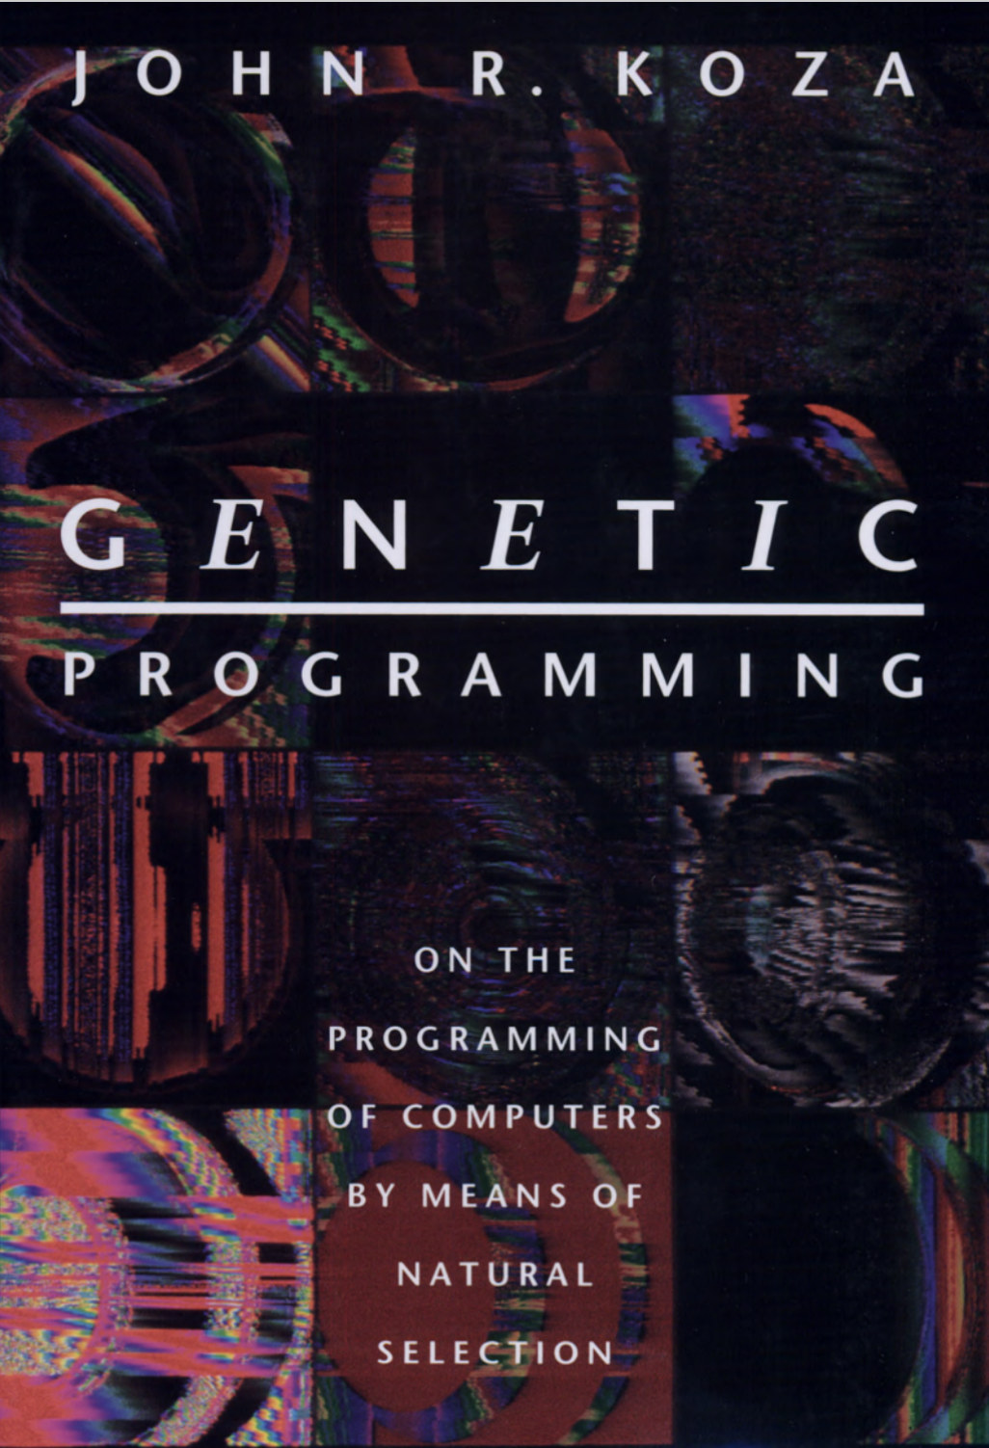
Genetic Programming (GP)
A term given to EA approaches where the genotype is a computer program
The phenotype is the result of executing the program

Slide 5
Genotype representation
We could represent a program as a sequence of ASCII characters…
… but the vast majority of individuals would not correspond to syntactically correct programs
Can’t run the program → no phenotype!
We need a representation where the genotype is certain (or at least very likely) to map to a valid phenotype
Several options – the classic one is a tree representation

Slide 6
Programs as trees
if (x > 10)
print(“Hello”)
else
x = x + 1
if-else
call
=
x
>
x
10
print
“Hello”
+
x
1

Slide 7
Abstract syntax trees
Representing programs as trees is nothing unusual – it’s used extensively inside compilers/interpreters
Abstract Syntax Trees (ASTs)
Language syntax has been abstracted away
A valid tree is probably a valid program
AST can be executed as-is, or translated back into source code

Slide 8
Fitness evaluation
Remember, fitness is a property of the phenotype
In GP, the first step in measuring fitness is to execute the program
Fitness is often measured based on the program’s output
But could also measure non-functional properties e.g. speed, memory usage
Fitness may be multi-objective

Slide 9
Mutation
Point mutation: replace a random node
if-else
call
=
x
>
x
10
print
“Hello”
+
x
1
==

Slide 10
Mutation
Subtree mutation: replace a random subtree
if-else
call
=
x
>
x
10
print
“Hello”
+
x
1
*
+
7
x
3

Slide 11
Crossover
if-else
call
=
x
>
x
10
print
“Hello”
+
x
1
while
<
x
5
=
x
/
+
x
1
2

Slide 12
Crossover
while
if-else
<
=
>
call
=
x
5
x
/
x
10
print
“Hello”
x
+
+
2
x
1
x
1

Slide 13
Biological inspiration
The version of evolutionary algorithms we saw in week 7 take inspiration from biological genetics
Genotype is a fixed-length string of “DNA”
GP moves away from this
Genotype is a variable-size tree structure
No real analogue of this in nature (that we know of)
However GP still retains much of the rest of the biological inspiration behind EAs

Slide 14
Weak vs strong typing
Nodes generally correspond to values when the program is executed, therefore have a type
Weak typing: the language rules are permissive about what type can go where in the tree
Strong typing: nodes require their children to have specific types, and GP operators are careful to preserve type

Slide 15
Disruption
As you know, a small change in a program can have a huge impact on its execution!
Genetic operators can be disruptive, destroying good individuals
Much work on operators to minimise disruption and maintain goodness of solutions
E.g. context preserving crossover
E.g. Automatically Defined Functions (ADFs)

Slide 16
Bloat
GP operators can often allow trees to grow arbitrarily
Often a lot of bloat resulting from “junk code”
Overly-convoluted code that could be simplified
Code that doesn’t actually do anything, e.g. the else branch of an if that is always true, or a calculation that is eventually multiplied by zero

Slide 17
Combatting bloat
Can put a hard limit on the size or depth of the tree
Can modify GP operators to prefer smaller trees
Can include tree size as part of the fitness measure, rewarding smaller trees
However, bloat has similarities to introns in biology – genes which appear to do nothing, but are actually important
Appears to be important for maintaining diversity in the population

Slide 18
Conclusion
Genetic programming is a family of evolutionary algorithms where the genotype is a computer program
Several possible genotype representations, but representations based on trees are popular
As with all EAs, there is an art to making it work but it can be extremely powerful

