Slide 1

10: Mixed Initiative PCG
COMP704: Machine Learning

Slide 2
Mixed initiative
Intersection of AI and HCI
Systems where both the human user and an AI agent can take initiative i.e. decide what to do next
Moving away from software as a tool and towards software as an assistant

Slide 3

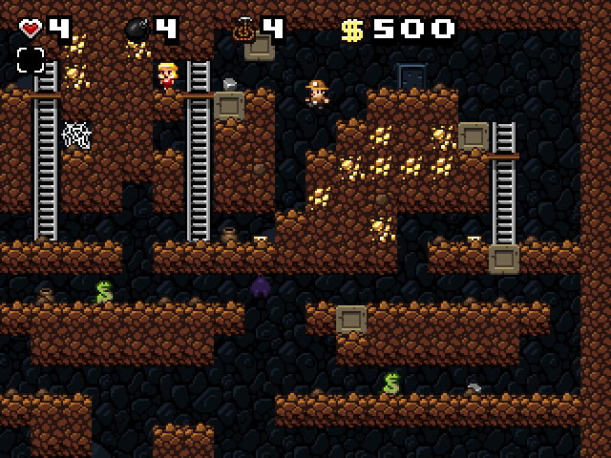

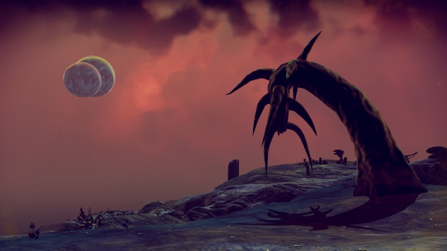
Mixed initiative for PCG
Content creation tools
PCG
Mixed initiative tools

Slide 4
Tanagra [Smith, Whitehead & Mateas 2010]
Mixed initiative tool for 2D platformer level design
Uses planning and constraint solving to fill in the gaps in user-created levels
Allows for direct manipulation of level pacing through “beats”

Slide 5
https://youtu.be/JaMr4_nEiYo

Slide 6
Sentient Sketchbook [Liapis, Yannakakis & Togelius 2013]
Mixed initiative tool for 2D top-down level design
User sketches high-level design
System provides analysis and makes suggestions (using evolutionary algorithms)

Slide 7
https://youtu.be/Eop1AuFcujE

Slide 8
Sentient World [Liapis, Yannakakis & Togelius 2013]
Adaptation of Sentient Sketchbook to terrain generation
User provides a rough sketch, AI agent suggests refinements
Based on novelty search
Population-based search algorithm that doesn’t try to find the optimum, but tries to find as diverse a population as possible

Slide 9
https://youtu.be/hLsnSSYyg-A

Slide 10
Procedural personas for sentient sketchbook [liapis, holmgård, Yannakakis, Togelius 2015]
Procedural personas: AI agents representing archetypal decision making styles
E.g. monster killer, treasure hunter, speed runner, …
Used in Sentient Sketchbook as critics: to evaluate content and make suggestions

Slide 11
https://youtu.be/DZxKj7w-osE

Slide 12
Ropossum [Shaker, Shaker & Togelius 2013]
Mixed initiative tool for puzzle game level design
AI agent for testing that levels are solvable
Evolutionary algorithm for generating solvable levels

Slide 13
https://youtu.be/FM3v0tbdKrs

Slide 14
Usefulness of mixed initiative
Can make content creation easier and/or faster
Can provide ideas to spark creativity
Can provide tools to assess quality, playability etc
Gives more control than pure PCG

