Slide 1
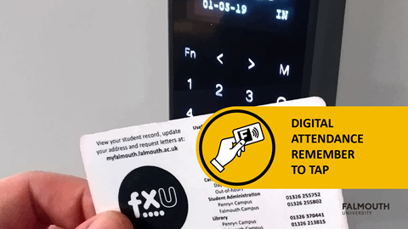
Registration reminder

Slide 2
GAM702 - Game Feel
Brian McDonald

