Slide 1
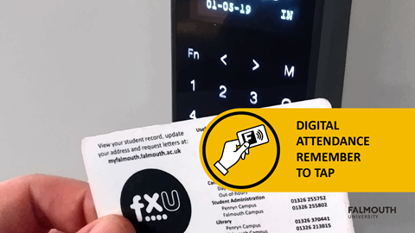
Attendance Reminder

Slide 2
GAM702 – Prototyping Tools
Brian McDonald

