Slide 1

9: Constraint SaTISFACTION
COMP702: Classical Artificial Intelligence

Slide 2
Paper Club
For next week’s seminar, please read:
A.M. Smith, M. Mateas. Answer Set Programming for Procedural Content Generation: A Design Space Approach, IEEE Transactions on Computational Intelligence and AI in Games, 2011.
(PDF Link on LearningSpace)

Slide 3
Constraint Satisfaction Problems

Slide 4

Constraint Satisfaction Problems (CSP)
A Constraint Satisfaction Problem (CSP) is defined by:
A set $\left\{X_{1},…, X_{n}\right\}$ of variables
A set $\left\{D_{1},…,D_{n}\right\}$ of domains, specifying what values each variable can take
A set $\left\{C_{1},…,C_{m}\right\}$ of constraints that the variables must satisfy
A solution is an assignment of a value to every variable which satisfies all the constraints

Slide 5
Sudoku
A 9x9 grid
Each square contains a number 1-9
A number cannot appear more than once in any given row, column, or 3x3 square outlined in bold
Some numbers are given – the puzzle is to fill in the rest
A properly designed Sudoku puzzle has exactly one solution
4 |  |  |  | 8 |  | 6
 | 5 | 9 | 4 |  | 7 | 1
 |  |  | 9 |  | 1 | 5 | 2
9 |  | 3
 | 6 |  |  |  |  |  | 1
 |  |  |  |  |  | 9 |  | 8
 | 3 | 2 | 1 |  | 5
 |  | 8 | 2 |  | 6 | 7 | 3
 |  | 6 |  | 7 |  |  |  | 9

Slide 6
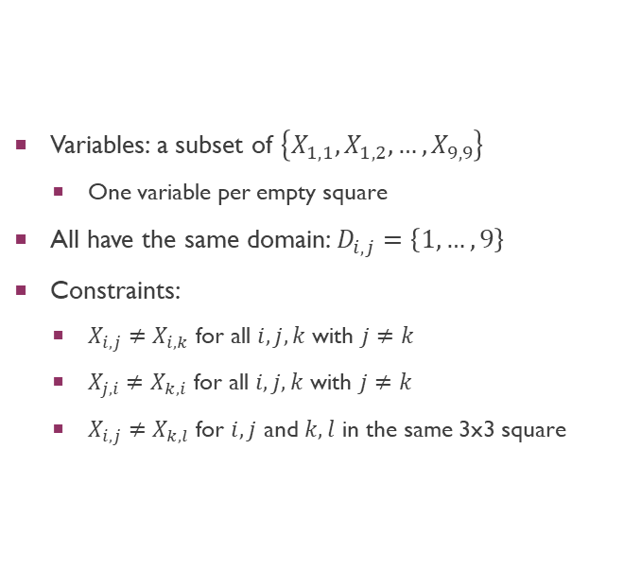
Sudoku as a CSP
Variables: a subset of $\left\{X_{1,1},X_{1,2},…,X_{9,9}\right\}$
One variable per empty square
All have the same domain: $D_{i,j}=\left\{1,…,9\right\}$
Constraints:
$X_{i,j}≠X_{i,k}$ for all $i,j,k$ with $j≠k$
$X_{j,i}≠X_{k,i}$ for all $i,j,k$ with $j≠k$
$X_{i,j}≠X_{k,l}$ for $i,j$ and $k,l$ in the same 3x3 square
4 |  |  |  | 8 |  | 6
 | 5 | 9 | 4 |  | 7 | 1
 |  |  | 9 |  | 1 | 5 | 2
9 |  | 3
 | 6 |  |  |  |  |  | 1
 |  |  |  |  |  | 9 |  | 8
 | 3 | 2 | 1 |  | 5
 |  | 8 | 2 |  | 6 | 7 | 3
 |  | 6 |  | 7 |  |  |  | 9

Slide 7
Solving Sudoku Backtracking
Pick an empty square
Try a possible value for that empty square
Try to solve the rest of the puzzle (recursively)
If we run into a dead end, go back and try a different value

Slide 8

Solving Sudoku Backtracking
Procedure SolveBacktracking(square)
For $n=1,…,9$
If square can have value $n$
Set value of square to $n$
If square is the last empty square or SolveBacktracking(next_empty_square)
Return true
End If
End If
End For
Clear the value of square
Return false
End Procedure

Slide 9
Solving Sudoku Constraint Propagation
Each empty square keeps track of which numbers it could possibly contain
Update every square
If a square has only one possible number, fill it in
Repeat until stuck

Slide 10
Solving Sudoku Constraint Propagation
Procedure SolveConstraintPropagation()
Repeat
For each empty square
Determine the list of possible numbers that could go in the square
If the list is empty
Return false // unsolvable
Else if the list has a single element
Fill in the number
End If
End For
Until no changes are made
Return true
End Procedure

Slide 11
Backtracking vs constraint propagation
Backtracking always finds a solution, but is inefficient
Constraint propagation is efficient, but doesn’t always find a solution
More sophisticated constraint propagation algorithms do exist
We could also combine the two
Use backtracking to “unstick” constraint propagation
Use constraint propagation to narrow down the options that backtracking needs to consider

Slide 12
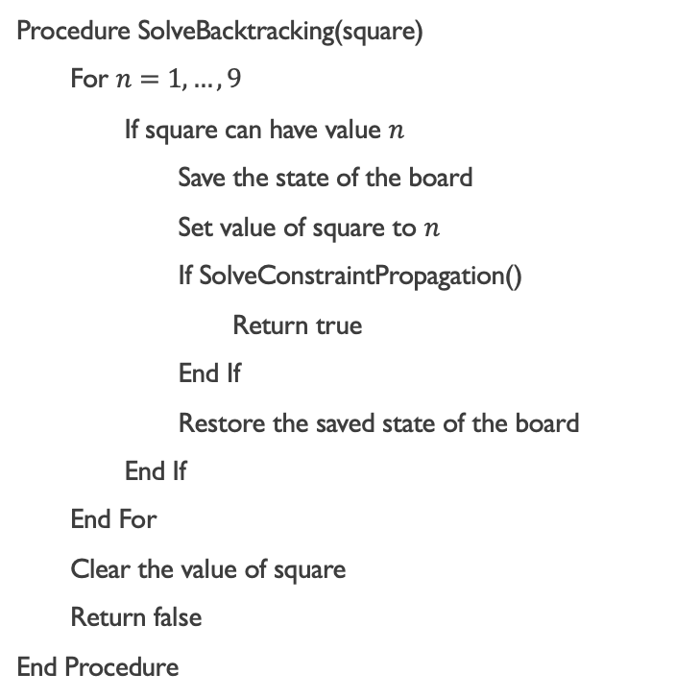
Solving Sudoku Backtracking + constraint propagation
Procedure SolveConstraintPropagation()
Repeat
For each empty square
Determine the list of possible numbers
If the list is empty
Return false // unsolvable
Else if the list has a single element
Fill in the number
End If
End For
Until no changes are made
If the puzzle is solved
Return true
Else
Return SolveBacktracking(first empty square)
End Procedure
Procedure SolveBacktracking(square)
For $n=1,…,9$
If square can have value $n$
Save the state of the board
Set value of square to $n$
If SolveConstraintPropagation()
Return true
End If
Restore the saved state of the board
End If
End For
Clear the value of square
Return false
End Procedure

Slide 13
Wave Function Collapse

Slide 14
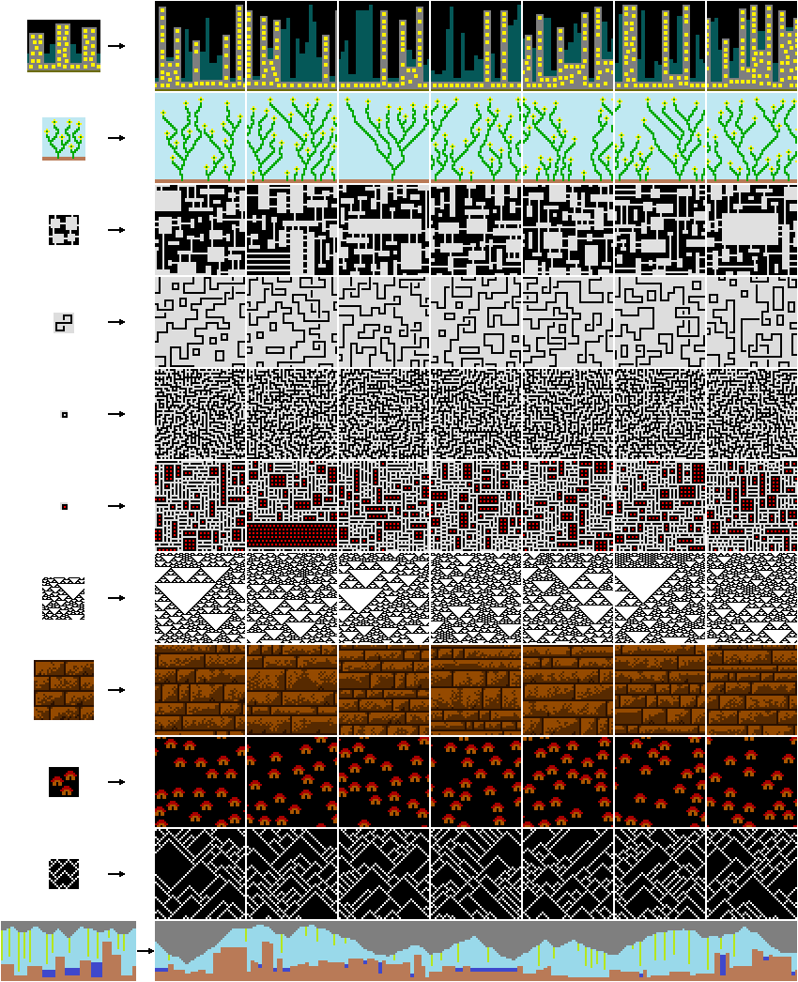
Wave Function Collapse
Procedural Content Generation algorithm
Invented by Maxim Gumin in 2016
Named after a concept from quantum mechanics

Slide 15
Wave Function Collapse The idea
Space is divided into cells, each of which has a state
E.g. pixels with a colour; voxels with a 3D mesh from a modular kit
Constraints on what cell states can neighbour each other are extracted from examples
A basic form of machine learning
Constraints are probabilistic – not just what is allowed next to a given cell, but what is more or less likely
Each cell has a probability distribution over states
A cell is chosen, its state is set according to its probabilities, neighbouring cells are updated according to constraints
The algorithm backtracks if it gets stuck

Slide 16

Choosing the next cell
Named after Claude Shannon (1916-2001), the “father of Information Theory”
A cell is chosen which has minimal Shannon entropy $S=−\sum_{i}{P_{i}\log{P_{i}}}$
Lower Shannon entropy = less uncertainty about the possible value of the cell

Slide 17
Wave Function Collapse Resources
These are also available on LearningSpace
https://github.com/mxgmn/WaveFunctionCollapse
http://www.procjam.com/tutorials/wfc/
http://oskarstalberg.com/game/wave/wave.html
https://twitter.com/exutumno

