Slide 1

10: Logic Programming
COMP702: Classical Artificial Intelligence

Slide 2
Logic

Slide 3
Predicates
A predicate is a function which returns a Boolean
In logic, a predicate is a parameterised statement which is true or false
E.g. LivesIn(Bob, Falmouth) could be a predicate representing the statement “Bob lives in Falmouth”
Two parameters: Bob and Falmouth

Slide 4
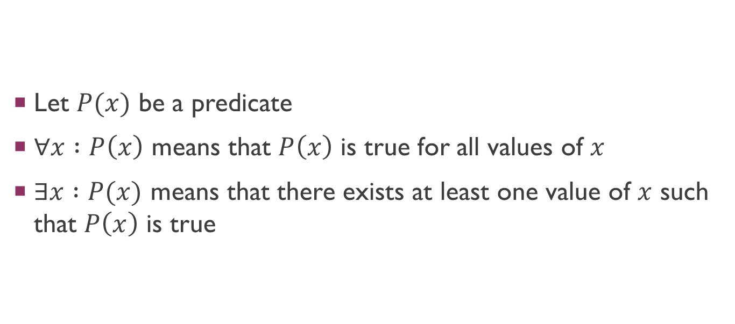
Quantifiers
Let $P(x)$ be a predicate
$∀x :P\left(x\right)$ means that $P\left(x\right)$ is true for all values of $x$
$∃x :P(x)$ means that there exists at least one value of $x$ such that $P\left(x\right)$ is true

Slide 5
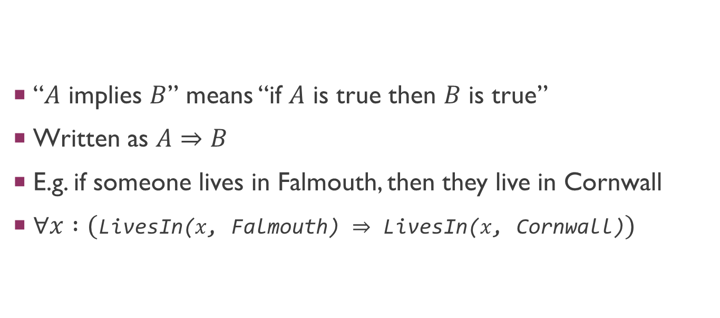
Implication
“$A$ implies $B$” means “if $A$ is true then $B$ is true”
Written as $A⇒B$
E.g. if someone lives in Falmouth, then they live in Cornwall
$∀x :($LivesIn($x$, Falmouth) $⇒$ LivesIn($x$, Cornwall)$)$

Slide 6
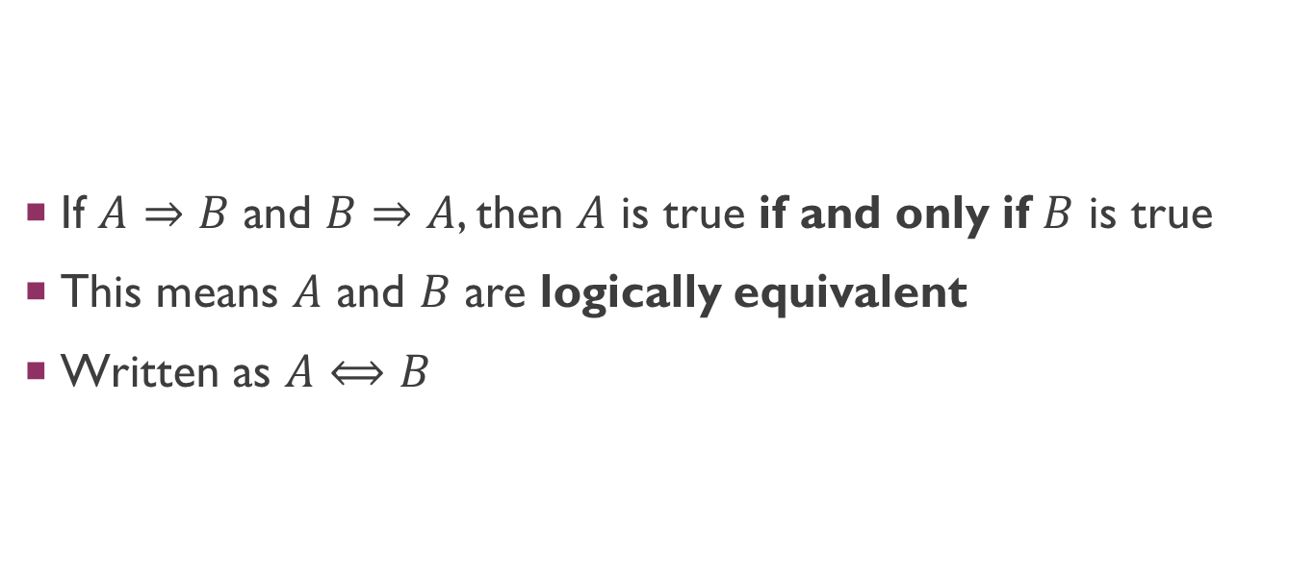
Equivalence
If $A⇒B$ and $B⇒A$, then $A$ is true if and only if $B$ is true
This means $A$ and $B$ are logically equivalent
Written as $A⟺B$

Slide 7
Prolog

Slide 8
Prolog
A declarative language for logic programming
First developed in early 1970s
Several implementations available today – I’m using SWI-Prolog (which is free open source)

Slide 9
Uses of Prolog
Well suited for declarative propositional logic
Can do constraint programming
Can do STRIPS-like planning
Backtracking search comes built in

Slide 10
Anatomy of a Prolog program
A standard Prolog program specifies:
Facts – these are predicates which are true
Rules – implications of the form Head :- Body, which states that Head is true if Body is true
A program by itself doesn’t do anything – we run queries against it
Is a given predicate true?
For what parameter values is a given predicate true?

Slide 11
A fact
lives_in is a predicate. Predicates are introduced when first used.
lives_in(bob, falmouth).
bob and falmouth are atoms – named variable values. Atoms begin with lowercase letters.

Slide 12
Queries
We can query predicates for truth or falsehood
?- lives_in(bob, falmouth).
true.
?- lives_in(bob, penryn).
false.

Slide 13
Queries
We can also introduce variables – Prolog gives us all possible values of the variable for which the predicate is true
?- lives_in(bob, X).
X = falmouth.
?- lives_in(Y, falmouth).
Y = bob.
?- lives_in(Z, penzance).
false.
Variables begin with uppercase letters (to distinguish them from atoms)
There are no variable values that make the predicate true, so Prolog returns false

Slide 14
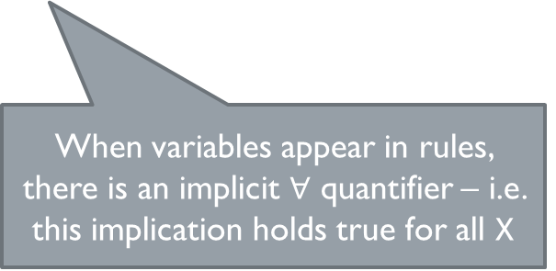
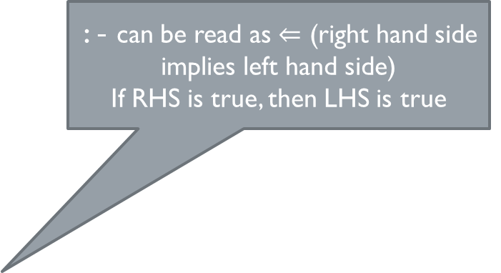
Rules
:- can be read as $⇐$ (right hand side implies left hand side)
If RHS is true, then LHS is true
lives_in(X, cornwall) :- lives_in(X, falmouth).
drinks_cider(X) :- lives_in(X, cornwall).
When variables appear in rules, there is an implicit $∀$ quantifier – i.e. this implication holds true for all X

Slide 15
Querying rules
We can run queries based on the chains of implications in our rules
?- lives_in(bob, cornwall).
true.
?- drinks_cider(X).
X = bob.

Slide 16
Pattern matching
We can define multiple rules with the same predicate, or even the same LHS
When searching in response to a query, Prolog applies whichever one matches

Slide 17
Conjunction
The RHS of a rule can contain a conjunction (an AND)
Denoted by predicates separated by commas
is_local_student(X) :- lives_in(X, cornwall), studies_at(X, falmouth).

Slide 18
How does Prolog execute queries?
Uses Selective Linear Definite (SLD) resolution
Multiple rules for a predicate imply a choice point, which leads to a backtracking search
Care is needed to avoid infinite loops etc
Can be thought of as a special case of a Boolean satisfiability problem (SAT problem)
In the general case, SAT is NP-complete

Slide 19
Constraint programming in Prolog

Slide 20
Constraint programming
Prolog can do constraint programming with the aid of libraries
Several available; e.g. clpfd allows for constraint programming with integer maths
:- use_module(library(clpfd)).
Introduces new relational operators #=, #<, #<= etc, which can be used for constraint solving

Slide 21
Solving equations
X #= 1 + 2.
X = 3.
15 #= 3 * Y.
Y = 5.
21 #= X*Y, X #> 1, Y #= 1, X #< Y.
X = 3,
Y = 7.

Slide 22
More examples
https://www.swi-prolog.org/man/clpfd.html

