Slide 1

12: Fuzzy Logic and probability
COMP702: Classical Artificial Intelligence

Slide 2
Fuzzy Logic
Boolean logic: variables are either true or false
Humans don’t tend to reason with hard Boolean logic – we use information that is vague, imprecise and uncertain
Fuzzy logic was introduced in 1960s to model this
Variables have a truth value between 0 and 1
Related to fuzzy set theory: instead of elements being either in or not in a set, they have a degree of membership between 0 and 1

Slide 3
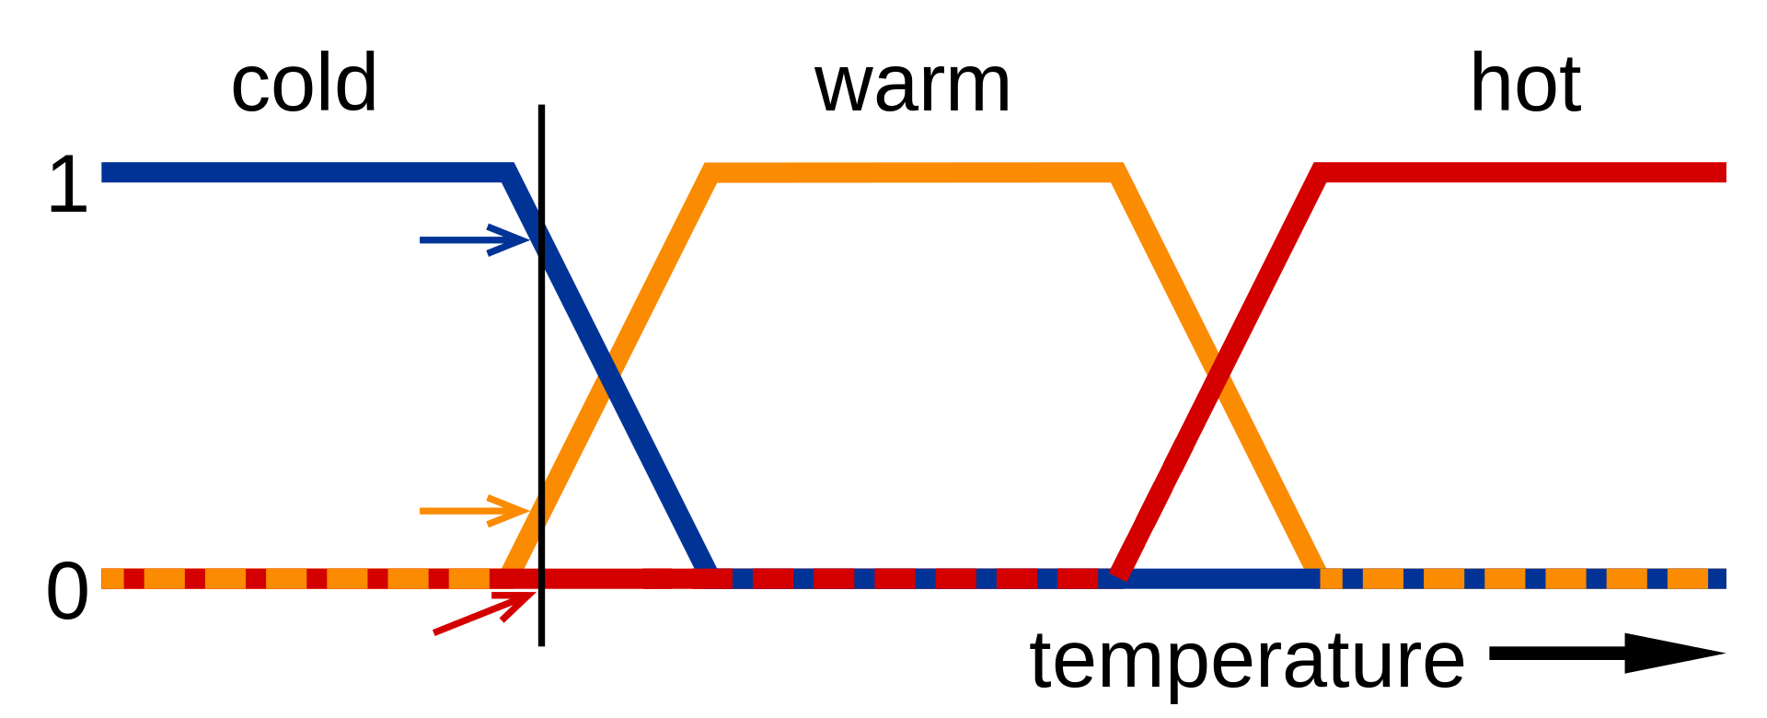
Fuzzy logic example
“It is cold”, “it is warm”, “it is hot” are fuzzy statements

Slide 4

Fuzzy Logical operators
$A$ AND $B$ → min($A, B$)
$A$ OR $B$ → max($A, B$)
NOT($A$) → $1−A$

Slide 5
Probability
Similar to fuzzy logic: values between 0 and 1
Fuzzy logic models vagueness
Probability models likelihood

Slide 6

Probability “logic”
$P\left(A AND B\right)=P\left(A\right)×P\left(B\right)$
$P\left(A OR B\right)=P\left(A\right)+P\left(B\right)−P\left(A AND B\right)$
$P\left(NOT A\right)=1−P\left(A\right)$

Slide 7
bELIEFS
Recall: in a game of imperfect information, the state of the world is not known
The information set is the set of all possible states
Some states are more likely than others
The agent’s beliefs can be modelled as a probability distribution over the information set
A function assigning a probability to each state
Probabilities add up to 1

Slide 8
Inference
The agent’s beliefs may change based on observing the game
In particular, based on what actions other players choose
E.g. in Poker, inferring what cards other players are likely to have based on their choices of bids

Slide 9
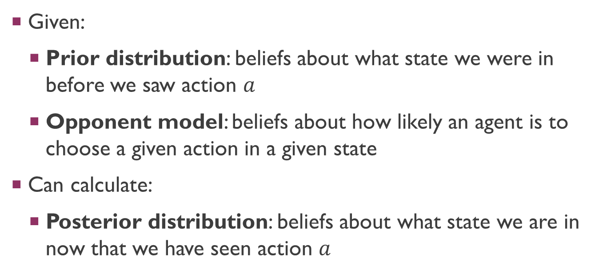
Bayesian inference
Given:
Prior distribution: beliefs about what state we were in before we saw action $a$
Opponent model: beliefs about how likely an agent is to choose a given action in a given state
Can calculate:
Posterior distribution: beliefs about what state we are in now that we have seen action $a$

Slide 10
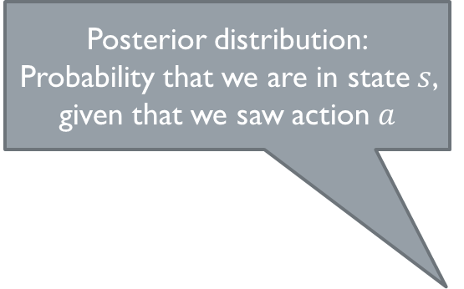

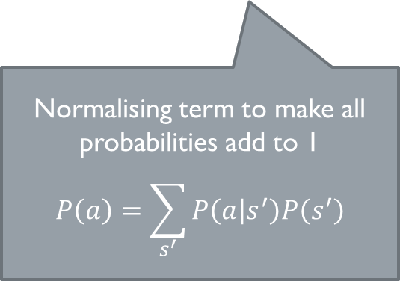

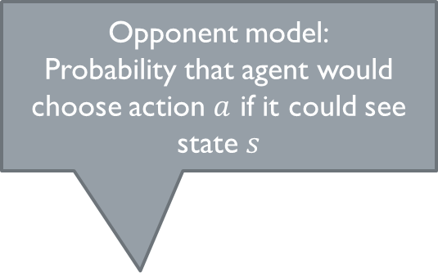
Bayesian inference
Opponent model:
Probability that agent would choose action $a$ if it could see state $s$
Posterior distribution:
Probability that we are in state $s$, given that we saw action $a$
$$P\left(s | a\right)=\frac{P\left(a | s\right)P\left(s\right)}{P\left(a\right)}$$
Prior distribution:
Probability that we were in state $s$
Normalising term to make all probabilities add to 1
$$P\left(a\right)=\sum_{s^{′}}{P\left(a | s^{′}\right)P\left(s^{′}\right)}$$

Slide 11
Bluffing
Bayesian inference relies on an opponent model
Assumption of rationality
However, if a rational agent knows that they are being observed and inferred upon, this might influence their behaviour…
Bluffing refers to any behaviour deliberately meant to fool inference

