Slide 1

7: Evolutionary Algorithms
COMP704: Machine Learning

Slide 2
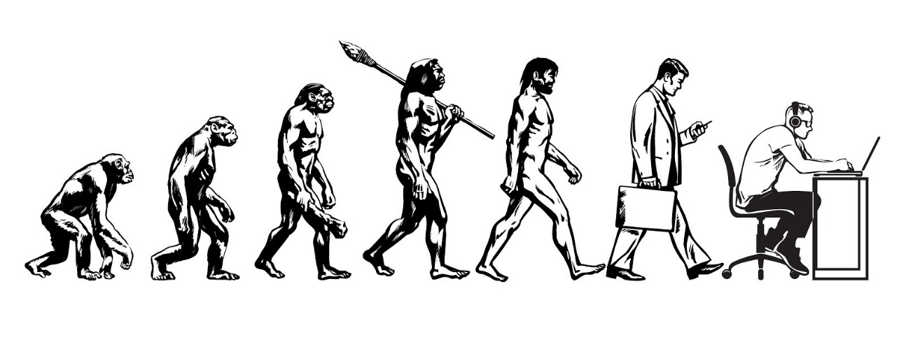
Biological evolution
Biological populations survive by reproduction
When organisms reproduce, they copy themselves imperfectly
Offspring take on traits from their parents
If offspring survive long enough to reproduce, their traits are passed on
“Survival of the fittest” – traits which are valuable for survival tend to propagate

Slide 3
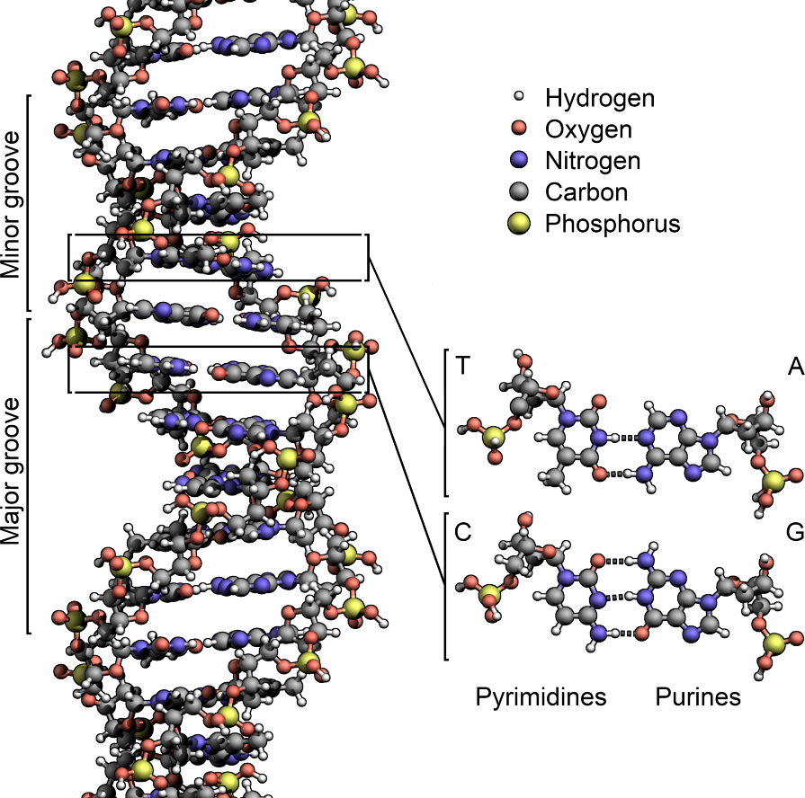
Genetics for Dummies
DNA: deoxyribonucleic acid
A molecular string of base pairs: adenine-thymine, cytosine-guanine
Essentially a string of characters A C G T
Grouped into genes, which in turn are grouped into chromosomes

Slide 4
Genetics for Dummies
DNA constructs proteins through complex chemical reactions
Proteins construct organisms
DNA is copied when cells and organisms reproduce
“Mistakes” sometimes happen during copying: this is called mutation
In sexual reproduction, offspring take some genes from each parent

Slide 5
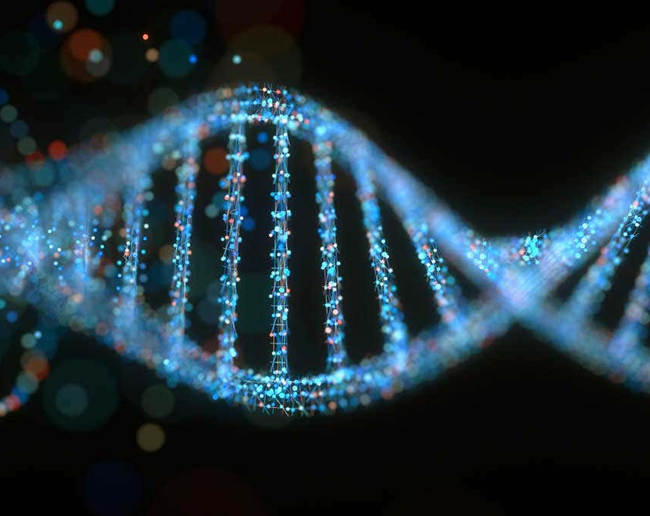
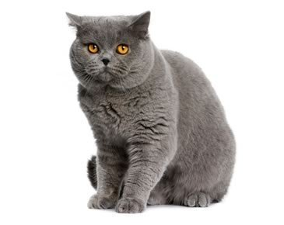
Genotypes and phenotypes
Genotype: DNA
Phenotype: organism
Genotype dictates the form the phenotype takes
Changes in the genotype cause changes in the phenotype
This is a one-way mapping: changes in the phenotype do not change the genotype
Discredited theory of Lamarckian evolution
Genotype is information (the sequence of base pairs in the genes)
Phenotype is a physical organism

Slide 6
Fitness
Fitness is a property of the phenotype
In biology: how capable the organism is of surviving and reproducing
This directly determines how likely its genes are to survive by being passed on
Fitness is endogenous: a by-product of the environment

Slide 7
Evolutionary algorithms (EAs)
Inspired by biological evolution
A family of population-based search algorithms
Genotype: search space representation
Phenotype: solution space representation
E.g. genotype is parameters to a content generator, phenotype is the generated content itself

Slide 8
Fitness
Fitness is still a property of the phenotype
However in EAs, fitness is usually exogenous rather than endogenous
Fitness is not a by-product of an environment, but is an explicit numerical function provided by the developer

Slide 9
Basic evolutionary algorithm
Initialise population
Evaluate fitness of population
No
Done?
Select parents for next generation
Yes
End
Breed offspring to form new population

Slide 10
Initialisation
Often initialise the population with random individuals
May also use known good individuals (though this can bias the search towards those solutions too much)
Initialise population
Evaluate fitness of population
No
Done?
Select parents for next generation
Yes
End
Breed offspring to form new population

Slide 11
Stopping
Stop when a good enough solution has been found?
Stop after a certain amount of time?
Initialise population
Evaluate fitness of population
No
Done?
Select parents for next generation
Yes
End
Breed offspring to form new population

Slide 12
Fitness
Need a fitness function to evaluate individuals
Fitness is a feature of the phenotype – probably have to map genotype to phenotype here
Initialise population
Evaluate fitness of population
No
Done?
Select parents for next generation
Yes
End
Breed offspring to form new population

Slide 13
Selection
Deterministic: choose the top X% by fitness score
Probabilistic: choose with probability proportional to fitness
Tournament: choose n at random and take the fittest
Artist as gardener: skip the fitness evaluation and ask a human user to choose
Initialise population
Evaluate fitness of population
No
Done?
Select parents for next generation
Yes
End
Breed offspring to form new population

Slide 14
Reproduction
Mutation: take one parent and change it slightly
Crossover: take two parents and combine them
Elitism: allow the fittest individuals in the current generation straight through to the next
Initialise population
Evaluate fitness of population
No
Done?
Select parents for next generation
Yes
End
Breed offspring to form new population

Slide 15
Mutation
0 0 1 1 1 0 1 0 0 1 1 0 1 0 0 1 0 1 0 1
0 0 1 1 1 0 1 0 0 1 1 0 1 0 1 1 0 1 0 1
One parent
Make a small random change to the genotype
E.g. if genotype is a binary string, flip a bit
(Or flip X% of bits, or flip each bit with probability P)

Slide 16
Crossover
00111010011010010101
10011010101000110110
00111010011000110110
Two parents
Split the genotype at a random crossover point
Combine part of the first parent and part of the second parent

Slide 17
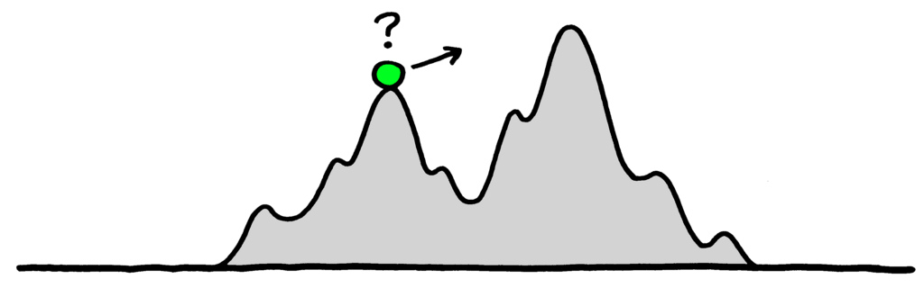
Why both?
Mutation helps avoid the problem of getting stuck in a local optimum – ensures diversity
Crossover works to recombine “useful” parts of genotype into fitter individuals – “building block hypothesis”

Slide 18
Workshop tomorrow
Assignment support!

