Slide 1


Module Induction
GAM705: Major Project

Slide 2
Aim and Structure
Outline of the Session
Different Kinds of Project
Assessment and Submissions
Where to ﬁnd what?
FAQs

Slide 3
The Staff
Alcwyn Parker (Module Leader)
Casto Vocal
Jeff Howard
Ady Smith
Ed Powley
Joan Casas-Roma
… ?
Matt Irwin
Archie Andrews
Michael Gray
Lectures, crits, etc.
Supervised studio practice

Slide 4
Aim and Structure

Slide 5
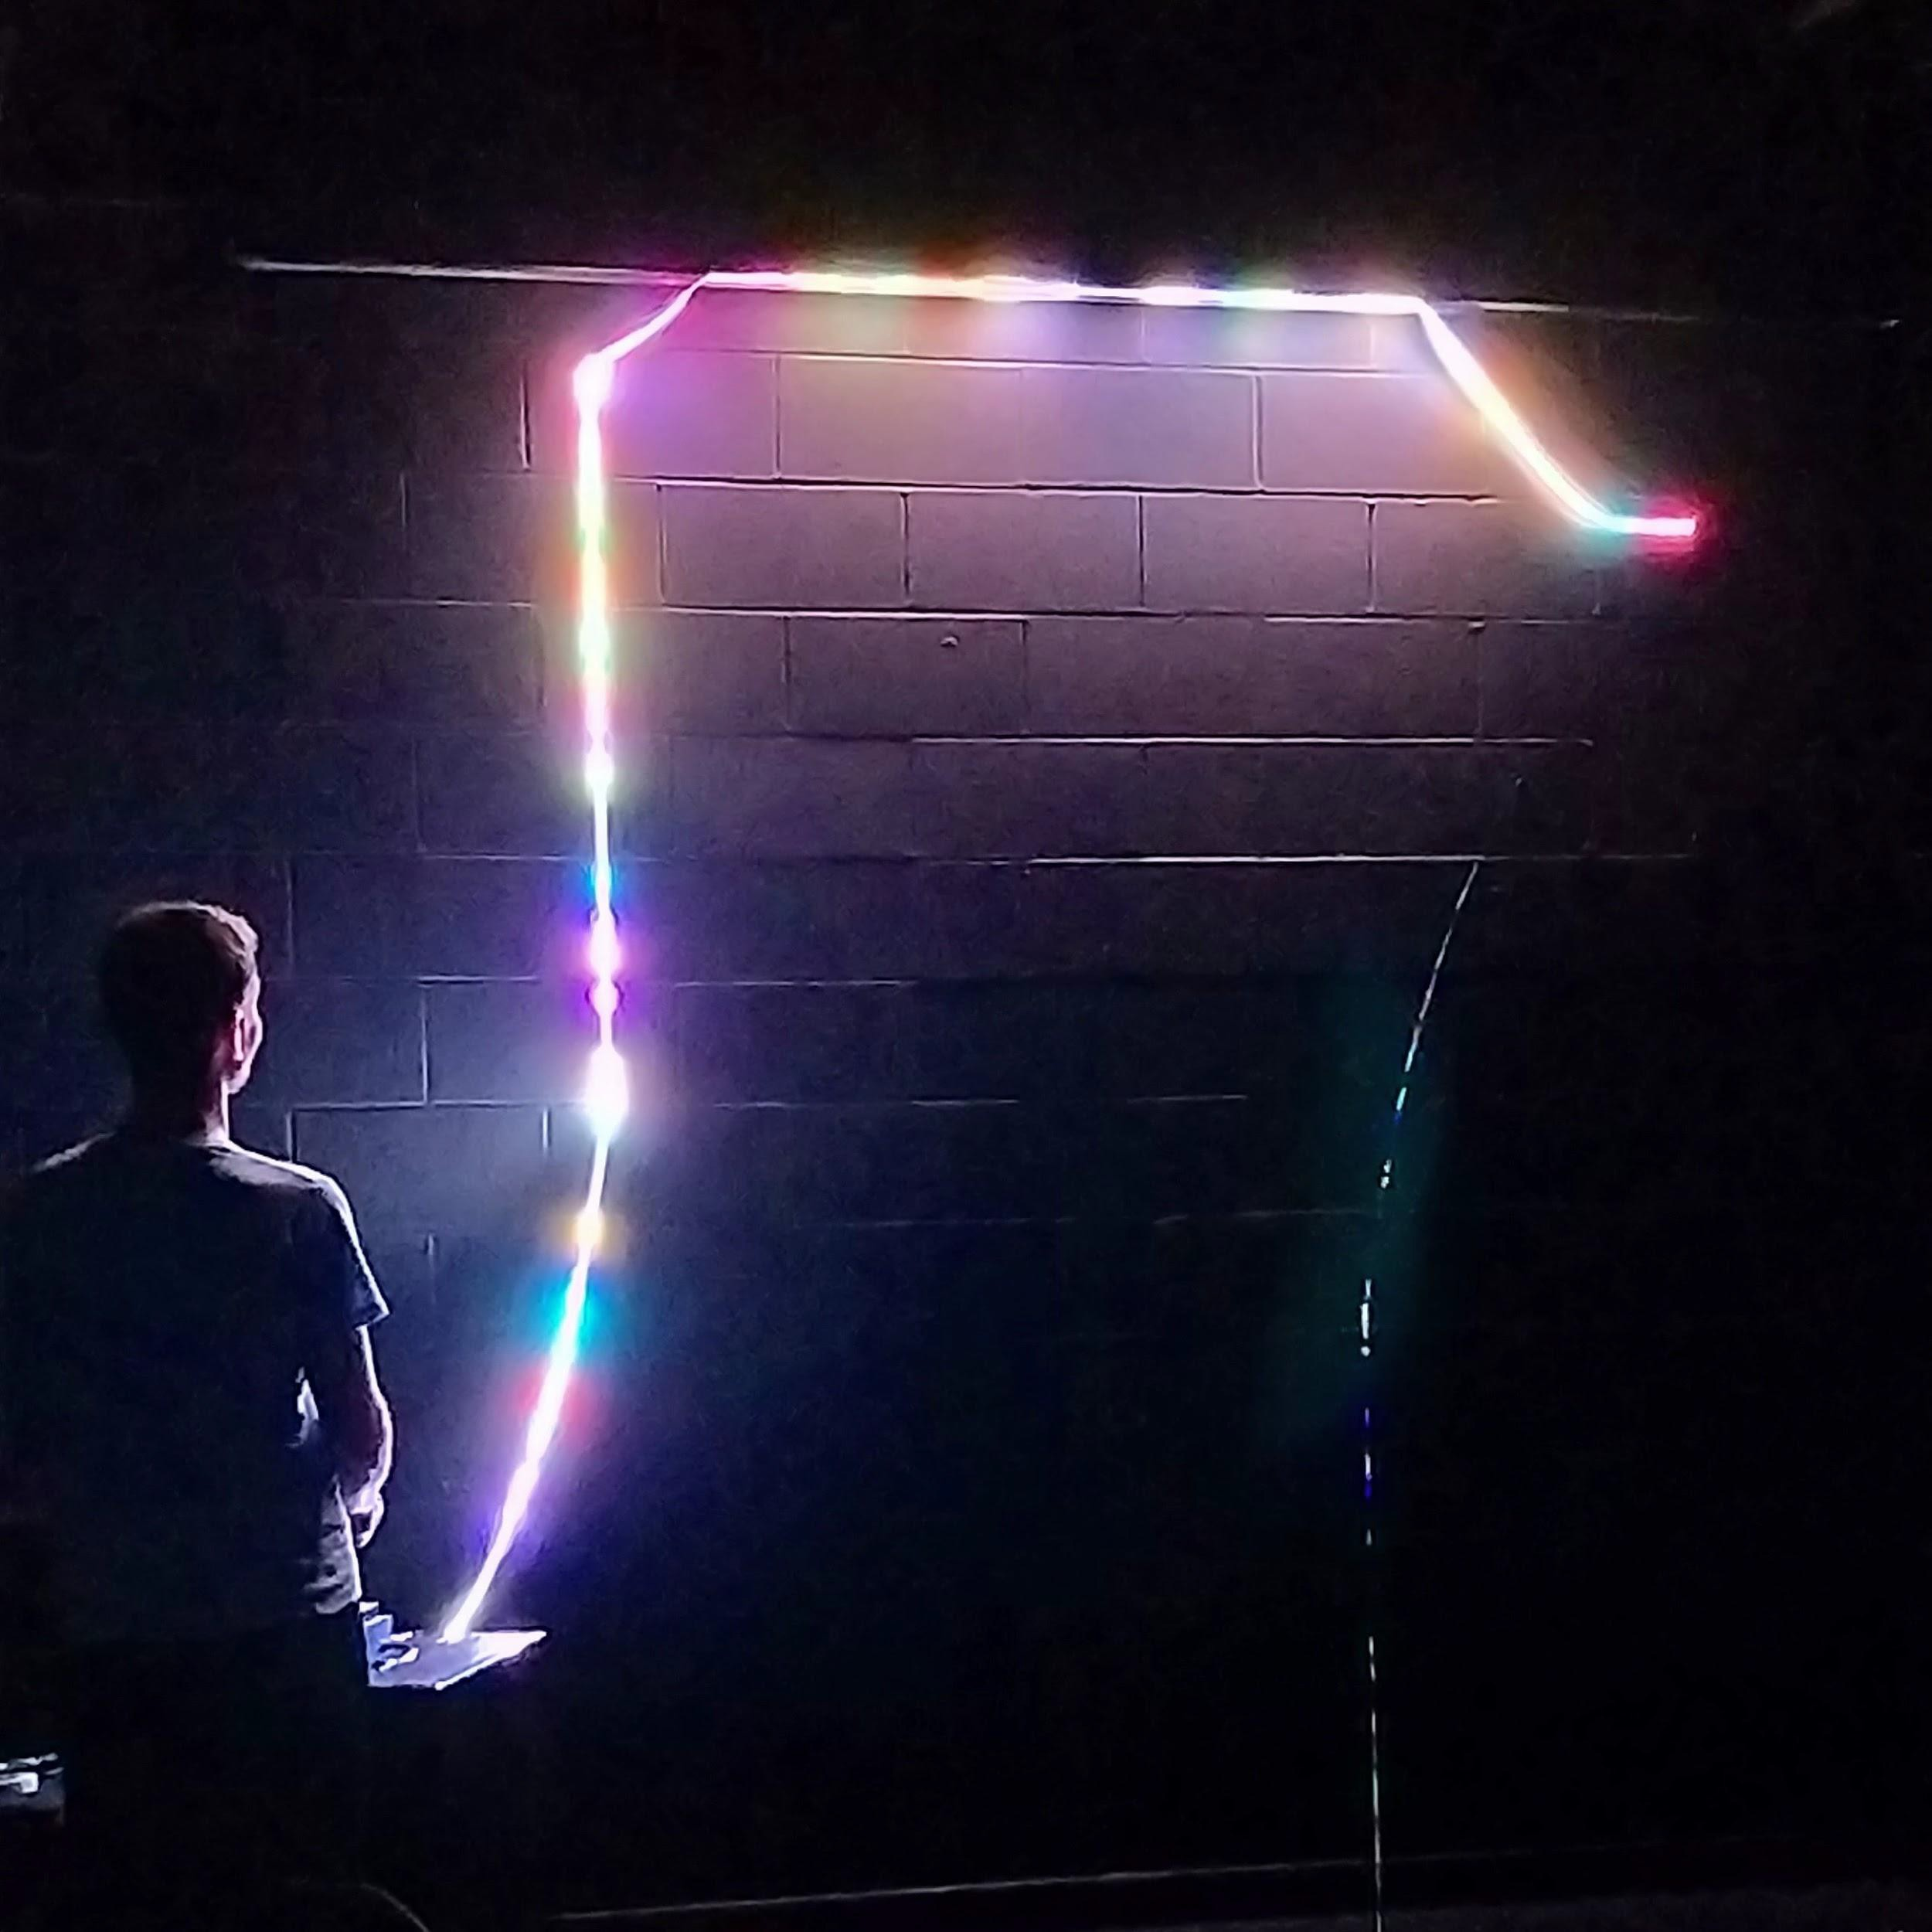
What is the module about?
You’ll be exploring research and putting it into practice in the context of game development.
Work on a major creative piece. You’ll be expanding and consolidating your skills through an extended project:
Expand on another module’s project
(with signiﬁcant amount of original content).
Work on a brand-new project.

Slide 6
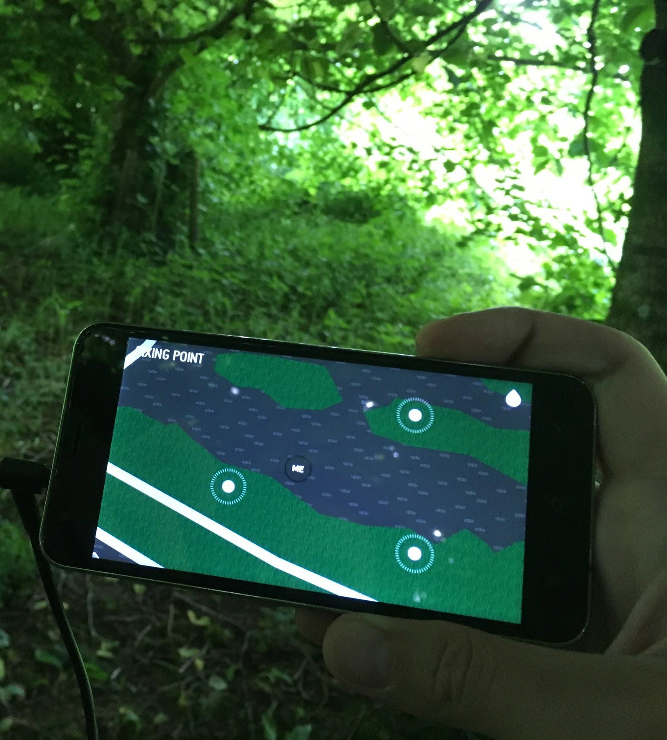
What is the module about?
You’ll begin by proposing your project through a pitch and proposal, and getting green light from staff members.
Research will help guide your vision and will help you foresee scope and viability.
Coming up with a solid proposal and plan is key to ensuring that your project will be achievable within the weeks the module runs.

Slide 7
How is the module structured?
Online lectures:
1h-long lectures, either real-time streaming or pre-recorded lectures.
Supervisor meetings:
Project progress according to weekly plan.
Group crits / Peer-reviews:
Review current project state and receive / give constructive feedback.
Supervised Studio Practice:
Technicians available to help.

Slide 8
Many Kinds of Projects

Slide 9
The Spectrum of Research
Research-
Practice-
based
informed
Practice
Invention
Research
Theoretical Research
Practice
Traditional Research
Practice-led Research
Practice as
Research

Slide 10
The Spectrum of Research
Research-
Practice-
based
informed
Practice
Invention
Research
Theoretical Research
Practice
Traditional Research
Practice-led Research
Practice as
Research
Purely theoretical research:
Ex: Studying game decision graphs using modal logic.

Slide 11
The Spectrum of Research
Research-
Practice-
based
informed
Practice
Invention
Research
Theoretical Research
Practice
Traditional Research
Practice-led Research
Practice as
Research
Design and effect measuring through experimentation:
Ex: A/B test measuring player engagement.

Slide 12
The Spectrum of Research
Research-
Practice-
based
informed
Practice
Invention
Research
Theoretical Research
Practice
Traditional Research
Practice-led Research
Practice as
Research
Documenting the process of creation:
Ex: Using real-world stop-motion for a 2D game graphics.

Slide 13
The Spectrum of Research
Research-
Practice-
based
informed
Practice
Invention
Research
Theoretical Research
Practice
Traditional Research
Practice-led Research
Practice as
Research
Creation of a brand-new artifact:
Ex: Original soundtrack composition for a game.

Slide 14
Assessment

Slide 15
Supervised Practice of Individual Projects
Your Major Project is about your individual work
(even if it’s part of a team project).
Your supervisor is a mentor / advisor, but the Major Project is based on your intellectual and professional independence (self-directed work).
Group crits and peer-reviews will complement your supervisor meetings through additional feedback and guidance from your peers.

Slide 16
Submissions and Deadlines
MyFalmouth is the place to check for oﬃcial summative deadlines!
21st August → Summative Deadline (week 12)
24th August → Final Presentations (Oral defense) (week 13)
Formative Sessions (Pitch and group crits; see MyTimetable):
Pitch session:
9th June (week 2)
Online crits (peer reviews):
15th June (week 3)
6th July (week 6)
27th July (week 9)
17th August (week 12).

Slide 17
Submission Format (Formative)
Formative deadlines are tied up to Group-Crit sessions:
Proposal / Pitch submission:
Submit slides + short document outlining the project + week plan.
Group crit submission (related to individual week plan):
Single ZIP ﬁle containing all relevant ﬁles + instructions.
If there is an artifact, there should be either an executable build, or a short video ﬁle showing the work being done.

Slide 18
Submission Format (Summative)
Final artefact (Orientative: discuss with your supervisor):
In the case of theoretical research, the main artefact will be an academic dissertation, following the proper format.
If project involves novel use of algorithms / coding techniques, there should be a brief academic report providing context, relevance and novelty.
If a game is part of the main deliverable, the deliverable should
be an executable build (and may include a research journal / report).
In the case of practice-based res. / invention, main deliverable can be a portfolio (may include a research journal / report).

Slide 19
It’s dangerous to go alone...

Slide 20
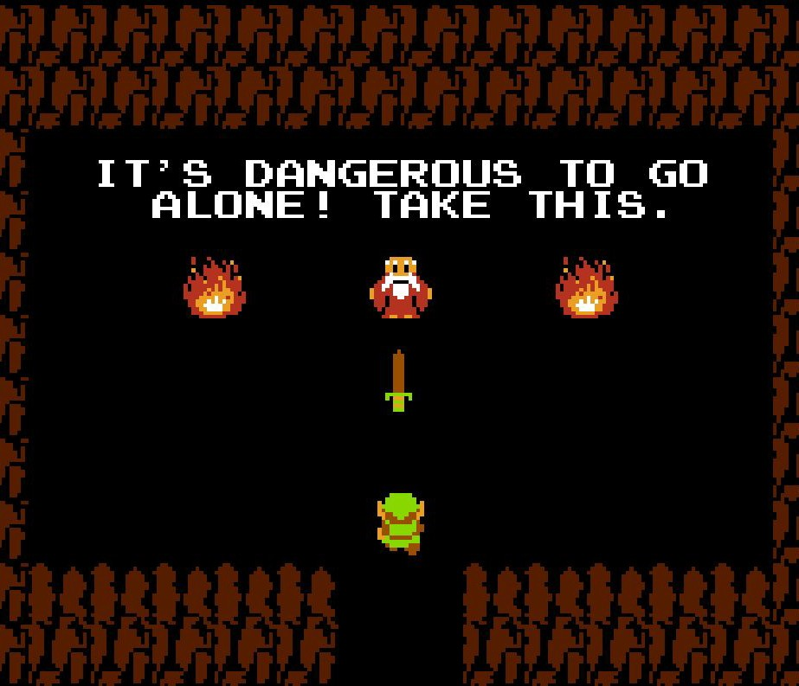
Where to ﬁnd what?
MyFalmouth:
Oﬃcial summative deadline date.
MyTimetable:
Lectures, group crits, supervised studio practice.
Learning Space:
Formative deadlines, formative submission links, video lectures, Group crits, resources...

Slide 21
Frequently Asked Questions

Slide 22
FAQs (1/3)
Can my project be a group project (ex: a game)?
Yes, but you must identify your role and contributions within the project.
I.e.; you will not be graded by the game as a whole, but rather by your work in it.
Can my project follow up from an existing project?
Yes, but you must signiﬁcantly expand it during this module:
A game already in beta that only needs minor tweaks and reﬁnements would not be enough as a major project.
A prototype / draft from a previous module that you want to signiﬁcantly expand / work on could do it.
Speak to your supervisor!

Slide 23
FAQs (2/3)
Do I need to write a memory / report?
Depends on the kind of project:
Developing a game does, or creating art for it does not need a report…
Unless there is something speciﬁc (question) you are researching by developing that game (comparing development techniques, design decisions, etc).
If so, how long should it be?
Depends on whether it has an artifact attached, as well as its goal:
A purely theoretical project should have a more comprehensive memory.
Potentially a publishable paper for a journal.
A practice-based project can have a shorter report / research journal.

Slide 24
FAQs (3/3)
Do I need to have an artifact as part of my project?
No, depending on the kind of project:
A purely theoretical project, or a project that studies players’ behaviours using pre-existing games and tools do not need an artifact.
Do I need to do an oral defense of my project?
Yes: regardless of what kind of project, you will need to present and defend it.
This means you will be asked questions regarding the rationale behind the project, any research you have (or should have) done, etc.
Documenting your project, even if you don’t submit any written Report, will help you keep track of this.
Even if based on pure invention, research should be replicable and understandable by anyone.

Slide 25
Questions?

