Slide 1


Proposal Preparation Workshop
GAM705: Major Project

Slide 2
Outline of the Session
Preparing a Proposal
Preparing a Pitch
Workshop

Slide 3
Project Proposal

Slide 4

Preparing a Project Proposal
According to BJ Fogg, founder, and director of the Stanford Behavior Design Lab:
"Sharing ideas early and often is one key to success for designers of end-user products and services".

Slide 5
Preparing a Project Proposal
Fogg developed a conceptual design document structure:
Articulate all the information needed to fully understand
a product (i.e.; artifact) in a structured and logical sequence.

Slide 6
Preparing a Project Proposal
Fogg developed a conceptual design document structure:
Articulate all the information needed to fully understand
a product (i.e.; artifact) in a structured and logical sequence.
This document is non-trivial in its creation but once complete, should help to solidify the concept in your own mind and ease the process of communicating your concept to your stakeholders.

Slide 7

BJ Fogg’s Conceptual Design Document
Title and overview
User description (incl. personas)
Storyboards of user experience
Prototypes
Features and functionality
The justiﬁcation for design (theor. and pract.)
Results of user testing (preliminary user test.)
Shortcomings of design
Expansion – stretch goals
Next steps in the design process
Summary

Slide 8
Distilling the Elements
Your project may not need all the elements:
“Storyboards and user experience” for an algorithm comparison?
“User description” for a theoretical analysis of ﬂow theory?

Slide 9
Distilling the Elements
Your project may not need all the elements:
“Storyboards and user experience” for an algorithm comparison?
“User description” for a theoretical analysis of ﬂow theory?
But some elements might simply need rephrasing:
“Prototypes” for artwork → “Sketches” / “Moodboards”?
“User testing” for IA engine → Why do users need a new IA?

Slide 10
Pitch, please

Slide 11
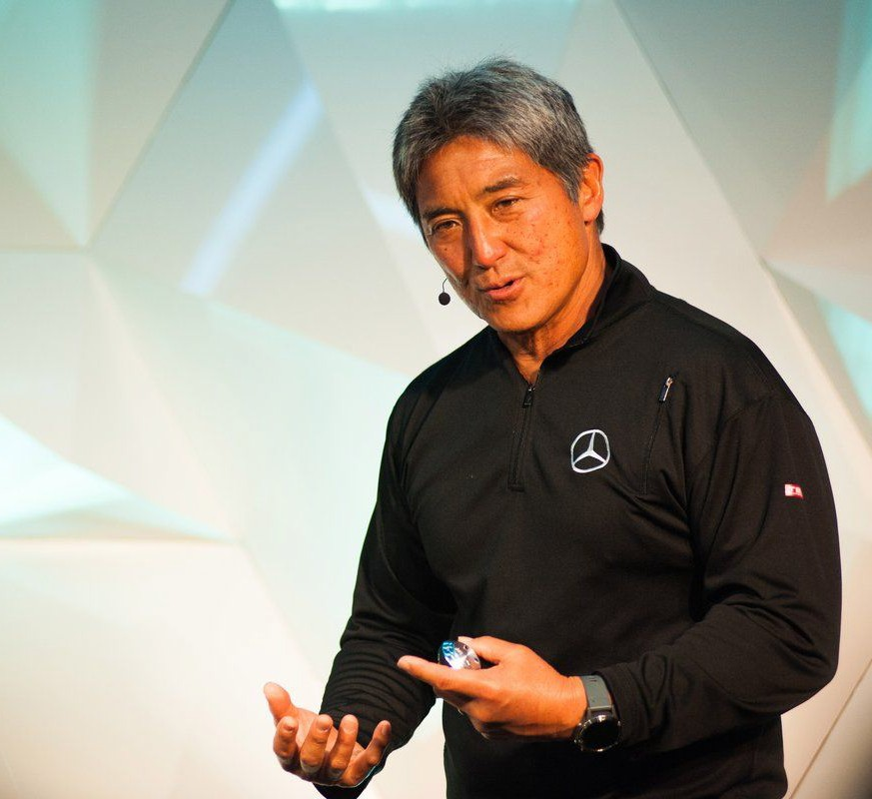
Preparing a Pitch
One of the most useful general approaches to pitching is that of Guy Kawasaki's
10-20-30 model of pitching.

Slide 12
Preparing a Pitch
One of the most useful general approaches to pitching is that of Guy Kawasaki's
10-20-30 model of pitching.
It relies on:
10 slides…
… that will take 20 minutes to present…
using 30 point fonts.

Slide 13
Preparing a Pitch
One of the most useful general approaches to pitching is that of Guy Kawasaki's
10-20-30 model of pitching.
It relies on:
10 slides…
… that will take 20 minutes to present…
using 30 point fonts.
(Although your pitch should only be around 10 minutes long!)

Slide 14
The Slide Deck, according to Kawasaki
A deﬁnition of what the problem is that you are attempting to solve
A slide that outlines what your solution is.
Your business model (how revenue comes into business and what to be spent on).
Your technology and ‘secret sauce’ (what makes your project distinct?).
The markets you will serve and the sales you expect to generate.
A slide that outlines your competitors
Key players in your team
A slide of project plans and milestones, what will be done by when
A slide of where you are currently at
A summary

Slide 15
Towards your Slide Deck
Although Kawasaki's format may not be ideal for all situations,
it follows a fairly standard underlying business planning model of:

Slide 16
Towards your Slide Deck
Although Kawasaki's format may not be ideal for all situations,
it follows a fairly standard underlying business planning model of:
Where are you now?
Where do you want to go?
How are you going to get there?

Slide 17
Towards your Slide Deck
It challenges you, as the pitch creator, to answer a lot of potentially hard questions, such as:

Slide 18
Towards your Slide Deck
It challenges you, as the pitch creator, to answer a lot of potentially hard questions, such as:
Where do the customers come from?
What will they spend money on, and why?
Who your competitors actually are?
When will your idea be ready?

Slide 19
Towards your Slide Deck
It challenges you, as the pitch creator, to answer a lot of potentially hard questions, such as:
Where do the customers come from?
What will they spend money on, and why?
Who your competitors actually are?
When will your idea be ready?
(Recall Kawasaki’s model is aimed towards getting funding for a project, or ensuring its viability: this could help you foresee
a marketisation strategy for your project.)

Slide 20
Towards your Slide Deck
Some of the slides might not be relevant to your project.
If you feel that this is the case, feel free to change the structure but we encourage you to discuss this with your project supervisor ﬁrst.

Slide 21
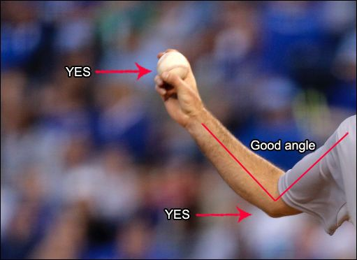
Good Practices in Pitching
Transmit your enthusiasm for the idea:
You should aim to get your audience on board and share your passion for the idea.

Slide 22
Good Practices in Pitching
Transmit your enthusiasm for the idea:
You should aim to get your audience on board and share your passion for the idea.
Get the audience involved from the beginning:
Present the problem and let them wonder about the solution.

Slide 23
Good Practices in Pitching
Transmit your enthusiasm for the idea:
You should aim to get your audience on board and share your passion for the idea.
Get the audience involved from the beginning:
Present the problem and let them wonder about the solution.
Your discourse should be clear, direct, fresh…
… While avoiding being shallow, confusing, or needlessly comic.

Slide 24
Good Practices in Pitching
Transmit your enthusiasm for the idea:
You should aim to get your audience on board and share your passion for the idea.
Get the audience involved from the beginning:
Present the problem and let them wonder about the solution.
Your discourse should be clear, direct, fresh…
… While avoiding being shallow, confusing, or needlessly comic.
Know the narrative of your pitch:
Tell your audience a “story”.

Slide 25
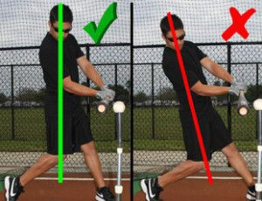
Bad Practices in Pitching
Don’t just read the slides, add value to them.
Text-to-speech tools are already widely available.
Recall that pitching ≠ lecturing!

Slide 26
Bad Practices in Pitching
Don’t just read the slides, add value to them.
Text-to-speech tools are already widely available.
Recall that pitching ≠ lecturing!
Avoid walls of text in slides.
You want people listening to you, and not reading the slide.
Fewer key concepts stick easier than huge paragraphs.

Slide 27
Bad Practices in Pitching
Don’t just read the slides, add value to them.
Text-to-speech tools are already widely available.
Recall that pitching ≠ lecturing!
Avoid walls of text in slides.
You want people listening to you, and not reading the slide.
Fewer key concepts stick easier than huge paragraphs.
Don’t rush it: take your time if you need it.
For example, use a rhetoric question to take a deep breath, or drink some water.

Slide 28
Questions?

