Slide 1


Module Induction
GAM705: Major Project

Slide 2
Aim and Structure
Outline of this part
Different Kinds of Project
Assessment and Submissions
Where to ﬁnd what?
FAQs

Slide 3
The Staff
Ed Powley (Module Leader)
Joseph Walton-Rivers
Matt Watkins
Jeff Howard
Rory Summerley
Michael Boylan
William Pryn
Matt Irwin
Archie Andrews
Micheal (Moon) Gray
Supervisors
Technicians

Slide 4
Aim and Structure

Slide 5
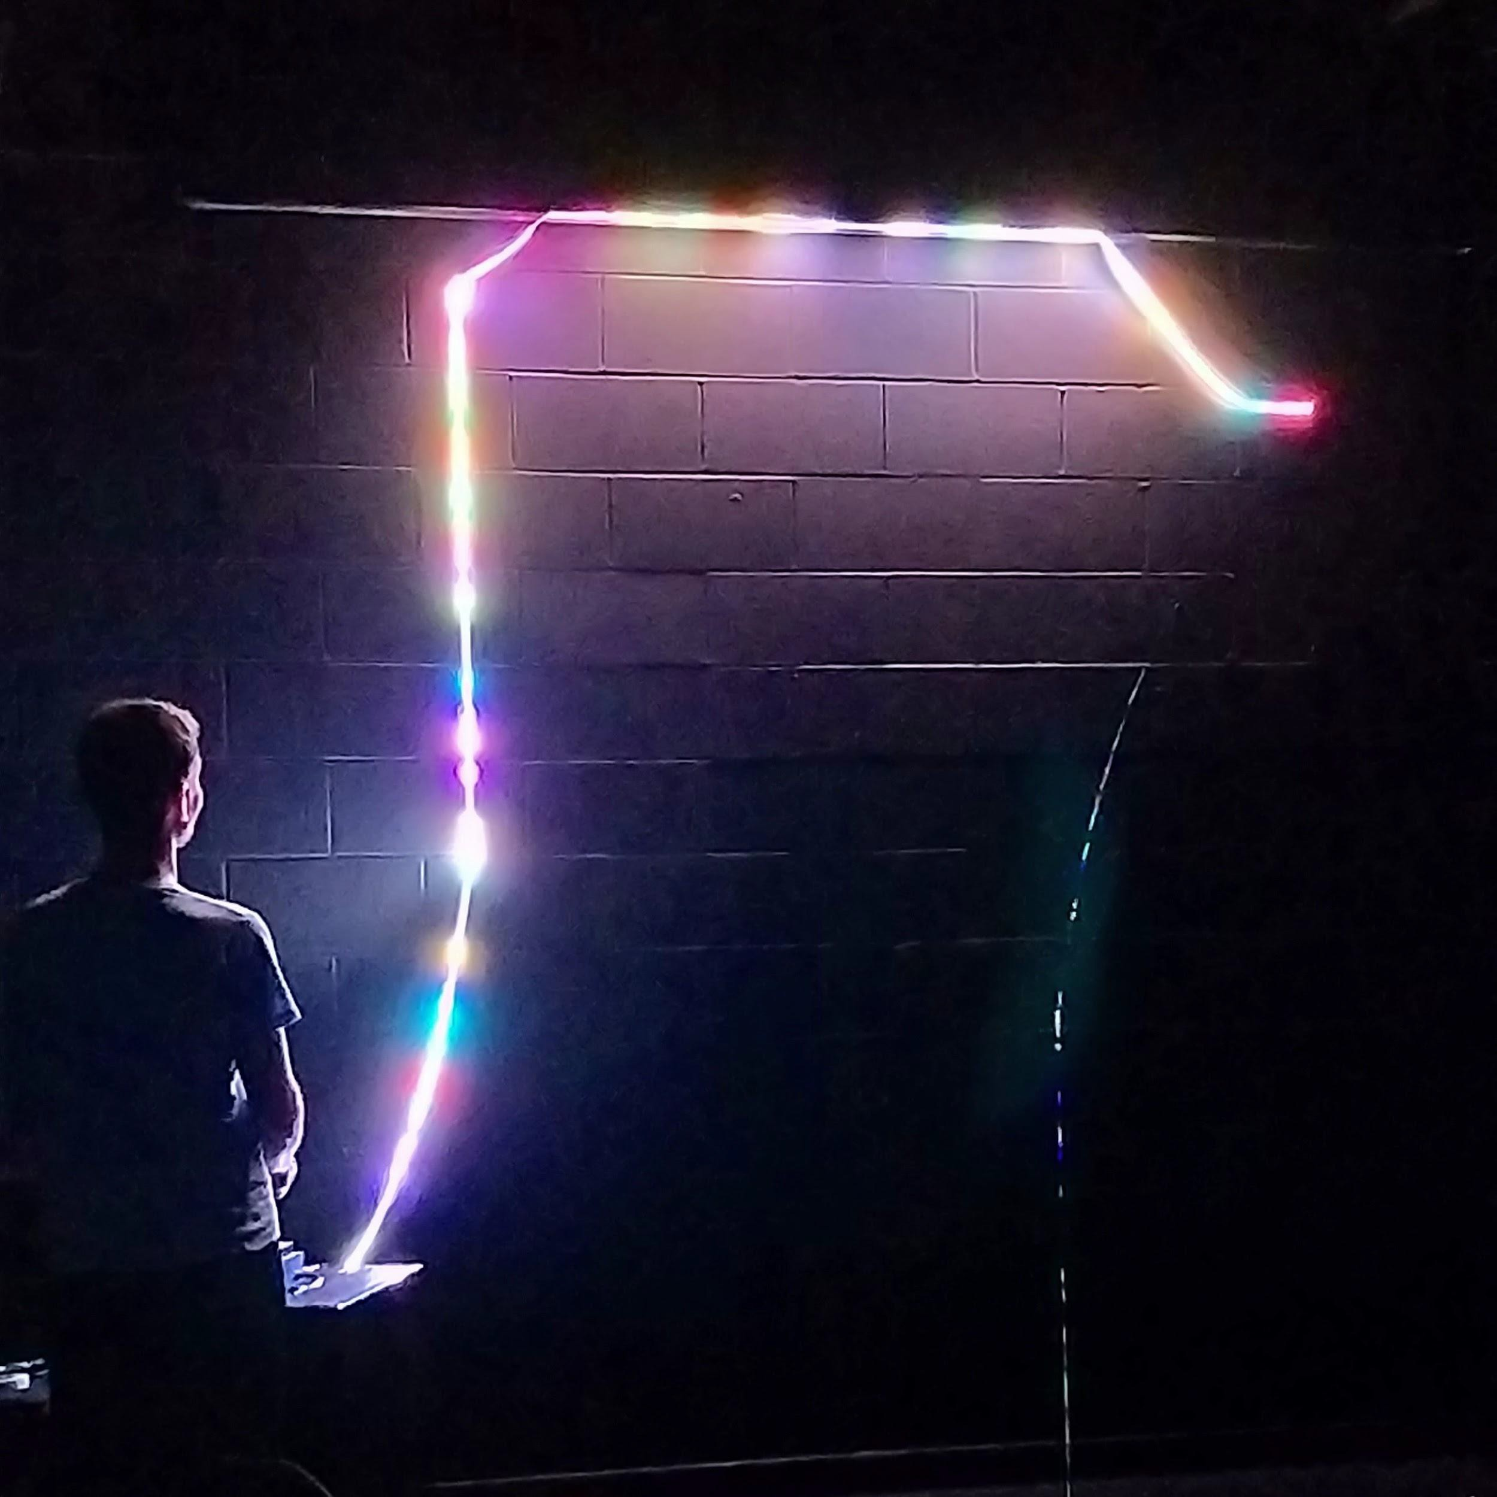
What is the module about?
You’ll be exploring research and putting it into practice in the context of game development.
Work on a major creative piece. You’ll be expanding and consolidating your skills through an extended project:
Expand on another module’s project
(with signiﬁcant amount of original content)
Work on a brand-new project
Contribute to an ongoing external project (with significant personal contribution)

Slide 6
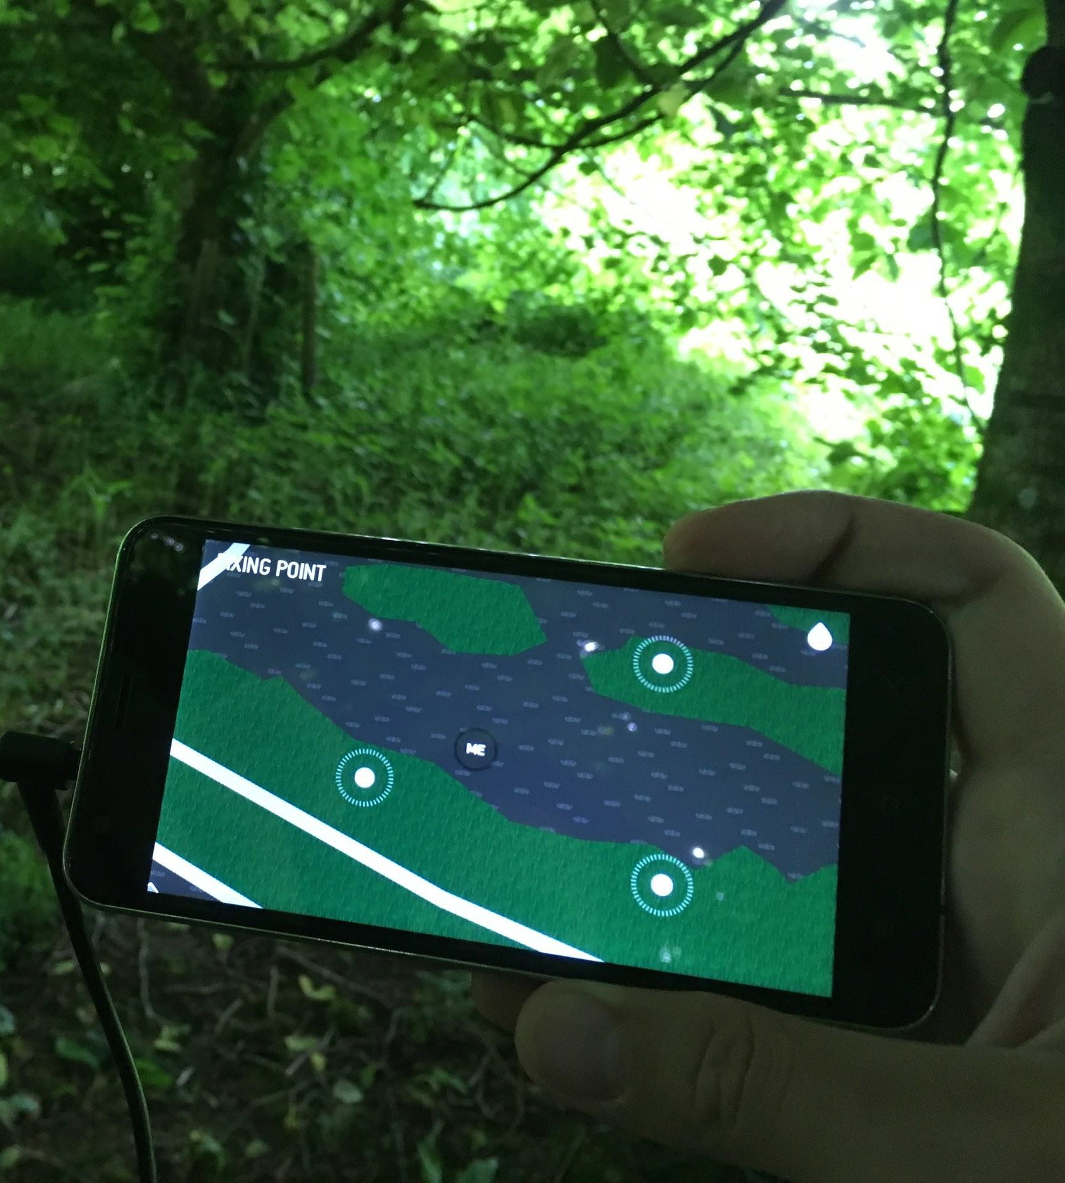
What is the module about?
You’ll begin by proposing your project through a pitch and proposal, and getting green light from staff members.
Research will help guide your vision and will help you foresee scope and viability.
Coming up with a solid proposal and plan is key to ensuring that your project will be achievable within the weeks the module runs.

Slide 7
Supervised Practice of Individual Projects
Your Major Project is about your individual work
(even if it’s part of a team project).
Your supervisor is a mentor / advisor, but the Major Project is based on your intellectual and professional independence (self-directed work).
We are here to support you, but the onus is on you to apply your specialist skills and direct your own work through the project.
Group crits and peer-reviews will complement supervision through additional feedback and guidance from your peers.

Slide 8
Module Roadmap
You are here
Final presentation
Project supervision meetings
Week 1 | Week 2 | Week 3 | Week 4 | Week 5 | Week 6 | Week 7 | Week 8 | Week 9 | Week 10 | Week 11 | Week 12 | Week 13
Proposal presentation
Peer review
Formal submission deadline

Slide 9
Timetabled sessions
As always, check MyTimetable for timetable information
Some sessions (e.g. supervision meetings) are online only
Other sessions (e.g. studio practice, presentation seminars) are hybrid – you may attend either on campus or online
Also check LearningSpace for asynchronous video lectures and other useful resources

Slide 10
Many Kinds of Projects

Slide 11
The Spectrum of Research
Research-
Practice-
based
informed
Practice
Invention
Research
Theoretical Research
Practice
Traditional Research
Practice-led Research
Practice as
Research

Slide 12
The Spectrum of Research
Research-
Practice-
based
informed
Practice
Invention
Research
Theoretical Research
Practice
Traditional Research
Practice-led Research
Practice as
Research
Purely theoretical research:
Ex: Studying game decision graphs using modal logic.

Slide 13
The Spectrum of Research
Research-
Practice-
based
informed
Practice
Invention
Research
Theoretical Research
Practice
Traditional Research
Practice-led Research
Practice as
Research
Design and effect measuring through experimentation:
Ex: A/B test measuring player engagement.

Slide 14
The Spectrum of Research
Research-
Practice-
based
informed
Practice
Invention
Research
Theoretical Research
Practice
Traditional Research
Practice-led Research
Practice as
Research
Documenting the process of creation:
Ex: Using real-world stop-motion for a 2D game graphics.

Slide 15
The Spectrum of Research
Research-
Practice-
based
informed
Practice
Invention
Research
Theoretical Research
Practice
Traditional Research
Practice-led Research
Practice as
Research
Creation of a brand-new artifact:
Ex: Original soundtrack composition for a game.

Slide 16
Assessment

Slide 17
Submissions and Deadlines
MyFalmouth is the place to check for oﬃcial summative deadlines!
20th August → Summative Deadline (week 12)
Students with ECs/ADs can find their adjusted dates on MyFalmouth
There are two assessed presentations (oral defenses)
You will present to your supervisor, other tutors and your fellow students
21st/22nd June → Proposal Pitches (week 4)
23rd/24th August → Final Presentations (Oral defense) (week 13)
Formative sessions (See MyTimetable):
Group supervision meetings: every 2 weeks, starting today
Peer review: 2nd August (week 10)

Slide 18
Submission Format
Final artefact (Orientative: discuss with your supervisor):
In the case of theoretical research, the main artefact will be an academic dissertation, following the proper format.
If project involves novel use of algorithms / coding techniques, there should be a brief academic report providing context, relevance and novelty.
If a game is part of the main deliverable, the deliverable should
be an executable build (and may include a research journal / report).
In the case of practice-based res. / invention, main deliverable can be a portfolio (may include a research journal / report).

Slide 19
Submission Format
Proposal Presentation
Worth 20% of the module
10 minute presentation + 5 minute Q&A
What is your project? What is your artefact?
What is the wider context of your project within your specialism?
What key ideas / results (from academic research or industry practice) is your project built upon?
What questions are you seeking to answer?
Who is the audience for your artefact, and what need does it fulfil for them?
What are the key legal, social, ethical, and/or professional issues?

Slide 20
Submission Format
Final Presentation (aka oral defense, aka viva)
Along with the artefact itself, worth 80% of the module
15 minute presentation + 5 minute Q&A
What did you do / make / write? Give a demo if appropriate
How did you approach the development of the project?
What questions did you answer?
Does your artefact fulfil the need you identified for your target audience?
What are the wider implications and value of your work?
What potential is there for future work?

Slide 21
It’s dangerous to go alone...

Slide 22
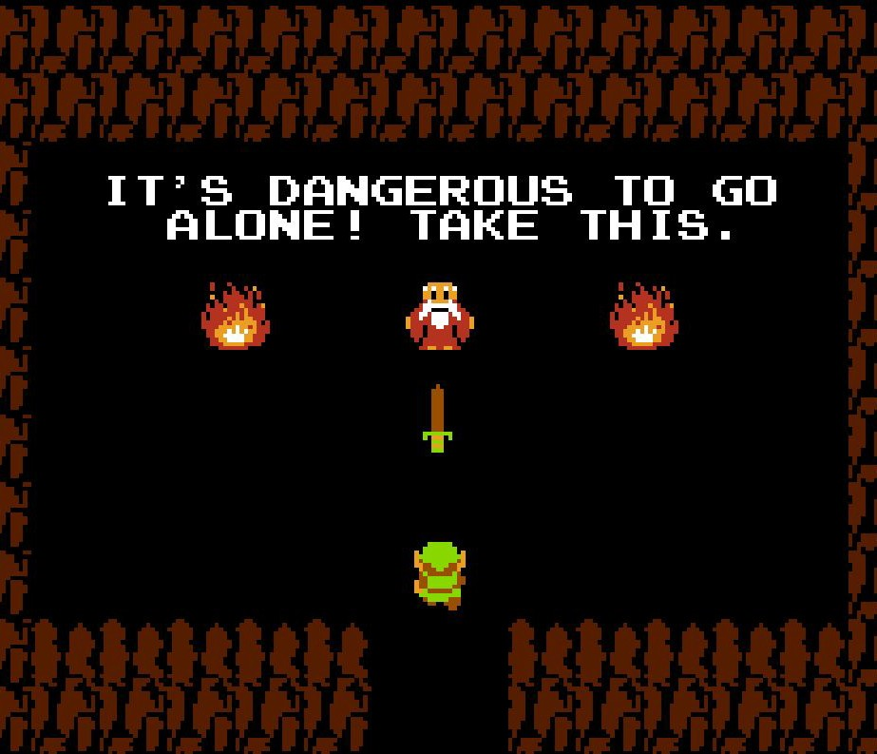
Where to ﬁnd information?
MyFalmouth:
Oﬃcial summative deadline date
MyTimetable:
Dates and times of scheduled sessions
Learning Space:
Formative deadlines, submission links, video lectures, resources...
The project handbook – formal assessment brief with deliverables and marking criteria

Slide 23
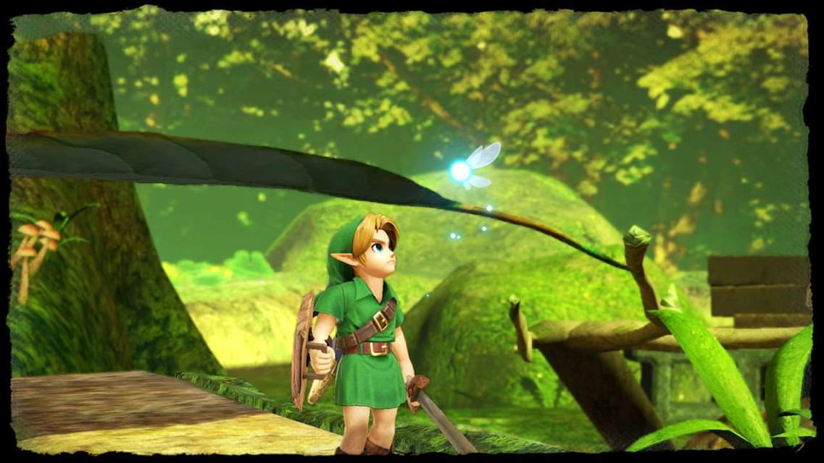
Where to ﬁnd support?
Your supervisor:
Feedback and guidance on your project
Do reach out between supervision meetings if you need to (though be aware of summer holidays affecting availability)
Technicians:
Available during studio practice sessions, as well as via teams/discord/email
Module leader:
Questions about assessment etc
Additional support and guidance
Your peers:
Support each other!
Give feedback in group supervisions etc

Slide 24
Frequently Asked Questions

Slide 25
FAQs (1/3)
Can my project be a group project (e.g. a game)?
Yes, but you must identify your role and contributions within the project.
I.e.; you will not be graded by the game as a whole, but rather by your work in it.
Can my project follow up from an existing project?
Yes, but you must signiﬁcantly expand it during this module:
A game already in beta that only needs minor tweaks and reﬁnements would not be enough as a major project.
A prototype / draft from a previous module that you want to signiﬁcantly expand / work on could do it.
Speak to your supervisor!

Slide 26
FAQs (2/3)
Do I need to write a journal / report / thesis?
Depends on the kind of project:
Developing a game or associated assets does not need a report…
Unless there is something speciﬁc (question) you are researching by developing that game (comparing development techniques, design decisions, etc).
If so, how long should it be?
Depends on whether it has an artefact attached, as well as its goal:
A purely theoretical project should be more comprehensive
Potentially a publishable paper
A practice-based project can have a shorter report / research journal, or no written component at all

Slide 27
FAQs (3/3)
Do I need to have an artefact as part of my project?
Yes, but what constitutes an “artefact” is flexible:
For a purely theoretical project, the “artefact” can be a written thesis for example
Do I need to do an oral defense of my project?
Yes: regardless of what kind of project, you will need to present and defend it.
This means you will be asked questions regarding the rationale behind the project, any research you have (or should have) done, etc.
Documenting your project, even if you don’t submit any written report, will help you keep track of this
Even if based on pure invention, research should be replicable and understandable by anyone.

Slide 28
Questions?

Slide 29
Proposal Preparation
GAM705: Major Project

Slide 30
Outline of this part
Preparing a Proposal
Preparing a Pitch
Workshop

Slide 31
Project Proposal

Slide 32
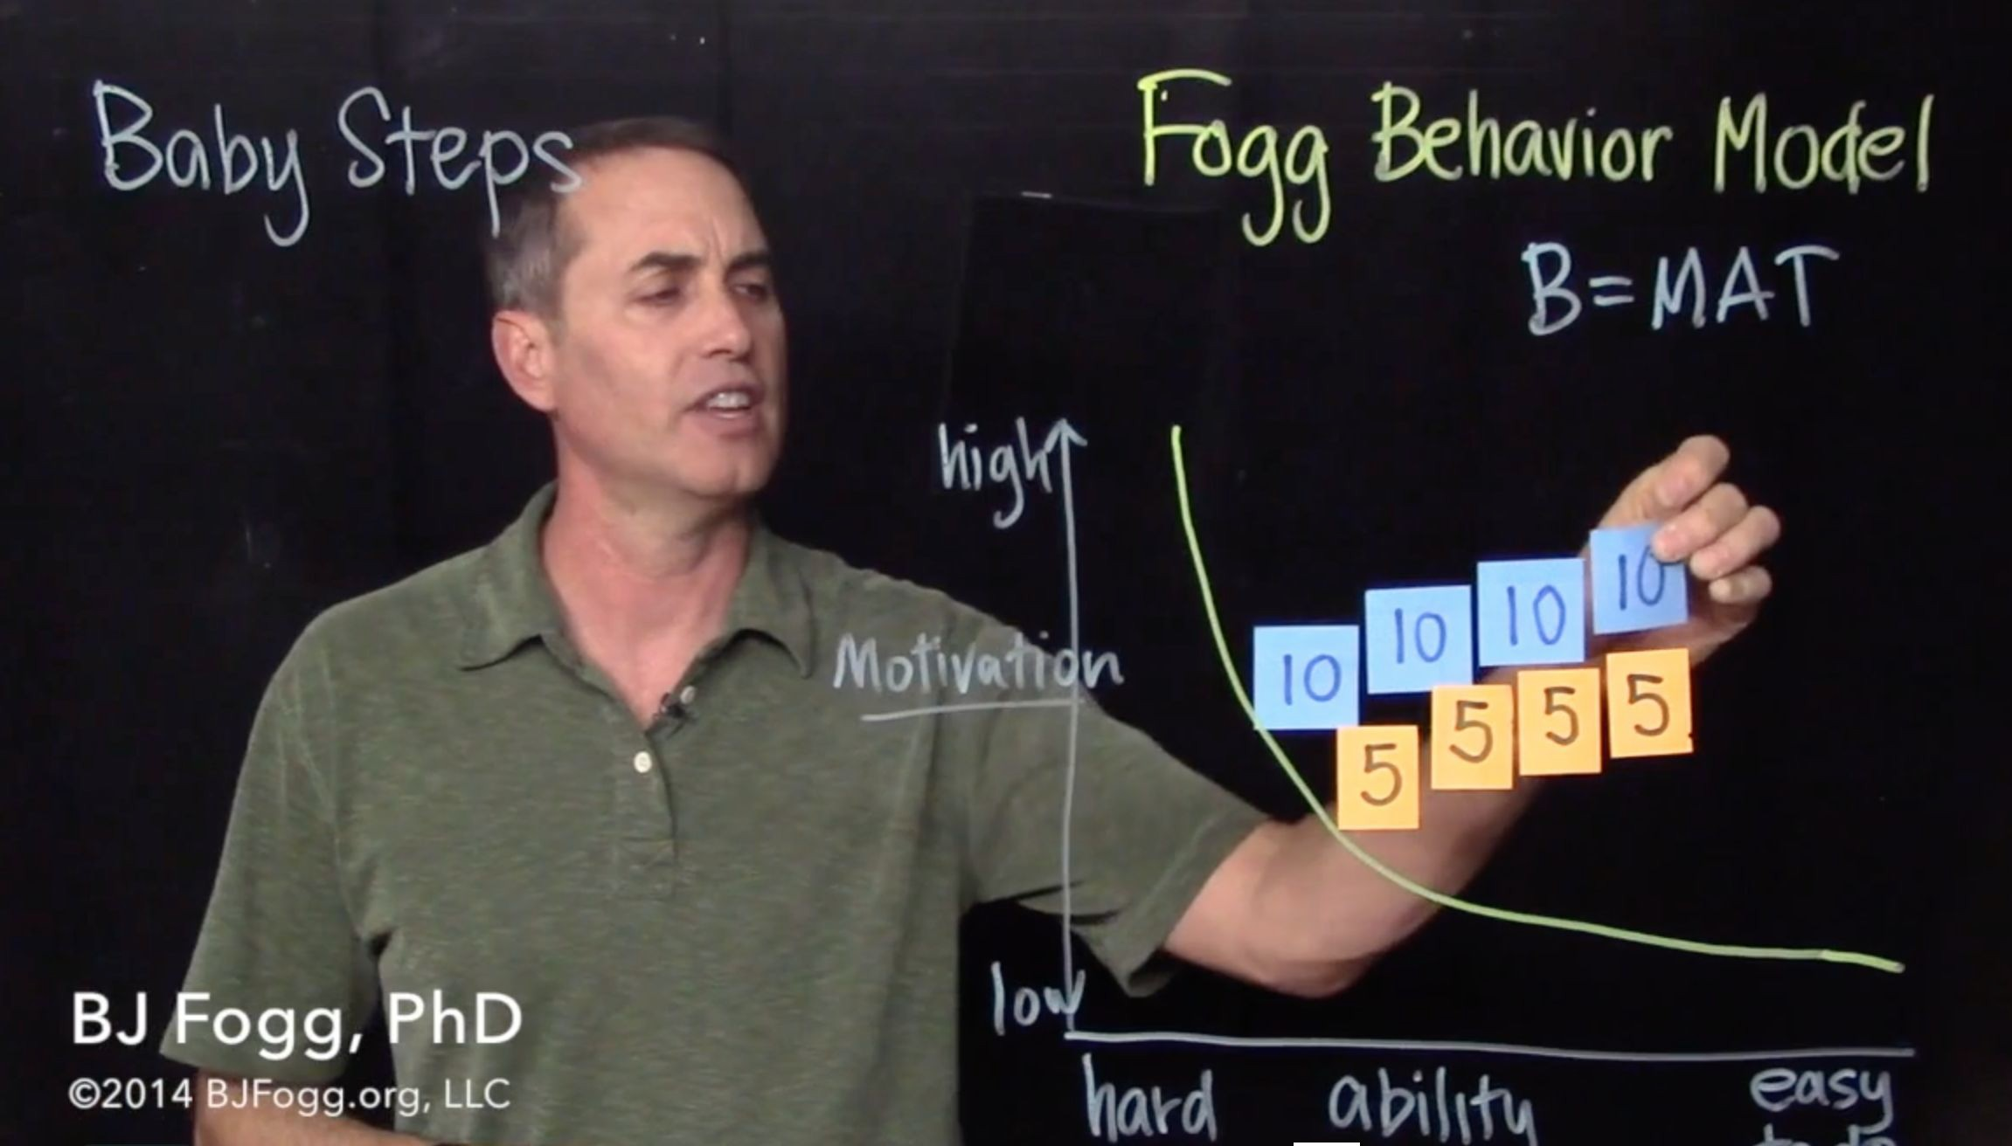
Preparing a Project Proposal
According to BJ Fogg, founder, and director of the Stanford Behavior Design Lab:
"Sharing ideas early and often is one key to success for designers of end-user products and services".

Slide 33
Preparing a Project Proposal
Fogg developed a conceptual design document structure:
Articulate all the information needed to fully understand
a product (i.e.; artifact) in a structured and logical sequence.
This document is non-trivial in its creation but once complete, should help to solidify the concept in your own mind and ease the process of communicating your concept to your stakeholders.

Slide 34

BJ Fogg’s Conceptual Design Document
Title and overview
User description (incl. personas)
Storyboards of user experience
Prototypes
Features and functionality
The justiﬁcation for design (theor. and pract.)
Results of user testing (preliminary user test.)
Shortcomings of design
Expansion – stretch goals
Next steps in the design process
Summary

Slide 35
Distilling the Elements
Your project may not need all the elements:
“Storyboards and user experience” for an algorithm comparison?
“User description” for a theoretical analysis of ﬂow theory?
But some elements might simply need rephrasing:
“Prototypes” for artwork → “Sketches” / “Moodboards”?
“User testing” for AI system → Why do users need a new AI?

Slide 36
Preparing a Pitch

Slide 37
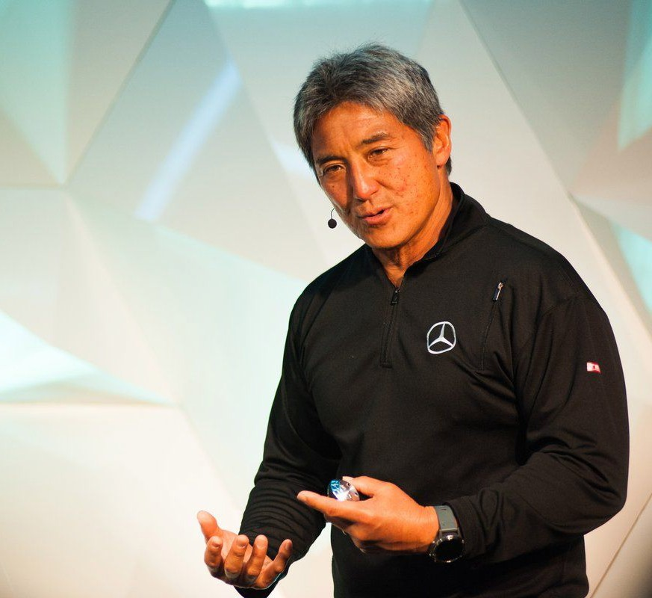
Preparing a Pitch
One of the most useful general approaches to pitching is that of Guy Kawasaki's
10-20-30 model of pitching.
It relies on:
10 slides…
… that will take 20 minutes to present…
using 30 point fonts.
(Although your pitch should only be around 10 minutes long -- so this should probably be more like a 5-10-30 model!)

Slide 38
The Slide Deck, according to Kawasaki
A deﬁnition of what the problem is that you are attempting to solve
A slide that outlines what your solution is.
Your business model (how revenue comes into business and what to be spent on).
Your technology and ‘secret sauce’ (what makes your project distinct?).
The markets you will serve and the sales you expect to generate.
A slide that outlines your competitors
Key players in your team
A slide of project plans and milestones, what will be done by when
A slide of where you are currently at
A summary

Slide 39
Towards your Slide Deck
Although Kawasaki's format may not be ideal for all situations,
it follows a fairly standard underlying business planning model of:
Where are you now?
Where do you want to go?
How are you going to get there?

Slide 40
Towards your Slide Deck
It challenges you, as the pitch creator, to answer a lot of potentially hard questions, such as:
Where do the customers come from?
What will they spend money on, and why?
Who your competitors actually are?
When will your idea be ready?
(Recall Kawasaki’s model is aimed towards getting funding for a project, or ensuring its viability: this could help you foresee
a marketisation strategy for your project.)

Slide 41
Towards your Slide Deck
Some of the slides might not be relevant to your project.
If you feel that this is the case, feel free to change the structure but we encourage you to discuss this with your project supervisor ﬁrst.

Slide 42
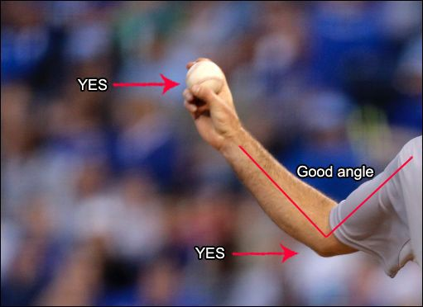
Good Practices in Pitching
Transmit your enthusiasm for the idea:
You should aim to get your audience on board and share your passion for the idea.
Get the audience involved from the beginning:
Present the problem and let them wonder about the solution.
Your discourse should be clear, direct, fresh…
… While avoiding being shallow, confusing, or needlessly comic.
Know the narrative of your pitch:
Tell your audience a “story”.

Slide 43
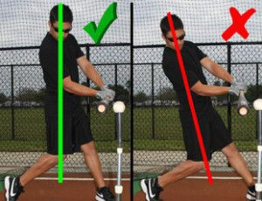
Bad Practices in Pitching
Don’t just read the slides, add value to them.
Text-to-speech tools are already widely available.
Recall that pitching ≠ lecturing!
Avoid walls of text in slides.
You want people listening to you, and not reading the slide.
Fewer key concepts stick easier than huge paragraphs.
Don’t rush it: take your time if you need it.
For example, use a rhetorical question to take a deep breath, or drink some water.

Slide 44
Questions?

