Slide 1
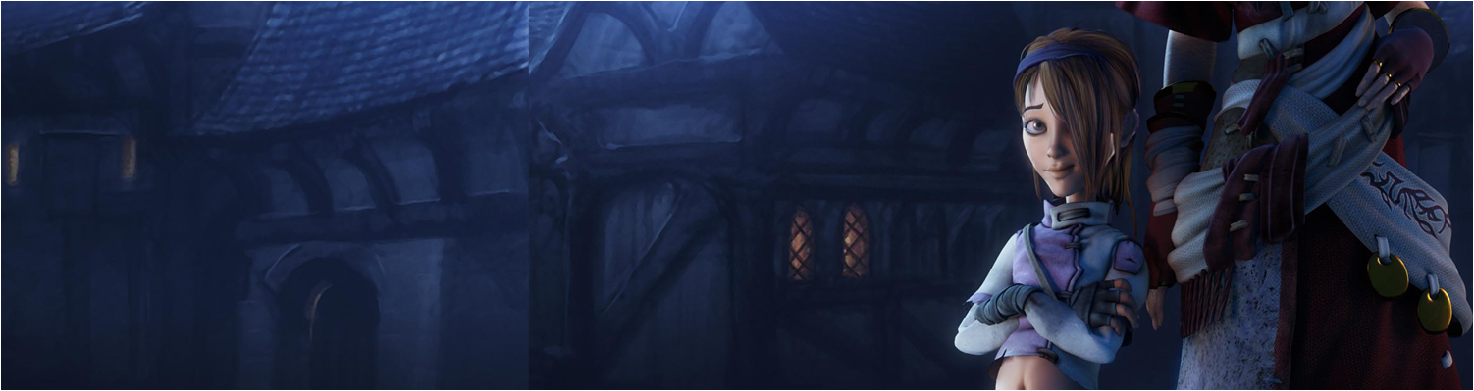

Lecture 5: Data Science – Machine Learning for gameplay
COMP704: Machine Learning
MSc Artificial Intelligence for Games

Slide 2
Today’s session:
Refactoring & Instrumenting Games for ML

Slide 3
Refactoring & Instrumenting Games for ML
What do you need to do to make applications that can ‘play’ using ML for AI?
Aka the assignment

Slide 4
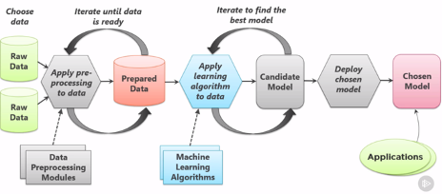
Refactoring & Instrumenting Games for ML
What do you need to do to make applications that can ‘play’ using ML for AI?
Aka the assignment
We’ve looked at this iterative model before

Slide 5
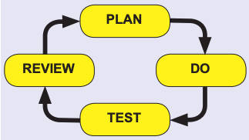
Refactoring & Instrumenting Games for ML
Now we can add more complexity
Build game with symbolic AI

Slide 6
Refactoring & Instrumenting Games for ML
Now we can add more complexity
Added stage of ‘build a game’:
Building a game
Building a symbolic AI system
Capturing gameplay data
Feeding ML results into non-symbolic AI model
Rinse & repeat when it doesn’t work quite right
Such is the nature of our black box AI

Slide 7
Refactoring & Instrumenting Games for ML
Now we can add more complexity
Added stage of ‘build a game’:
Building a game
Building a symbolic AI system
Capturing gameplay data
Feeding into non-symbolic AI model
Rinse & repeat when it doesn’t work quite right
Such is the nature of our black box AI
To a degree, these stages are interlinked
Your architectural & game play designs will be driven by what comes before and what follows each stage

Slide 8
Refactoring & Instrumenting Games for ML
Over-arching consideration(s)
Need to be able to generate training (& test) data that will train an algorithm
This will depend on game type i.e. what kind of data can you extract from a game
Does it need to be regression or classification
Continuous or discrete
How much data do you need to collect
Are there any significant use cases to consider?
How are you going to manage and store it

Slide 9
Refactoring & Instrumenting Games for ML
Over-arching consideration(s)
Need to be able to generate training (& test) data that will train an algorithm
How will the data be generated
What will your synthetic symbolic AI algorithms look like
Will you augment this with real players?

Slide 10
Refactoring & Instrumenting Games for ML
Over-arching consideration(s)
How will you feed the prediction data back into your game

Slide 11
Refactoring & Instrumenting Games for ML
How to make a game that can capture data for ML
Breakout game
Not a particularly great pygame demo, but it could be a typical starting point
From a data PoV:
State of world (bricks & ball)
Like the Mariflow world array
Either:
Player position as regression
Plyer movement as classifications (move left / right)

Slide 12
Refactoring & Instrumenting Games for ML
Refactoring the game to make it work (better)
Fix dodgy collisions / gameplay issues
Ball can run along bat and off the screen
Generally, want to only collision test ball when it is traveling down the screen
Current code doesn’t allow this due to angle model
May also be issues with ball colliding with two things at once
Hard to direct the ball off the bat
In ‘traditional’ pong ball will come off at different angles depending on where on the bat it hits
Need to implement & use this to develop pong strategies (clear a column and get ball on top of bricks)
Game over on every miss
Need to make the game run to level completion to collect more data

Slide 13
Refactoring & Instrumenting Games for ML
Refactoring the game to make it work (better)
Make game play ‘headerless’
Currently, game will do one update per frame (16.6mS)
From pygame.flip()
Removing rendering means we can run the game at 500-1000 fps or higher
16 x faster -> 16 x data collection
Can do this without making the game ‘play faster’
Can also run multiple instances of game and collect data remotely (HTTP server)

Slide 14
Refactoring & Instrumenting Games for ML
Building symbolic AI
Where should the player go to hit the ball?
Easiest (and worst) solution
Player.x = ball.x
This will work, but wont produce great results
More interesting solutions require
Where will the ball be when the player can hit it (forward projection)?
Where can the player hit it to (prediction)?
Where’s the best place to hit the ball to (estimation)?

Slide 15

Refactoring & Instrumenting Games for ML
Building symbolic AI
Where will the ball be when the player can hit it (forward projection)?
We know the algorithm for the ball’s movement
Can have a copy of the ball’s data (position & speed) and project where the ball will go
Best to do this under the bricks & when the ball is travelling towards the player (hence the refactoring)
Ball will have a pretty consistent travel time in comparison to the upward journey
Don’t forget to include the bounces

Slide 16
Refactoring & Instrumenting Games for ML
Building symbolic AI
Where can the player hit it to (prediction)?
This relies on refactoring the ball/player collider to make it a bit more predictable
Can use a similar approach to project balls up the screen to see what they hit

Slide 17
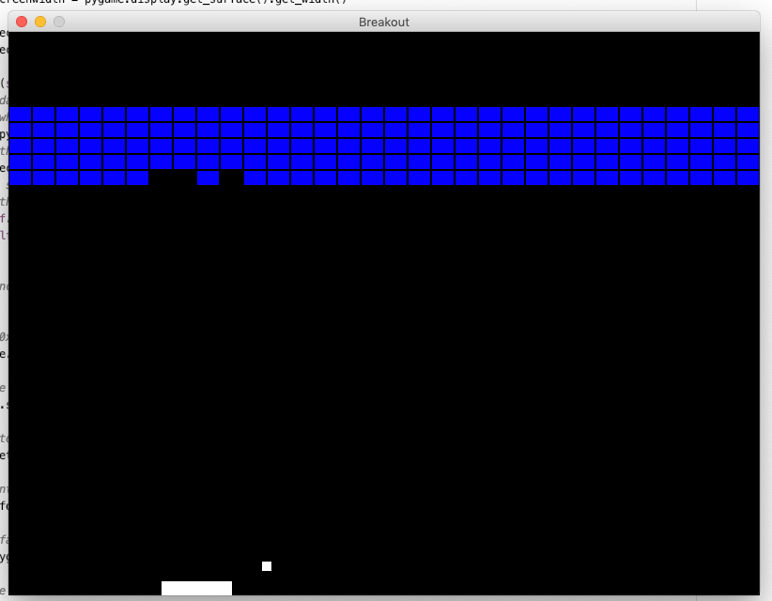
Refactoring & Instrumenting Games for ML
Building symbolic AI
Where can the player hit it to (prediction)?

Slide 18
Refactoring & Instrumenting Games for ML
Building symbolic AI
Where’s the best place to hit the ball to (estimation)?
Give all the available bricks some value
Choose to hit whatever brick has the highest value
This is where we can look at breakout ‘strategy’
One strategy is to concentrate on a single column in order to break through to the top.
Therefore, the deeper into a column bricks are, the higher value they will have
Also gives you an approach to actually clear levels

Slide 19
Refactoring & Instrumenting Games for ML
Building symbolic AI
These three generic approaches form the basis of a lot of goal-oriented planning approaches
forward projection?
prediction?
estimation?
If you’re not making breakout (and, of course, you aren’t) look at these approaches for your symbolic AI

Slide 20
Refactoring & Instrumenting Games for ML
Capturing Data
What data to capture
How to capture it
How to store it
How to process it for ML

Slide 21
Refactoring & Instrumenting Games for ML
Capturing Data
What data to capture
You will have an idea of what data to capture
Generally, look to capture game elements
Keep in a raw format so you can process them off-line
Don’t want to lose capture data, unless your capture / symbolic AI changes
Will be refined with every piece of ML research you do
See from house price data:
Granularity of data
Clustering / quantisation of data

Slide 22
Refactoring & Instrumenting Games for ML
Capturing Data
How to capture it
What constitutes useful data?
Mariflow captures at 15fps
This is different data to shooting games where fire events may occur at any time
Do you want to capture failure data
What will break out data where paddle misses the ball give you?
May need to buffer data locally before you decide to commit it to your training data

Slide 23
Refactoring & Instrumenting Games for ML
Capturing Data
How to store it
If you’re collecting ‘lots’ of data (multiple AI sessions)
Look to manage through a database
Think about how sets of data will need to be managed and tagged to identify them
HTTP server example is a useful front end for this
More so than lots of files

Slide 24
Refactoring & Instrumenting Games for ML
Capturing Data
How to process it for ML
Saw this in last week’s lecture
Often data needs to be processed prior to ML process
Keep source data in a source format
Don’t process during capture
If your processing is wrong (it’s likely to be), you will lose all that data

Slide 25
Refactoring & Instrumenting Games for ML
Feeding ML results into non-symbolic AI model
Need to think about how your game will work with prediction data
If you’re classifying, can give the AI a player-like interface of ‘key presses’
As that will be the ML-algorithm output
Default breakout interface is mouse position
No limitation on how far the player can move in one frame
Worth building those limitations back into the refactor to stop the AI from ‘cheating’

Slide 26
Refactoring & Instrumenting Games for ML
Rinse & repeat when it doesn’t work quite right
All good blogging fodder (as is every step in this model)

Slide 27
Tell me about your games …

Slide 28
Do you have any questions for me?

Slide 29
Workshop
This week will be assignment support :)
Bring in your work so far and we can work out how to take it further

