Slide 1

7: A* Search
COMP702: Classical Artificial Intelligence

Slide 2
Paper Club
For next week’s seminar, please read:
Pepels, T, Winands, M.H.M., Lanctot, M. (2014). Real-Time Monte Carlo Tree Search in Ms Pac-Man. IEEE Transactions on Computational Intelligence and AI in Games, 6(3):245-257.
(PDF Link on LearningSpace)

Slide 3
Pathfinding

Slide 4
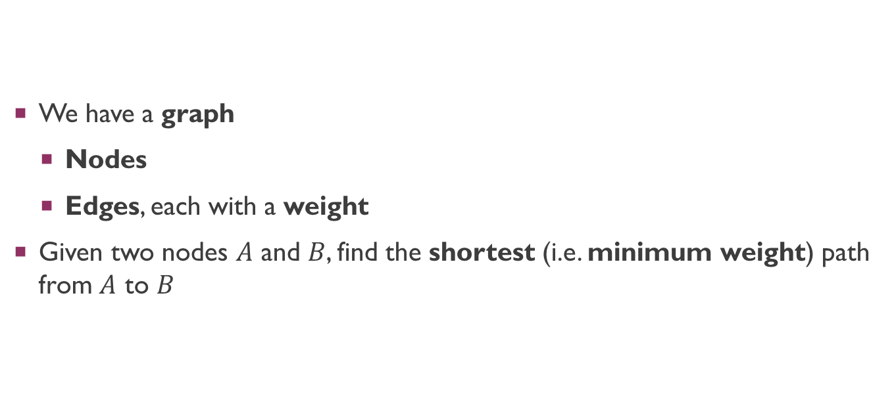
The problem
We have a graph
Nodes
Edges, each with a weight
Given two nodes $A$ and $B$, find the shortest (i.e. minimum weight) path from $A$ to $B$

Slide 5
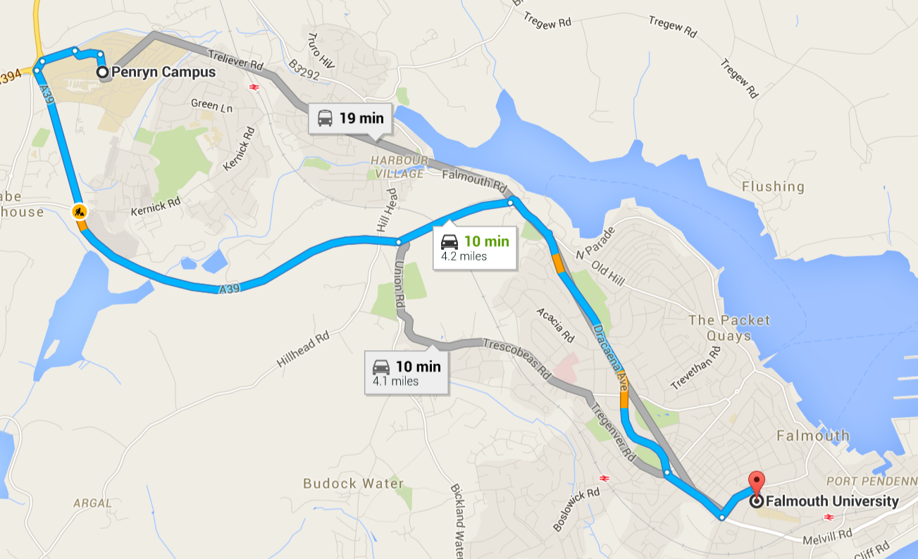
Applications of pathfinding

Slide 6
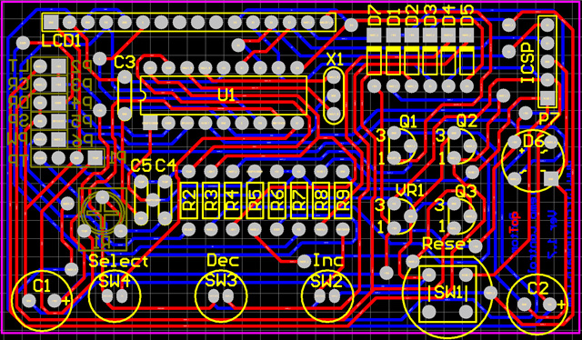
Applications of pathfinding

Slide 7
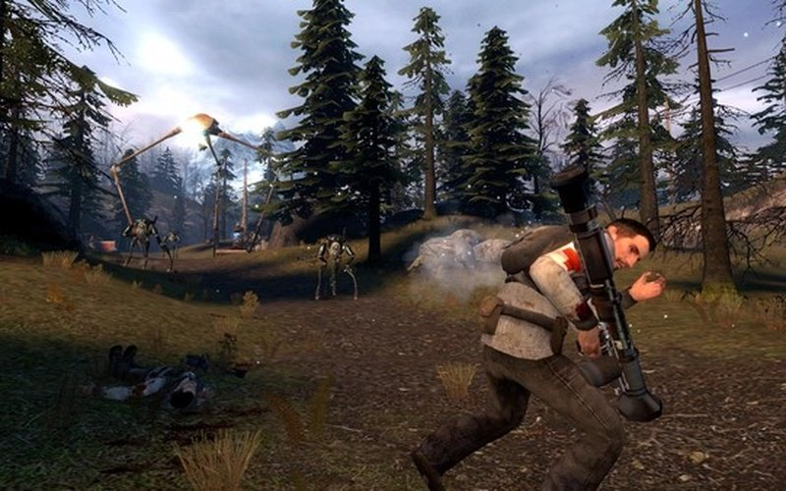
Applications of pathfinding

Slide 8
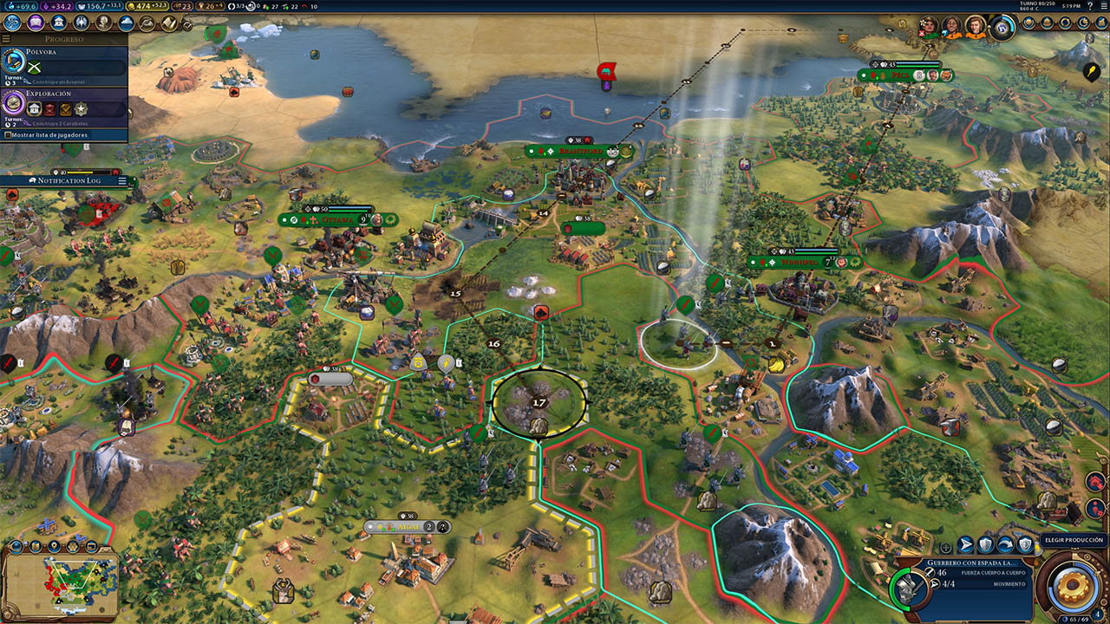
Applications of pathfinding

Slide 9
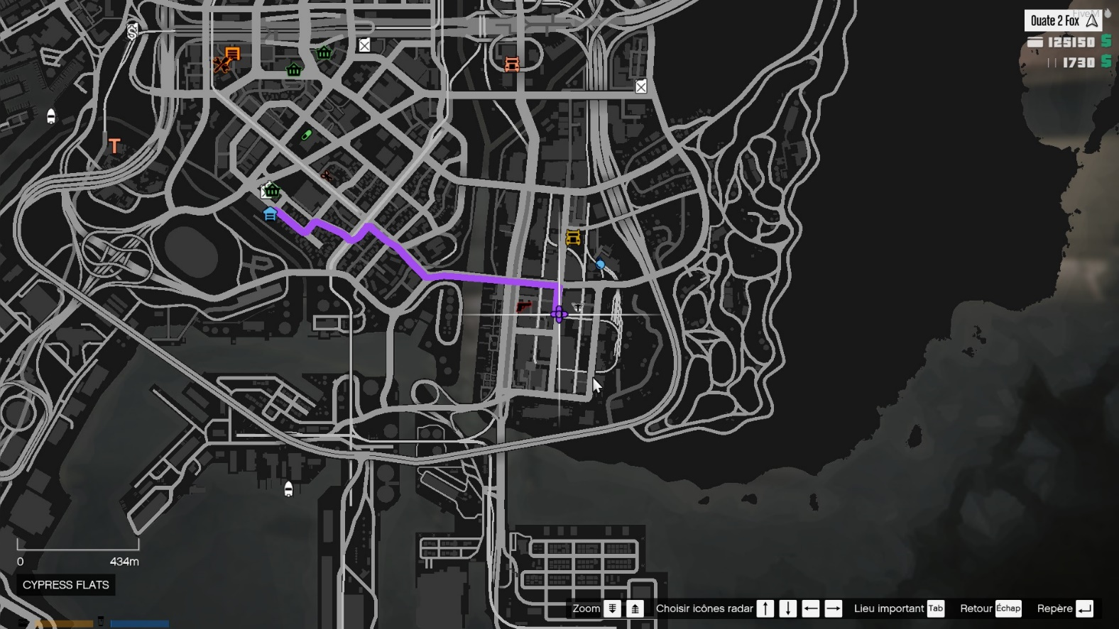
Applications of pathfinding

