Slide 1
ARM Cortex M7
Aidan Szilagyi and Falong Fan

Slide 2
Dossier Requirements
Prepare a dossier of documentation about the processor.
You should have at least 2 primary sources, more if necessary, to fully explain the 1) microarchitecture, including register file organization and branch predictor, 2) unique features of the ISA, 3) the memory system, including cache organization and memory consistency model (MCM)
  At least one academic article is preferred, but vendor documentation and trade press articles from reputable sources (eg, Tom's Hardware, Chips and Cheese) are acceptable. When in doubt, ask me
You may also wish to include secondary sources (e.g., vendor datasheet, ISA spec, etc.) as background
If possible, a source for performance characterization should be included as well
  An academic article is preferred but may be difficult to find. Trade press benchmarking will often be the only source
Include the link to the slides on the dossier website
2. Compile the dossier so that it is available to the class.
A public-facing website is preferred, e.g. hosted on Github if possible
Make sure links are accessible to UVA faculty and students (ok if the article itself is only available on Grounds or via the UVA VPN, e.g. ACM and IEEE articles)

Slide 3
Presentation Requirements
3. Prepare a 15-minute overview presentation to be given in class
Provide novel features of the ISA and MCM, as well as the register file organization
Discuss the pipeline; be sure to address precise exceptions
Discuss the cache hierarchy
Conclude with questions for discussion
Use Google Slides and include the link to the slides from your dossier website

Slide 4
Sources
ARM Datasheet: https://support.arm.com/documentation/102838/latest/
Freescale Whitepaper: https://www.nxp.com/docs/en/white-paper/CORTEXM7WP.pdf
Technical Reference Manual: https://documentation-service.arm.com/static/5e906dc68259fe2368e2abbe
ARM M-Family Book (Chapter 6 for M7): https://www.sciencedirect.com/book/monograph/9780323854948/the-designers-guide-to-the-cortex-m-processor-family
Chapter 6: https://re5qy4sb7x.search.serialssolutions.com/?ctx_ver=Z39.88-2004&ctx_enc=info:ofi/enc:UTF-8&url_ver=Z39.88-2004&rfr_id=info:sid/Elsevier:SD&svc_val_fmt=info:ofi/fmt:kev:mtx:sch_svc&rft_val_fmt=info:ofi/fmt:kev:mtx:journal&rft.aulast=MARTIN&rft.auinit=T&rft.date=2023&rft.isbn=9780323854948&rft.spage=203&rft.epage=230&rft.title=The+Designer%27s+Guide+to+the+Cortex-M+Processor+Family&rft.atitle=Cortex-M7+Processor&rft_id=info:doi/10.1016/B978-0-323-85494-8.00007-3
ARM Whitepaper on DSP Capabilities: https://community.arm.com/cfs-file/__key/communityserver-discussions-components-files/471/7607.ARM-white-paper-_2D00_-DSP-capabilities-of-Cortex_2D00_M4-and-Cortex_2D00_M7.pdf

Slide 5
Overview
ARM Cortex M-family of processors focuses on Microcontrollers, FPGAs, ASICs, and SoCs,
All ARM Cortex M-family processors can use the Thumb-1 Instruction set
The M7 is the successor to the M4, with a focus on DSP
Has been used in several microcontrollers, including:
Atmel E7, S7, V7 NXP Kinetis KVX5, i.MX RT, S32K3xx ST STM32 F7, H7
Notes:
Thumb instruction sets are 16-bits
The M7 is the successor to the M4, with a focus on DSP - It has a DSP extension, as well as TCMs and a 64-bit AXI interface
Additionally, other microcontrollers not listed use the M7 as a secondary core

Slide 6
Specification
Implements the ARMv7E-M architecture (Harvard)
6-stage pipeline with branch speculation (issue two instructions per cycle)
Instruction Sets: Thumb-1, Thumb-2,
Saturated arithmetic support, DSP, 32-bit integer multiply, MAC, and divide
Non-maskable Interrupt and 240 physical interrupts
Optionally: Up to 64kB data Cache, up to 64kB instruction cache, single/double precision FPU, Embedded Trace Macrocell (ETM), MPU, wake-up interrupt controller, DCLS

Slide 7
Novel Features of ISA
Implements the Thumb-1 and Thumb-2 compressed instruction sets: (16-bit)
Compared to ARM, Thumb-1 typically allows restricted registers and operands, fewer addressing modes, no condition field
16-bit, designed to improve compiled code density.
Thumb-2 introduced variable instruction lengths, allowing 32-bit instructions:
Preserves most of richness of ARM instructions while still improving compression
Notes:
Note that Thumb-2 is not a subset of the ARM instruction set, it is entirely different
The 16-bit Thumb-1 instruction set reduces instruction size by 50%, but practically speaking, you can’t condense everything, but this results in a 35% decrease in instruction size.

Slide 8
16-bit Thumb-2 Instructions:
Thumb-2 Wide Instructions:
MOV r0, r1
SUB r2, #1
CMP r0, #10
AND r0, r1
LSL r0, r1, #2
LDR r0, [r1, #4]
BEQ label
CMP r0, #0
ITE EQ
MOVEQ r1, #1
MOVNE r1, #0
MOV r8, r0
ADD.W r0, r1, #1000
MOVW r0, #0x5678
LDR.W r8, [r9, #1000]
ADD.W r0, r1, r2, LSL #3
UBFX r0, r1, #8, #8
(extract arbitrary bit field)
BFC r0, #8, #8
(clear a bit field)
ARM Instruction Set:
ADDEQ r0, r1, r2

Slide 9
Memory Subsystem
ITCM - 64-bit wide interface
DTCM - 2 32-bit wide interfaces (DMA Controller can access)
Separate Instruction and Data Caches:
0 - 64kB instruction cache (2-way associative)
0 - 64kB data cache (4-way associative)
Optional Error Correcting Code (ECC) support for caches and TCMs
Notes:
Predictable latency of the Tightly Coupled Memory makes it good for real-time systems

Slide 10
Novel Features of Register File Organization
Designed for “large scale dual-issue”
6 Read ports
32x32 bit accumulating into a 64-bit value requires 4 read ports
Can execute another instruction that requires 2 read ports in parallel
UMLAL r0, r1, r2, r3
ADD r4, r5, r6
Also, 64-bit store requires 2 32-bit data registers and 1 address register
4 write ports: Writing 2 64-bit values requires 4 32-bit writes
(For M7Fs, FP Register File has four 32-bit read ports and two 32-bit write ports)

Slide 11
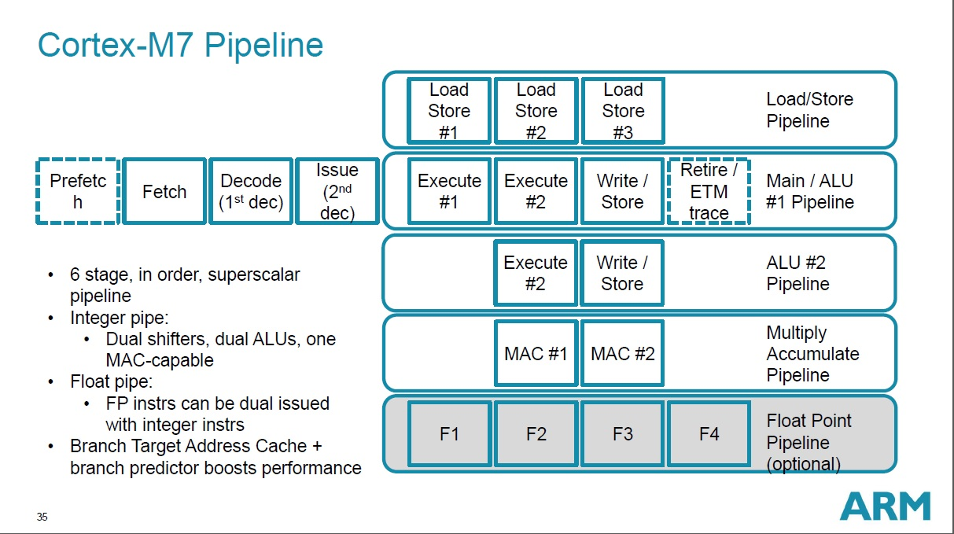
Pipeline (address precise exceptions)
6-stage, dual-issue, in-order pipeline
4x64-bit instruction prefetch
Execute:
1 Regular ALU (single cycle basic operations)
1 ALU capable of SIMD operations
MAC pipeline (Two cycle latency, but one MAC per cycle throughput)
Integer Divide, optional FP pipeline
Store:
2 32-bit load channels to TCM, cache, AXI. Store buffering
Dynamic Branch Prediction, Branch Target Address Cache (single cycle), and Forward Flagging

Slide 12
Nested Vectored Interrupt Controller (NVIC)
Up to 240 external interrupts plus NMI
8 - 256 priority levels (3 - 8 priority bits), pre-empt priority and sub-priority
Vectored - handler address fetched from the vector table, no software dispatch
Nested - pre-emption by priority, dynamic reprioritization
Hardware stacking of R0-R3, R12, LR, PC, xPSR. ISRs are plain C functions
Lazy FP context save (stacked on the first FP instruction in the ISR)
Tail-chaining and late arrival (back-to-back ISRs skip the unstack/restack)
12 cycle entry latency, 14 worst case
Optional Wake-up Interrupt Controller (WIC)

Slide 13
Cache Hierarchy
L1 only, split I/D, on the AXIM path. No L2, no coherency hardware
TCM and AHBP accesses are not cached
Instruction cache - 0/4/8/16/32/64kB, 2-way associative, 32-byte lines
Data cache - 0/4/8/16/32/64kB, 4-way associative, 32-byte lines
Pseudo-random replacement
Policy set per region by MPU attributes: WB-RA-WA, WB-RA, or WT-RA
Disabled at reset, boot code must invalidate before enabling
Store buffer between D-cache and AXIM (buffered write faults are imprecise)
DMA coherency is software-managed (clean/invalidate by MVA or set/way)

Slide 14
Discussion Questions

