Slide 1
Homework
Reading Assignment
  Professional Assembly Language, pp 39-59, 62-65
Lab 1
  Load and read Lab1 write up
  Go To the Lab Section you registered!
Get ready for mp1
  Download the VMWare Workstation software:
  /nobackup/blade71/cheungr/
  Set up the virtualized SAPC environment using instructions listed in: http://www.cs.umb.edu/~cheungr/cs341/VMWare-for-Tutor.pdf

Slide 2
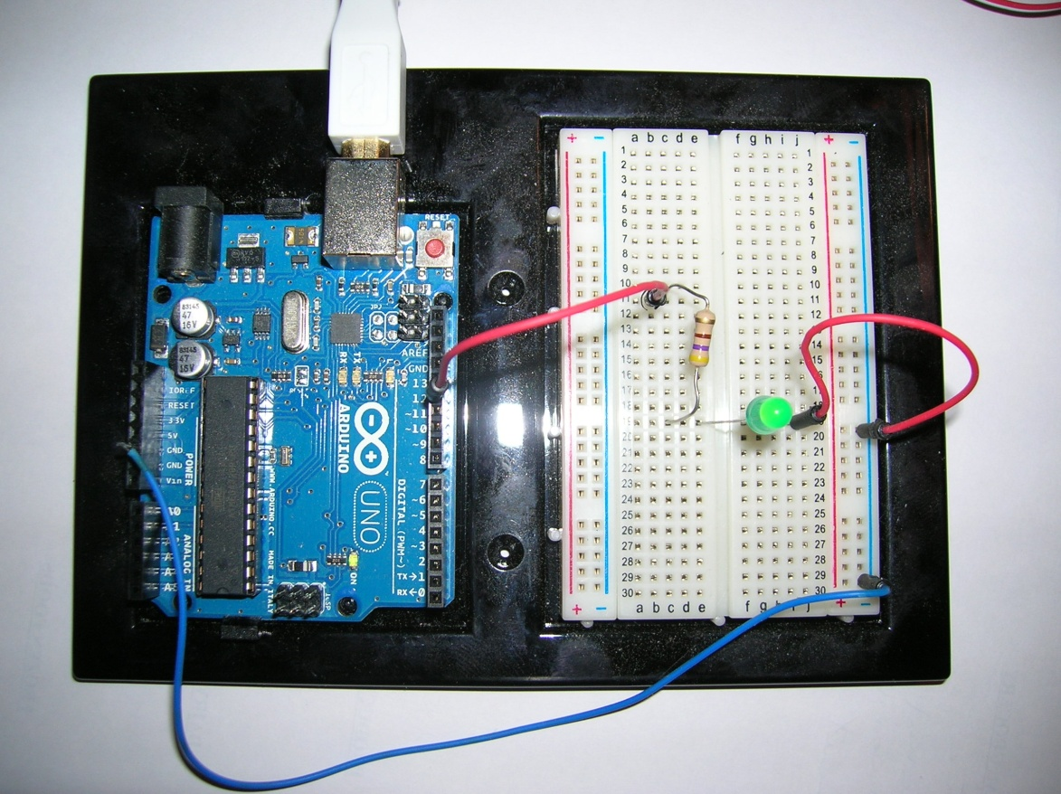
Embedded Systems Lab
Introduction to CS341 lab equipment
Arduino microcomputer system / breadboard

Slide 3
Embedded Systems Lab
Microprocessor – AtMega328P
  8 bit AVR processor @ up to 20 MHz clock
  32 Kbytes program memory plus 1 Kbyte RAM
Programmed using a language like C/C++ with a custom I/O support library
Development system cost $36.00!
Buying the processor alone in quantity would probably be about the price of a candy bar

Slide 4
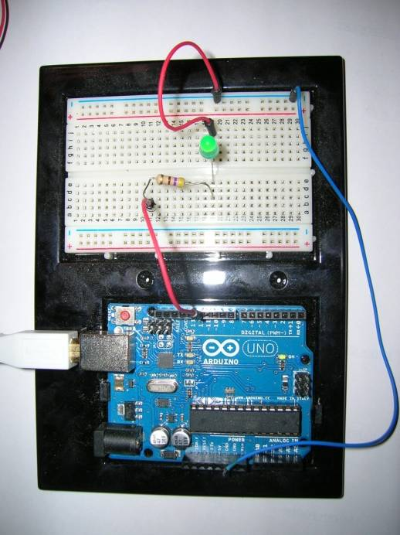
Embedded Systems Lab
To use embedded software development tools, a development host is attached to a target host via:
  RS-232
  Ethernet
  USB
  Other?
Development
Host
PC
USB Cable

Slide 5
MP Development Environment
You will also develop C and assembly code for a virtual embedded system on a PC
You will use two VMware virtual machines
  One VM provides a Linux development system
  One VM emulates an embedded system with Tutor
Tutor is just a debug monitor - not really an operating system like Linux
Tutor allows operations prohibited by an O/S

Slide 6
MP Development Environment
PC
ulab.cs.umb.edu
(Unix)
SSH
Secure
Telnet
tutor-vserver
(Linux)
SCP
Your home
directory
and your
cs341 directory
COM1
COM2
tutor
(Tutor)
Virtual Development System
Virtual Embedded System

Slide 7
MP Development Environment
On your PC:
  use SSH to login to users@cs.umb.edu
  rlogin to ulab
On ulab:
  copy/edit source files
  compile and/or assemble them
  create tutor executable files (.lnx)
On your PC:
  openVMWare
  start tutor-vserver and tutor

Slide 8
MP Development Environment
On tutor-vserver:
  use scp to transfer .lnx files to local Linux
  use mtip to control and monitor the tutor VM
  (Linux prompt>) mtip –f filename.lnx
  . . .
  Tutor>
To download the executable “filename.lnx”
  Tutor> ~d (Wait for “….Done.” Response)
To start running the downloaded program:
  Tutor> go 100100

Slide 9
MP Development Environment
PC
Reset tutor VM
tutor-vserver
tutor
Send ctrl+alt+del
mtip
Tutor
Transparent Relaying of Tutor commands
~q
(Quits mtip)
~d
file.lnx
Memory
You

Slide 10
The “new” Virtualized SAPC Picture
Instructions on how to set up the Virtualized SAPC Environment:
  VMWare Workstation for PCs:
  http://www.cs.umb.edu/~cheungr/cs341/VMWare-for-Tutor.pdf
  Modifications for VMWare Fusion on MACs:
  http://www.cs.umb.edu/~cheungr/cs341/VMWare-Fusion-config.pdf

Slide 11
SAPC Software
BIOS
  burned in ROM
  available at power-up
  initializes the hardware, loads and start the Tutor bootstrap
Tutor (and its bootstrap)
  loaded from floppy disk into RAM
  runs in kernel mode
  initializes more hardware, switches from 16-bit real mode to 32-bit protected mode

Slide 12
SAPC Software Support Directories
Make sure you have edited the .cshrc file in your home directory to have the line:
  module load standard ulab
to set the right environmental variables
Related SAPC directories
  $pcinc : headers
  $pcex : C examples
  $pcbook : for S&S¹ chapters 2 and 3, assembler examples
  $pclibsrc : sources for the SAPC support library
  ¹ “ The IBM Personal Computer from the inside out” by Sargent and Shoemaker

Slide 13
System Build Processes
The system build processes for C and assembly source courses are driven by our make files
However, it is important to understand how the component build steps work with the SW tools:
  Sun/UNIX Intel/SAPC
  gcc i386-gcc
  as i386-as (informally called “gas”)
  ld i386-ld
  nm i386-nm
  objdump i386-objdump (alias “disas”)

Slide 14
Build for gcc Compilation
C Source
Code
Translation
Unit
Assembly
Code
Object
Code
Executable
File
prog.c
prog.i
prog.s
prog.o
prog
gcc -E
gcc -S
gcc -c
gcc -o

Slide 15
Build for i386-gcc Compilation
C Source
Code
Translation
Unit
Assembly
Code
Object
Code
Executable
File
prog.c
prog.i
prog.s
prog.opc
prog.lnx
i386-gcc -E
i386-gcc -S
i386-gcc -c
i386-gcc -o

Slide 16
Build for i386-gcc and i386-as
C Source
Code
Assembly
Code
Object
Code
Executable
File
progc.c
prog.s
prog.opc
prog.lnx
i386-gcc -c
i386-as
i386-ld

Slide 17
Build - Symbol Table Generation
The syms file shows the memory address assigned for each variable or source label
Object
Code
Executable
File
Symbol
File
prog.opc
prog.lnx
syms
i386-nm
i386-nm

Slide 18
Example: Test Program Demo
Login to LINUX host users.cs.umb.edu and then ssh to UNIX host ulab.cs.umb.edu
Compile a program named test.c for running on both Unix and tutor VM
  Produce UNIX executable (test) using gcc
  Run it using ./test
  Produce tutor executable (test.lnx) using make
  File transfer it to tutor-vserver VM
  Download it to the tutor VM
  Run it using go

Slide 19
Setup Test files on Unix
Make a subdirectory “test” on your cs341 directory
Copy these files to that directory
  $pcex/makefile
  $pcex/test.c
Note the name $pcex is defined by the ulab module in your .cshrc file. If you can’t use $pcex as a directory name, check your ulab module configuration in .cshrc

Slide 20
Running the test program on UNIX
Create the UNIX executable “test”
ulab(60)% gcc –o test test.c
Execute it (avoiding conflict with UNIX “test”)
ulab(60)% ./test
Follow the program’s directions. It should finish up quickly and hand control back to UNIX. You will see a UNIX prompt again.

Slide 21
Running the test program on tutor VM
Make the tutor VM executable on ulab:
ulab(65)% make C=test
  The suffix “.lnx” is short for Linux, since we are using a Linux-defined executable format
Transfer the test files to the tutor-vserver VM:
  Log into tutor-vserver VM using the credentials provided
  Transfer files from ulab to tutor-vserver VM:
vserver$ scp username@users.cs.umb.edu:cs341/test/test.* .
Note the .

Slide 22
Running the test program on tutor VM (cont’d)
Download the test.lnx file to the tutor VM
  At the tutor-vserver VM, enter
vserver$ mtip -f test.lnx
  After connecting to the tutor VM, you’ll see:
  ….
  Using board #1
  Reboot the tutor VM by selecting the “Send Ctrl+Alt+Del” button at the tutor VM. You’ll see:
  Please type <CR> to confirm console settings:
  Hit <CR> at the vserver VM to get the Tutor prompt. Enter ~d to download the test.lnx file to the tutor VM
  After downloading, Tutor prompt will appear again

Slide 23
Running the test program on tutor VM (cont’d)
To execute the program, type
Tutor> go 100100
Follow the program’s directions. It should finish up quickly and hand control back to Tutor. You will see Tutor prompt again.
You can run it again by issuing command “go 100100”
Type “~q” or two ctrl-Cs to quit out of mtip

Slide 24
More mtip Commands
The ESCAPE CHARACTER: ~ This is the escape character that MUST precede ALL COMMANDS. (if you need to change it, use the -e argument to mtip)
The Most Important Commands: (uppercase or lowercase: ~Q or ~q for quit, etc.)
~h - Help. Will display all commands possible.
~q - quit mtip back to UNIX.
~d - This command will download the file argued in the command line by the -f.
~f - This command will allow you to specify the download file from inside mtip (same effect as -f on command line)
~\char - Send one char to board "as is”
~! - This will allow you to issue a UNIX command to a subshell.

