Slide 2
Agenda
Data Science
Case Study: Analyzing Immomio PropertyTenants
Machine Learning
Supervised Learning
Unsupervised Learning
Neural Nets
Concept
Training a neural network
Reinforcement Learning

Slide 3
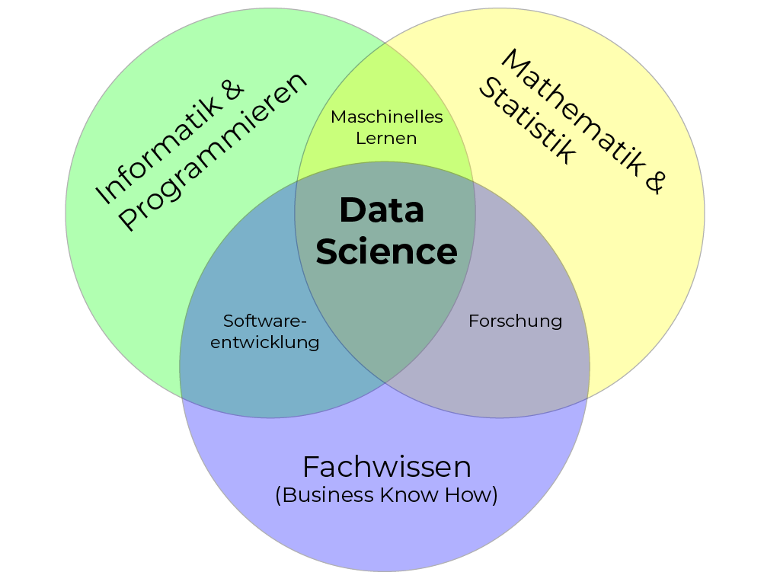
Data Science

Slide 4
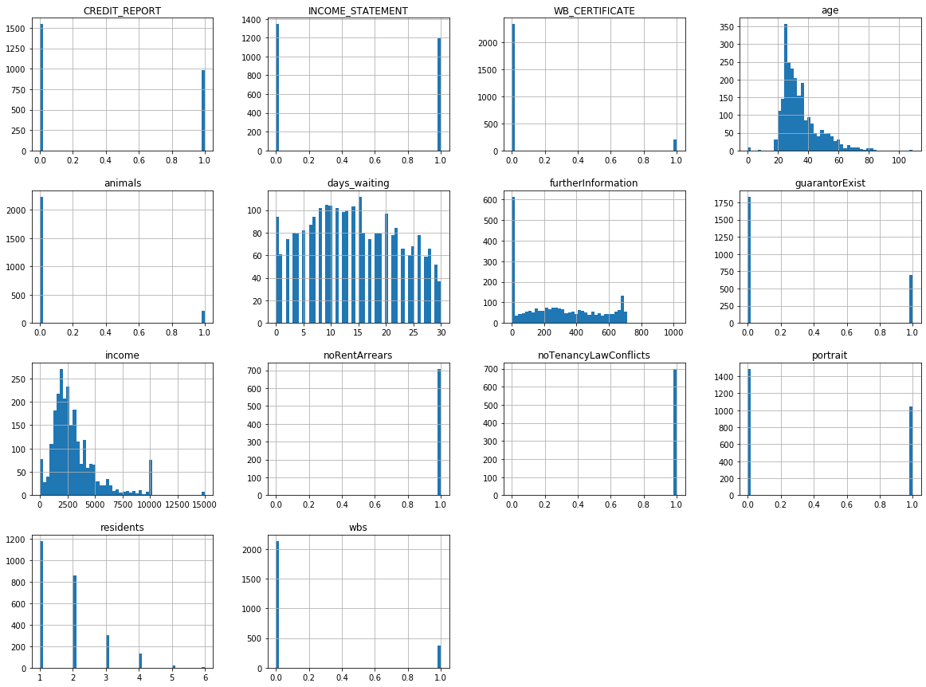
Analyzing Immomio PropertyTenants
m = 31
m = 14
m = 235
m = 2500
3117 Datasets

