Slide 1
HTTP connections
Question: should each request/response pair be sent over a separate or the same TCP connection?
non-persistent HTTP
at most one object sent over single TCP connection
  connection then closed
=> downloading multiple objects required multiple connections
persistent HTTP
multiple objects can be sent over single TCP connection between client, server

Slide 2
Non-persistent HTTP
suppose user enters URL:
(contains text,
references to 10
jpeg images)
www.someSchool.edu/someDepartment/home.index
1a. HTTP client initiates TCP connection to HTTP server (process) at www.someSchool.edu on port 80
1b. HTTP server at host www.someSchool.edu waiting for TCP connection at port 80. “accepts” connection, notifying client
2. HTTP client sends HTTP request message (containing URL) into TCP connection socket. Message indicates that client wants object someDepartment/home.index
3. HTTP server receives request message, forms response message containing requested object, and sends message into its socket
time

Slide 3
Non-persistent HTTP (cont.)
4. HTTP server closes TCP connection.
5. HTTP client receives response message containing html file, displays html. Parsing html file, finds 10 referenced jpeg objects
time
6. Steps 1-5 repeated for each of 10 jpeg objects

Slide 4

Non-persistent HTTP: response time
Round-trip time (RTT): time for a small packet to travel from client to server and back
HTTP response time:
one RTT to initiate TCP connection
one RTT for HTTP request and first few bytes of HTTP response to return
file transmission time
(Overall) non-persistent HTTP response time =
  2RTT+ file transmission time
initiate TCP
connection
RTT
request
file
RTT
time to
transmit
file
file
received
time
time

Slide 5
Persistent HTTP: response time
First request is same as non-persistent HTTP
Subsequent HTTP response time:
one RTT for HTTP request and first few bytes of HTTP response to return
file transmission time
initiate TCP
connection
RTT
request
file 1
RTT
time to
transmit
file 1
file 1 received
request
file 2
RTT
time to
transmit
file 2
file 2 received
time
time

Slide 6
Non-Persistent & Persistent HTTP
non-persistent HTTP issues:
requires 2 RTTs per object
OS overhead for each TCP connection
browsers often open parallel TCP connections to fetch referenced objects
persistent HTTP:
server leaves connection open after sending response
subsequent HTTP messages between same client/server sent over open connection
client sends requests as soon as it encounters a referenced object

Slide 7
Concurrent HTTP
What?
  Not part of the HTTP specification
  Implemented by almost all web browsers
  After the initial HTTP connection which retrieves the HTML body, initiate multiple (4~6) HTTP sessions (per domain) to retrieve multiple objects (e.g., images) in parallel.
Why?
  Reduce delay in waiting for previous HTTP response to complete transfer (aka head-of-line blocking)
  Potentially overlaps the server-side processing time of multiple HTTP requests
  Effectively multiplies the TCP congestion window size by the number of TCP connections, resulting in higher aggregate throughput
Shortcomings:
  Use up more resources at server
  Unfairness to competing data flows

Slide 8
HTTP request message
two types of HTTP messages: request, response
HTTP request message:
  ASCII (human-readable format)
carriage return character
request line
(GET, POST,
HEAD commands)
line-feed character
GET /index.html HTTP/1.1\r\n
Host: www-net.cs.umass.edu\r\n
User-Agent: Firefox/3.6.10\r\n
Accept: text/html,application/xhtml+xml\r\n
Accept-Language: en-us,en;q=0.5\r\n
Accept-Encoding: gzip,deflate\r\n
Accept-Charset: ISO-8859-1,utf-8;q=0.7\r\n
Keep-Alive: 115\r\n
Connection: keep-alive\r\n
\r\n
header
lines
carriage return,
line feed at start
of line indicates
end of header lines
* Check out the online interactive exercises for more examples: http://gaia.cs.umass.edu/kurose_ross/interactive/

Slide 9
HTTP request message: general format
method
sp
URL
sp
version
cr
lf
request
line
header field name
value
cr
lf
~
~
header
lines
~
~
header field name
value
cr
lf
cr
lf
~
entity body
~
body
~
~

Slide 10
User-server state: cookies
Q: As HTTP server is stateless, how can a Web site identify users?
A: Cookies, defined in [RFC 6265], allow sites to keep
track of users.
example:
Susan always access Internet from PC
visits specific e-commerce site for first time
when initial HTTP requests arrives at site, site creates:
  unique ID
  entry in backend database for ID

Slide 11
Cookies (continued)
aside
what cookies can be used for:
authorization
shopping carts
recommendations
user session state (Web e-mail)
cookies and privacy:
cookies permit sites to learn a lot about you
you may supply name and e-mail to sites
how to keep “state”:
protocol endpoints: maintain state at sender/receiver over multiple transactions
cookies: http messages carry state

Slide 12
Cookies: keeping “state” (cont.)
client
server
ebay 8734
usual http request msg
Amazon server
creates ID
1678 for user
cookie file
usual http response
set-cookie: 1678
backend
database
create
entry
ebay 8734
amazon 1678
usual http request msg
cookie: 1678
cookie-
specific
action
access
usual http response msg
one week later:
access
ebay 8734
amazon 1678
usual http request msg
cookie: 1678
cookie-
specific
action
usual http response msg

Slide 13
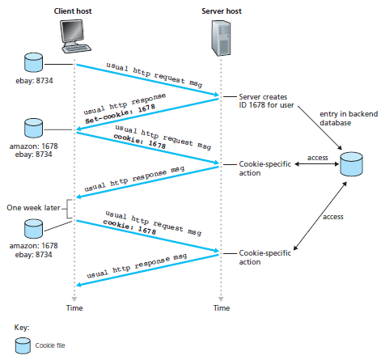
User-server state: cookies
many Web sites use cookies
four components:
  1) cookie header line of HTTP response message
  2) cookie file kept on user’s host, managed by user’s browser
  3) backend database at Web site
  4) cookie header line in next HTTP request message

Slide 14

Web caches (proxy server)
goal: satisfy client request without involving origin server
user sets browser: Web accesses via cache (i.e., proxy server)
browser sends all HTTP requests to cache
  object in cache: cache returns object
  else cache requests object from origin server, then returns object to client
proxy
server
HTTP request
HTTP request
client
origin
server
HTTP response
HTTP response
HTTP request
HTTP response
client
origin
server

Slide 15
More about Web caching
cache acts as both client and server
  server for original requesting client
  client to origin server
typically cache is installed by ISP (university, company, residential ISP)
why Web caching?
reduce response time for client request
reduce traffic on an institution’s access link
Internet dense with caches: enables “poor” content providers to effectively deliver content (so too does P2P file sharing)

Slide 16
Chapter 2: outline
2.1 principles of network applications
  app architectures
  app requirements
2.2 Web and HTTP
2.3 FTP
2.4 electronic mail
  SMTP, POP3, IMAP
2.5 DNS
2.6 P2P applications
2.7 Socket programming with UDP and TCP

Slide 17
Electronic mail
outgoing
message queue
user mailbox
Three major components:
user agents
mail servers
simple mail transfer protocol: SMTP
User Agent
a.k.a. “mail reader”
composing, editing, reading mail messages
e.g., Outlook, Thunderbird, iPhone mail client
user
agent
mail
server
user
agent
SMTP
mail
server
user
agent
SMTP
SMTP
user
agent
mail
server
user
agent
user
agent

Slide 18
Electronic mail: mail servers
outgoing
message queue
user mailbox
mail servers:
mailbox contains incoming messages for user
message queue of outgoing (to be sent) mail messages
SMTP protocol between mail servers to send email messages
  client: sending-mail server
  “server”: receiving-mail server
user
agent
mail
server
user
agent
SMTP
mail
server
user
agent
SMTP
SMTP
user
agent
mail
server
user
agent
user
agent

Slide 19
Electronic Mail: SMTP [RFC 2821]
uses TCP to reliably transfer email message from client to server, port 25
direct transfer: sending server to receiving server
three phases of transfer
  handshaking (greeting)
  transfer of messages
  closure
command/response interaction (like HTTP, FTP)
  commands: ASCII text
  response: status code and phrase
messages must be in 7-bit ASCII

Slide 20
Sample SMTP interaction
S: 220 hamburger.edu (server's host name)
C: HELO crepes.fr (client's host name)
S: 250 Hello crepes.fr, pleased to meet you
C: MAIL FROM: <alice@crepes.fr> (beginning of message)
S: 250 alice@crepes.fr... Sender ok
C: RCPT TO: <bob@hamburger.edu>
S: 250 bob@hamburger.edu ... Recipient ok
C: DATA
S: 354 Enter mail, end with "." on a line by itself
C: Do you like ketchup? (two-line message)
C: How about pickles?
C: . (end of message)
S: 250 Message accepted for delivery
C: QUIT (all messages have been sent)
S: 221 hamburger.edu closing connection

Slide 21


Scenario: Alice sends message to Bob
1) Alice uses UA to compose message “to” bob@someschool.edu
2) Alice’s UA sends message to her mail server; message placed in message queue
3) client side of SMTP opens TCP connection with Bob’s mail server
4) SMTP client sends Alice’s message over the TCP connection
5) Bob’s mail server places the message in Bob’s mailbox
6) Bob invokes his user agent to read message
user
agent
mail
server
user
agent
1
mail
server
2
3
6
4
Alice’s mail server
5
Bob’s mail server

Slide 22
SMTP: final words
SMTP uses persistent connections: If the sending mail server has several messages to send to the same receiving mail server, it can send all of the messages over the same TCP connection.
comparison with HTTP:
HTTP: pull protocol (pull the information from the server)
SMTP: push protocol (sending mail server pushes the file to the receiving mail server)
Both have ASCII command/response interaction, status codes

Slide 23
Mail message format
SMTP: protocol for exchanging email msgs
RFC 822: standard for text message format:
header lines, e.g.,
  To:
  From:
  Subject:
Body: the “message”
  ASCII characters only
header
blank
line
body

Slide 24
Mail access protocols
user
agent
mail access
protocol
user
agent
SMTP
SMTP
(e.g., POP,
IMAP)
sender’s mail
server
receiver’s mail
server
SMTP: delivery/storage to receiver’s server
mail access protocol: retrieval from server
  POP: Post Office Protocol [RFC 1939]: authorization, download
  IMAP: Internet Mail Access Protocol [RFC 1730]: more features, including manipulation of stored msgs on server
  HTTP: gmail, Hotmail, Yahoo! Mail, etc.

Slide 25
POP3 protocol
POP3 is an extremely simple mail access protocol
    its functionality is rather limited.
POP3 begins when the user agent (the client) opens a TCP connection to the mail server (the server) on port 110.
With the TCP connection established, POP3 progresses through three phases:
  Authorization
  Transaction
  Update

Slide 26
POP3 protocol
S: +OK POP3 server ready
C: user bob
S: +OK
C: pass hungry
S: +OK user successfully logged on
authorization phase
client commands:
  user: declare username
  pass: password
server responses
  +OK
  -ERR
transaction phase, client:
list: list the size of each of the stored messages
retr: retrieve message (indexed by number) from server
dele: delete message from server
quit
C: list
S: 1 498
S: 2 912
S: .
C: retr 1
S: <message 1 contents>
S: .
C: dele 1
C: retr 2
S: <message 2 contents>
S: .
C: dele 2
C: quit
S: +OK POP3 server signing off

Slide 27
POP3 protocol
Update phase: Two modes of operations:
  “download and delete”: the user agent deletes the messages on the mail server after downloading them
  “download and keep”: the user agent leaves the messages on the mail server after downloading them
POP3 is stateless across sessions.

Slide 28
IMAP protocol
keeps all messages in one place: at server
allows user to organize messages in folders
keeps user state across sessions:
  E.g., names of folders and mappings between message IDs and folder name

Slide 29
Web-Based E-mail
user
agent
HTTP
SMTP
HTTP
user
agent
sender’s mail
server
receiver’s mail
server
User agent: Web browser
User communicates with remote mailbox via HTTP:
  Send e-mail: e-mail message is sent from browser to mail server over HTTP (not SMTP)
  Mail server message exchange: Still using SMTP
  Access message in mailbox: e-mail message is sent from mail server to browser using the HTTP (not POP3 or IMAP)

Slide 30
Chapter 2: outline
2.1 principles of network applications
  app architectures
  app requirements
2.2 Web and HTTP
2.3 FTP
2.4 electronic mail
  SMTP, POP3, IMAP
2.5 DNS
2.6 P2P applications
2.7 Socket programming with UDP and TCP

Slide 31
DNS: domain name system
people: many identifiers:
  SSN, name, passport #
Internet hosts, routers:
  IP address (32 bit) - used for addressing datagrams
  “name”, e.g., www.yahoo.com - used by humans
Q: how to map between IP address and “name”, and vice versa ?
Domain Name System (DNS):
distributed database implemented in hierarchy of many name servers
application-layer protocol: hosts, name servers communicate to resolve names (address/name translation)
  note: core Internet function, implemented as application-layer protocol
  complexity at network’s “edge”

Slide 32
DNS: services
hostname to IP address translation
  Hostname: mnemonic identifier for a host
    E.g., www.yahoo.com
host aliasing
  E.g., canonical hostname: relay1.west-coast.enterprise.com
  Two alias: enterprise.com and www.enterprise.com (more mnemonic)
mail server aliasing
  E.g., E-mail address: bob@hotmail.com
  Alias hostname: hotmail.com
  Canonical hostname: relay1.west-coast.hotmail.com
  Note: a company’s mail server and Web server can have identical (aliased) hostnames, e.g., enterprise.com.
load distribution
  replicated Web servers: many IP addresses correspond to one name

Slide 33
DNS structure
why not centralize DNS?
single point of failure
traffic volume
distant centralized database
maintenance
A: doesn’t scale!

Slide 34
DNS: a distributed, hierarchical database
Root DNS Servers
Top-Level Domains (TLD)
…
…
com DNS servers
org DNS servers
edu DNS servers
yahoo.com
DNS servers
pbs.org
DNS servers
poly.edu
DNS servers
umass.edu
DNS servers
amazon.com
DNS servers
Principle
parent server has IP-name records for children
To resolve IP for www.amazon.com; 1st approx:
queries root server to find .com DNS server
client queries .com DNS server to get amazon.com DNS server
client queries amazon.com DNS server to get IP address for www.amazon.com

Slide 35
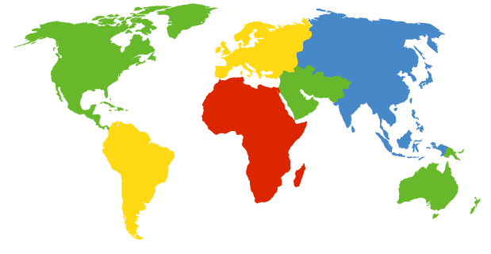
DNS: root name servers
contacted by local name server that cannot resolve name
root name server:
  contacts authoritative name server if name mapping not known
  → gets mapping
  → returns mapping to local name server
c. Cogent, Herndon, VA (5 other sites)
d. U Maryland College Park, MD
h. ARL Aberdeen, MD
j. Verisign, Dulles VA (69 other sites )
k. RIPE London (17 other sites)
i. Netnod, Stockholm (37 other sites)
e. NASA Mt View, CA
f. Internet Software C.
Palo Alto, CA (and 48 other sites)
m. WIDE Tokyo
(5 other sites)
400 root name “servers” worldwide
a. Verisign, Los Angeles CA
(5 other sites)
b. USC-ISI Marina del Rey, CA
l. ICANN Los Angeles, CA
(41 other sites)
g. US DoD Columbus, OH (5 other sites)

Slide 36
TLD, authoritative servers
Top-level domain (TLD) servers:
  responsible for com, org, net, edu, aero, jobs, museums, and all top-level country domains, e.g.: uk, fr, ca, jp
  further delegates query to authoritative DNS servers
Authoritative DNS servers:
  organization’s own DNS server(s), providing authoritative hostname to IP mappings for organization’s named hosts (e.g., *.cityu.edu.hk), known as a DNS zone
  can be maintained by organization or service provider
  can further sub-divide into smaller DNS zones each with their own authoritative DNS server (e.g., *.cs.cityu.edu.hk)

Slide 37
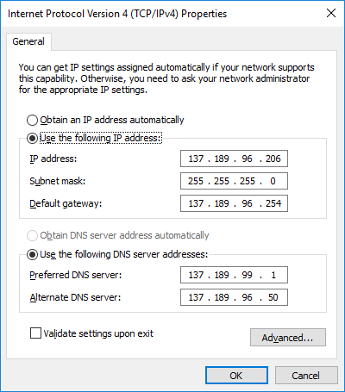
Local DNS name server
does not strictly belong to hierarchy
each ISP (residential ISP, company, university) has one
  also called “default name server”
when host makes DNS query, query is sent to its local DNS server
  has local cache of recent name-to-address translation pairs (but may be out of date!)
  acts as proxy, forwards query into hierarchy
C:\>ipconfig /all
Ethernet adapter Ethernet:
Connection-specific DNS Suffix . :
Description . . . . . . . . . . . : Intel(R) Ethernet Connection I217-LM
Physical Address. . . . . . . . . : 64-00-6A-5F-70-A3
DHCP Enabled. . . . . . . . . . . : No
Autoconfiguration Enabled . . . . : Yes
IPv4 Address. . . . . . . . . . . : 137.189.96.206(Preferred)
Subnet Mask . . . . . . . . . . . : 255.255.255.0
Default Gateway . . . . . . . . . : 137.189.96.254
DHCPv6 IAID . . . . . . . . . . . : 56885354
DHCPv6 Client DUID. . . . . . . . : 00-01-00-01-1D-96-3D-F9-64-00-6A-5F-70-A3
DNS Servers . . . . . . . . . . . : 137.189.99.1
137.189.96.50

Slide 38
DNS name resolution example
root DNS server
2
Example: host at cis.poly.edu wants IP address for gaia.cs.umass.edu
Recursive query:
puts burden of name resolution on contacted name server
E.g., (1,8)
3
TLD DNS server
4
5
local DNS server
dns.poly.edu
7
6
1
8
authoritative DNS server
dns.cs.umass.edu
requesting host
cis.poly.edu
gaia.cs.umass.edu

Slide 39
DNS name resolution example
root DNS server
Iterative query:
contacted server replies with name of server to contact
“I don’t know this name, but ask this server”
E.g., (2,3), (4,5), (6,7)
Typical query pattern:
query from the requesting host to the local DNS server is recursive
remaining queries are iterative.
2
3
TLD DNS server
4
5
local DNS server
dns.poly.edu
7
6
1
8
authoritative DNS server
dns.cs.umass.edu
requesting host
cis.poly.edu
gaia.cs.umass.edu

Slide 40
DNS name
resolution example
root DNS server
2
3
Another possible query pattern: All the queries are recursive
heavy load at upper levels of hierarchy
7
6
TLD DNS
server
local DNS server
dns.poly.edu
5
4
1
8
authoritative DNS server
dns.cs.umass.edu
requesting host
cis.poly.edu
gaia.cs.umass.edu

Slide 41
DNS caching
once (any) name server learns mapping, it caches it
  Query for same hostname: DNS server can provide desired IP address, even if it is not authoritative
  => improve delay performance and to reduce the number of DNS messages ricocheting around
cached entries may be out-of-date (best effort name-to-address translation!)
  cache entries removed after time to live (TTL)
  if name host changes IP address, may not be known Internet-wide until all TTLs expire
update/notify mechanisms proposed IETF standard
  RFC 2136

Slide 42
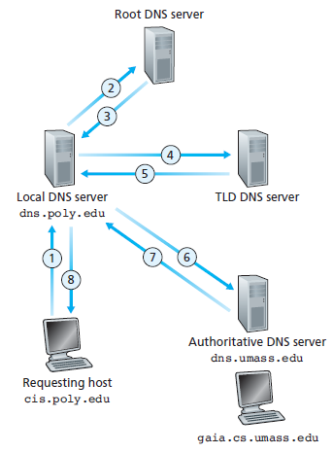
DNS records
DNS: distributed database storing resource records (RR)
RR format: (name, value, type, ttl)
type=A
  name is hostname (e.g., relay1.bar.foo.com)
  value is IP address
type=NS
  name is domain (e.g., foo.com)
  value is hostname of authoritative name server for this domain (e.g., dns.foo.com)

Slide 43
DNS records (cont’d)
RR format: (name, value, type, ttl)
type=CNAME
  name is alias name
  value is canonical (the real) name
  E.g., (foo.com, relay1.bar.foo.com, CNAME, ttl)
type=MX
  value is name of mail server associated with name
  E.g., (foo.com, mail.bar.foo.com, MX, ttl)

