Slide 1
DNS protocol, messages
query and reply messages, both with same message format
2 bytes
2 bytes
msg header
identification: 16 bit # for query, reply to query uses same #
flags:
  query or reply
  recursion desired by client (if DNS server does not have the record) or not
  recursion supported or not
  DNS server is an authoritative server for a queried name
identification
flags
# questions
# answer RRs
# authority RRs
# additional RRs
questions (variable # of questions)
answers (variable # of RRs)
authority (variable # of RRs)
additional info (variable # of RRs)

Slide 2
DNS protocol, messages
2 bytes
2 bytes
identification
flags
# questions
# answer RRs
# authority RRs
# additional RRs
name, type fields
for a query
questions (variable # of questions)
RRs in response
to query
answers (variable # of RRs)
records of other
authoritative servers
authority (variable # of RRs)
additional “helpful”
info that may be used
additional info (variable # of RRs)

Slide 3
Inserting records into DNS
example: new startup “Network Utopia”
register name networkuptopia.com at DNS registrar (e.g., Network Solutions)
  provide names, IP addresses of authoritative server (primary and secondary)
    registrar inserts two RRs into .com TLD server:
    (networkutopia.com, dns1.networkutopia.com, NS, ttl)
    (dns1.networkutopia.com, 212.212.212.1, A, ttl)
create RRs at your authoritative server
  type A record for Web server www.networkuptopia.com
    (networkutopia.com, 212.212.212.10, A, ttl)

Slide 4
Attacking DNS
DDoS attacks
Bombard root servers with traffic
  Not successful to date
  Traffic Filtering
  Local DNS servers cache IPs of TLD servers, allowing root server bypass
Bombard TLD servers
  Potentially more dangerous
Redirect attacks
Man-in-middle
  Intercept queries
DNS poisoning
  Send bogus relies to DNS server, which caches
Exploit DNS for DDoS
Send queries with spoofed source address: target IP
Requires amplification

Slide 5
Chapter 2: outline
2.1 principles of network applications
  app architectures
  app requirements
2.2 Web and HTTP
2.3 FTP
2.4 electronic mail
  SMTP, POP3, IMAP
2.5 DNS
2.6 P2P applications
2.7 Socket programming with UDP and TCP

Slide 6


















Pure P2P architecture
no always-on server
arbitrary end systems directly communicate
peers are intermittently connected and change IP addresses
examples:
  file distribution (BitTorrent)
  Streaming (KanKan)
  VoIP (Skype)

Slide 7

File distribution: client-server vs P2P
Question: how much time to distribute file (size F) from one server to N peers?
  peer upload/download capacity is limited resource
u_{s}: server upload capacity
u₁
d_{i}: peer i download capacity
file, size F
u_{s}
d₁
u₂
d₂
server
d_{i}
u_{N}
network (with abundant
bandwidth)
u_{i}
d_{N}
u_{i}: peer i upload capacity

Slide 8
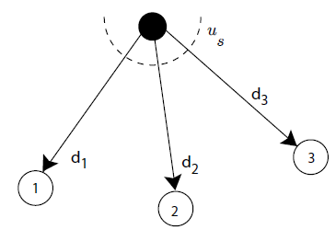
File distribution time: client-server
Server upload: must sequentially send (upload) N file copies:
  time to send one copy: F/u_{s}
  time to send N copies: NF/u_{s}
Client download: each client must download file copy
  d_{min} = min client download rate
  max client download time: F/d_{min}
time to distribute F
to N clients using
client-server approach
D_{c-s} ≥ max{NF/u_{s,},F/d_{min}}
increases linearly in N

Slide 9
File distribution time: P2P
Server upload: must upload at least one copy
  time to send one copy: F/u_{s}
F
u_{s}
d_{i}
Client download: each client must download file copy
  max client download time: F/d_{min}
network
u_{i}
Clients upload: as aggregate must upload NF bits
  max upload rate is u_{s} + Σu_{i}
time to distribute F
to N clients using
P2P approach
D_{P2P} ≥ max{F/u_{s,},F/d_{min,},NF/(u_{s} + Σu_{i})}
increases linearly in N …
… but so does this, as each peer brings service capacity

Slide 10
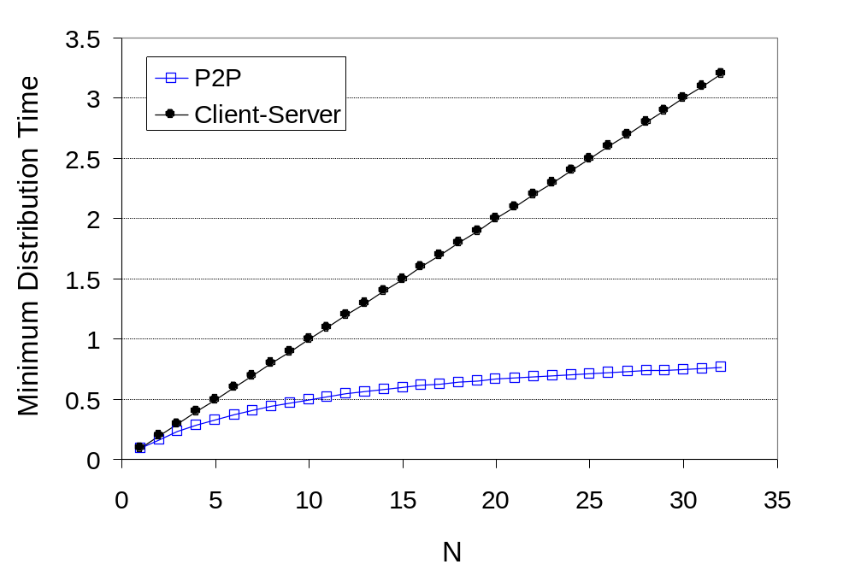
Client-server vs. P2P: example
client upload rate = u, F/u = 1 hour, u_{s} = 10u, d_{min} ≥ u_{s}
Minimal distribution time of P2P architecture is always less than that of the client-server architecture.
Scalability: Peers serve as redistributors as well as consumers of bits.

Slide 11


P2P file distribution: BitTorrent
file divided into 256Kb chunks
peers in torrent send/receive file chunks
tracker: tracks peers
participating in torrent
torrent: group of peers exchanging chunks of a file
Alice arrives …
… obtains list
of peers from tracker
… and begins exchanging
file chunks with peers in torrent

Slide 12


P2P file distribution: BitTorrent
peer joining torrent:
  has no chunks, but will accumulate chunks over time from other peers
  registers with tracker to get list of peers, connects to subset of peers (“neighbors”)
while downloading, peer uploads chunks to other peers
peer may change peers with whom it exchanges chunks
churn: peers may come and go
  once peer has entire file, it may (selfishly) leave or (altruistically) remain in torrent

Slide 13
BitTorrent: requesting file chunks
requesting chunks:
at any given time, different peers have different subsets of file chunks
periodically, Alice asks each peer for list of chunks that they have
Alice requests missing chunks from peers, rarest first
=> rarest chunks get more quickly redistributed
=> (roughly) equalize the numbers of copies of each chunk in the torrent

Slide 14
BitTorrent: sending file chunks
sending chunks:
(tit-for-tat) Alice sends chunks to those four peers currently sending her chunks at highest rate
  other peers are choked by Alice (do not receive chunks from her)
  re-evaluate top 4 every10 secs
(randomization) every 30 secs: randomly select another peer, starts sending chunks
  “optimistically unchoke” this peer
  newly chosen peer may join top 4

Slide 15

BitTorrent: tit-for-tat
(1) Alice “optimistically unchokes” Bob
(2) Alice becomes one of Bob’s top-four providers; Bob reciprocates
(3) Bob becomes one of Alice’s top-four providers
higher upload rate, find better trading partners, get file faster !

Slide 16
Chapter 2: outline
2.1 principles of network applications
2.2 Web and HTTP
2.3 electronic mail
  SMTP, POP3, IMAP
2.4 DNS
2.5 P2P applications
2.6 video streaming and content distribution networks (CDNs)
2.7 socket programming with UDP and TCP

Slide 17





Video Streaming and CDNs: context
video traffic: major consumer of Internet bandwidth
  Netflix, YouTube: 37%, 16% of downstream residential ISP traffic
  ~1B YouTube users, ~75M Netflix users
challenge:
  Scale: - how to reach ~1B users?
    single mega-video server won’t work (why?)
  Heterogeneity: different users have different capabilities (e.g., wired versus mobile; bandwidth rich versus bandwidth poor)
solution: distributed, application-level infrastructure

Slide 18

Multimedia: video
spatial coding example: instead of sending N values of same color (all purple), send only two values: color value (purple) and number of repeated values (N)
digital image: array of pixels
  each pixel represented by bits
video: sequence of images displayed at constant rate
  e.g., 24 images/sec
coding: use redundancy within and between images to decrease # bits used to encode image
  spatial (within image)
  temporal (from one image to next)
……………………..
……………….…….
frame i
temporal coding example: instead of sending complete frame at i+1, send only differences from frame i
frame i+1

Slide 19
Multimedia: video
We can also use compression to create multiple versions of the same video, each at a different quality level.
  E.g. three versions of the same video, at rates of 300 kbps, 1 Mbps, and 3 Mbps.
Users can then decide which version they want to watch as a function of their current available bandwidth.
  E.g., High-speed Internet connections: 3 Mbps version.
  E.g., 3G with a smartphone: 300 kbps version.

Slide 20
HTTP Streaming
In HTTP streaming, the video is simply stored at an HTTP server as an ordinary file with a specific URL.
When a user wants to see the video, the client establishes a TCP connection with the server and issues an HTTP GET request for that URL.
The server then sends the video file, within an HTTP response message.
Has been extensively deployed in practice (for example, by YouTube since its inception.

Slide 21


HTTP Streaming
simple scenario:
Internet
video server
(stored video)
client
Shortcoming: All clients receive the same encoding of the video,
despite the large variations in the amount of bandwidth available to a client,
both across different clients and also over time for the same client.

Slide 22
Streaming multimedia: DASH
DASH: Dynamic, Adaptive Streaming over HTTP
server:
  divides video file into multiple chunks
  each chunk stored, encoded at different rates
  manifest file: provides URLs for different chunks

Slide 23
Streaming multimedia: DASH
client:
  periodically measures server-to-client bandwidth
  consulting manifest, requests one chunk at a time
    chooses maximum coding rate sustainable given current bandwidth
    can choose different coding rates at different points in time (depending on available bandwidth at time)
“intelligence” at client: client determines
  when to request chunk (so that buffer starvation, or overflow does not occur)
  what encoding rate to request (higher quality when more bandwidth available)
  where to request chunk (can request from URL server that is “close” to client or has high available bandwidth)

Slide 24
Content distribution networks
challenge: how to stream content (selected from millions of videos) to hundreds of thousands of simultaneous users?
option 1: single, large “mega-server”
  single point of failure
  point of network congestion
  long path to distant clients
  multiple copies of video sent over outgoing link
….quite simply: this solution doesn’t scale

Slide 25
Content distribution networks
option 2: store/serve multiple copies of videos at multiple geographically distributed sites
CDN typically adopts one of two different server placement philosophies:
  enter deep: push CDN servers deep into many access networks
    close to users
    used by Akamai, 1700 locations
  bring home: smaller number (10’s) of larger clusters in Internet Exchange Points (IXPs) near (but not within) access networks
    used by Limelight

Slide 26
Internet structure: network of networks
Internet exchange point
…
…
access
net
access
net
access
net
access
net
access
net
IXP
access
net
access
net
ISP A
…
…
IXP
access
net
access
net
ISP B
ISP C
access
net
access
net
peering link
access
net
access
net
…
access
net
access
net
…
access
net

Slide 27




Content Distribution Networks (CDNs)
CDN: stores copies of content at CDN nodes
  e.g. Netflix stores copies of MadMen
subscriber requests content from CDN
  directed to nearby copy, retrieves content
  may choose different copy if network path congested
…
…
…
manifest file
…
where’s Madmen?
…
…
Notes:
27

Slide 28
Chapter 2: outline
2.1 principles of network applications
2.2 Web and HTTP
2.3 electronic mail
  SMTP, POP3, IMAP
2.4 DNS
2.5 P2P applications
2.6 video streaming and content distribution networks
2.7 socket programming with UDP and TCP

Slide 29
Socket programming
goal: learn how to build client/server applications that communicate using sockets
socket: door between application process and end-end-transport protocol
application
socket
application
controlled by
app developer
process
process
transport
transport
network
network
controlled
by OS
link
Internet
link
physical
physical

Slide 30
Socket programming
  Two socket types for two transport services:
  UDP: unreliable datagram
  TCP: reliable, byte stream-oriented
  Application Example:
Client reads a line of characters (data) from its keyboard and sends the data to the server.
The server receives the data and converts characters to uppercase.
The server sends the modified data to the client.
The client receives the modified data and displays the line on its screen.

Slide 31
Socket programming with UDP
UDP: no “connection” between client & server
no handshaking before sending data
sender explicitly attaches IP destination address and port # to each packet
receiver extracts sender IP address and port # from received packet
UDP: transmitted data may be lost or received out-of-order
Application viewpoint:
UDP provides unreliable transfer of groups of bytes (“datagrams”) between client and server

Slide 32
Client/server socket interaction: UDP
server (running on serverIP)
client
create socket:
create socket, port= x:
clientSocket =
socket(AF_INET,SOCK_DGRAM)
serverSocket =
socket(AF_INET,SOCK_DGRAM)
Create datagram with server IP and
port=x; send datagram via
clientSocket
read datagram from
serverSocket
write reply to
serverSocket
specifying
client address,
port number
read datagram from
clientSocket
close
clientSocket
Application 2-32

Slide 33
Example app: UDP client
Python UDPClient
include Python’s socket
library
from socket import *
serverName = ‘hostname’
serverPort = 12000
clientSocket = socket(socket.AF_INET,
socket.SOCK_DGRAM)
message = raw_input(’Input lowercase sentence:’)
clientSocket.sendto(message,(serverName, serverPort))
modifiedMessage, serverAddress =
clientSocket.recvfrom(2048)
print modifiedMessage
clientSocket.close()
create UDP socket for client
get user keyboard
input
Attach server name, port to message; send into socket
read reply characters from
socket into string
print out received string and close socket

Slide 34
Example app: UDP client (cont’d)
  serverName = ‘hostname’
  a string containing either:
    Server’s IP address or
    Server’s hostname → DNS lookup will automatically be performed to get the IP address.
  clientSocket = socket(socket.AF_INET, socket.SOCK_DGRAM)
  AF_INET: IPv4
  SOCK_DGRAM: UDP socket

Slide 35
Example app: UDP client (cont’d)
  modifiedMessage, serverAddress = clientSocket.recvfrom(2048)
  modifiedMessage: packet’s data
  serverAddress: packet’s source address
  buffer size = 2048

Slide 36
Example app: UDP server
Python UDPServer
from socket import *
serverPort = 12000
serverSocket = socket(AF_INET, SOCK_DGRAM)
serverSocket.bind(('', serverPort))
print “The server is ready to receive”
while 1:
message, clientAddress = serverSocket.recvfrom(2048)
modifiedMessage = message.upper()
serverSocket.sendto(modifiedMessage, clientAddress)
create UDP socket
bind socket to local port number 12000
loop forever
Read from UDP socket into message, getting client’s address (client IP and port)
send upper case string back to this client

Slide 37
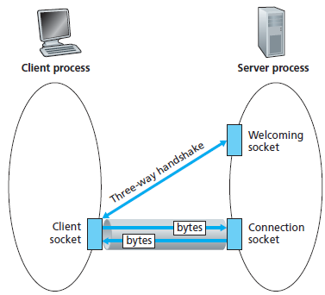
Socket programming with TCP
client must contact server
server process must first be running
server must have created socket (Welcoming socket) that welcomes client’s contact
client contacts server by:
Creating TCP socket, specifying IP address, port number of server process
when client creates socket (Client socket): client TCP establishes connection to server TCP
when contacted by client, server TCP creates new socket (Connection socket) for server process to communicate with that particular client
  allows server to talk with multiple clients
  source port numbers used to distinguish clients

Slide 38
Client/server socket interaction: TCP
server (running on hostid)
client
create socket,
port=x, for incoming request:
serverSocket = socket()
wait for incoming
connection request
TCP
connection setup
create socket,
connect to hostid, port=x
connectionSocket =
serverSocket.accept()
clientSocket = socket()
send request using
clientSocket
read request from
connectionSocket
write reply to
connectionSocket
read reply from
clientSocket
close
connectionSocket
close
clientSocket

Slide 39
Example app: TCP client
Python TCPClient
from socket import *
serverName = ’servername’
serverPort = 12000
clientSocket = socket(AF_INET, SOCK_STREAM)
clientSocket.connect((serverName,serverPort))
sentence = raw_input(‘Input lowercase sentence:’)
clientSocket.send(sentence)
modifiedSentence = clientSocket.recv(1024)
print ‘From Server:’, modifiedSentence
clientSocket.close()
create TCP socket for server, remote port 12000
TCP connection is established between the client and server
No need to attach server name, port

Slide 40
Example app: TCP server
Python TCPServer
from socket import *
serverPort = 12000
serverSocket = socket(AF_INET,SOCK_STREAM)
serverSocket.bind((‘’,serverPort))
serverSocket.listen(1)
print ‘The server is ready to receive’
while 1:
connectionSocket, addr = serverSocket.accept()
sentence = connectionSocket.recv(1024)
capitalizedSentence = sentence.upper()
connectionSocket.send(capitalizedSentence)
connectionSocket.close()
create TCP welcoming
socket
server begins listening for incoming TCP requests
loop forever
server waits on accept()
for incoming requests, new socket created on return
read bytes from socket (but not address as in UDP)
close connection to this client (but not welcoming socket)

Slide 41
Chapter 2: summary
our study of network apps now complete!
application architectures
  client-server
  P2P
application service requirements:
  reliability, bandwidth, delay
Internet transport service model
  connection-oriented, reliable: TCP
  unreliable, datagrams: UDP
specific protocols:
  HTTP
  SMTP, POP, IMAP
  DNS
  P2P: BitTorrent
  DASH
socket programming: TCP, UDP sockets

Slide 42
Chapter 2: summary
most importantly: learned about protocols!
typical request/reply message exchange:
  client requests info or service
  server responds with data, status code
message formats:
  headers: fields giving info about data
  data: info being communicated
important themes:
control vs. data msgs
  in-band, out-of-band
centralized vs. decentralized
stateless vs. stateful
reliable vs. unreliable msg transfer
“complexity at network edge”

