Slide 1

Chapter 3
Transport Layer
A note on the use of these ppt slides:
We’re making these slides freely available to all (faculty, students, readers). They’re in PowerPoint form so you see the animations; and can add, modify, and delete slides (including this one) and slide content to suit your needs. They obviously represent a lot of work on our part. In return for use, we only ask the following:
If you use these slides (e.g., in a class) that you mention their source (after all, we’d like people to use our book!)
If you post any slides on a www site, that you note that they are adapted from (or perhaps identical to) our slides, and note our copyright of this material.
Thanks and enjoy! JFK/KWR
All material copyright 1996-2013
J.F Kurose and K.W. Ross, All Rights Reserved
Modified by Man Hon Cheung

Slide 2
Chapter 3: Transport Layer
our goals:
understand principles behind transport layer services:
  multiplexing, demultiplexing
  reliable data transfer
  flow control
  congestion control
learn about Internet transport layer protocols:
  UDP: connectionless transport
  TCP: connection-oriented reliable transport
  TCP congestion control

Slide 3
Chapter 3 outline
3.1 transport-layer services
3.2 multiplexing and demultiplexing
3.3 connectionless transport: UDP
3.4 principles of reliable data transfer
3.5 connection-oriented transport: TCP
  segment structure
  reliable data transfer
  flow control
  connection management
3.6 principles of congestion control
3.7 TCP congestion control

Slide 4


















Transport services and protocols
application
transport
network
data link
physical
provide logical communication between app processes running on different hosts
transport protocols run in end systems
  send side: breaks app messages into segments, passes to network layer
  rcv side: reassembles segments into messages, passes to app layer
more than one transport protocol available to apps
  Internet: TCP and UDP
logical end-end transport
application
transport
network
data link
physical

Slide 5
“Packet” at different layers
message
M
application
transport
network
link
physical
segment
H_{t}
M
H_{t}
datagram
H_{n}
H_{n}
H_{t}
M
frame
H_{l}
H_{n}
H_{t}
M

Slide 6
Transport vs. network layer
network layer: logical communication between hosts
transport layer: logical communication between processes
  relies on, enhances, network layer services
household analogy:
12 kids in Ann’s house sending letters to 12 kids in Bill’s house:
hosts = houses
processes = kids
app messages = letters in envelopes
transport protocol = Ann and Bill who demux to in-house siblings
network-layer protocol = postal service

Slide 7
Internet transport-layer protocols
reliable, in-order delivery (TCP)
  congestion control
  flow control
  connection setup
unreliable, unordered delivery: UDP
  no-frills extension of “best-effort” IP
services not available:
  delay guarantees
  bandwidth guarantees
application
transport
network
data link
physical
network
data link
physical
network
data link
physical
network
data link
physical
logical end-end transport
network
data link
physical
network
data link
physical
network
data link
physical
network
data link
physical
application
transport
network
data link
physical

Slide 8
Chapter 3 outline
3.1 transport-layer services
3.2 multiplexing and demultiplexing
3.3 connectionless transport: UDP
3.4 principles of reliable data transfer
3.5 connection-oriented transport: TCP
  segment structure
  reliable data transfer
  flow control
  connection management
3.6 principles of congestion control
3.7 TCP congestion control

Slide 9

Multiplexing/demultiplexing
multiplexing at sender:
handle data from multiple
sockets, add transport header, pass segment to network layer
demultiplexing at receiver:
use header info to deliver
received segments to correct
socket
application
application
P1
P2
application
socket
P3
transport
P4
process
transport
network
transport
network
link
network
link
physical
link
physical
physical

Slide 10
How demultiplexing works
host receives IP datagrams
  each datagram has source IP address, destination IP address
each datagram carries one transport-layer segment
  each segment has source, destination port number
host uses IP addresses & port numbers to direct segment to appropriate socket
32 bits
source port #
dest port #
other header fields
application
data
(payload)
TCP or UDP segment format

Slide 11
UDP Connectionless demultiplexing
created socket has host-local port #:
DatagramSocket mySocket1 = new DatagramSocket(12534);
UDP socket is fully identified by a two-tuple consisting of a destination IP address and a destination port number.
If two UDP segments have:
  different source IP addresses and/or source port numbers,
  same destination IP address and destination port number
  => the two segments will be directed to the same destination process via the same destination socket.

Slide 12
Connectionless demux: example
DatagramSocket serverSocket = new DatagramSocket
(6428);
DatagramSocket mySocket2 = new DatagramSocket
(9157);
DatagramSocket mySocket1 = new DatagramSocket (5775);
application
application
P1
application
P3
P4
transport
transport
network
transport
network
link
network
link
physical
link
physical
physical
source port: 6428
dest port: 9157
source port: 6428
dest port: 5775
source port: 9157
dest port: 6428
source port: 5775
dest port: 6428

Slide 13
TCP Connection-oriented demux
TCP socket identified by 4-tuple:
  source IP address
  source port number
  dest IP address
  dest port number
demux: receiver uses all four values to direct segment to appropriate socket
server host may support many simultaneous TCP sockets:
  each socket identified by its own 4-tuple
  web servers have different sockets for each connecting client
  non-persistent HTTP will have different socket for each request

Slide 14
Connection-oriented demux: example
application
application
P4
P5
P6
application
P3
P2
P3
server: IP address B
transport
transport
network
transport
network
link
network
link
physical
link
physical
physical
host: IP address A
source IP,port: B,80
dest IP,port: A,9157
host: IP address C
source IP,port: C,5775
dest IP,port: B,80
source IP,port: A,9157
dest IP, port: B,80
source IP,port: C,9157
dest IP,port: B,80
three segments, all destined to IP address: B,
dest port: 80 are demultiplexed to different sockets

Slide 15
Connection-oriented demux: example
threaded server: To handle multiple requests at the same time
application
application
application
P4
P3
P3
P2
transport
transport
network
transport
network
link
network
link
physical
link
physical
server: IP address B
physical
host: IP address A
source IP,port: B,80
dest IP,port: A,9157
host: IP address C
source IP,port: C,5775
dest IP,port: B,80
source IP,port: A,9157
dest IP, port: B,80
source IP,port: C,9157
dest IP,port: B,80

Slide 16
Chapter 3 outline
3.1 transport-layer services
3.2 multiplexing and demultiplexing
3.3 connectionless transport: UDP
3.4 principles of reliable data transfer
3.5 connection-oriented transport: TCP
  segment structure
  reliable data transfer
  flow control
  connection management
3.6 principles of congestion control
3.7 TCP congestion control

Slide 17
UDP: User Datagram Protocol [RFC 768]
“no frills,” “bare bones” Internet transport protocol
“best effort” service, UDP segments may be:
  lost
  delivered out-of-order to app
connectionless:
  no handshaking between UDP sender, receiver
  each UDP segment handled independently of others
Applications:
  streaming multimedia apps (loss tolerant, rate sensitive)
  DNS
  Simple network management protocol (SNMP)
reliable transfer over UDP:
  add reliability at application layer
  application-specific error recovery!

Slide 18
UDP: segment header
length, in bytes of UDP segment, including header
32 bits
source port #
dest port #
length
checksum
why is there a UDP?
no connection establishment (which can add delay)
simple: no connection state at sender, receiver
small header size
no congestion control: UDP can blast away as fast as desired
application
data
(payload)
UDP segment format

Slide 19
UDP checksum
Goal: detect “errors” (e.g., flipped bits) in transmitted segment
sender:
treat segment contents, including header fields, as sequence of 16-bit integers
checksum: addition of segment contents → one’s complement
sender puts checksum value into UDP checksum field
receiver:
compute checksum of received segment
check if computed checksum equals checksum field value:
  NO - error detected
  YES - no error detected. But maybe errors nonetheless? More later ….

Slide 20
Internet checksum: example
example: add two 16-bit integers
1 1 1 1 0 0 1 1 0 0 1 1 0 0 1 1 0
1 1 1 0 1 0 1 0 1 0 1 0 1 0 1 0 1
1 1 0 1 1 1 0 1 1 1 0 1 1 1 0 1 1
1 1 0 1 1 1 0 1 1 1 0 1 1 1 1 0 0
1 0 1 0 0 0 1 0 0 0 1 0 0 0 0 1 1
wraparound
sum
checksum
Note: when adding numbers, a carryout from the most significant bit needs to be added to the result

Slide 21
Chapter 3 outline
3.1 transport-layer services
3.2 multiplexing and demultiplexing
3.3 connectionless transport: UDP
3.4 principles of reliable data transfer
3.5 connection-oriented transport: TCP
  segment structure
  reliable data transfer
  flow control
  connection management
3.6 principles of congestion control
3.7 TCP congestion control

Slide 22
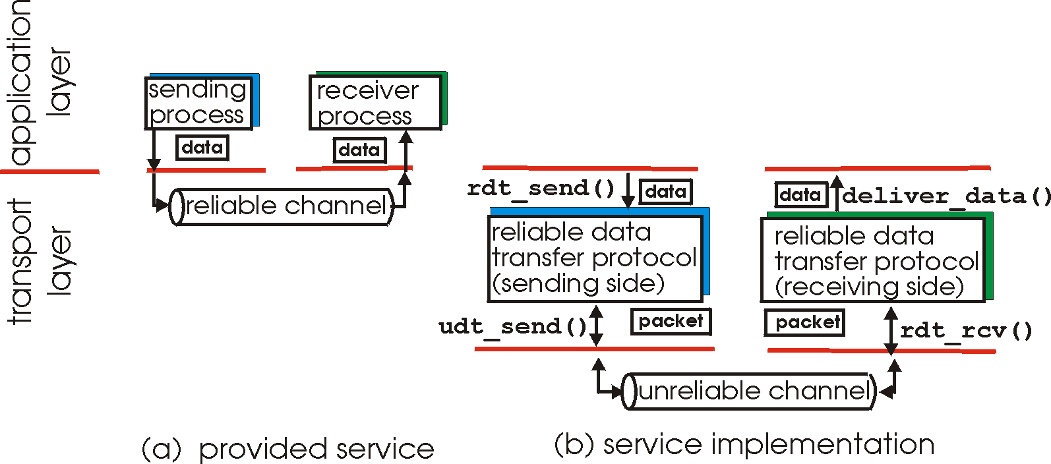
Principles of reliable data transfer
important in application, transport, link layers
  top-10 list of important networking topics!
characteristics of unreliable channel will determine complexity of reliable data transfer protocol (rdt)

Slide 23
Principles of reliable data transfer
important in application, transport, link layers
  top-10 list of important networking topics!
characteristics of unreliable channel will determine complexity of reliable data transfer protocol (rdt)

Slide 24
Principles of reliable data transfer
important in application, transport, link layers
  top-10 list of important networking topics!
characteristics of unreliable channel will determine complexity of reliable data transfer protocol (rdt)

Slide 25
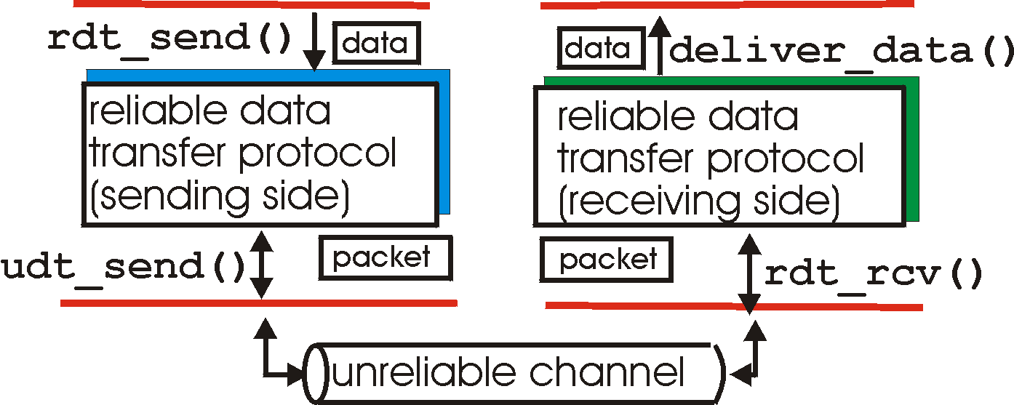
Reliable data transfer: getting started
rdt_send(): called from above, (e.g., by app.). Passed data to
deliver to receiver upper layer
deliver_data(): called by rdt to deliver data to upper
send
side
receive
side
udt_send(): called by rdt,
to transfer packet over
unreliable channel to receiver
rdt_rcv(): called when packet arrives on rcv-side of channel

Slide 26
Reliable data transfer: getting started
we’ll:
incrementally develop sender, receiver sides of reliable data transfer protocol (rdt)
consider only unidirectional data transfer
  but control info will flow on both directions!
use finite state machines (FSM) to specify sender, receiver
event causing state transition
actions taken on state transition
state: when in this “state” next state uniquely determined by next event
state
1
state
2
event
actions

Slide 27
Reliable data transfer: getting started

Slide 28
rdt1.0: reliable transfer over a reliable channel
underlying channel perfectly reliable
  no bit errors
  no loss of packets
separate FSMs for sender, receiver:
  sender sends data into underlying channel
  receiver reads data from underlying channel
Wait for call from above
rdt_send(data)
Wait for call from below
rdt_rcv(packet)
extract (packet,data)
deliver_data(data)
packet = make_pkt(data)
udt_send(packet)
sender
receiver

Slide 29
rdt2.0: channel with bit errors
underlying channel may flip bits in packet
  checksum to detect bit errors
Q: how to recover from errors:
  acknowledgements (ACKs): receiver explicitly tells sender that pkt received OK
  negative acknowledgements (NAKs): receiver explicitly tells sender that pkt had errors
  sender retransmits pkt on receipt of NAK
new mechanisms in rdt2.0 (beyond rdt1.0):
  error detection
  receiver feedback: control msgs (ACK,NAK) rcvr->sender
How do humans recover from “errors”
during conversation?

Slide 30
rdt2.0: channel with bit errors
underlying channel may flip bits in packet
  checksum to detect bit errors
Q: how to recover from errors:
  acknowledgements (ACKs): receiver explicitly tells sender that pkt received OK
  negative acknowledgements (NAKs): receiver explicitly tells sender that pkt had errors
    sender retransmits pkt on receipt of NAK
new mechanisms in rdt2.0 (beyond rdt1.0):
  error detection
  feedback: control msgs (ACK,NAK) from receiver to sender

Slide 31
rdt2.0: FSM specification
rdt_send(data)
sndpkt = make_pkt(data, checksum)
udt_send(sndpkt)
receiver
rdt_rcv(rcvpkt) &&
isNAK(rcvpkt)
Wait for call from above
Wait for ACK or NAK
rdt_rcv(rcvpkt) &&
corrupt(rcvpkt)
udt_send(sndpkt)
udt_send(NAK)
rdt_rcv(rcvpkt) && isACK(rcvpkt)
Λ
Wait for call from below
sender
rdt_rcv(rcvpkt) &&
notcorrupt(rcvpkt)
extract(rcvpkt,data)
deliver_data(data)
udt_send(ACK)

Slide 32
rdt2.0: operation with no errors
rdt_send(data)
snkpkt = make_pkt(data, checksum)
udt_send(sndpkt)
rdt_rcv(rcvpkt) &&
isNAK(rcvpkt)
Wait for call from above
Wait for ACK or NAK
rdt_rcv(rcvpkt) &&
corrupt(rcvpkt)
udt_send(sndpkt)
udt_send(NAK)
rdt_rcv(rcvpkt) && isACK(rcvpkt)
Wait for call from below
Λ
rdt_rcv(rcvpkt) &&
notcorrupt(rcvpkt)
extract(rcvpkt,data)
deliver_data(data)
udt_send(ACK)

Slide 33
rdt2.0: error scenario
rdt_send(data)
snkpkt = make_pkt(data, checksum)
udt_send(sndpkt)
rdt_rcv(rcvpkt) &&
isNAK(rcvpkt)
Wait for call from above
Wait for ACK or NAK
rdt_rcv(rcvpkt) &&
corrupt(rcvpkt)
udt_send(sndpkt)
udt_send(NAK)
rdt_rcv(rcvpkt) && isACK(rcvpkt)
Wait for call from below
Λ
rdt_rcv(rcvpkt) &&
notcorrupt(rcvpkt)
extract(rcvpkt,data)
deliver_data(data)
udt_send(ACK)

Slide 34
rdt2.0 has a fatal flaw!
what happens if ACK/NAK corrupted?
sender doesn’t know what happened at receiver!
can’t just retransmit → possible duplicate
handling duplicates:
sender retransmits current pkt if ACK/NAK corrupted
sender adds sequence number to each pkt
receiver discards (doesn’t deliver up) duplicate pkt
rdt 2.1: Include Sequence number

Slide 35
rdt2.1: sender, handles garbled ACK/NAKs
[Retransmit current packet if ACK/NAK is corrupted]
rdt_send(data)
sndpkt = make_pkt(0, data, checksum)
udt_send(sndpkt)
rdt_rcv(rcvpkt) &&
( corrupt(rcvpkt) ||
isNAK(rcvpkt) )
Wait for call 0 from above
Wait for ACK or NAK 0
udt_send(sndpkt)
rdt_rcv(rcvpkt)
&& notcorrupt(rcvpkt)
&& isACK(rcvpkt)
rdt_rcv(rcvpkt)
&& notcorrupt(rcvpkt)
&& isACK(rcvpkt)
Λ
Λ
Wait for ACK or NAK 1
Wait for
call 1 from above
rdt_rcv(rcvpkt) &&
( corrupt(rcvpkt) ||
isNAK(rcvpkt) )
rdt_send(data)
udt_send(sndpkt)
sndpkt = make_pkt(1, data, checksum)
udt_send(sndpkt)
[Sequence number]

Slide 36
rdt2.1: receiver, handles garbled ACK/NAKs
rdt_rcv(rcvpkt) && notcorrupt(rcvpkt)
&& has_seq0(rcvpkt)
[Deliver data to upper layer if packet is not corrupted & has correct seq #]
[Send NAK for corrupted packet]
extract(rcvpkt,data)
deliver_data(data)
sndpkt = make_pkt(ACK, chksum)
udt_send(sndpkt)
rdt_rcv(rcvpkt) && (corrupt(rcvpkt)
rdt_rcv(rcvpkt) && (corrupt(rcvpkt)
sndpkt = make_pkt(NAK, chksum)
udt_send(sndpkt)
sndpkt = make_pkt(NAK, chksum)
udt_send(sndpkt)
Wait for
0 from below
Wait for
1 from below
rdt_rcv(rcvpkt) &&
not corrupt(rcvpkt) &&
has_seq1(rcvpkt)
rdt_rcv(rcvpkt) &&
not corrupt(rcvpkt) &&
has_seq0(rcvpkt)
sndpkt = make_pkt(ACK, chksum)
udt_send(sndpkt)
sndpkt = make_pkt(ACK, chksum)
udt_send(sndpkt)
rdt_rcv(rcvpkt) && notcorrupt(rcvpkt)
&& has_seq1(rcvpkt)
[Discard duplicate packet if seq # is not correct]
extract(rcvpkt,data)
deliver_data(data)
sndpkt = make_pkt(ACK, chksum)
udt_send(sndpkt)

Slide 37
rdt2.1: discussion
sender:
seq # added to pkt
  two seq. #’s (0,1) will suffice
must check if received ACK/NAK corrupted
twice as many states
  state must “remember” whether “expected” pkt should have seq # of 0 or 1
receiver:
must check if received packet is duplicate
  state indicates whether 0 or 1 is expected pkt seq #

Slide 38
rdt2.2: a NAK-free protocol
same functionality as rdt2.1, using ACKs only
Q: How to remove NAK?
A: ACK + seq #
  instead of NAK, receiver sends ACK for last pkt received OK
  receiver must explicitly include seq # of pkt being ACKed
duplicate ACK at sender results in same action as NAK: retransmit current pkt

Slide 39
rdt2.2: sender, receiver fragments
instead of NAK, receiver sends ACK for last pkt received OK
rdt_send(data)
sndpkt = make_pkt(0, data, checksum)
udt_send(sndpkt)
rdt_rcv(rcvpkt) &&
( corrupt(rcvpkt) ||
isACK(rcvpkt,1) )
Wait for call 0 from above
Wait for ACK
0
udt_send(sndpkt)
sender FSM
fragment
rdt_rcv(rcvpkt)
&& notcorrupt(rcvpkt)
&& isACK(rcvpkt,0)
rdt_rcv(rcvpkt) &&
(corrupt(rcvpkt) ||
has_seq1(rcvpkt))
Λ
Wait for
0 from below
receiver FSM
fragment
sndpkt=make_pkt(ACK1,chksum)
udt_send(sndpkt)
rdt_rcv(rcvpkt) && notcorrupt(rcvpkt)
&& has_seq1(rcvpkt)
extract(rcvpkt,data)
deliver_data(data)
sndpkt = make_pkt(ACK1, chksum)
udt_send(sndpkt)

Slide 40
rdt3.0: channels with errors and loss
new assumption: underlying channel can also lose packets (data, ACKs)
  checksum, seq. #, ACKs, retransmissions will be of help … but not enough
approach: sender waits “reasonable” amount of time for ACK
retransmits if no ACK received in this time
if pkt (or ACK) just delayed (not lost):
  retransmission will be duplicate, but seq. #’s already handles this
  receiver must specify seq # of pkt being ACKed
requires countdown timer

Slide 41
rdt3.0 sender
[Retransmits packet after timeout]
rdt_send(data)
rdt_rcv(rcvpkt) &&
( corrupt(rcvpkt) ||
isACK(rcvpkt,1) )
sndpkt = make_pkt(0, data, checksum)
udt_send(sndpkt)
start_timer
rdt_rcv(rcvpkt)
Λ
Λ
Wait for
call 0 from above
Wait for ACK0
timeout
udt_send(sndpkt)
start_timer
rdt_rcv(rcvpkt)
&& notcorrupt(rcvpkt)
&& isACK(rcvpkt,1)
rdt_rcv(rcvpkt)
&& notcorrupt(rcvpkt)
&& isACK(rcvpkt,0)
stop_timer
stop_timer
Wait for ACK1
Wait for
call 1 from above
timeout
udt_send(sndpkt)
start_timer
rdt_rcv(rcvpkt)
rdt_send(data)
Λ
rdt_rcv(rcvpkt) &&
( corrupt(rcvpkt) ||
isACK(rcvpkt,0) )
sndpkt = make_pkt(1, data, checksum)
udt_send(sndpkt)
start_timer
Λ

Slide 42
rdt 3.0 (Summary)
Stop-and-wait protocol: At most one packet in flight at any time
Receiver sends ACK when it receives data
Sender:
  On receiving ACK, sends new data
  On timeout, resends current data
Summary: rdt3.0 is a protocol that reliably transfers data over a channel that can corrupt or lose packets

Slide 43

rdt3.0 in action
sender
receiver
sender
receiver
send pkt0
pkt0
send pkt0
pkt0
rcv pkt0
rcv pkt0
ack0
send ack0
ack0
send ack0
rcv ack0
rcv ack0
send pkt1
pkt1
send pkt1
pkt1
rcv pkt1
X
ack1
send ack1
loss
rcv ack1
send pkt0
pkt0
rcv pkt0
timeout
resend pkt1
ack0
send ack0
pkt1
rcv pkt1
ack1
send ack1
rcv ack1
send pkt0
pkt0
(a) no loss
rcv pkt0
ack0
send ack0
(b) packet loss

Slide 44
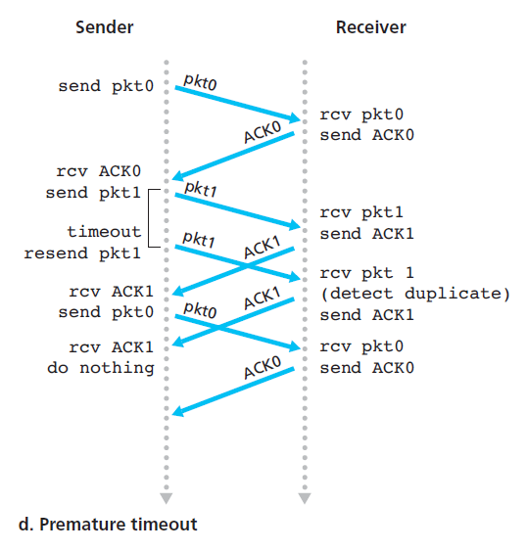
rdt3.0 in action
sender
receiver
send pkt0
pkt0
rcv pkt0
ack0
send ack0
rcv ack0
send pkt1
pkt1
rcv pkt1
ack1
send ack1
X
loss
timeout
resend pkt1
pkt1
rcv pkt1
ack1
(detect duplicate)
rcv ack1
send ack1
send pkt0
pkt0
rcv pkt0
ack0
send ack0
(c) ACK loss

