Slide 1
Performance of rdt3.0
rdt 3.0 is correct, but performance stinks
e.g.: 1 Gbps link, 15 ms prop. delay, 1KB = 8000 bit packet:
L
8000 bits
D_{trans} =
=
=
8 microsecs
R
10⁹ bits/sec
  RTT = 15 ms * 2 = 30 msec

Slide 2

rdt3.0: stop-and-wait operation
sender
receiver
first packet bit transmitted, t = 0
last packet bit transmitted, t = L / R
first packet bit arrives
RTT
last packet bit arrives, send ACK
ACK arrives, send next
packet, t = RTT + L / R
  U _{sender}: utilization, i.e., fraction of time sender busy sending
  Throughput =1KB / 30.008 msec = 267 kbps
  given 1 Gbps link!
network protocol limits use of physical resources!

Slide 3


Pipelined protocols
pipelining: sender allows multiple, “in-flight”, yet-to-be-acknowledged packets
  range of sequence numbers must be increased
  buffering at sender and/or receiver
two generic forms of pipelined protocols: go-Back-N, selective repeat

Slide 4

Pipelining: increased utilization
sender
receiver
first packet bit transmitted, t = 0
last bit transmitted, t = L / R
first packet bit arrives
RTT
last packet bit arrives, send ACK
last bit of 2nd packet arrives, send ACK
last bit of 3rd packet arrives, send ACK
ACK arrives, send next
packet, t = RTT + L / R
3-packet pipelining increases
utilization by a factor of 3!

Slide 5
Pipelined Protocols
Go-back-N
Selective Repeat

Slide 6
Pipelined protocols: overview
Go-back-N:
sender can have up to N unacked packets in pipeline
receiver only sends cumulative ack
  doesn’t ack packet if there’s a gap
sender has timer for oldest unacked packet
  when timer expires, retransmit all unacked packets
Selective Repeat:
sender can have up to N unacked packets in pipeline
rcvr sends individual ack for each packet
sender maintains timer for each unacked packet
  when timer expires, retransmit only that unacked packet

Slide 7

Go-Back-N: sender
1. Window: up to N consecutive unack’ed packets allowed
2. cumulative ACK(n): all packets with a sequence number up to and including n have been correctly received at the receiver
  may receive duplicate ACKs (see receiver)
3. timer for oldest in-flight pkt (i.e., send_base)
  timeout: retransmit packets from send_base to nextseqnum-1 (i.e., yellow region)

Slide 8
GBN: sender extended FSM
rdt_send(data)
// Checks if blue region is available:
  If so, creates a packet.
  If not, returns data back to upper layer.
if (nextseqnum < base+N) {
sndpkt[nextseqnum] = make_pkt(nextseqnum,data,chksum)
udt_send(sndpkt[nextseqnum])
if (base == nextseqnum)
start_timer
nextseqnum++
}
else
refuse_data(data)
Λ
base=1
nextseqnum=1
// If timeout, retransmit packets in yellow region.
timeout
Wait
start_timer
udt_send(sndpkt[base])
udt_send(sndpkt[base+1])
…
udt_send(sndpkt[nextseqnum-1])
rdt_rcv(rcvpkt)
&& corrupt(rcvpkt)
Λ
rdt_rcv(rcvpkt) &&
notcorrupt(rcvpkt)
// Cumulative ACK: Update send_base
base = getacknum(rcvpkt)+1
If (base == nextseqnum)
stop_timer
else
start_timer

Slide 9
GBN: receiver extended FSM
default
udt_send(sndpkt)
rdt_rcv(rcvpkt)
&& notcurrupt(rcvpkt)
&& hasseqnum(rcvpkt,expectedseqnum)
Λ
Wait
extract(rcvpkt,data)
deliver_data(data)
sndpkt = make_pkt(expectedseqnum,ACK,chksum)
udt_send(sndpkt)
expectedseqnum++
expectedseqnum=1
sndpkt =
make_pkt(expectedseqnum,ACK,chksum)
If a packet with seq # n is
received correctly AND
in order (i.e., data last delivered to the upper layer came from a packet with sequence number n-1):
  delivers the data portion of packet to upper layer
  receiver sends an ACK for packet n
Ow, receiver discards packet and resends an ACK for the most recently received in-order packet.

Slide 10
GBN: receiver extended FSM (cont’d)
default
udt_send(sndpkt)
rdt_rcv(rcvpkt)
&& notcurrupt(rcvpkt)
&& hasseqnum(rcvpkt,expectedseqnum)
Λ
Wait
extract(rcvpkt,data)
deliver_data(data)
sndpkt = make_pkt(expectedseqnum,ACK,chksum)
udt_send(sndpkt)
expectedseqnum++
expectedseqnum=1
sndpkt =
make_pkt(expectedseqnum,ACK,chksum)
Simple receiver operations:
  need only remember expectedseqnum
  no receiver buffering!

Slide 11

GBN in action
sender window (N=4)
sender
receiver
0 1 2 3 4 5 6 7 8
send pkt0
send pkt1
send pkt2
send pkt3
(wait)
0 1 2 3 4 5 6 7 8
receive pkt0, send ack0
receive pkt1, send ack1
receive pkt3, discard,
(re)send ack1
0 1 2 3 4 5 6 7 8
X
0 1 2 3 4 5 6 7 8
loss
0 1 2 3 4 5 6 7 8
rcv ack0, send pkt4
rcv ack1, send pkt5
0 1 2 3 4 5 6 7 8
receive pkt4, discard,
(re)send ack1
ignore duplicate ACK
receive pkt5, discard,
(re)send ack1
pkt 2 timeout
0 1 2 3 4 5 6 7 8
send pkt2
send pkt3
send pkt4
send pkt5
0 1 2 3 4 5 6 7 8
0 1 2 3 4 5 6 7 8
rcv pkt2, deliver, send ack2
rcv pkt3, deliver, send ack3
rcv pkt4, deliver, send ack4
rcv pkt5, deliver, send ack5
0 1 2 3 4 5 6 7 8

Slide 12
Selective repeat
sender window
  N consecutive seq #’s
  limits seq #s of sent, unACKed pkts
receiver individually acknowledges all correctly received pkts
  buffers pkts, as needed, for eventual in-order delivery to upper layer
sender timer for each unACKed pkt
  Timeout: sender only resends pkts for which ACK not received

Slide 13

Selective repeat: sender, receiver windows

Slide 14
Selective repeat
sender
receiver
If received data from above:
if next available seq # in window (i.e., blue region available), send pkt
ACK(n) in [sendbase,sendbase+N] (i.e., sender window):
mark pkt n as received (yellow → green)
if n is smallest unACKed pkt, advance send_base to next unACKed seq #
timeout(n):
resend pkt n, restart timer
pkt n in [rcvbase, rcvbase+N-1] (i.e., receiver window)
send ACK(n)
  out-of-order: buffer
  in-order: deliver (also deliver buffered, in-order pkts), advance window to next not-yet-received pkt
pkt n in [rcvbase-N,rcvbase-1]
ACK(n)
otherwise:
ignore

Slide 15
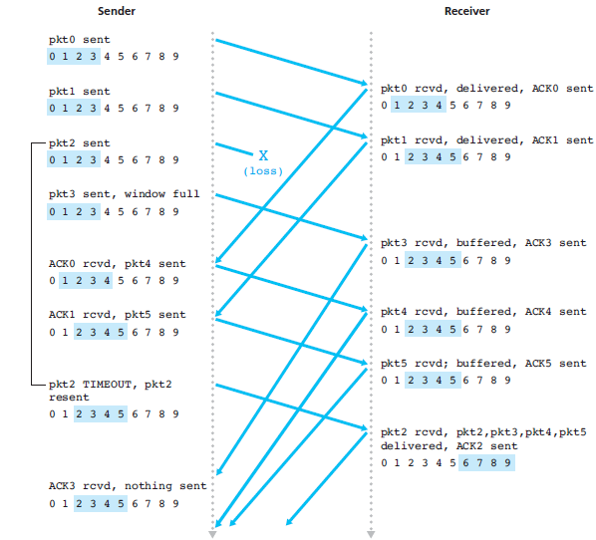
Selective repeat in action

Slide 16
Chapter 3 outline
3.1 transport-layer services
3.2 multiplexing and demultiplexing
3.3 connectionless transport: UDP
3.4 principles of reliable data transfer
3.5 connection-oriented transport: TCP
  segment structure
  reliable data transfer
  flow control
  connection management
3.6 principles of congestion control
3.7 TCP congestion control

Slide 17
TCP: Overview RFCs: 793,1122,1323, 2018, 2581
point-to-point:
  one sender, one receiver
reliable, in-order byte steam:
  no “message boundaries”
pipelined:
  TCP congestion and flow control set window size
full duplex data:
  bi-directional data flow in same connection
connection-oriented:
  handshaking (exchange of control msgs) initializes sender, receiver state before data exchange
flow controlled:
  sender will not overwhelm receiver

Slide 18
TCP segment structure
32 bits
source port #
dest port #
counting
by bytes
of data
(not segments!)
sequence number
ACK: ACK # valid
acknowledgement number
head
len
not
used
U
receive window
A
P
R
S
F
# bytes
rcvr willing
to accept
→ flow control
checksum
Urg data pointer
RST, SYN, FIN:
connection management
(setup, teardown
commands)
options (variable length)
application
data
(variable length)
Internet
checksum
(as in UDP)

Slide 19
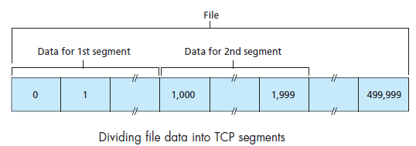
TCP seq. numbers
Maximum segment size (MSS): Maximum amount of data that can be grabbed and placed in a segment
Sequence number for a segment: Byte-stream number of the first byte in the segment
E.g., file size = 500,000 bytes and MSS = 1,000 bytes
  Seq # of 1st segment: 0; 2nd segment: 1000

Slide 20
TCP ACKs
ACK number that receiver puts in its segment
= seq # of next byte expected from other side
  E.g., Host A has received all bytes 0 through 535 from B
  -> ACK number = 536
  E.g., Host A has received one segment from Host B containing bytes 0 through 535 and another segment containing bytes 900 through 1,000
  -> ACK number = 536
  (acknowledges bytes up to the first missing byte of 536)
Cumulative ACK: TCP acknowledges bytes up to the first missing byte in the stream
Q: how receiver handles out-of-order segments
  A: TCP spec doesn’t say, - up to implementor

Slide 21
TCP seq. numbers
outgoing segment from sender
source port #
dest port #
sequence number
acknowledgement number
rwnd
checksum
urg pointer
window size
N
  sender sequence number space
sent
ACKed
sent, not-yet ACKed
(“in-flight”)
usable
but not
yet sent
not
usable
incoming segment to sender
source port #
dest port #
sequence number
acknowledgement number
A
rwnd
checksum
urg pointer

Slide 22

TCP seq. numbers, ACKs
E.g.: Telnet application: Host A (client) types a character and Host B (server) echoes back
suppose the starting sequence numbers are 42 and 79 for the client and server, respectively
Segment 1:
  Client is waiting for byte 79
Host A
Host B
User
types
‘C’
Seq=42, ACK=79, data = ‘C’
host ACKs
receipt of
‘C’, echoes
back ‘C’
Seq=79, ACK=43, data = ‘C’
host ACKs
receipt
of echoed
‘C’
Seq=43, ACK=80
simple telnet scenario

Slide 23
TCP seq. numbers, ACKs
Segment 2: ACK = 43 (server is telling the client that it has successfully received everything up through byte 42 and is now waiting for bytes 43 onward.)
Segment 3: Empty data field
Host A
Host B
User
types
‘C’
Seq=42, ACK=79, data = ‘C’
host ACKs
receipt of
‘C’, echoes
back ‘C’
Seq=79, ACK=43, data = ‘C’
host ACKs
receipt
of echoed
‘C’
Seq=43, ACK=80
simple telnet scenario

Slide 24
TCP round trip time, timeout
Q: how to set TCP timeout value?
too short: premature timeout, unnecessary retransmissions
too long: slow reaction to segment loss
longer than RTT
  but RTT varies
Q: how to estimate RTT?
SampleRTT: measured time from segment transmission until ACK receipt
  ignore retransmissions
SampleRTT will vary
  But we want estimated RTT to be“smoother”
  → average several recent measurements, not just current SampleRTT

Slide 25
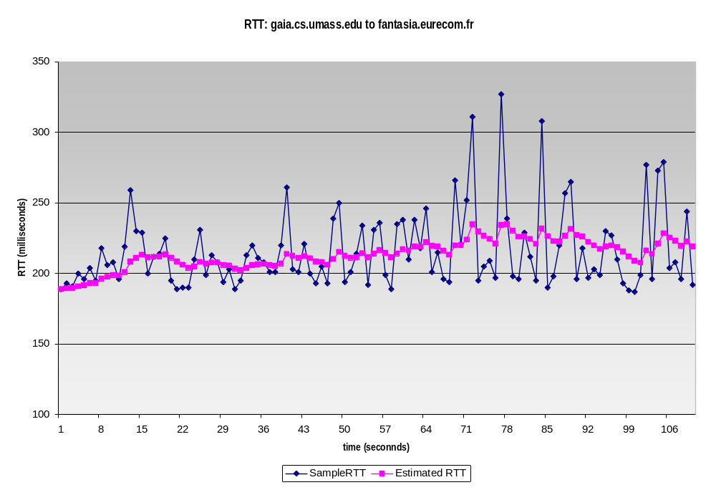
TCP round trip time, timeout
EstimatedRTT = (1- α)*EstimatedRTT + α*SampleRTT
exponential weighted moving average
influence of past sample decreases exponentially fast
typical value: α = 0.125
RTT: gaia.cs.umass.edu to fantasia.eurecom.fr
RTT (milliseconds)
sampleRTT
EstimatedRTT
time (seconds)

Slide 26

TCP round trip time, timeout
timeout interval: EstimatedRTT plus “safety margin”
  large variation in EstimatedRTT -> larger safety margin
estimate SampleRTT deviation from EstimatedRTT:
DevRTT = (1-β)*DevRTT +
β*|SampleRTT-EstimatedRTT|
(typically, β = 0.25)
TimeoutInterval = EstimatedRTT + 4*DevRTT
estimated RTT
“safety margin”

