Slide 1







Problem 1
$$d_{1}$$
C1
$$u_{1}$$
$$d_{2}$$
$$u_{2}$$
C2
Network
$$u_{s}$$
S
……
……
$$u_{N}$$
$$d_{N}$$
CN

Slide 2
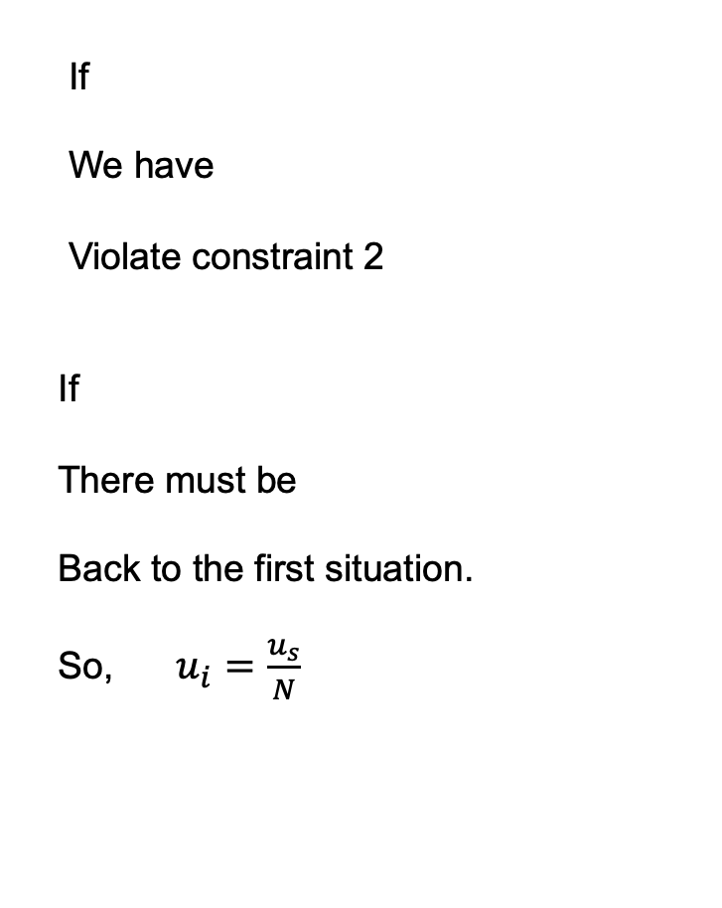
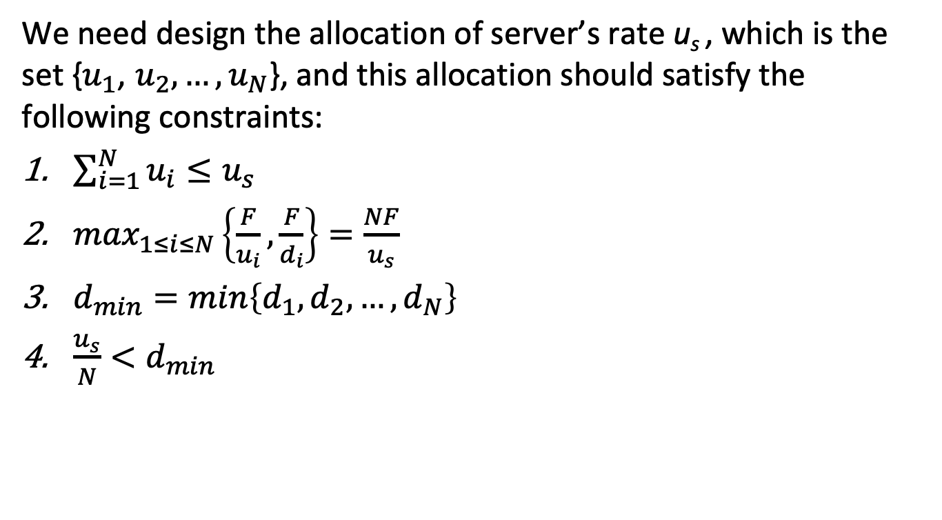



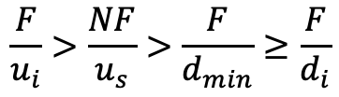
Problem 1a
We need design the allocation of server’s rate u_{s} , which is the set {$u_{1}$, $u_{2}, …,u_{N}$}, and this allocation should satisfy the following constraints:
$\sum_{i=1}^{N}{u_{i}≤u_{s}}$
$\max_{1≤i≤N}\left\{\frac{F}{u_{i}}, \frac{F}{d_{i}}\right\}=\frac{NF}{u_{s}}$
$d_{min}=min\left\{d_{1},d_{2}, …,d_{N}\right\}$
$\frac{u_{s}}{N}<$ $d_{min}$
If
We have
Violate constraint 2
If
There must be
Back to the first situation.
So, $u_{i}=\frac{u_{s}}{N}$
$$u_{i} <\frac{u_{s}}{N}$$
$$\frac{F}{u_{i}}>\frac{NF}{u_{s}}>\frac{F}{d_{min}}≥\frac{F}{d_{i}}$$
$$u_{i} >\frac{u_{s}}{N}$$
$$u_{j(j≠i)} <\frac{u_{s}}{N}$$

Slide 3
Problem 1 a
Consider a distribution scheme in which the server sends the file to each client, in parallel, at a rate of u_{s}/N.
Note that this rate is less than each of the client’s download rate, since by assumption u_{s}/N < d_{min}.
Thus each client can also receive at rate u_{s}/N. Since each client receives at rate u_{s}/N, the time for each client to receive the entire file is F/( u_{s}/N) = NF/ u_{s}.
Since all the clients receive the file in NF/ u_{s}, the overall distribution time is also NF/ u_{s}.

Slide 4
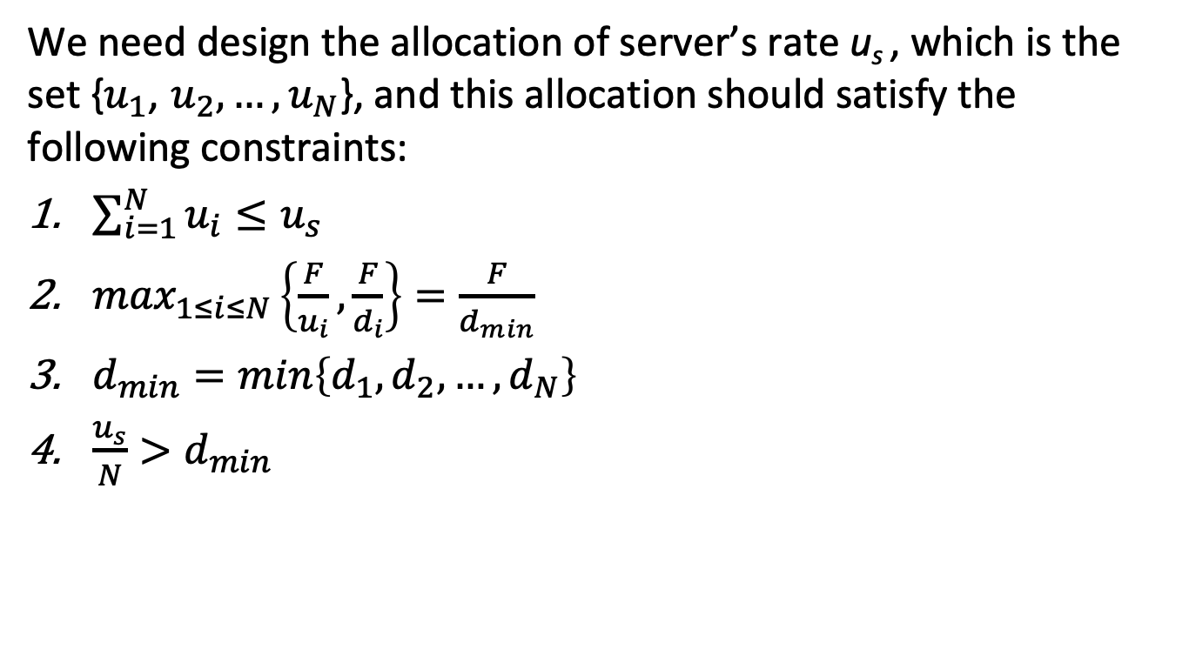
Problem 1b
We need design the allocation of server’s rate u_{s} , which is the set {$u_{1}$, $u_{2}, …,u_{N}$}, and this allocation should satisfy the following constraints:
$\sum_{i=1}^{N}{u_{i}≤u_{s}}$
$\max_{1≤i≤N}\left\{\frac{F}{u_{i}}, \frac{F}{d_{i}}\right\}=\frac{F}{d_{min}}$
$d_{min}=min\left\{d_{1},d_{2}, …,d_{N}\right\}$
$\frac{u_{s}}{N}>$ $d_{min}$

Slide 5
Problem 1 b
b) Consider a distribution scheme in which the server sends the file to each client, in parallel, at a rate of d_{min}.
Note that the aggregate rate, N d_{min}, is less than the server’s link rate u_{s}, since by assumption u_{s}/N > d_{min}.
Since each client receives at rate d_{min}, the time
for each client to receive the entire file is F/ d_{min}.
Since all the clients receive the file in this time, the overall distribution time is also F/ d_{min}.

Slide 6

File distribution time: client-server
server transmission: must sequentially send (upload) N file copies:
  time to send one copy: F/u_{s}
  time to send N copies: NF/u_{s}
F
u_{s}
d_{i}
network
u_{i}
client: each client must download file copy
  d_{min} = min client download rate
  min client download time: F/d_{min}
time to distribute F
to N clients using
client-server approach
D_{c-s} > max{NF/u_{s,},F/d_{min}}
increases linearly in N

Slide 7
File distribution time: P2P
server transmission: must upload at least one copy
  time to send one copy: F/u_{s}
F
u_{s}
d_{i}
client: each client must download file copy
  min client download time: F/d_{min}
network
u_{i}
clients: as aggregate must download NF bits
  max upload rate (limting max download rate) is u_{s} + Σu_{i}
time to distribute F
to N clients using
P2P approach
D_{P2P} > max{F/u_{s,},F/d_{min,},NF/(u_{s} + Σu_{i})}
increases linearly in N …
… but so does this, as each peer brings service capacity

Slide 8
Problem 2
For calculating the minimum distribution time for client-server distribution, we use the following formula:
Similarly, for calculating the minimum distribution time for P2P distribution, we use the following formula:
Where, F = 15 Gbits
u_{s} = 30 Mbps
d_{min =} d_{i} = 2 Mbps
D_{c-s} > max{NF/u_{s,},F/d_{min}}
D_{P2P} > max{F/u_{s,},F/d_{min,},NF/(u_{s} + Σu_{i})}

Slide 9
BitTorrent: sending file chunks
sending chunks:
(tit-for-tat) Alice sends chunks to those four peers currently sending her chunks at highest rate
  other peers are choked by Alice (do not receive chunks from her)
  re-evaluate top 4 every10 secs
(randomization) every 30 secs: randomly select another peer, starts sending chunks
  “optimistically unchoke” this peer
  newly chosen peer may join top 4

Slide 10
Problem 3a
Yes. His first claim is possible, as long as there are enough peers staying in the swarm for a long enough time. Bob can always receive data through optimistic unchoking by other peers.

Slide 11
Problem 3b
His second claim is also true. He can run a client on each host, let each client “free-ride,” and combine the collected chunks from the different hosts into a single file. He can even write a small scheduling program to make the different hosts ask for different chunks of the file. This is actually a kind of Sybil attack in P2P networks.

Slide 12
Streaming multimedia: DASH
DASH: Dynamic, Adaptive Streaming over HTTP
server:
  divides video file into multiple chunks
  each chunk stored, encoded at different rates
  manifest file: provides URLs for different chunks

Slide 13
Streaming multimedia: DASH
client:
  periodically measures server-to-client bandwidth
  consulting manifest, requests one chunk at a time
    chooses maximum coding rate sustainable given current bandwidth
    can choose different coding rates at different points in time (depending on available bandwidth at time)
“intelligence” at client: client determines
  when to request chunk (so that buffer starvation, or overflow does not occur)
  what encoding rate to request (higher quality when more bandwidth available)
  where to request chunk (can request from URL server that is “close” to client or has high available bandwidth)

Slide 14
Problem 4
a) N files, under the assumption that we do a one-to-one matching by pairing video versions with audio versions in a decreasing order of quality and rate.
N=3
N=3
 | Video | Audio
High quality
Medium quality
Low quality
One to one matching

Slide 15
Problem 4
b) 2N files.
N=3
N=3
 | Video | Audio
High quality
Medium quality
Low quality

