Slide 1










The network core
mesh of interconnected routers
packet-switching: hosts break application-layer messages into packets
  forward packets from one router to the next, across links on path from source to destination
  each packet transmitted at full link capacity

Slide 2





Packet-switching: store-and-forward
L bits
per packet
source
3
2
1
R bps
R bps
destination
takes L/R seconds to transmit (push out) L-bit packet into link at R bps
store and forward: entire packet must arrive at router before it can be transmitted on next link
one-hop numerical example:
L = 7.5 Mbits
R = 1.5 Mbps
one-hop transmission delay = 5 sec
end-end delay = 2L/R (assuming zero propagation delay)
more on delay shortly …

Slide 3
Q1
a) At time t₀ the sending host begins to transmit. At time t₁ = L/R₁, the sending host completes transmission and the entire packet is received at the router (no propagation delay). Because the router has the entire packet at time t₁, it can begin to transmit the packet to the receiving host at time t₁. At time t₂ = t₁ + L/R₂, the router completes transmission and the entire packet is received at the receiving host (again, no propagation delay). Thus, the end-to-end delay is L/R₁ + L/R₂.

Slide 4
Q1
b)Case of 2 links: When the first node sends the P-th packet to the second node, thereby incurring a net delay of PL/R, the second node sends the
(P-1)-th packet to the third node. Hence an additional delay of L/R would be incurred for sending the P-th packet from the second node to the third node. Thus, the net delay would be (P+1)L/R.

Slide 5
Alternative core: circuit switching
end-end resources allocated to, reserved for “call” between source & dest:
In diagram, each link has four circuits.
  call gets 2nd circuit in top link and 1st circuit in right link.
dedicated resources: no sharing
  circuit-like (guaranteed) performance
circuit segment idle if not used by call (no sharing)
Commonly used in traditional telephone networks

Slide 6
Q2
a) Between the switch in the upper left and the switch in the upper right we can have 4 connections. Similarly we can have four connections between each of the 3 other pairs of adjacent switches. Thus, this network can support up to 16 connections.
b) We can 4 connections passing through the switch in the upper-right-hand corner and another 4 connections passing through the switch in the lower-left-hand corner, giving a total of 8 connections.

Slide 7
Q2
C) Yes. For the connections between A and C, we route two connections through B and two connections through D. For the connections between B and D, we route two connections through A and two connections through C. In this manner, there are at most 4 connections passing through any link.

Slide 8
Circuit switching: FDM versus TDM
Example:
FDM
4 users
frequency
time
TDM
frequency
time
Notes:
Two simple multiple access control techniques.
Each mobile’s share of the bandwidth is divided into portions for the uplink and the downlink. Also, possibly, out of band signaling.
As we will see, used in AMPS, GSM, IS-54/136

Slide 9
Q3
Each circuit has a transmission rate of (1.536 Mbps)/12 = 128 kbps, so it takes (160,000 bits)/(128 kbps) = 1.25 seconds to transmit the file. To this, we add the circuit establishment time of 0.6 seconds, giving a total of 1.85 seconds to send the file.

Slide 10
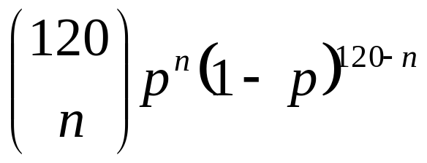
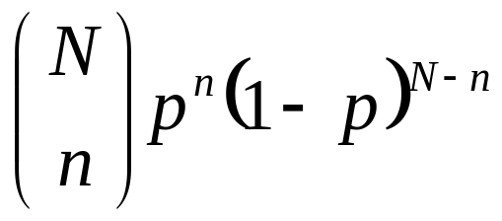
Q4
a) 3Mbps/150 kbps = 20 users can be supported.
b) p = 0.1
c)
Binomial distribution B(N, p): assume the success probability of an independent trial is p, then
the probability of getting exactly n successes in N trials is

