Slide 1
CITYU MSC CYBERSECURITY · CS5292
Cybersecurity Audits
and Compliance
WEEK 1 — INTRODUCTION
Prof. Jason Lee | Wednesdays 19:00–22:00 | 2 September 2026

Slide 2
TONIGHT · 19:00–20:50
Tonight's Session
19:00
Buffer — settling in
19:05
Welcome & About Me
19:10
Course Objectives & Structure — and why this course leans on industry voices
19:50
Break
20:00
A Global Tour: the Frameworks That Shape This Field
20:50
Break, then Group Task — Target Breach RFI vs. ISO 27001
21:50–22:00 optional Q&A for anyone who can stay — formal class end per the timetable.
CS5292 · Week 1 · Tonight's Session
Prof. Jason Lee

Slide 3
01
SECTION
Who Am I
Before we talk about the course, a word on why I'm the one teaching it.
CS5292 · Week 1 · Who Am I
Prof. Jason Lee

Slide 4
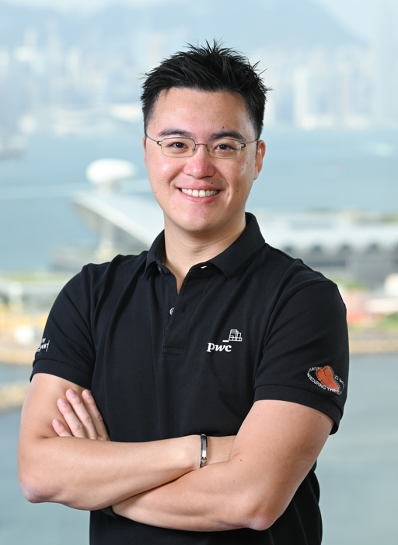
ABOUT YOUR INSTRUCTOR
Jason Lee
12+ years leading cybersecurity, technology risk, and regulatory-compliance engagements for top MNCs and Hong Kong clients, inside PwC's Dark Lab practice.
Lead Manager developing and advising on Hong Kong's own frameworks — HKMA's CFI / C-RAF 2.0, HKAB's Secure Tertiary Data Backup Guideline, HKIA's GL20, and the Digital Policy Office's S17/G3 guidelines.
Founder of Dark Lab Academy and lead on HKIRC's Cybersec Training Hub (cyberhub.hk) — building cyber literacy across Hong Kong, not just inside client walls.
Senior Manager, PwC Hong Kong · Dark Lab
Incoming Instructor · CS5292
Hands-on experience translating frameworks into real audit findings and Requests for Information — the same discipline this course is built around.
CRTIA
OSCP
GCTI
CISSP
CISA
FRM
CREST Registered Threat Intelligence Analyst
Offensive Security Certified Professional
GIAC Cyber Threat Intelligence (SANS)
Certified Information Systems Security Professional
Certified Information Systems Auditor
Financial Risk Manager (GARP)
CS5292 · Week 1 · Who Am I
Prof. Jason Lee

Slide 5
SETTING THE COMPASS
Course Objectives
1
2
3
Think and Work Like an Auditor
Master HK's Regulatory Terrain
Operate in GRC and Technical Worlds
Translate frameworks into real audit findings — draft RFIs, evaluate evidence, judge control design vs. operating effectiveness.
Navigate PDPO, Cap. 653, GL20, C-RAF 2.0 — and place it against the global frameworks that inform it.
Move fluently between governance/compliance thinking and the technical detail beneath it — one skill, not two.
4
5
Read the Frontier, Not Just the Established
Build a Portfolio, Not Just Sit an Exam
Apply the same audit judgment to AI governance, crypto-asset regulation, and cloud compliance-as-code.
Leave with a semester's worth of applied deliverables — workpapers, control mappings, a capstone case study.
CS5292 · Week 1 · Who Am I
Prof. Jason Lee

Slide 6
FROM PRACTICE TO CLASSROOM
What This Means for How I'll Teach
1
2
3
Real Engagement Scars
The RFI Skill, Every Week
Industry Voices, Not Just Mine
Not textbook theory — findings, evidence gaps, and RFIs drawn from actual assessments I've run.
The same request-for-information discipline a working practitioner uses, practiced in almost every session.
Nearly every week hands the floor to someone doing this work right now, so you hear more than one perspective.
CS5292 · Week 1 · Who Am I
Prof. Jason Lee

Slide 7
02
SECTION
Course Structure
How the semester is built, and why it leans so heavily on people outside this room.
CS5292 · Week 1 · Course Structure
Prof. Jason Lee

Slide 8
THE RELEVANCE OF INDUSTRY VIEWS
Why This Course Leans on Industry
Audit and compliance is a practiced craft, not a memorized one. Theory tells you what a control should look like; a practitioner tells you what actually happens when it doesn't.
10
Almost every week this semester hands the floor to someone doing this work right now — CISOs, regulators, SOC leads, Big Four advisors — alongside structured lecture content.
of 13 weeks bring an
industry guest speaker
into this room
CS5292 · Week 1 · Course Structure
Prof. Jason Lee

Slide 9
THE SEMESTER AT A GLANCE
The 13-Week Arc
W1
Foundations
Introduction to Cybersecurity Audit & Compliance
W2–6
The Hong Kong Scope Funnel
Cap.653 (newest, narrowest law) → PDPO (oldest, broadest) → S17/G3 (public sector) → GL20/C-RAF 2.0 (regulated) → NIST CSF (no law at all)
W7
Midterm
Synthesis of Weeks 1–6
W8–12
Modern Practice
Simulation testing, crypto-asset compliance, AI auditing AI, cloud & compliance-as-code, accreditation
W13
Capstone
Final Group Case Study Workshop
CS5292 · Week 1 · Course Structure
Prof. Jason Lee

Slide 10
HOW YOU'LL BE ASSESSED
Assessment Weighting
No individual take-home homework — you're assessed through in-class group work, examinations, and a capstone case study.
The weekly portfolio is one aggregate 5% grade across all in-class group tasks, not 5% per week.
The Group Case Study (Week 13) sits alongside the Exam — it does not replace it.
CS5292 · Week 1 · Course Structure
Prof. Jason Lee

Slide 11
THE STANDARD TEMPLATE
The Weekly Rhythm (Guest Weeks)
5m
30m
10m
10m
50m
10m
35–50m
15m
Buffer
Speaker
Q&A
Break
Lecture
Break
Group Task
Optional Q&A
Weeks 1, 3, and 13 replace the speaker block with a second lecture or activity block — no outside guest that week.
CS5292 · Week 1 · Course Structure
Prof. Jason Lee

Slide 12
03
SECTION
Before the Frameworks
Regulation is reactive. Every framework on the next tour was some regulator's response to an incident that came first.
CS5292 · Week 1 · Before the Frameworks
Prof. Jason Lee

Slide 13
CAUSE, THEN EFFECT
The Incidents That Forced the Issue
JUN
NOV
FEB
DEC
2005
2013
2016
2020
CardSystems Solutions
Target Corporation
Bangladesh Bank / SWIFT
SolarWinds
~40 million card numbers exposed — six months after PCI DSS v1.0 shipped.
~40 million card numbers and 70 million customer records exposed in-store.
US$81 million stolen via forged SWIFT transfers (Lazarus Group).
Trojanized software update reaches ~18,000 organizations worldwide.
→ FRAMEWORK RESPONSE
→ FRAMEWORK RESPONSE
→ FRAMEWORK RESPONSE
→ FRAMEWORK RESPONSE
Proved PCI DSS was needed on day one, not a paperwork exercise.
Sharpened the US executive order that becomes NIST CSF 1.0 three months later.
HKMA launches CFI / C-RAF 1.0 just ten months later.
Sharpens EU focus on third-party ICT risk — feeds directly into DORA.
A deliberately small sample, not a complete list — each has a clean, well-documented line to a framework already on this tour.
CS5292 · Week 1 · Global Tour of Frameworks
Prof. Jason Lee

Slide 14
04
SECTION
A Global Tour of Frameworks
1990s → 2020s. Not exhaustive — a practitioner's map of the terrain.
CS5292 · Week 1 · A Global Tour of Frameworks
Prof. Jason Lee

Slide 15
THIRTY YEARS, ONE DISCIPLINE
Three Decades of Audit & Compliance
Global / International
Hong Kong
Commonwealth
China
1988 — Australia Privacy Act enacted
1998 — BS7799-2 published (UK)
2004 — HKMA TM-E-1 (E-banking)
2010 — Malaysia PDPA enacted
2014 — NIST CSF 1.0 + FFIEC CAT tool released
2018 — UK Data Protection Act, GDPR & NIS Regs
2019–24 — Malaysia BNM RMiT (+ cloud update)
2024 — Cap.653 enacted — effective 1 Jan 2026
1994 — China MLPS 1.0 concept introduced
2000 — ETO enacted + HKMA e-banking security guidance
2004 — PCI DSS v1.0 published
2011 — SOC 2 / SSAE 16 replaces SAS 70
2014 — UK Cyber Essentials + BoE CBEST launched
2018–22 — Australia NDB scheme & ASD Essential Eight
2020 — HKMA C-RAF 2.0 / iCAST launched
2024 — NIST CSF 2.0 released
1995 — PDPO enacted (Cap. 486)
2001 — HKMA SA-2 (Outsourcing)
2005 — ISO/IEC 27001 published
2012 — Singapore PDPA enacted
2016 — HKMA CFI / C-RAF 1.0 launched
2019 — Australia APRA CPS 234 effective
2021 — China DSL + PIPL enacted
2025 — EU DORA effective (adopted 2022)
1996 — COBIT v1 published (ISACA)
2003 — HKMA TM-G-1 (Technology Risk)
2008 — CIS Controls launched (SANS Top 20)
2013–24 — Singapore MAS TRM Guidelines & ABS AASE
2017 — China Cybersecurity Law effective
2019 — China MLPS 2.0 effective
2022 — ISO/IEC 27001:2022 revision
PDPO = Personal Data (Privacy) Ordinance · ETO = Electronic Transactions Ordinance · SA-2 / TM-G-1 / TM-E-1 = HKMA Supervisory Policy Manual modules · CFI = Cybersecurity Fortification Initiative · C-RAF = Cyber Resilience Assessment Framework · iCAST = intelligence-led Cyber-Attack Simulation Testing · PCI DSS = Payment Card Industry Data Security Standard · CIS = Center for Internet Security · COBIT = Control Objectives for Information and Related Technologies (ISACA) · FFIEC CAT = Federal Financial Institutions Examination Council Cybersecurity Assessment Tool · SSAE = Statement on Standards for Attestation Engagements · DORA = Digital Operational Resilience Act (EU) · PDPA = Personal Data Protection Act (SG / MY) · MAS = Monetary Authority of Singapore · ABS AASE = Assoc. of Banks in Singapore Adversarial Attack Simulation Exercises · BNM RMiT = Bank Negara Malaysia Risk Management in Technology · NDB = Notifiable Data Breaches (Australia) · ASD = Australian Signals Directorate · MLPS = Multi-Level Protection Scheme (China) · DSL = Data Security Law (China) · PIPL = Personal Information Protection Law (China) · CPS 234 = APRA's Prudential Standard
CS5292 · Week 1 · Global Tour of Frameworks
Prof. Jason Lee

Slide 16
THE GLOBAL LAYER
GLOBAL / INTL. · 9/31 ON THE TIMELINE
Global Reference Points
Framework
Origin & Steward
Key Milestones
ISO/IEC 27001
ISO, via UK's BS7799
1998 BS7799-2 → 2005 ISO 27001 → 2013 rev. → 2022 rev.
COBIT
ISACA
1996 v1 → 2012 COBIT 5 → 2019 COBIT 2019
NIST CSF
US NIST
2014 CSF 1.0 → 2018 CSF 1.1 → 2024 CSF 2.0
CIS Controls
Center for Internet Security, via SANS
2008 SANS Top 20 → 2015 owned by CIS → 2021 v8
SOC Reports
AICPA
SAS 70 → 2011 SSAE 16 (SOC 1/2/3) → 2017 SSAE 18
PCI DSS
PCI Security Standards Council
2004 v1.0 — global card-data security standard
FFIEC CAT
US FFIEC
2015 tool → 2025 sunset — echoes in HKMA's C-RAF
EU DORA
European Commission / ESAs
Adopted 2022 → effective 17 Jan 2025 — ICT risk, 3rd-party oversight, TLPT
CS5292 · Week 1 · Global Tour of Frameworks
Prof. Jason Lee

Slide 17
THE HONG KONG LAYER
HONG KONG · 8/31 ON THE TIMELINE
Hong Kong's Own Arc
STATUTE
STATUTE
HKMA
HKMA
HKMA
1995–96
2000
2000
2001
2003
PDPO
ETO
Security Guidance
SA-2
TM-G-1
Personal Data (Privacy) Ordinance (Cap. 486)
Electronic Transactions Ordinance (Cap. 553) — legal recognition for e-signatures and records
HKMA's first formal e-banking security-risk guidance — 4 years ahead of TM-E-1
Outsourcing (HKMA Supervisory Policy Manual)
General Principles for Technology Risk Management
HKMA
HKMA
HKMA
STATUTE · EFF. 2026
2004
2016
2020
2024
TM-E-1
CFI / C-RAF 1.0
C-RAF 2.0
Cap.653
Risk Management of e-Banking
Cybersecurity Fortification Initiative — Cyber Resilience Assessment Framework
Cyber Resilience Assessment Framework 2.0, incl. iCAST
Protection of Critical Infrastructures (Computer Systems) Ordinance
The arc isn't as thin as PDPO-then-silence-then-SA-2 — it runs quieter in the middle: the 2000 Electronic Transactions Ordinance gave e-signatures legal standing, and HKMA's first e-banking security guidance beat TM-E-1 by four years.
CS5292 · Week 1 · Global Tour of Frameworks
Prof. Jason Lee

Slide 18
GROUNDING THE TIMELINE
Why This Isn't Just Theory
A staff member lost a USB flash drive holding working documents with patients' names, HKID numbers, and laboratory test items — and couldn't confirm the data had been deleted per protocol.
~10,000
patient records on a lost
USB flash drive
Prince of Wales Hospital notified the police and the Privacy Commissioner immediately; no evidence of actual misuse was found at the time.
PDPO had already existed for over a decade by 2008 — this is the kind of ordinary, low-tech incident that turned data protection into a practitioner's discipline in Hong Kong.
6 MAY 2008
Prince of Wales Hospital,
Hospital Authority
We'll go deeper on PCPD's approach — and a full case study — in Week 3.
CS5292 · Week 1 · Global Tour of Frameworks
Prof. Jason Lee

Slide 19
THE COMMONWEALTH LAYER
COMMONWEALTH · 10/31 ON THE TIMELINE
Commonwealth Neighbors
United Kingdom
Singapore
Malaysia
Australia
1998 BS7799-2 — origin of ISO 27001
2012 Personal Data Protection Act
2010 Personal Data Protection Act
1988 Privacy Act
2014 Cyber Essentials scheme launched
2013 MAS Technology Risk Mgmt Guidelines
2019 BNM RMiT — Risk Mgmt in Technology
2018 Notifiable Data Breaches scheme
2014 Bank of England CBEST launched
2021 MAS TRM Guidelines revised
2024 RMiT updated — cloud guidance added
2019 APRA CPS 234 takes effect
2018 Data Protection Act · NIS Regs · GDPR
2024 ABS AASE — Adversarial Attack Sim.
2022 ASD Essential Eight mandated (govt)
CS5292 · Week 1 · Global Tour of Frameworks
Prof. Jason Lee

Slide 20
THE MAINLAND LAYER
CHINA · 4/31 ON THE TIMELINE
China's Parallel Track
1994
2017
2019
2021
2021
MLPS 1.0
Cybersecurity Law (CSL)
MLPS 2.0
Data Security Law (DSL)
PIPL
Multi-Level Protection Scheme concept introduced
PRC's foundational cyber statute takes effect
GB/T 22239-2019 baseline takes effect
Classifies and governs data by risk tier
Personal Information Protection Law — China's GDPR-equivalent
CS5292 · Week 1 · Global Tour of Frameworks
Prof. Jason Lee

Slide 21
THE FULL SYLLABUS, AT A GLANCE (1/2)
Every Framework This Course Touches
W1
Foundations
ISO/IEC 27001 · CIS Controls · SOC 2
W2
HK Cyber Law
Cap. 653 — Protection of Critical Infrastructures (Computer Systems) Ordinance (effective 1 Jan 2026)
W3
PCPD & Privacy
PDPO (Cap. 486)
W4
Public Sector
DPO's S17 / G3
W5
Financial Sector
IA's GL20 · HKMA C-RAF 2.0 · EU DORA
W6
No Law At All
NIST CSF 2.0
W7
Midterm
Synthesis of Weeks 1–6
CS5292 · Week 1 · Global Tour of Frameworks
Prof. Jason Lee

Slide 22
THE FULL SYLLABUS, AT A GLANCE (2/2)
Every Framework This Course Touches
W8
Simulation Testing
MITRE ATT&CK · HKMA iCAST · BoE CBEST · Singapore AASE · EU TIBER-EU
W9
Crypto-Assets
EU MiCA (Markets in Crypto-Assets Regulation)
W10
AI Auditing AI
NIST AI Risk Management Framework
W11
Cloud & Compliance-as-Code
HKMA Guidance on Cloud Computing · Practice Guide on Cloud Adoption
W12
Accreditation & CISO Function
ISACA (CISA, CRISC, CGEIT, CDPSE) · ISC2 (CISSP, CCSP, CGRC, SSCP, CC)
W13
Capstone
Synthesis of Weeks 1–12
CS5292 · Week 1 · Global Tour of Frameworks
Prof. Jason Lee

Slide 23
A DELIBERATE SELECTION
Why These, and Why Non-Exhaustive
Tonight's deep tour was curated, not the whole map — the table you just saw is the fuller picture, and we'll meet nearly every row on it before Week 13.
The selection reflects two things: what I actually saw and worked on inside a Big Four practice, and what Hong Kong organizations are being measured against today.
From Week 2 onward, this course pivots to a Hong Kong-specific lens — everything global tonight was the map; next week we start walking the terrain.
The terrain keeps shifting: DORA went live in Jan 2025 alongside MiCA and TIBER-EU, and NIS2 is expanding the same discipline across 18 critical sectors.
CS5292 · Week 1 · Global Tour of Frameworks
Prof. Jason Lee

Slide 24
05
SECTION
Cybersecurity Fundamentals
The vocabulary this course assumes — cyberspace, the CIA triad, and why any of this matters.
CS5292 · Week 1 · Cybersecurity Fundamentals
Prof. Jason Lee

Slide 25
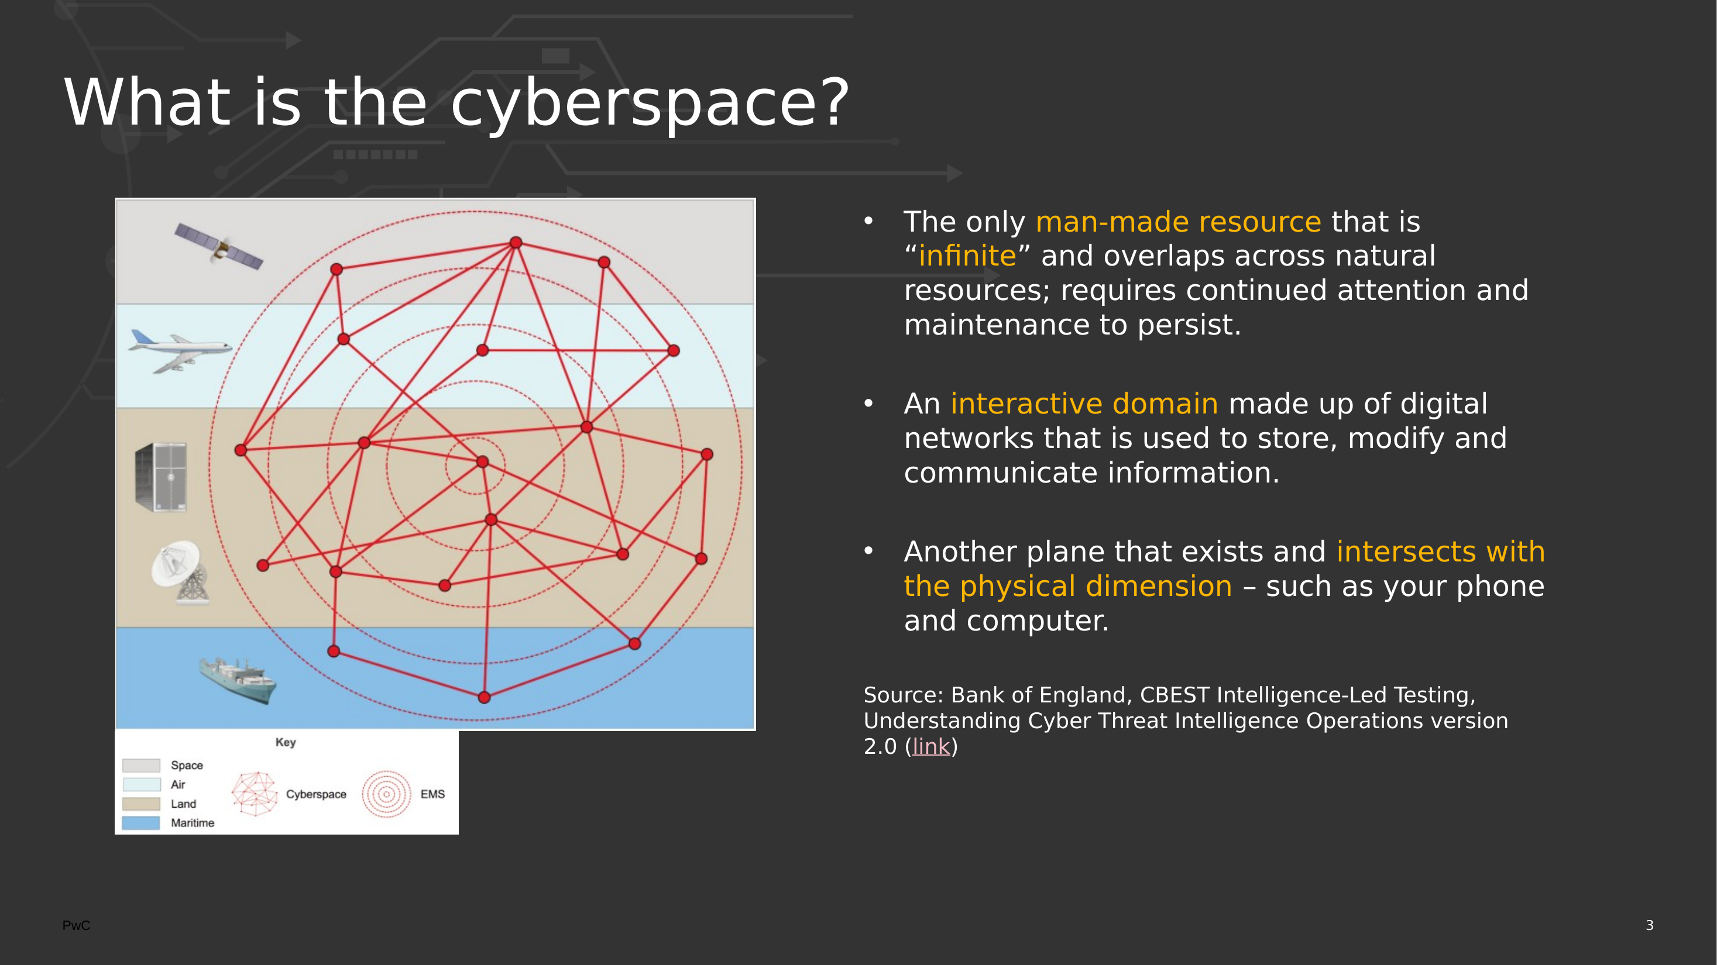

Slide 26
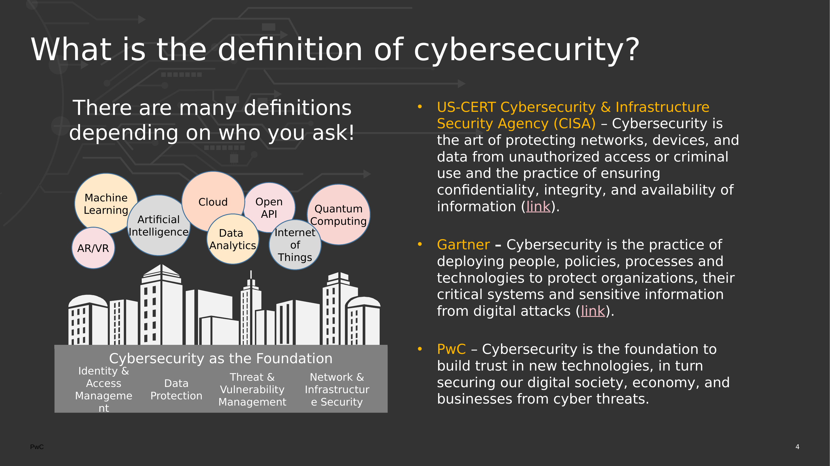

Slide 27
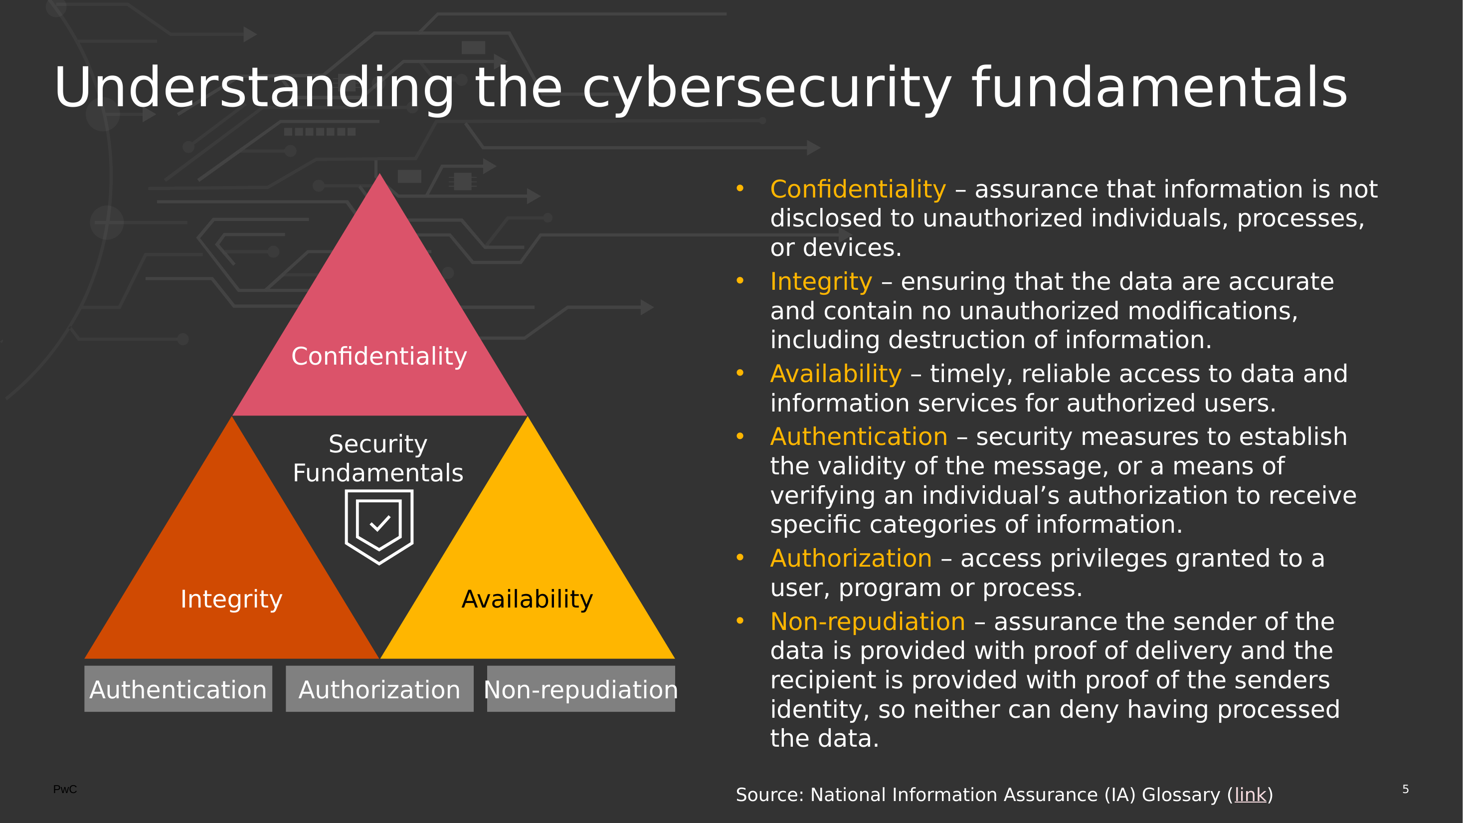

Slide 28
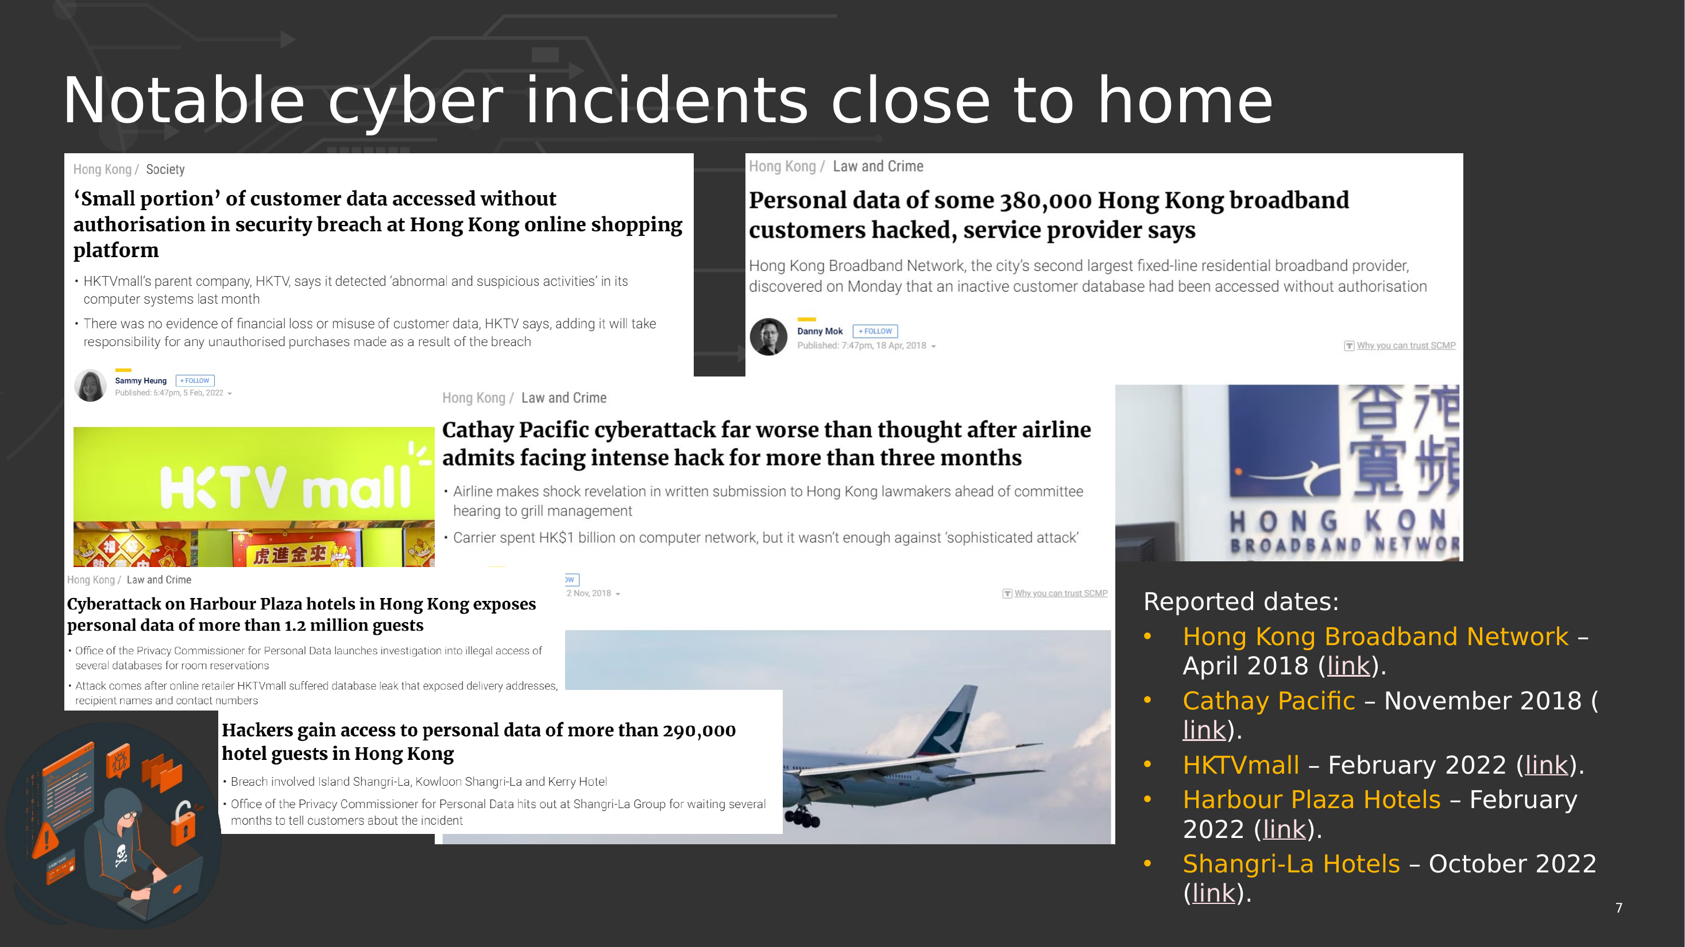

Slide 29
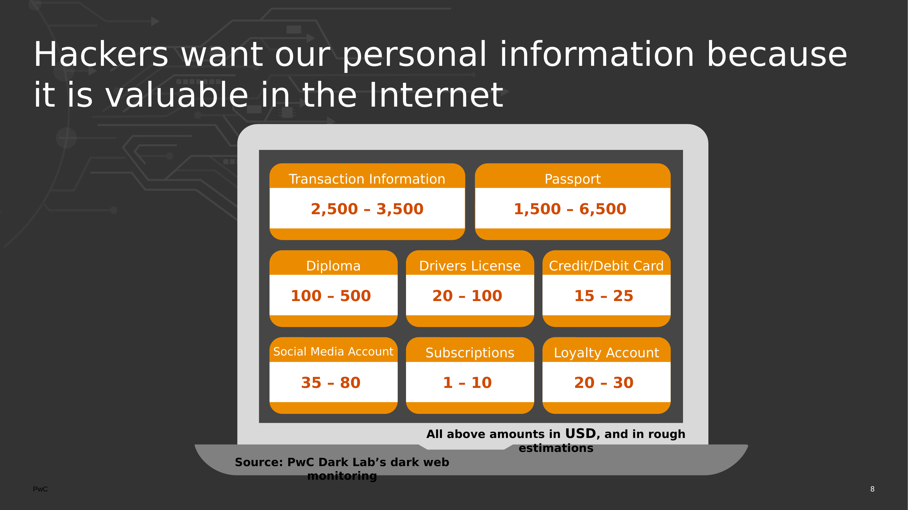

Slide 30
06
SECTION
GRC + Technical
Why this course refuses to pick a side.
CS5292 · Week 1 · GRC + Technical
Prof. Jason Lee

Slide 31
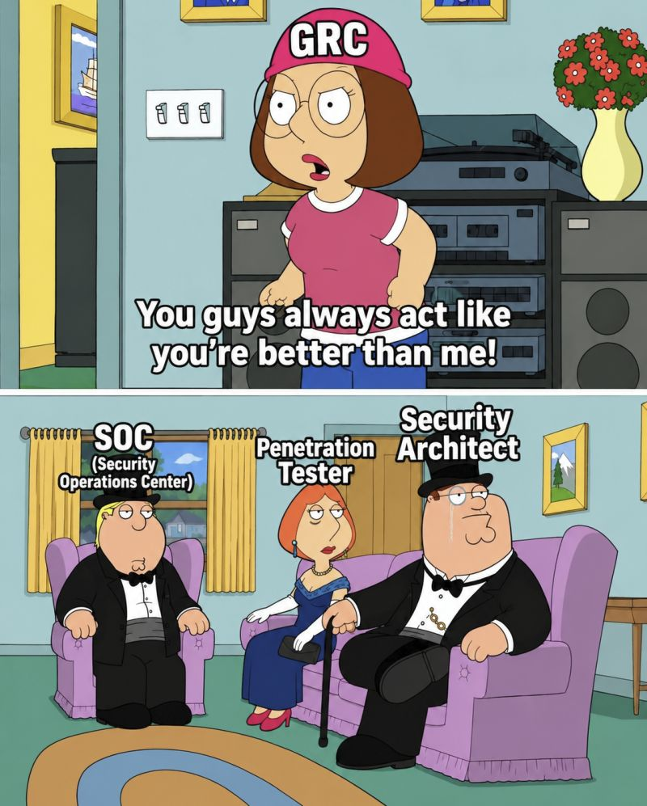
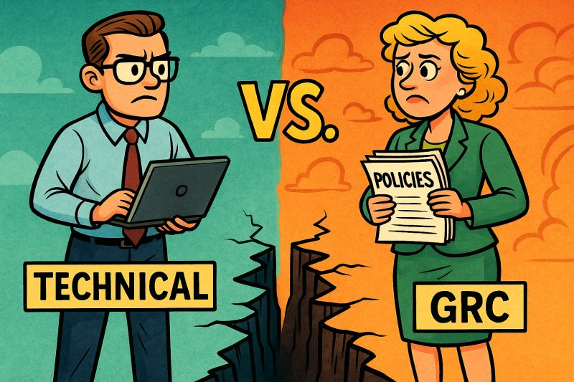
A FAMILIAR RIVALRY
Sound Familiar?
CS5292 · Week 1 · GRC + Technical
Prof. Jason Lee

Slide 32
THE COURSE PHILOSOPHY
Cybersecurity Is Not GRC vs. Technical. It's Both.
If you can't move between both worlds at a functional level, you're not ready to operate independently.
1
This course is labeled “Audit and Compliance” — but it's really about the integration of both.
2
Expect technical material woven in throughout. When it goes beyond our class time, you're expected to research, read, or ask.
3
Every framework we study this semester exists to answer one question a technical control alone can't: how do you prove it's working?
4
CS5292 · Week 1 · GRC + Technical
Prof. Jason Lee

Slide 33
UP NEXT
Break, then: Group Task
Target Breach RFI vs. ISO 27001 — groups of 3–4 draft and submit, then we review the expected approach together.
CS5292 · Week 1 · See you after the break
Prof. Jason Lee

