Slide 1
TLP:RED
Three Cases,
From the Field.
CNCBI, HKIB, and Cyberport — three incidents I worked on the PwC response team, from initial access to what regulators found
CS5292 Week 3 · Part 2 of 2
TLP:RED — classroom use only, not for redistribution.
CS5292 · Week 3 · Part 2 · TLP:RED · 01

Slide 2
TLP:RED
PART 2
Three escalating cases. CNCBI first, then HKIB, then Cyberport — the most detailed, covered from two real angles: the technical incident response, and the independent review against its Enforcement Notice.
What You’re
About to Hear.
CS5292 · Week 3 · Part 2 · TLP:RED · 02

Slide 3
TLP:RED
BEFORE WE START
Real organisations, sanitized specifics — and this is itself a compliance lesson
What stays real
What’s relativized
Org and threat-actor names, CVEs, anything independently published — fair game, citable.
Our own timelines become Day 0, Day 1, Day N — never a calendar date or clock time.
Left out entirely
Why it’s TLP:RED
Exact IPs, hostnames, account names, individual names — some material is legally privileged.
This deck carries real public-research screenshots — classroom only, not for redistribution.

Slide 4
TLP:RED
ROADMAP
Three cases, same four-part spine each time
CASE 1
CASE 2
1. CNCBI
2. HKIB
A zero-day, an asset list before an RFI, and a case that never reached PCPD.
A 2.5-year-old patch gap, credential theft to full ransomware in about a day.
CASE 3A
CASE 3B
3. Cyberport, Angle A
3. Cyberport, Angle B
Technical incident response — access, containment, eradication, root cause.
Independent review against the EN — a completely different job.
Background → timeline → recommendations → PCPD alignment, every time.

Slide 5
TLP:RED
CASE 1
A globally famous zero-day, a narrow blast radius, and a case that — unlike the other two — never became a public PCPD matter. Worth asking why.
China CITIC Bank
International.
CS5292 · Week 3 · Part 2 · TLP:RED · 03

Slide 6
TLP:RED
CNCBI · THREAT ACTOR
Who is CL0P, and what do they want
RaaS since 2019
Financial gain
File-transfer focus
a Ransomware-as-a-Service group with roots in malware delivery dating to 2014
not state-sponsored, not hacktivist — the leak site is a collections tool
Accellion (2020), GoAnywhere MFT (2023), then MOVEit — their signature move
CL0P’s usual playbook is double extortion: encrypt the network and threaten to leak stolen data if the ransom isn’t paid. For the MOVEit campaign, they broke from that pattern entirely — more on that shortly.
CISA and FBI jointly attributed the MOVEit campaign to CL0P; independent research (Dark Lab, and others) corroborated it via leak-site analysis.

Slide 7
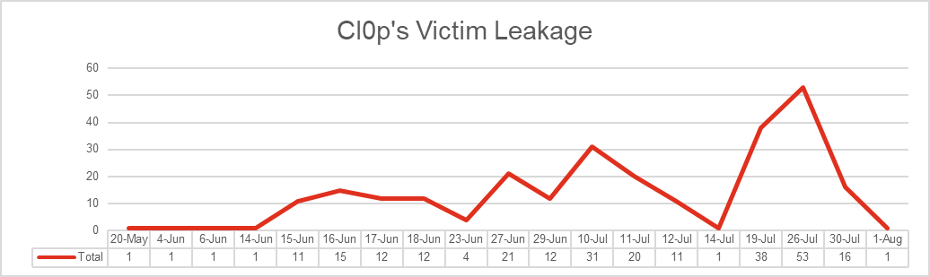
TLP:RED
CNCBI · THREAT ACTOR
A leak-site campaign, not one attack
By 1 August 2023, CL0P had listed 262 organisations on its leak site from this one campaign — and actually posted data for 94% of them.
Cl0p’s MOVEit leak-site listings over time. Source: Dark Lab, “MOVEit Cl0p: You’re Not The Only One” (Sept 2023).

Slide 8
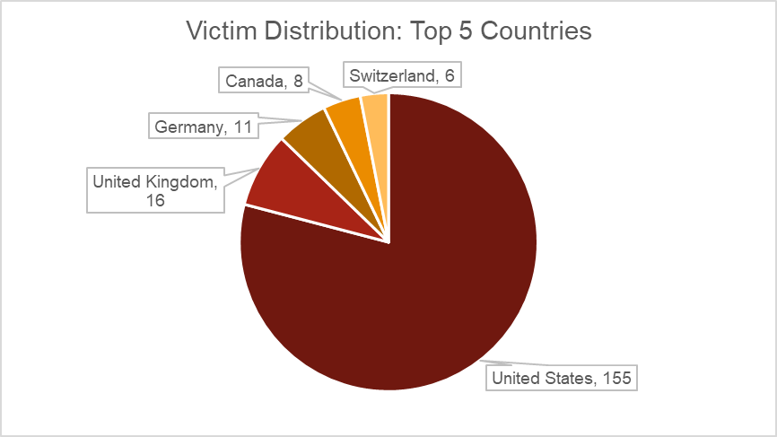
TLP:RED
CNCBI · THREAT ACTOR
Opportunistic, not targeted
Roughly two-thirds of disclosed victims were US-based — that tracks with where internet-facing MOVEit instances are concentrated, not a deliberate US focus.
CL0P’s targeting here was opportunistic: whoever ran MOVEit exposed to the internet was in scope, regardless of sector or size.
Some victims appeared in the leak site more than once, in up to six separate data “parts” — CL0P’s own operational backlog processing hundreds of victims at once.
Top-5 victim countries by count. Source: Dark Lab (Sept 2023).

Slide 9
TLP:RED
CNCBI · THE PLATFORM
MOVEit: built to face the internet
MOVEit Transfer is enterprise managed file-transfer software — its whole purpose is exchanging files with external partners, so by design it has to be internet-facing. That’s exactly what made it attractive.
CVE-2023-34362: a SQL-injection zero-day, actively exploited since 27 May 2023, giving an unauthenticated attacker direct access to the underlying database — no phishing, no stolen credentials required.
The shift: CL0P’s usual move is double extortion. Hitting hundreds of victims in one campaign, they went single-extortion instead — steal the data, skip the encryption. Faster to run at that scale, across that many victims, simultaneously.
Same playbook as their prior hits (Accellion 2020, GoAnywhere MFT Feb 2023): one zero-day in the right file-transfer product reaches hundreds of organisations at once, everywhere, because that class of software is deployed almost identically wherever it runs.

Slide 10
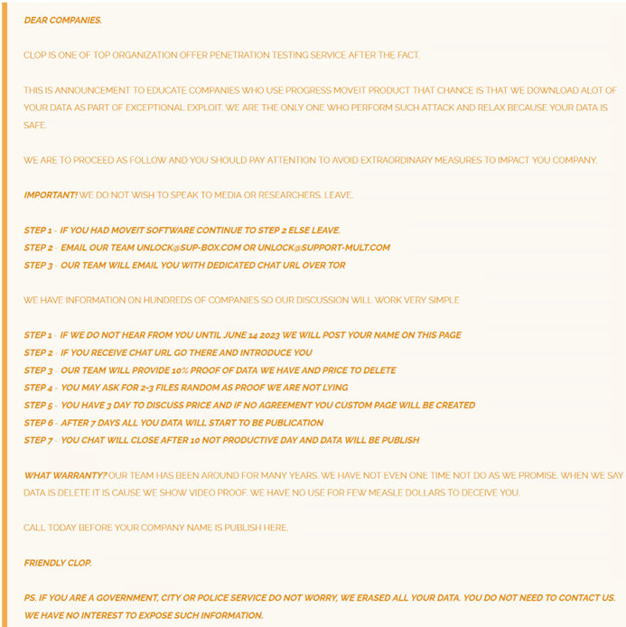
TLP:RED
CNCBI · THE NOTICE
CNCBI, listed among roughly 260 others
This is the generic note CL0P posted for every MOVEit victim once listed — not a message planted on CNCBI’s own systems. There was no on-host ransom note here.
CNCBI’s attribution came from exactly this: the leak-site listing and this note, plus TTP overlap — not a forensic artefact confirming CL0P by name.
The ask is blunt: pay, or a 10% proof sample goes up, then the rest after a stated deadline.

Slide 11
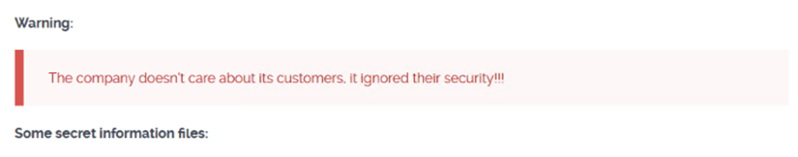
TLP:RED
CNCBI · THE NOTICE
What being listed looked like
CL0P’s stated policy: publish incrementally if a victim doesn’t pay — a small proof first, then more, then everything after the deadline. In practice, the deadlines shifted, and some victims’ data appeared early.
CNCBI’s own review of what was actually published found no customer data among it — a materially different outcome from simply being listed.
CL0P’s public-shaming banner on a victim’s leak-site page — generic wording, not specific to any one organisation.

Slide 12
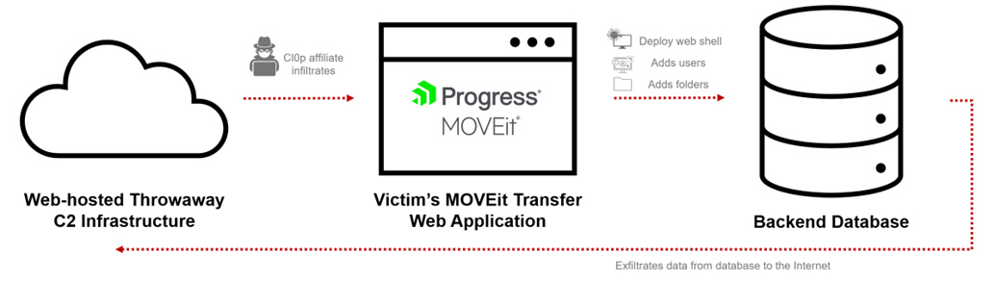
TLP:RED
CNCBI · ATTACK PATH
Access to exfiltration in under an hour, published a month later
Day 0: exploit, web-shell, and exfiltration — all in the same session, under an hour. Day 31: CL0P publishes on its leak site.

Slide 13
TLP:RED
CNCBI · ATTRIBUTION
Why attribution mattered here
Knowing it was CL0P — not just “a zero-day hit us” — told us what to expect: single extortion, no lateral movement typically, exfiltration via the platform itself rather than a foothold across the network.
That shaped where we focused forensics: the MOVEit host and its own logs first, rather than a domain-wide hunt — consistent with how CL0P has run every one of its file-transfer campaigns.
Attribution came from the leak-site claim plus TTP overlap with known CL0P activity — not a ransom note, not a forensic signature unique to CL0P on this host.

Slide 14
TLP:RED
CNCBI · METHODOLOGY
What to ask for, and why
The asset list, first: perimeter firewall, a handful of file/database/application servers, and a handful of domain controllers — before anything else, we needed to know what existed.
Then targeted logs: only once scoped could we ask by name — perimeter firewall traffic, MOVEit’s own web logs, database logs, host forensics.
CL0P’s own playbook helped prioritize the ask: their MOVEit campaigns typically show no lateral movement, so host forensics could focus on the MOVEit server itself first, rather than a domain-wide sweep — informed by threat intel, not guesswork.
Why iterative mattered: the firewall traffic spike told us which host to pull forensics from next — each answer generated the next specific ask, not a blanket “send us everything.”

Slide 15
TLP:RED
CNCBI · RECOMMENDATIONS
Fixes: hygiene first, then maturity
HYGIENE — DO THIS FIRST
BEST PRACTICE — THEN THIS
Reset every credential; revoke active sessions
MFA on the file-transfer platform itself
Patch on vendor advisory, not on convenience
Restrict MOVEit’s exposure to trusted IPs only
Endpoint detection on the hosting servers
File-integrity monitoring on the platform
Red-team exercises against file-transfer paths
SIEM and EDR uplift across the estate
Secure, clean rebuild before returning to service
Regular independent security assessment, not one-off

Slide 16
TLP:RED
CNCBI · PCPD ALIGNMENT
No PCPD case doesn’t mean no risk
Not selected, not exempt
Same exposure, no enforcement
PCPD doesn’t investigate every breach — this one simply wasn’t chosen. That’s a selection reality, not a clean bill of health.
CNCBI’s gap here (no MFA on the platform) mirrors exactly what PCPD flags when it does act on other cases.
The lesson for compliance work: build your control environment as if every incident could be selected — you don’t control PCPD’s selection criteria.

Slide 17
TLP:RED
CASE 2
The textbook patch-management failure you already met in Part 1 — now with the practitioner-side detail behind the public PCPD report.
The Hong Kong
Institute of Bankers.
CS5292 · Week 3 · Part 2 · TLP:RED · 04

Slide 18
TLP:RED
HKIB · THREAT ACTOR
Who is LockBit
RaaS, “old guard”
Double extortion
Under 100 → 1,000+
one of the longest-running ransomware-as-a-service operations, active since around 2019
the classic playbook — encrypt, then threaten to leak, unlike CL0P’s MOVEit approach
LockBit 2.0’s victim count from 2020 to 2021, on the affiliate model
Affiliates buy or brute-force access, then deploy a common toolkit — the model is volume, not bespoke targeting.
A recurring pattern in LockBit cases generally: a weak or reused credential on a perimeter device is the way in, not a sophisticated exploit chain.

Slide 19
TLP:RED
HKIB · THE VULNERABILITY
A vulnerability nobody worried about
CVSS 5.0
CVSS 9.8
2019 → 2021
the original 2019 score (CVSS v2) — “Medium,” a path-traversal information-disclosure bug
the same vulnerability, re-scored under CVSS v3.1 by NVD once its real impact was understood
from a quiet patch to a mass credential-harvesting campaign
CVE-2018-13379: an unauthenticated attacker could read files off a FortiGate SSL-VPN portal — including session credential files — via a crafted URL. Fortinet patched it in 2019.
At CVSS 5.0, almost nobody rushed. Then COVID-19 hit, and internet-facing SSL-VPN became every organisation’s remote-access lifeline overnight — including systems still on the vulnerable version.

Slide 20
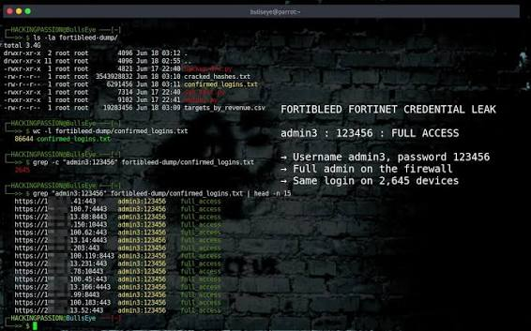
TLP:RED
HKIB · THE VULNERABILITY
The 2021 dump
In September 2021, a threat actor published SSL-VPN access details for roughly 87,000 FortiGate devices — usernames and passwords scraped from systems still unpatched at the time of scanning.
Patching alone wasn’t enough after the fact: a password scraped before the patch stayed valid until someone reset it. Fortinet’s own advice was patch, reset, and turn on MFA — all three, not one.
A researcher’s replay of the leaked-credential dataset — full administrative access from a single reused password.

Slide 21
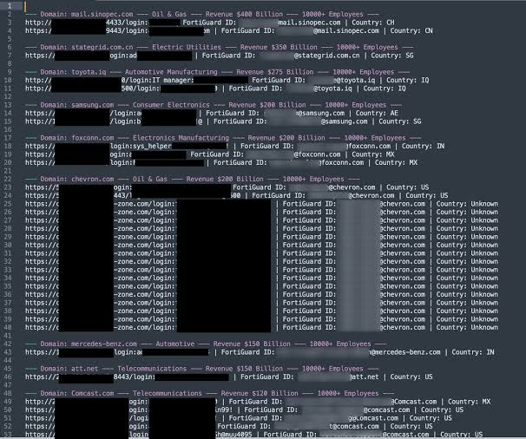
TLP:RED
HKIB · THE VULNERABILITY
The scale of it
Oil & gas, telecoms, automotive, electronics, government-linked entities — this was opportunistic mass scanning, not a targeted intrusion against any one sector.
HKIB — a financial-sector training body, not a bank itself — was simply one more internet-facing SSL-VPN in that same exposed population.
The leaked dataset spanned industries and geographies indiscriminately.

Slide 22
TLP:RED
HKIB · BACKGROUND
Two and a half years later, still exposed
2.5 years
Day 0 → Day 1
113,000+
between the 2019 patch and exploitation here — the same gap PCPD’s report calls out
from stolen VPN credentials to ransomware executed across the domain — well under 24 hours
individuals affected, per PCPD’s own published report (R23-6319)
This is the same case already on the enforcement-notice count you saw in Part 1: 2022 · 1 (HKIB).
CVE-2018-13379 — a FortiGate SSL-VPN information-disclosure flaw that leaks valid session credentials to an unauthenticated attacker.

Slide 23
TLP:RED
HKIB · TIMELINE (SANITIZED)
Four stages, one very fast escalation
Stage | What happened
Infiltration | Stolen SSL-VPN session credentials, obtained via the FortiGate vulnerability, used to log in as a valid user — no malware needed to get in the door
Privilege Escalation | A privilege-escalation attempt against the domain controller failed — a patch HKIB had applied actually held. The attacker fell back to password spraying and succeeded on a different account.
Lateral Movement | RDP used to move to multiple servers and endpoints; a new account added to a privileged group for persistence; endpoint anti-virus disabled ahead of deployment
Ransomware Execution | Deployed across servers and endpoints the same day — LockBit 2.0

Slide 24
TLP:RED
HKIB · RECOMMENDATIONS
Seventeen findings, two kinds of gap
HYGIENE
BEST PRACTICE
Stale service-account passwords, unchanged for years
End-of-life systems still in production
Domain admin accounts used for daily work
Weak, crackable passwords in use
No formal patch / vulnerability-management cycle
Local admin credentials shared across endpoints
Outstanding containment actions left incomplete
No dedicated security function or framework
No network segmentation between zones
No 24×7 monitoring or threat intelligence
No tested disaster-recovery / BCP plan
No data-loss-prevention controls
No log retention on critical infrastructure
Incident response never formally documented
No EDR — antivirus only
No asset inventory or classification
Pen tests never covered internal infrastructure

Slide 25
TLP:RED
HKIB · PCPD ALIGNMENT
PCPD recommends what the technical work already found
This is the pattern worth remembering: PCPD’s public recommendations after an incident are rarely novel — they’re close to what the incident responders already told the client to fix, sometimes months earlier.
The gap PCPD calls out and the gap our own findings called out are the same gap. The regulator isn’t discovering something new; it’s confirming what internal work already knew.
One honest limit: limited host-based logging left some lateral-movement questions at “assessed, not confirmed” — a real forensic limit, not a gap papered over.

Slide 26
TLP:RED
PULSE CHECK
CNCBI and HKIB were both compromised through a vulnerability, not a phishing email. One triggered a PCPD investigation; the other didn’t.
WHY DO YOU THINK THAT IS THE CASE?
CS5292 · Week 3 · Part 2 · TLP:RED · 05

Slide 27
TLP:RED
CASE 3
The most detailed case, deliberately last, told from two real angles I worked: Angle A, the technical incident responder chasing the attacker. Angle B, months later, the independent reviewer checking whether the fix actually held.
Cyberport.
CS5292 · Week 3 · Part 2 · TLP:RED · 06

Slide 28
TLP:RED
ANGLE A · TECHNICAL INCIDENT RESPONSE
Same job as CNCBI and HKIB: request the assets, follow the forensics, verify containment and eradication actually held — not just that they were reported as done.
Chasing the
Attacker.
CS5292 · Week 3 · Part 2 · TLP:RED · 07

Slide 29
TLP:RED
ANGLE A · BACKGROUND
Exposed remote access, a recovered credential
Day 0
Same day
Trigona
login via exposed remote desktop, a recovered admin credential
remote-access and cloud-sync tools deployed for persistence
the ransomware group — more on them shortly
Cyberport discovered the encryption internally, before any outside notification — then, separately, learned the data had also been posted for sale.
PwC was engaged through Cyberport’s outside counsel once the leak-site posting confirmed this was more than a contained ransomware event.

Slide 30
TLP:RED
ANGLE A · INITIAL ACCESS
How they actually got in
The forensic finding is precise but incomplete: the threat actor logged in through an exposed, internet-facing remote-desktop service using a recovered administrative credential. “Recovered” — not a confirmed live brute-force crack.
The best explanation on the record: a parallel scan of Cyberport’s wider internet footprint found leaked and reused credentials on other public-facing portals — the kind of exposure that hands an attacker a working password without ever guessing one.
This matters for how you frame a finding: state what the evidence actually shows, not the version that makes the best story. “Recovered, likely via credential reuse” is honest; “brute-forced” is a guess dressed up as a fact.

Slide 31
TLP:RED
Data moved first — encryption came over a week later, in two waves
When | What happened
Day 0 | Initial access via the exposed remote-access service; remote-access and cloud-sync tools deployed same day
Day ~4–5 | Tens of thousands of files staged from one file-server share, synced out via the cloud tool over several days
Day ~7–8 | Wave 1 — Windows servers and domain infrastructure encrypted
Day ~12 | Wave 2 — virtualization hosts encrypted, a deliberate second push
~Day 30 / ~Day 73 | Cyberport listed on the leak site / months later, pro-Ukraine hacktivists took Trigona’s own leak site offline

Slide 32
TLP:RED
ANGLE A · RESPONSE
Eight containment actions, all completed
Network-wide blocking of the threat actor’s known infrastructure; highest-risk hosts shut down to cut off re-access.
The remote-access tool the attacker abused was blocked outright; inbound remote-desktop access blocked at the perimeter.
Every compromised account reset or disabled; IOCs removed host by host; admin ports (RDP, SSH, FTP) closed externally.
Findings from a parallel perimeter scan addressed in the same pass, not deferred.

Slide 33
TLP:RED
ANGLE A · THREAT ACTOR
Who is Trigona
RaaS since 2022
Double extortion
Opportunistic
a newer ransomware-as-a-service operation, active from mid-2022
encrypt and threaten to leak — the classic playbook, unlike CL0P’s MOVEit approach
exposed remote-access and database services, not a specific sector or region
Trigona affiliates are known to exploit a mix of known vulnerabilities and weak or reused credentials on exposed services — consistent with what happened here.
Financially motivated, double-extortion by design: encrypt and threaten to leak, rather than either alone.

Slide 34
TLP:RED
ANGLE A · THREAT INTEL
Mapped against MITRE ATT&CK, not just prose
Tool observed | MITRE ATT&CK technique
A network-discovery utility, run to enumerate hosts and services | T1046 — Network Service Discovery
A log-cleaning tool, used to clear Windows event logs on multiple hosts | T1070.001 — Indicator Removal: Clear Windows Event Logs
A remote-access utility, installed across multiple endpoints | T1570 — Lateral Tool Transfer
All tools here are legitimate, publicly available software, repurposed for malicious use.

Slide 35
TLP:RED
ANGLE A · RECOMMENDATIONS
Four categories, one theme underneath all of them
Category | What we found, and recommended
Perimeter housekeeping | A remote-access service was exposed with no additional hardening (SSO/VPN, MFA, IP allow-listing) — add it
Endpoint & identity controls | Security software lacked tamper protection — enable it, and build in defense-in-depth
Network segmentation | Core infrastructure sat reachable from the general environment — isolate production from hypervisors
Privileged-account hygiene | 20 domain admin accounts found; 4 hadn’t rotated in 1–2 years — house-keep and tier access
That last row should sound familiar — the same stale-privileged-account pattern shows up across nearly every case in this course, this engagement included.

Slide 36
TLP:RED
PULSE CHECK
Cyberport completed all 8 containment actions and 16 recommendations from the incident report — and still ended up with a public PCPD Enforcement Notice.
RAISE YOUR HAND IF “WE FIXED IT AFTER” SHOULD COUNT FOR ANYTHING IN HOW PCPD WEIGHS A CASE
CS5292 · Week 3 · Part 2 · TLP:RED · 08

Slide 37
TLP:RED
ANGLE B · REVIEWING AGAINST THE EN
Months later, a different engagement entirely. Not “what happened” but “does this control actually work” — documentation, interviews, and samples, not forensic artefacts.
Checking
the Fix.
CS5292 · Week 3 · Part 2 · TLP:RED · 09

Slide 38
TLP:RED
ANGLE B · THE SHIFT
Control design vs. operating effectiveness
As incident responder (Angle A)
As independent reviewer (Angle B)
I request assets, follow forensic evidence, and keep asking questions until containment and eradication are actually verified.
I request documentation and samples, and ask a different question: is the control well designed, and is there evidence it actually operates that way in practice.
The gap between the two is real: a forensic investigator pulls the control’s actual output directly. A reviewer, months later, is one step removed — asking for evidence of that output instead.
The job is closing that gap as much as possible: asking for the sample that sits as close to the real control output as you can get. That takes real technical know-how — knowing what evidence would actually prove the point, not just what’s easy to hand over.

Slide 39
TLP:RED
ANGLE B · THE ENFORCEMENT NOTICE
What PCPD actually ordered Cyberport to do
# | Requirement
1 | Thoroughly review the security of every system holding personal data, with effective detection in place
2 | Implement MFA for all remote users accessing its information systems
3 | Engage an independent expert for an annual risk assessment and security audit
4 | Put in place clear, comprehensive information-security policies covering prevention, detection, and response
5 | Delete all personal data already held past its retention period
6 | Set a clear, specific data-retention policy with defined deletion procedures
7 | Implement measures to ensure staff actually comply with the above
Two months from the date of the notice to comply — and to prove it. Source: PCPD Investigation Report R24-12170 (public).

Slide 40
TLP:RED
ANGLE B · THE RFI
Turning each order into a real ask
PCPD’s requirement | What I’d actually request
MFA, all remote users | The full list of remote-access paths, then per path: enrollment logs proving MFA on every account, plus the exception list and how exceptions are compensated for
Annual risk assessment | The assessment report itself, its scope statement, and the reviewer’s engagement letter — is the scope as wide as the notice implies?
Delete + retention policy | The retention policy document, then a sample of actual deletion logs or disposal records — not a description of the policy
Staff compliance measures | Training completion records or attestations, sampled across business units — not just the training deck

Slide 41
TLP:RED
ANGLE B · BACKGROUND
Same client, a different scope entirely
Same client
Documentation-led
Built around the EN
A separate engagement, months after the incident-response work above had already concluded.
Policies, interview notes, and evidence samples this time — not forensic artefacts.
Scoped directly to what the Enforcement Notice required Cyberport to demonstrate.
Engaged through the same outside counsel as the incident response, once containment and eradication work had already concluded.
The question an Enforcement Notice actually poses isn’t “did you fix it” — it’s “show us the evidence that you did.”

Slide 42
TLP:RED
ANGLE B · METHODOLOGY
How you actually test operating effectiveness
Read the policies
Interview the owners
Plans, procedures, standards, technical specs — this establishes design, not proof of practice.
The people who actually designed and run each control — not just the policy’s author.
Pull a sample, not a claim
Get as close to control output as you can
Actual disposal records, actual sign-offs, actual test results — evidence, not an assertion that it happened.
The closer the sample sits to what the control actually produces, the harder it is to fake — see the MFA example next.

Slide 43
TLP:RED
ANGLE B · EXAMPLE 1
MFA isn’t a yes/no question
Don’t start with “do you have MFA.” Start with “what is every asset reachable remotely from the internet” — VPN, M365, a VDI gateway, but also anything else: an exposed database, an admin portal, a server nobody remembers is internet-facing. Trigona’s own entry point here was exactly that kind of overlooked asset.
Then drill into each one: is MFA enforced for every account on that asset, with no exceptions? If there are exceptions, what compensates — a strong, rotated password, IP allow-listing, heightened monitoring on that account?
A single “yes, we have MFA” answer, without the asset-by-asset drill-down, is exactly the kind of claim a reviewer with real technical know-how doesn’t accept at face value.

Slide 44
TLP:RED
ANGLE B · EXAMPLE 2
Proving “yes,” not just claiming it
Say a notice requires deleting personal data past its retention period. Reading the retention policy only proves the rule exists on paper — it proves nothing about whether it was followed.
Proving it takes a sample: pulling actual disposal records and checking them against what should already be gone, not accepting a written assurance that it happened.
That’s the whole distinction in practice: design is “there’s a policy.” Operating effectiveness is “here’s the sample we pulled, and here’s what it showed.”

Slide 45
TLP:RED
ANGLE B · THE SHAPE OF A RESULT
What a review like this typically concludes
Across a notice with several requirements, an organisation responding seriously to a regulator tends to land in the middle: most items rated cleanly effective, a handful rated “effective, a different route,” very few rated as outright failing.
That shape matters for how a regulator weighs a case — a notice met mostly through genuine, verified controls reads very differently than one met on paper only.
It’s also why this section can’t hand you a scoreboard: the actual ratings are the client’s confidential work product. What’s transferable is the method, not the marks.

Slide 46
TLP:RED
ANGLE B · PCPD ALIGNMENT
Two independent sources, the same underlying picture
What the incident work found (Angle A) | What PCPD’s public report found
No tamper protection; attacker disabled security software | Single-layer anti-malware, disabled by the attacker
No MFA on the exposed remote-access service | No MFA on remote access
Stale privileged accounts, one unrotated over a year | Related access-control weaknesses in the enforcement findings
The EN-compliance review, months later, tested whether these actually got fixed. Its findings are confidential work product — the method behind it (design vs. operating effectiveness, sample testing) is the lesson.

Slide 47
TLP:RED
PART 2 · CLOSING THOUGHT
Why some breaches become PCPD cases
PCPD doesn’t investigate or issue an enforcement notice on every breach it hears about. We don’t know their exact selection criteria — only what’s publicly visible: heightened attention when children’s personal data is involved, and cases that started from a complaint tend to get looked at.
That uncertainty cuts one way, not the other: every organisation has to treat its own breach response as if it could be the one selected, because how you handle containment, evidence, and disclosure is very likely what ends up reflected in PCPD’s findings and recommendations if it is.
That’s the real takeaway for this course: the quality of your incident work and your compliance posture is what determines how well-prepared you are — whether or not PCPD ever comes knocking.

