Slide 1
CreditWise Loan Approval System
Intelligent Loan Approval Prediction Using Machine Learning
Famid Khandoker • Md. Ryin Akand
Department of Computer Science & Engineering
Bangladesh University of Business & Technology (BUBT)
Dhaka, Bangladesh

Slide 2
Table of Contents
Project presentation overview
01
02
Introduction & Motivation
Problem Statement & Objectives
03
04
Dataset Analysis
Data Pre-processing & Feature Engineering
05
06
Methodology & Machine Learning Models
Exploratory Data Analysis
07
08
Model Performance & Comparison
Decision Tree Visualization
09
Conclusion & Future Direction
CreditWise Loan Approval System • 2

Slide 3
Introduction, Problem & Objectives
Introduction
Problem Statement
Objectives
Loan approval depends on financial, credit, employment and demographic information. Manual assessment can be slow and inconsistent. CreditWise uses machine learning to support preliminary approval prediction.
Large numbers of applications require systematic analysis. A data-driven model can learn patterns from historical applications and provide consistent preliminary predictions.
• Analyze applicant data • Clean and transform features • Perform EDA • Train 3 classifiers • Compare Accuracy, Precision, Recall and F1-score
CreditWise Loan Approval System • 3

Slide 4
Dataset Analysis & Pre-processing
Preparing applicant data for reliable classification
Dataset Features
Feature Engineering
Personal: Gender, Marital Status, Education Financial: Applicant/Coapplicant Income, Savings Risk: Credit Score, DTI Ratio, Existing Loans Other: Employment Status, Loan Purpose, Property Area
DTI_Ratio_sq = DTI_Ratio² Credit_Score_sq = Credit_Score² Applicant_Income_log = log(1 + Applicant_Income) These transformations capture nonlinear patterns.
Pre-processing
Target Variable
• Missing values: mean/mode imputation • Removed Applicant_ID • Label/One-Hot Encoding • Train-test split • StandardScaler for numerical features
Loan_Approved 1 = Approved 0 = Rejected The processed features are used as input to the classification models.
CreditWise Loan Approval System • 4

Slide 5
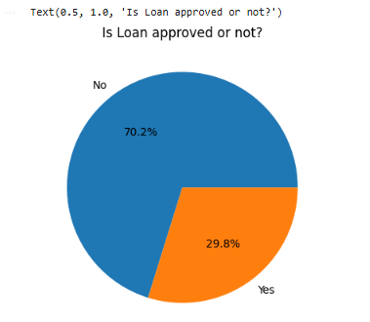
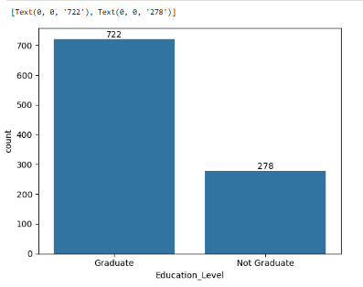
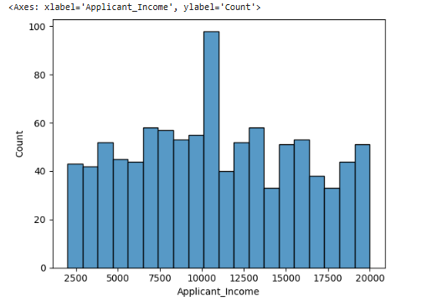
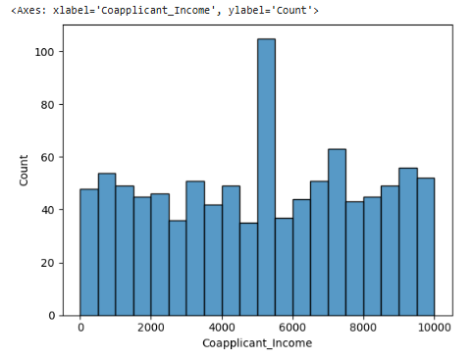
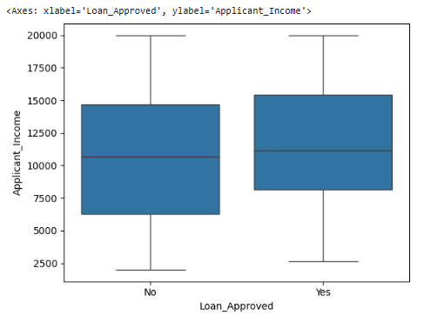
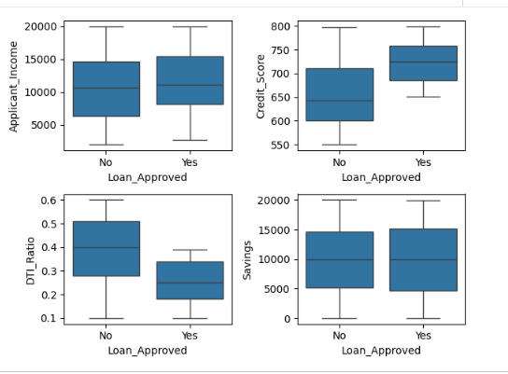
Exploratory Data Analysis
Visual inspection of the applicant dataset
CreditWise Loan Approval System • 5

Slide 6
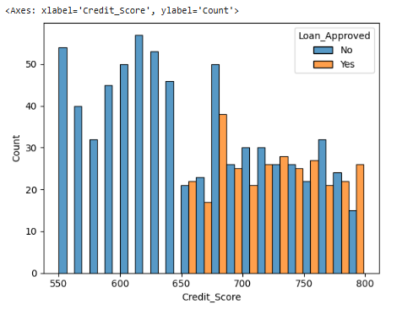
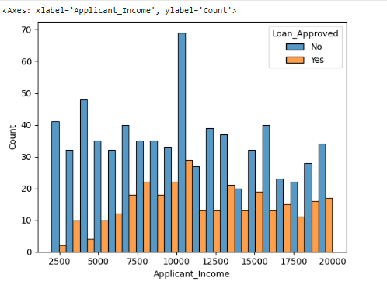
Outlier & Correlation Analysis
Understanding relationships among important variables
Key takeaway
Correlation analysis helps identify relationships between numerical features and loan approval; boxplots highlight spread and potential outliers.
CreditWise Loan Approval System • 6

Slide 7
Methodology & Machine Learning Models
1
2
3
4
5
6
7
Dataset
Pre-processing
EDA
Feature Engineering
Scaling
Model Training
Evaluation
Logistic Regression
K-Nearest Neighbors
Gaussian Naive Bayes
Binary classifier that estimates approval probability. Strong baseline and interpretable.
Distance-based classifier. Scaling is important because predictions depend on feature distances.
Probabilistic classifier based on Bayes' theorem with Gaussian feature assumptions.
CreditWise Loan Approval System • 7

Slide 8
Model Performance
Three-model comparison using four evaluation metrics
Model | Accuracy | Precision | Recall | F1-Score
Logistic Regression | 86.50% | 78.33% | 77.05% | 77.69%
KNN | 76.00% | 62.75% | 52.46% | 57.14%
Gaussian Naive Bayes | 86.50% | 80.36% | 73.77% | 76.92%
Interpretation
Logistic Regression and Gaussian Naive Bayes both achieved 86.5% accuracy. Gaussian Naive Bayes had the highest precision (80.36%), while Logistic Regression led in recall (77.05%) and F1-score (77.69%).
CreditWise Loan Approval System • 8

Slide 9
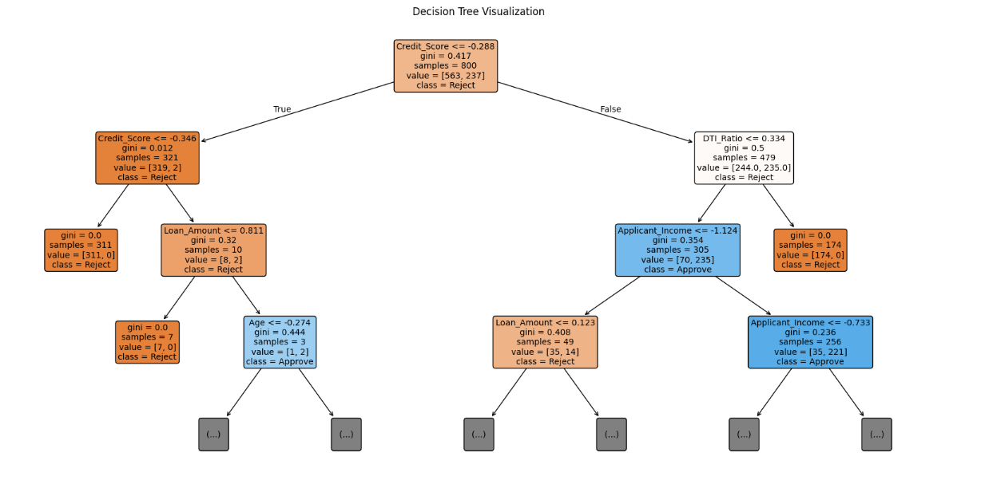
Decision Tree Visualization
Separate visualization for understanding hierarchical feature-based decisions
What it shows
Each node applies a feature threshold; branches lead to progressively more specific approval/rejection decisions.
Why separate?
The reported numerical comparison uses Logistic Regression, KNN and Gaussian Naive Bayes. The Decision Tree is shown as an additional model visualization.
Key idea
Tree visualization improves interpretability of rule-based decisions.
CreditWise Loan Approval System • 9

Slide 10
Conclusion & Future Direction
Conclusion
Future Direction
• CreditWise demonstrates a complete ML pipeline for loan approval prediction. • Logistic Regression and Gaussian Naive Bayes achieved 86.5% accuracy. • Gaussian Naive Bayes achieved the highest precision. • Logistic Regression achieved the best recall and F1-score. • KNN performed lower on this dataset.
• Hyperparameter tuning and cross-validation • ROC-AUC analysis • Explainable AI for transparent decisions • Fairness and bias analysis • FastAPI/Flask deployment • Web or mobile prediction interface • Real-time applicant prediction
Thank You

