Slide 1

AI-Driven Non-Financial Risk Prediction and Control Effectiveness System for Banking
Capstone Project – Post Graduate Diploma in Artificial Intelligence & Machine Learning
Submitted by: GAT
School: Asian Institute of Management (AIM) – Emeritus

Slide 2

Business and Data Science Problem
Business Problem
Data Science Problem
Banks face thousands of non-financial risk events yearly: system outages, fraud, compliance breaches, vendor failure.
This could lead to financial losses, customer impact, regulatory sanctions, reputational damage.
Traditional tools are backward-looking and reactive.
There is a need for proactive and predictive risk management to prevent losses and to have more effective resource allocation.
Predict whether a non-financial risk event will occur within the next 30 days (Event Occurrence, target_event_30d).
Estimate the potential severity of such events (Severity Amount, target_severity_amt).
Explains model decisions in a transparent and auditable manner.

Slide 3
Dataset Preparation and EDA
Observations | Handling Strategy
‘date’ feature is an ‘object’ | Change to ‘datetime’
‘incident_narrative’ column has missing values | Create binary indicator (has_incident_narrative) Replace null values with “No narrative’
No duplicates | N/A
Mean of the 'target_event_30d' column is approximately 4% | Potential class imbalance but this is the nature of NFR. Accept and include in interpretations.
'sum_loss_amt_365d' and 'target_severity_amt’ columns are highly skewed | Expected in NFR context. Most days, there are no loss but when it occurs, loss could be significant. Accept and include in interpretations.
Outliers are identified for several columns | Outliers represent critical rare events or extreme operational conditions relevant to risk modeling. Keep and include in interpretations.
Synthetic dataset
10,000 records | 120 units | 2-year span
Structured risk indicators (KRI, RCSA, HR, IT, external signals) + narratives

Slide 4
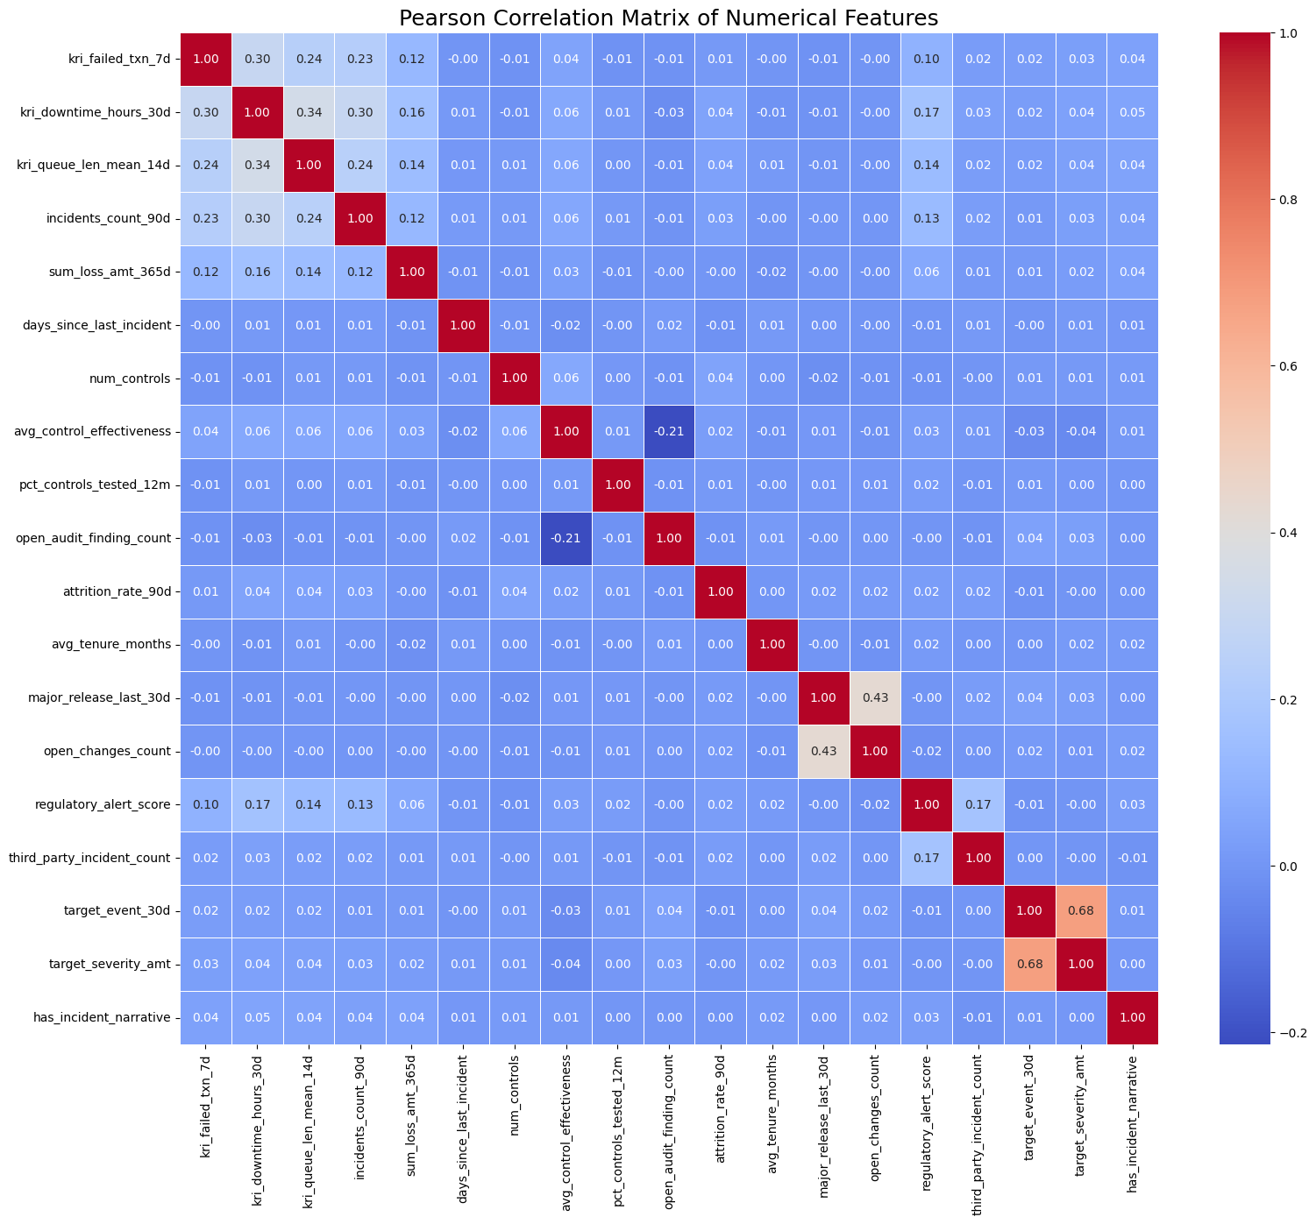
Feature Engineering
Observations | Feature Engineering
High correlation between the two Target Variables (target_event_30d and target_severity_amt) | Logically the nature of operational events and the dataset. No further feature engineering .
Weak correlations of other variables with Target Variables | Feature engineer: How much unresolved audit pressure exists relative to how strong the controls are?: audit_pressure = open_audit_finding_count / (avg_control_effectiveness + ε) How stressed the change environment is during a major system release?: change_stress = major_release_last_30d × open_changes_count How overloaded the operational process is?: ops_stress = kri_failed_txn_7d × kri_queue_len_mean_14d How often incidents are occurring in an environment with weak controls?: control_gap = (1 − avg_control_effectiveness/5) × incidents_count_90d
Heavily skewed distributions | This reflects that most days have no loss, but when losses occur, they can be substantial. Feature engineer: Is this business unit experiencing an unusually high volume of transaction failures?: high_failed_txn_flag = 1 if kri_failed_txn_7d > 90th percentile Has the system experienced unusually severe or prolonged downtime recently?: high_downtime_flag = 1 if kri_downtime_hours_30d > 90th percentile Is this business unit experiencing high incident counts? high_incidents_flag = 1 if incidents_count_90d > 90th percentile
Dataset has high dimensionality and complexity | The low variance indicates that operational risk is inherently high-dimensional. As such, dimensionality reduction will not be applied to the final models.

Slide 5
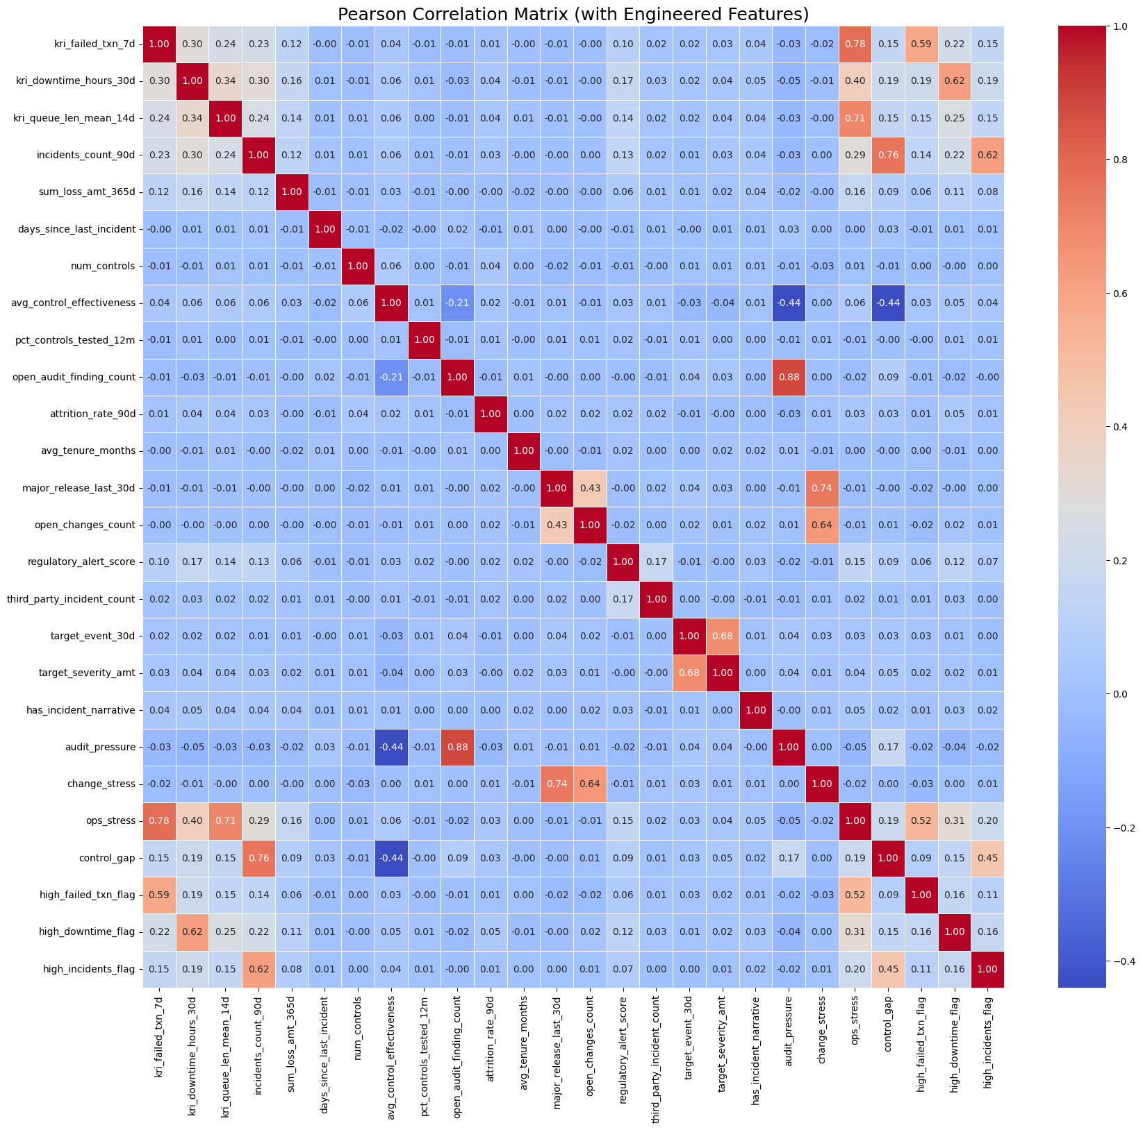
After Feature Engineering
Several of the engineered features show improved or more meaningful correlations with the target variables compared to their individual components.
This indicates that the feature engineering efforts have been successful in creating stronger signals for risk prediction.

Slide 6
Modeling (Event Occurrence – Classification)
ROC-AUC provide limited insight. Note that dataset is imbalanced, with approximately 4% positive events. Accepted in NFR context.
PR-AUC values are low, which is expected given the rarity of events and the weak marginal signal of individual risk indicators.
Recall@Top-10% is the metric that is more aligned with the ability to prioritize risk within constrained investigative capacity.
Decision: LightGBM is the best model to use.
Next Step: Across all evaluated models, ROC-AUC values are close to 0.5 , use tuning threshold to check if ROC-AUC will improve.
Objective: Predict whether a non-financial risk event will occur within the next 30 days
index | ROC-AUC | PR-AUC | Recall | Recall@Top-10%
LightGBM | 0.49443526 | 0.04035478 | 0.01265823 | 0.13924051
Logistic Regression | 0.52948425 | 0.04168236 | 0.36708861 | 0.08860759
Random Forest | 0.47994518 | 0.03739842 | 0 | 0.07594937
Decision Tree | 0.49582232 | 0.0392383 | 0.03797468 | 0.08860759
SVC | 0.46668072 | 0.03611753 | 0.15189873 | 0.06329114

Slide 7
Modeling (Event Occurrence – Classification, After Tuning)
index | Optimal Recall Threshold | Optimal Recall | Optimal Recall@Top-10% Threshold | Optimal Recall@Top-10%
LightGBM | 0.05 | 0.63291139 | 0.05 | 0.13924051
Logistic Regression | 0.05 | 1 | 0.05 | 0.08860759
Random Forest | 0.05 | 0.27848101 | 0.05 | 0.07594937
Decision Tree | 0.05 | 0.03797468 | 0.05 | 0.08860759
SVC | 0.05 | 0.01265823 | 0.05 | 0.06329114
Threshold tuning significantly improved the ability of models to detect rare non-financial risk events.
Logistic Regression achieved perfect recall after threshold tuning but this came at the expense of meaningful risk prioritization.
Decision: LightGBM - provides the best balance between high event detection and effective concentration of true events within the top-risk segment, making it the most suitable model for non-financial risk management.

Slide 8
Modeling (Severity Amount - Regression)
Loss severity data in NFR is typically highly skewed and heavy-tailed.
Mean Absolute Error (MAE) - reflects typical prediction error.
Root Mean Squared Error (RMSE) - penalizes large deviations more heavily.
In NFR, where understanding and explaining the drivers of loss magnitude is critical, MAE is the better metric to consider.
Model Choice: LightGBM - achieves the lowest MAE.
Objective: Estimate the potential severity of events that will occur within the next 30 days
index | RMSE | MAE
LightGBM | 12907.0186 | 7765.67504
Linear Regression | 12310.5532 | 8256.58213
Random Forest | 12797.7757 | 8202.28299
Decision Tree | 15250.3297 | 10554.4323

Slide 9
Addressing Limitations and Ethical AI
Addressing Limitations
Ethical AI
Class Imbalance
  NFR events are rare (~4%), which can cause under detection.
  Addressed through: stratified sampling, class weighting, and probability threshold tuning.
  Ensure material risk events are prioritized within limited review capacity.
Target Leakage
  Preserve predictive integrity.
  Addressed through: severity amount feature was excluded from event prediction, event occurrence was excluded from severity amount modeling.
  Ensure all predictions are forward-looking and decision-relevant.
Overfitting
  Prevent the models from learning noise or historical artefacts.
  Addressed through: independent train–test evaluation, model regularization, and the use of ensemble tree-based methods. Conservative learning behavior was applied.
  Ensure stable performance on unseen data.
Current Scope
  Synthetic data contains no direct sensitive attributes, so demographic bias testing is not applicable.
Potential Bias Risks
  Business units, HR indicators, historical patterns, and incident narratives may act as indirect proxies in real-world data.
Fairness Governance
  Monitor prediction parity, error rates, and threshold impacts across identified proxy groups.
Mitigation Controls
  Apply debiasing techniques, fairness-aware validation, careful feature design, and ongoing monitoring.
Risk Committee Assurance
  The model framework is designed to support fair, explainable, and regulator-ready deployment.

Slide 10
Business Impact and Results
Priority Business Units
Potential Loss Avoided
UNIT_116
UNIT_112
UNIT_045
UNIT_098
UNIT_070
UNIT_051
UNIT_090
UNIT_017
UNIT_032
UNIT_103
The AI-Driven NFR Prediction Model forecasted that NFR events will occur in the next 30 days.
These are the top 10 business units that should be prioritized because of highest predicted probability.
Focus on proactive measures, mitigation strategies, and effective control design and implementation.
$7.6 M
This figure represents the projected financial loss should risk events materialize within the top 10 prioritized business units.

Slide 11
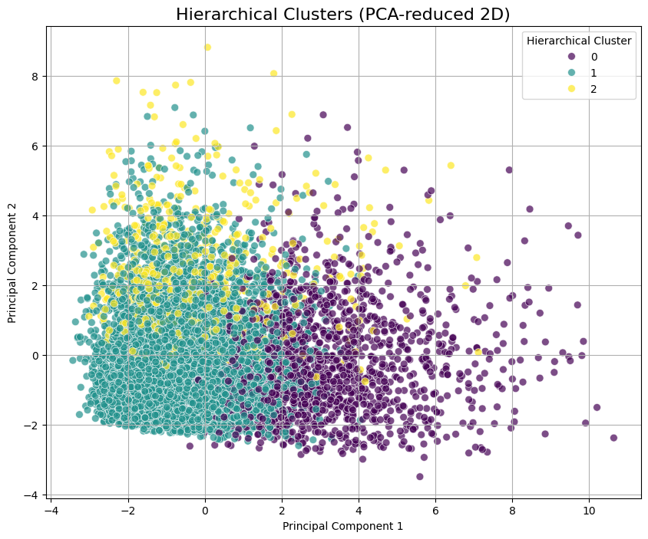
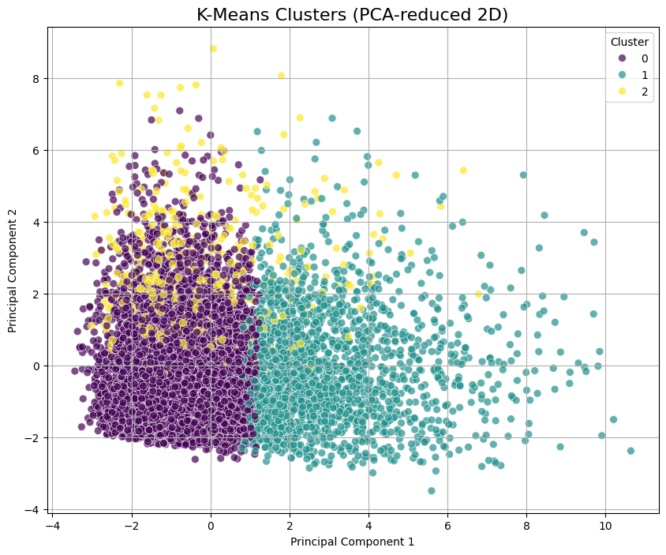
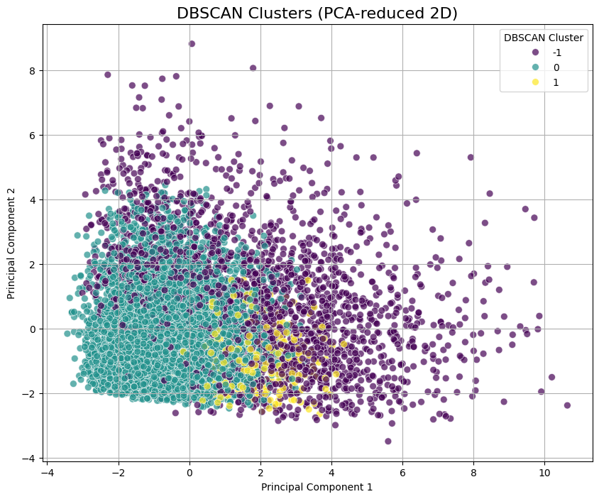
Experimentation: Unsupervised Learning
If we must choose: Hierarchical Clustering
  Higher Silhouette Score and balanced cluster structure indicate better internal cohesion and separation, which is desirable for exploratory segmentation of risk profiles.
However:
  Silhouette Scores across all methods highlight that NFR data does not naturally form strongly separable clusters.
  This reflects the complex, overlapping, and multi-factor nature of operational and non-financial risks.
Conclusion:
  Use unsupervised clustering as an exploratory and complementary analysis, not a core predictive mechanism.
index | Sil Score
K-Means | 0.214
DBSCAN | 0.182
Hierarchical Clustering | 0.239

Slide 12
Experimentation: Recommender System and Deep Learning
Recommender System
Deep Learning
Suitability for NFR - content-based recommendation approach (instead collaboration)
Data Preparation and Risk Profiling
  24 relevant numerical risk indicators (excludes identifiers and target variable to prevent leakage)
  120 distinct business unit profiles
  Scaled to ensure comparability
Similarity computation – Cosine similarity used for comparing high-dimensional feature vectors
Implementation and Validation - Testing the system using UNIT_001 successfully returned a ranked list of five peer units with closely aligned risk profile.
For further study: Incorporate textual data, dynamic profiles, hybrid similarity metrics
Deep learning models were not performed due to limited data volume, tabular feature structure, and the need for transparent, auditable explanations in a non-financial risk context.
Area for Further Study for NFR: Management: Deep learning techniques are most appropriate for non-financial risk applications involving unstructured or sequential data, such as incident narratives, regulatory communications, and time-series escalation patterns.

