Slide 1
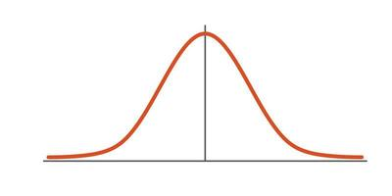
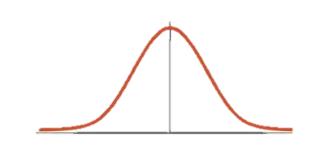
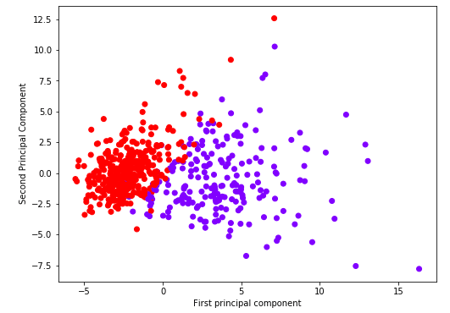
SMILES | PKM2 Inhib. | ERK2 Inhib. | Feature i | → N=209
C=C(C)c1nc(N)… | 1 | 0 | x | …
C=CCNC(=O)… | 0 | 1 | y | …
↓ N=1116 | … | … | … | …
SMILES | PKM2 Inhib. | Feature i | → N=209
C=C(C)c1nc(N)… | 1 | … | …
C=CCNC(=O)… | 0 | … | …
↓ N=1116 | … | … | …
SMILES | ERK2 Inhib. | Feature i | → N=209
C=C(C)c1nc(N)… | 0 | x | …
C=CCNC(=O)… | 1 | y | …
↓ N=1116 | … | … | …
Mann-Whitney U Test
H0: µ0 = µ1, H1: µ0 ≠ µ1 p-value < 0.05
Nfeatures = X
Nfeatures = X
70/30 Train/Test Split
70/30 Train/Test Split
PCA: Training
PCA: Testing
PCA: Training
PCA: Testing
Ncomponents = X
Ncomponents = X
ML Model Training
ML Model Training
ML Model Testing
ML Model Testing

