Slide 1
PRICING ANALYST BUSINESS CASE · BUDGETAIR.US · 2022 ORDERS
The Aeroprice fee change:
what it really cost us — and what to do next
Impact analysis of the October 2022 Aeroprice channel-fee change · 120,396 orders · every number reproducible
Live dashboard · streamlit.app
Ask the data · Claude MCP server
Code & data · GitHub
Felicity Fan · July 2026

Slide 2
The 'cheaper' new contract would have cost us $131,696 on 2022's orders
+$131,696
58.5%
−58.5% vs −5.1%
≥ $10.50
Extra cost, full year — same orders priced under both fee schemes
of Aeroprice orders pay more under the new terms
cheap-fare volume after the change: Aeroprice vs a channel with no fee change
partner fee avoided per budget order won back on our own Direct site
The story in four sentences
1
The new contract looks cheaper — lower percentage, lower cap — but its brand-new $10.50 minimum fee lands on 58.5% of the channel's orders: cheap tickets that were already barely profitable.
2
On the sales mix we actually had, it costs +$131,696 a year. On the post-change mix it looks roughly neutral (−$1,768) — only because the punished cheap-fare segment had already left.
3
Cheap fares collapsed in Aeroprice (−58.5%) while a comparable channel with no fee change barely moved (−5.1%). Most of that demand was not recaptured by our other channels — it likely went to competitors.
4
Our response: segment the channel — stop competing on sub-$262 fares in Aeroprice, reinvest the savings on expensive fares, reclaim budget fares via Direct, and renegotiate tiered terms (details: slide 12).
Executive summary · budgetair-fee-analysis.streamlit.app 2

Slide 3
From 12 monthly files to one auditable dataset
The compiling process behind the two deliverable CSV files — every step scripted, flagged, and reproducible.
12 monthly CSVs 120,396 orders, Jan–Dec 2022
Three data decisions, stated up front
Zero-value tickets. 362 orders (0.3%) have a $0 ticket — a percentage fee is undefined on them. Flagged and excluded from fee maths, kept in the data for transparency.
Clean & flag 362 zero-ticket orders flagged, not deleted
Total ticket value. Defined as base fare + tax — the base the percentage, floor and cap apply to.
Fee engine old & new scheme applied to every order
Margin. Treated as net of all costs including the actual fee paid. So the impact is measured as a counterfactual, not by comparing accounting lines.
2 deliverable CSVs order-level fact table + impact summary
Reproducible by design. One script (analysis.py) rebuilds both CSVs and prints a validation block; the dashboard and the AI interface recompute every number from those files. Automated QA: 47/47 checks against the deployed app.
Dashboard · MCP both read the same outputs
Task 1 · Data & method · budgetair-fee-analysis.streamlit.app 3

Slide 4
Method: same orders under both price schemes, plus a no-change control channel
How we measure the cost
How we measure the behaviour
Apply both fee schemes to the same orders and compare. Because the orders are identical, the difference is purely the contract — seasonality, demand and mix are all held constant.
Volumes shift with seasons, so a before/after comparison alone would mislead. We compare Aeroprice against Google Flights — a comparable channel whose fee did not change. Any drop in Aeroprice beyond the control channel's is attributable to the fee change, not the season.
 | Rate | Minimum | Maximum
Old (before 1 Oct) | 4.0% | $0 | $24.00
New (from 1 Oct) | 3.8% | $10.50 | $19.00
Assumptions, stated and locked
A1 Total ticket value = base fare + tax. A2 Fee applied per order — per-passenger shown as a sensitivity (appendix: it would be worse, +$231k). A3 Fee formulas exactly as in the contract table above. A4 Margin is net of all costs, incl. the fee actually paid. A5 Fee terms are known only for Aeroprice — no fee is estimated for any other channel.
Task 1 · Data & method · budgetair-fee-analysis.streamlit.app 4

Slide 5
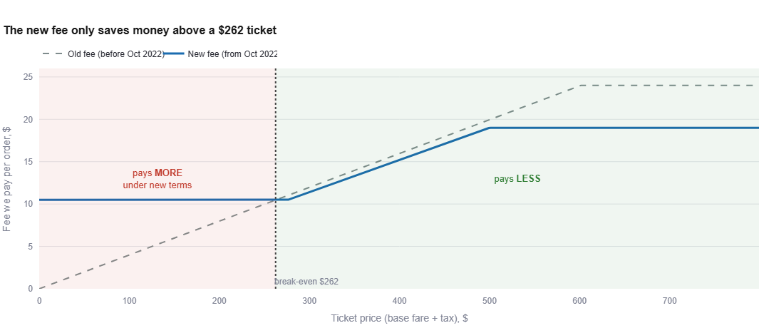
Below a $262 ticket the new terms charge more — and 58.5% of our orders live there
Why $262.50? It is the exact break-even where the new $10.50 minimum equals the old 4% fee ($10.50 ÷ 4%). A $100 ticket used to pay $4.00; it now pays $10.50. The savings only start above $262 — where the lower rate and the $19 cap beat the old terms — but expensive tickets are the minority of the channel.
The mechanics · budgetair-fee-analysis.streamlit.app 5

Slide 6
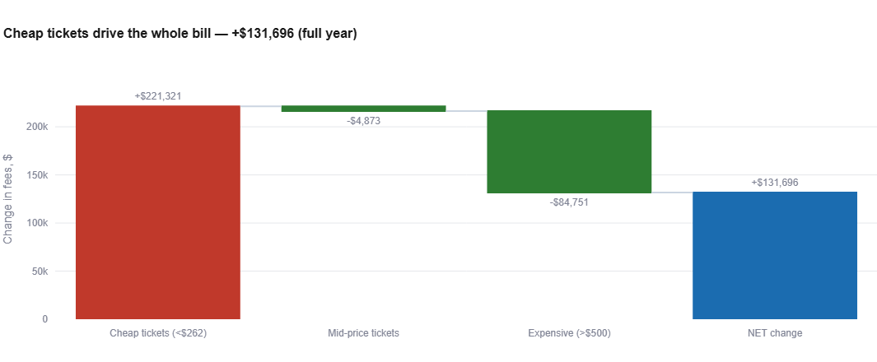
On the year we actually sold, the new fee costs +$131,696 — a third of channel profit
+$131,696
full-year extra cost (same orders, both schemes)
−$1,768
on the after-change mix only (Oct–Dec) — roughly neutral
+31.8%
of the full-year margin earned on the channel
Why it looks 'neutral' after October: the cheap tickets the fee punishes had already left the channel by then. Judging the contract on Oct–Dec alone would understate its true cost.
Q1 · Overall impact · budgetair-fee-analysis.streamlit.app 6

Slide 7
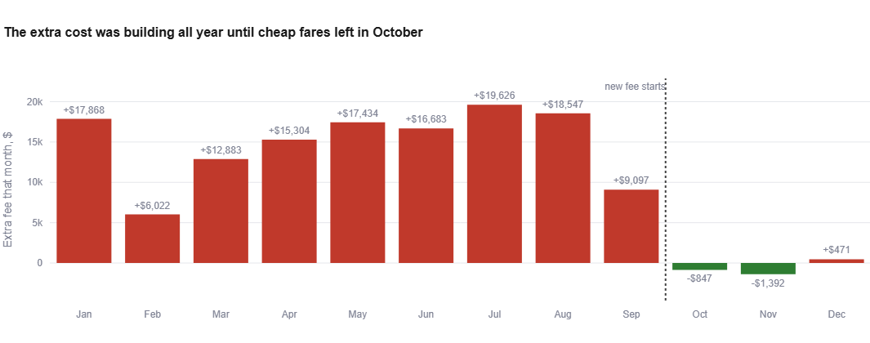
The extra cost was building every month — until the punished fares left
Jan–Sep: with the full cheap-fare volume on board, the new scheme would have cost an extra $6k–$20k every single month (+$133k in total). Oct–Dec: roughly flat — not because the fee got kinder, but because the fares it punishes had fled. These are counterfactuals on identical orders: a clean apples-to-apples view for the renegotiation case.
Q1 · Overall impact · budgetair-fee-analysis.streamlit.app 7

Slide 8
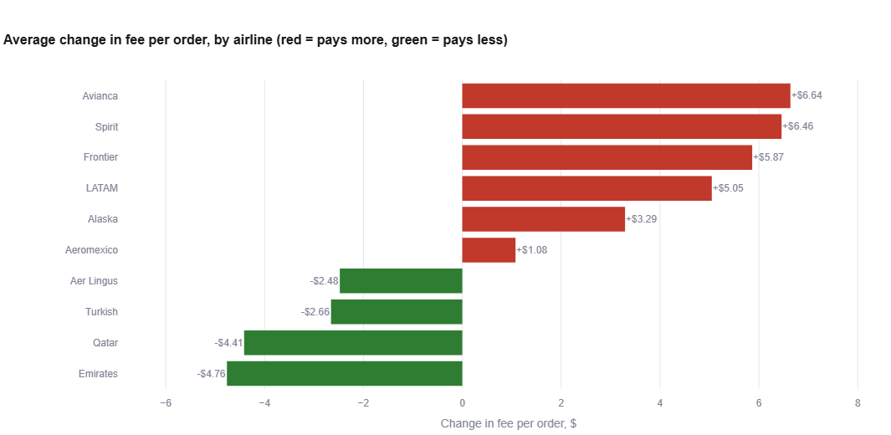
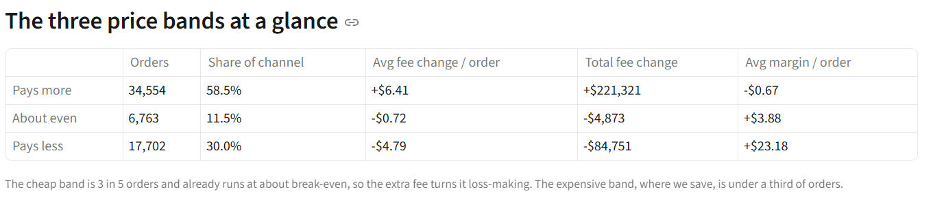
The same change punishes budget airlines and rewards long-haul ones
4.0% → 17.5%
effective fee on a sub-$100 ticket — a third of Aeroprice volume
+$6.41 / −$4.79
average fee change per order: cheap fares vs expensive fares
Losers: one-way, domestic, low-cost and short-haul carriers. Winners: long-haul international returns on legacy and Gulf carriers.
Q2 · Winners & losers · budgetair-fee-analysis.streamlit.app 8

Slide 9
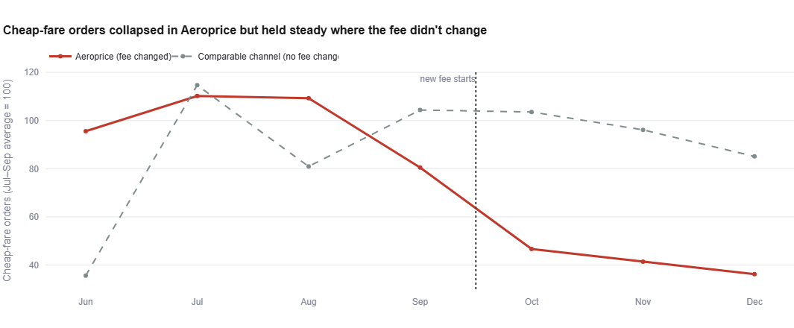
Cheap fares didn't move channels — they disappeared
−58.5%
Aeroprice cheap-fare volume, summer avg → Q4
−5.1%
the same measure on a channel with no fee change
≈ 2,200 / mo
Both lines indexed to their July–September average (=100), so the drop is comparable, not the raw sizes.
cheap-fare orders that vanished and were not recaptured anywhere
Total cheap-fare demand across all our channels fell from ~5,600 to ~3,100 orders a month — most of the displaced demand likely went to competitors. Aeroprice's share of all cheap fares fell from 72.6% to 51.1%. The typical Aeroprice ticket jumped from ~$130 to over $400 (appendix).
The evidence · budgetair-fee-analysis.streamlit.app 9

Slide 10
Revise pricing by segment — the fee floor is a channel-fit problem, not a markup problem
Segment | Action | Pro | Con
Cheap fares <$262.50 59% of orders | Stop full-price competition: partial pass-through of the fee; de-prioritise deep-discount inventory in this channel. | Stops guaranteed losses — the $10.50 fee alone exceeds the segment's −$0.67 average margin. | Volume and search-ranking loss (already visible in Q4); weaker 'billboard' visibility from cheap fares.
Expensive fares >$500 30% of orders | Reinvest the ~$4.79/order saving into sharper prices to win ranking on long-haul fares. | Healthy-margin segment (+$23.18/order); price-sorted platforms reward small cuts disproportionately. | Competitors on the same new terms may match, competing the saving away.
Structural the contract itself | Renegotiate a fare-tiered fee; route budget inventory to channels without a minimum fee. | Fixes the root cause; the +$131,696 full-year counterfactual is the negotiation lever. | Partner may resist; re-routing volume takes time and coordination.
Principle: the fee changed asymmetrically, so the optimal markup changes asymmetrically — one uniform response would be wrong in both directions.
Q3 · Pricing strategy · budgetair-fee-analysis.streamlit.app 10

Slide 11
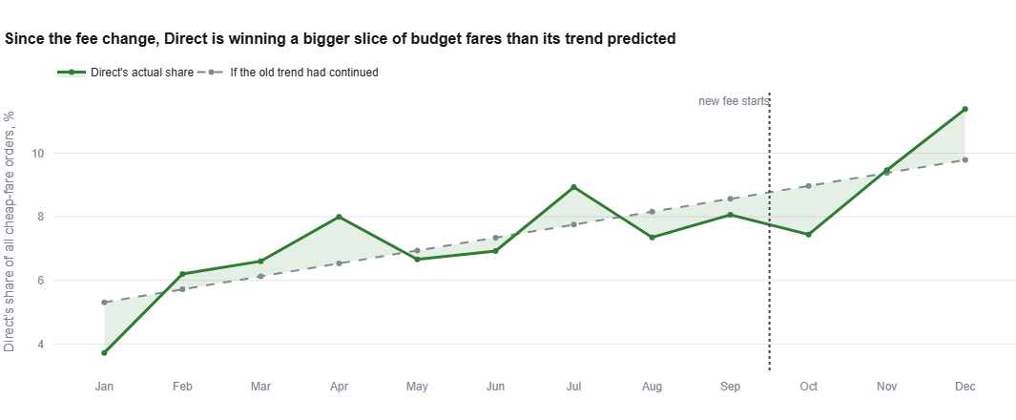
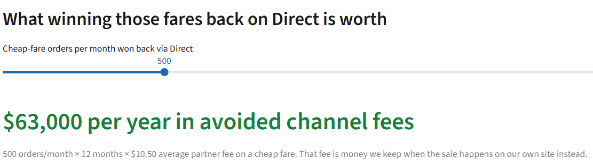
Our own Direct site is now the cheapest place to sell a budget fare
How to capture it Make Direct the designated home for budget fares: member-only and app-exclusive pricing funded by the avoided fee, and retargeting of metasearch visitors. Every order shifted saves at least $10.50 before any margin.
Direct pays no partner fee — so the effect is behavioural: by December, Direct's share of cheap fares reached 11.4%, +1.6 pp above its own pre-change trend. Real, but small and late: Direct is not yet catching the falling demand. It should be.
Q4 · Direct channel · budgetair-fee-analysis.streamlit.app 11

Slide 12
Four actions — each with a number attached
1
Stop competing on sub-$262 fares inside Aeroprice
2
Reinvest the cap saving into long-haul prices
They lose money there by construction: +$6.41 average extra fee on a segment averaging −$0.67 margin per order.
~$4.79 saved per expensive order funds sharper prices exactly where margin is healthy (+$23.18/order) and ranking is won.
3
Make Direct the home for budget fares
4
Renegotiate a fare-tiered fee
Each order won back avoids ≥ $10.50 in fees — 500 orders/month is worth $63,000 a year before any margin.
Armed with the counterfactual: on 2022's real orders, the new terms cost +$131,696 — 59% of what the channel earned before the change.
Recommendations · budgetair-fee-analysis.streamlit.app 12

Slide 13
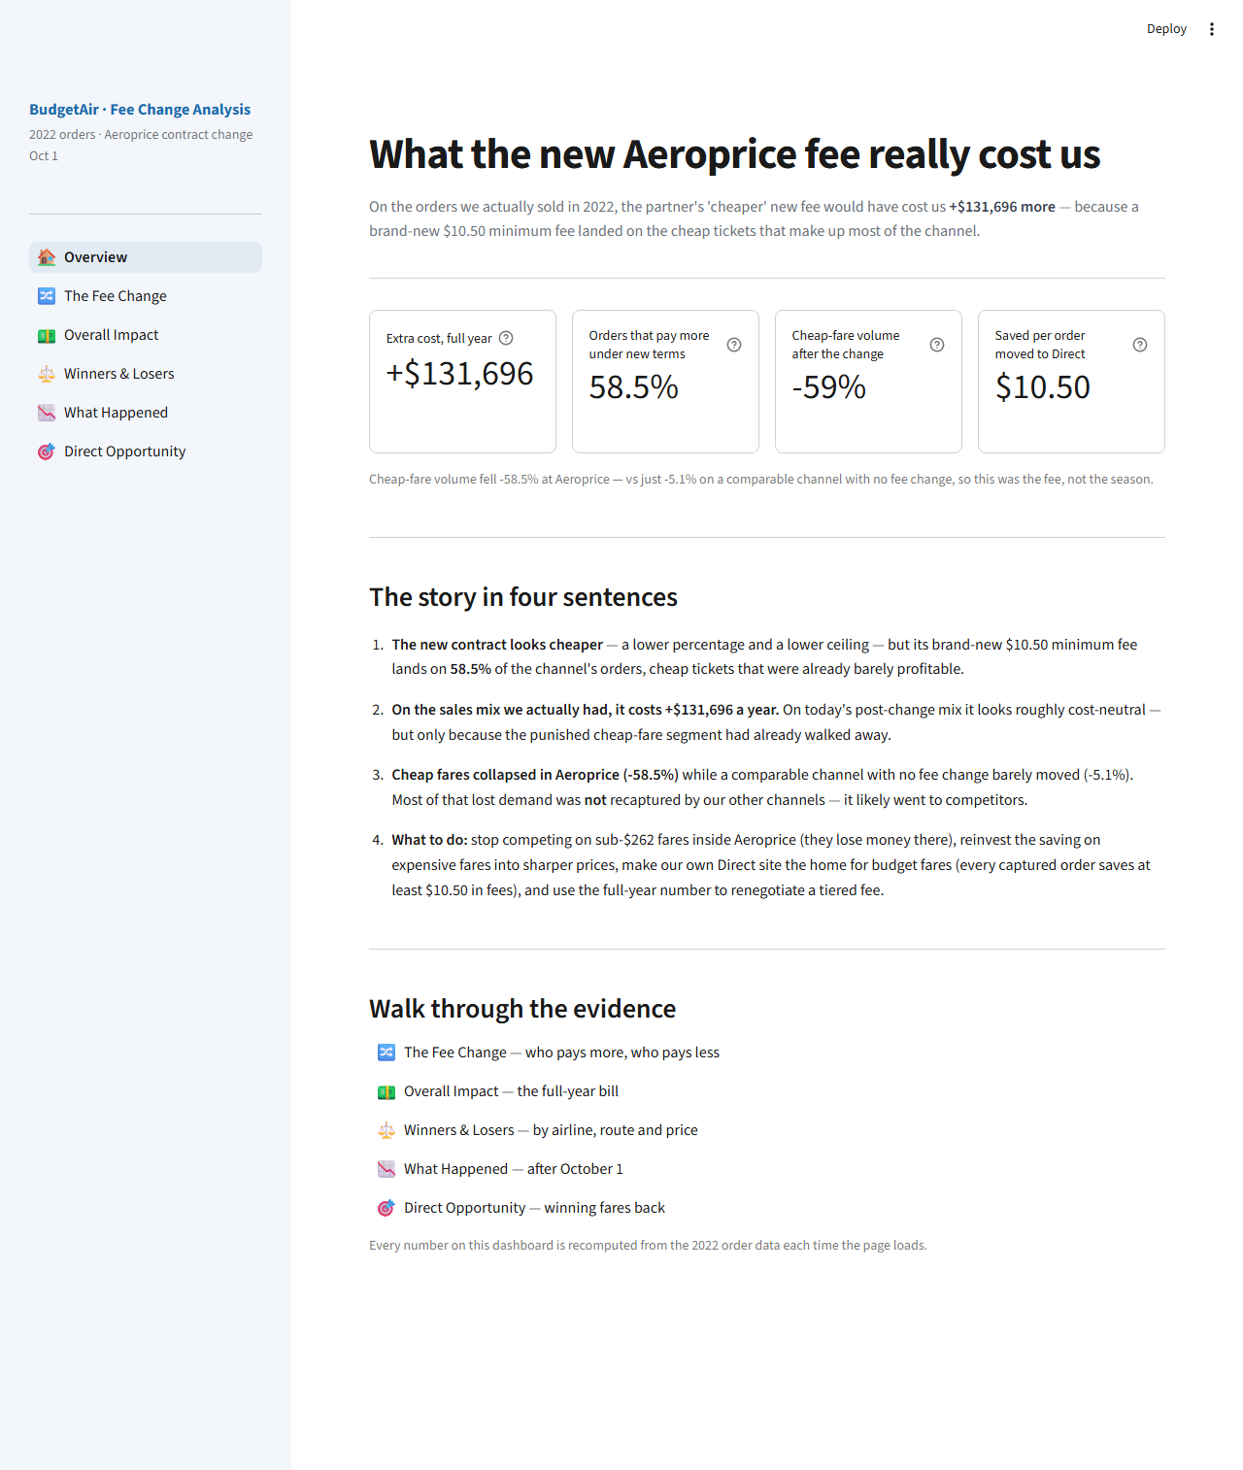
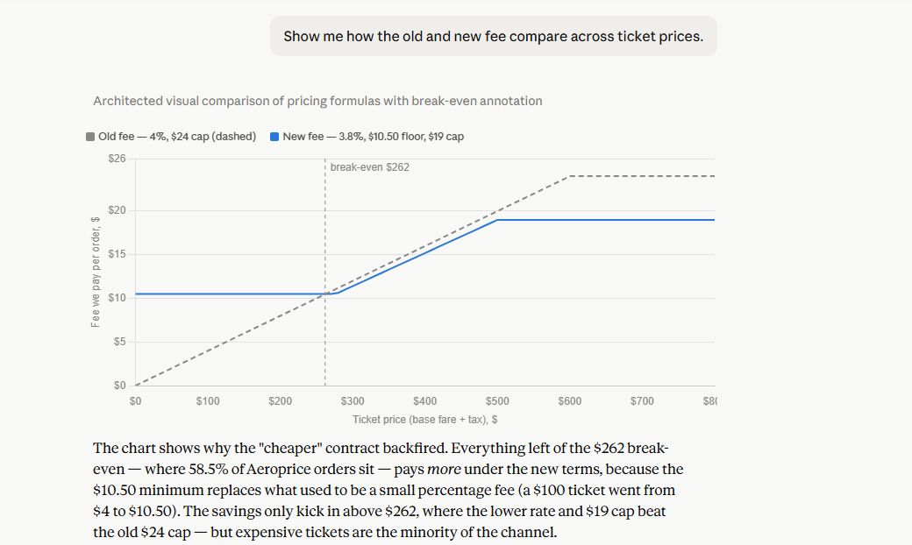
This analysis ships as a product: a dashboard, an AI interface, and a QA'd pipeline
Interactive dashboard
Ask the data in plain English (MCP)
Productionising it
Today. one pipeline feeds slides, dashboard and AI — a single source of truth with a startup consistency gate.
Next. interactive in-chat views (MCP Apps): our charts, click-to-drill into any segment.
Nine curated tools answer stakeholder questions with charts — the AI narrates, our code computes, so numbers can't be invented. Deployed on Cloud Run · eval 11/12, 0 fabrications · 12/12 manual sign-off
At scale. same pattern on the live warehouse: curated, governed tools for self-serve pricing analytics.
Six pages mirroring this deck; every number recomputed from the data on load. Deployed · automated browser QA 47/47
All links on the title slide — dashboard, MCP endpoint, GitHub.
Bonus deliverables · budgetair-fee-analysis.streamlit.app 13

Slide 14
Appendix · Fee applied per passenger instead of per order: the impact would be larger
+$131,696
+$231,170
base case — percentage, minimum and maximum applied per ORDER (matches the contract wording)
sensitivity — the same rules applied per PASSENGER
Why it grows: splitting an order across passengers lowers each ticket's value, pushing more of them under the $10.50 minimum — the floor then binds several times per order instead of once. Why this matters: our per-order base case is the conservative reading of the contract. If the fee is in fact charged per passenger, every headline in this deck understates the damage.
Appendix · budgetair-fee-analysis.streamlit.app 14

Slide 15
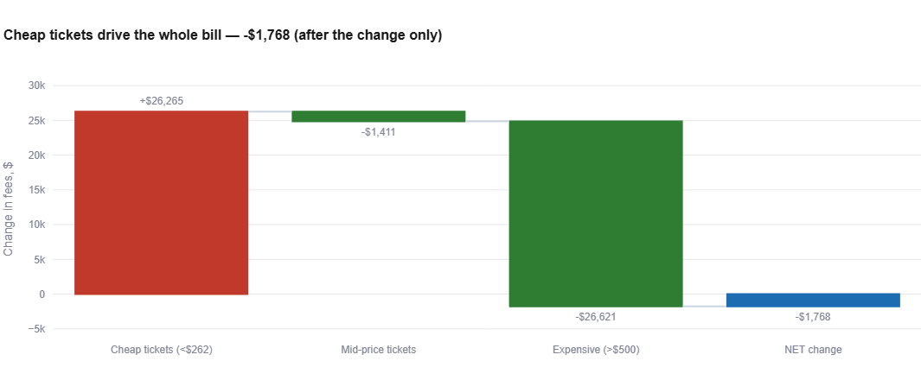
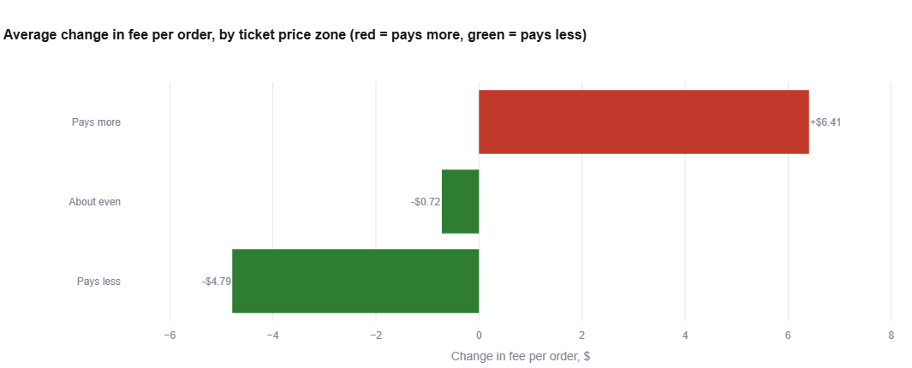
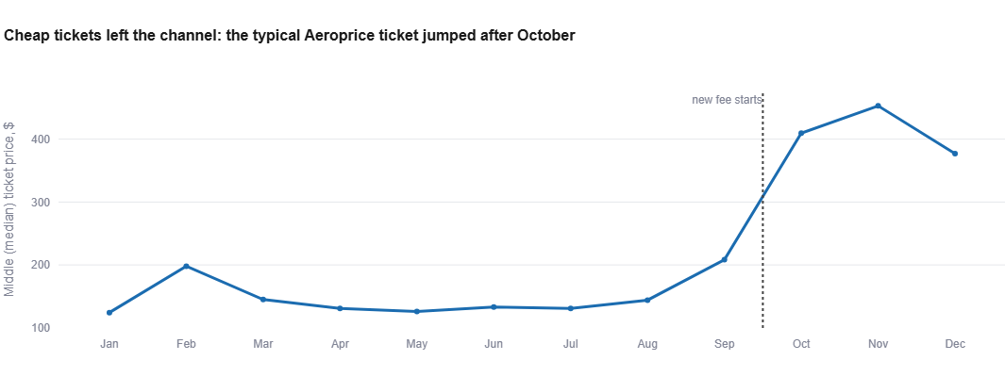
Appendix · Supporting views
Oct–Dec only: the same waterfall is roughly flat once the cheap fares have gone.
The three price bands: +$6.41 / −$0.72 / −$4.79 average fee change per order.
Reading these together: the after-change waterfall (top left) is what the contract looks like if you only inspect Q4 — the zone view (top right) and the median-ticket jump (bottom left) show why: the paying segment exited, flattering the average.
The typical (median) Aeroprice ticket jumped from ~$130 to $400+ after 1 Oct — cheap tickets left the channel.
Appendix · budgetair-fee-analysis.streamlit.app 15

Slide 16
Appendix · Reproducibility & quality controls
Deliverable | What it is | Quality control
orders_compiled_enriched.csv | order-level fact table: all 120,396 orders with cleaning flags, both fee schemes, zones | every fee verifiable per order
impact_summary.csv | month × channel × price-zone rollup behind every chart | reconciles to the fact table
analysis.py | one script rebuilds both CSVs from the 12 raw files | prints a validation block of headline numbers on every run
Streamlit dashboard (live) | six pages, every number recomputed from the CSVs on load | automated browser QA: 47/47 checks against the deployed app
MCP server (live, Cloud Run) | nine curated tools; AI narrates, code computes | refuses to start on data drift · golden eval 11/12, 0 fabricated numbers · 12/12 manual sign-off
One source of truth: slides, dashboard and AI interface all read the same two CSVs produced by the same script — every number in this deck exists identically in all three.
Appendix · budgetair-fee-analysis.streamlit.app 16

