Slide 1

Building with Coding Agents
Ship a Python Streamlit Dashboard
PyLadies Amsterdam · July 14, 2026

Slide 2
Data scientist · applied ML & MLOps
I build automated workflows, AI agents, and end-to-end pipelines
Route here: coding-agent projects + hackathons
Tonight: you direct, the agent codes.
Hi, I'm Felicity

Slide 3
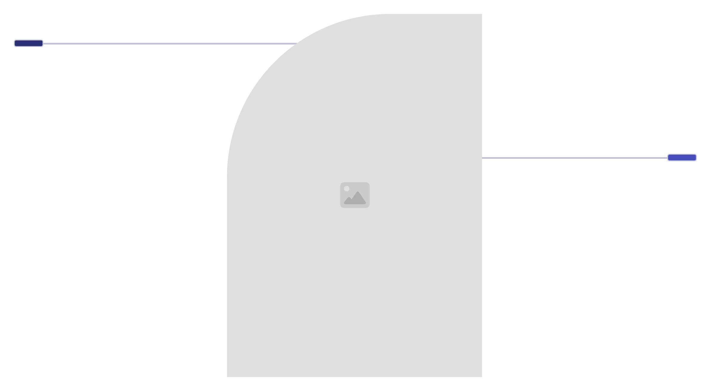

What is a coding agent?
A language model connected to your computer: it can read your files, run commands, write code, and see the results — then decide what to do next.
Chat AI
Answers questions and explains concepts.
Coding Agent
Reads files, runs commands, writes and tests code.
Examples: Claude Code, Gemini CLI, Cursor.

Slide 4
You are the architect. The agent is the contractor.
Don't micromanage every line. Don't say "build me a house" and disappear.
Context
Requirements
What this is and who it's for
Exactly what to build
Write a brief a skilled professional could execute.
Constraints
Checkpoint
What not to do
"Show me the plan first"

Slide 5
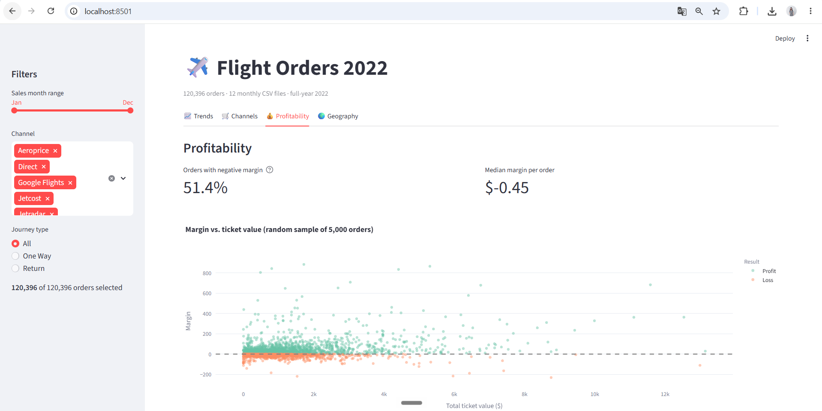

What you'll build tonight
A real dashboard from 120,396 flight orders — 4 KPI views, 3 filters — almost entirely by directing an agent.
A fact hiding in the data: more than half of all orders lose money (median margin: −$0.45).

Slide 6
Tools tonight
Claude Code
Gemini CLI
Any agent
My demos — needs a Claude subscription or API key
Free with a Google account
The exercises are prompts and markdown, not code
Smoke test — paste in your agent:
"Read data/DATA.md and tell me how many CSV files this project has" → the answer is 12.

Slide 7
CLAUDE.md — the agent's onboarding document
Every session starts with total amnesia. CLAUDE.md is the file the agent reads first, every time: what the project is, the tech stack, the rules.
1
2
What the project is
The tech stack
Write it once — stop re-explaining forever.
3
The rules
Keep it lean: it is loaded always, so every line costs.

Slide 8
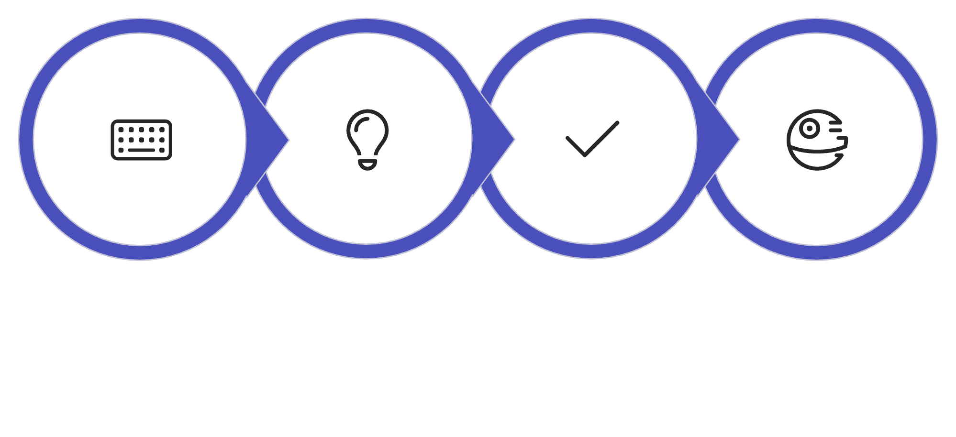
Plan before code
"Propose your plan first. Wait for my approval."
Write Prompt
Agent Proposes
Approve Plan
Construction
Review the architectural drawings before construction starts. The plan is where a mistake costs one sentence to fix — instead of a rebuild.

Slide 9
Guardrails — the polite kind
Rules you state in words — the agent reads them and usually honors them.
data/ is read-only
Ask before adding dependencies
The agent must never modify source data files
No surprise packages in your environment
Remember that "usually". We fix it in Block 2.

Slide 10
EXERCISE 1
🛠 Exercise 1 — The Brief & the Plan
Files — in order
Where to start
starter-prompt.md
CLAUDE-template.md
requirements-card.md
Open workshop.html → Exercise 1
Stuck?
Open solutions.html — copy, continue, study later.
Done = your agent proposed a plan, you approved it, dashboard v1 is building.
The exercises are prompts and markdown — any agent works.

Slide 11
UP NEXT
Skills, Hooks & Multi-Agent Patterns
A practical guide to expertise written down, guardrails with teeth, and knowing when one agent isn't enough.
SKILLS
SLASH COMMANDS
HOOKS
Markdown files of instructions the agent absorbs as knowledge
Buttons you press — triggered by you, by typing /name
Guardrails enforced by the system — cannot be forgotten or talked past

Slide 12
PRIMITIVES
Skills & Slash Commands — Expertise, Written Down
Both are markdown files of instructions. The difference is who pulls the trigger:
Skill
Slash Command
Triggered by
The agent, automatically, when relevant
You, by typing /name
Mental model
Knowledge it absorbed
A button you press
Example
"here's how we style charts"
/check-dashboard
Skills load only when needed — cheap. Rule of thumb: the third time you type the same prompt, save it.

Slide 13
MEMORY & COST
The Context Window Is a Budget
Everything the agent "knows" right now lives in a limited window — and quality degrades as it fills (context rot).
CLAUDE.md = always-paid tax
Skills = pay-per-use
Long sessions = compact & clear
Load only when relevant. The cost is zero until the moment they're needed.
Keep it lean. Every token here is spent on every single request.
Run /compact at milestones, /clear between tasks. Files survive compaction; conversation fades.
Files survive compaction; conversation fades.

Slide 14

COMMUNITY PATTERNS
The Community Builds With These Exact Primitives
One compresses what the agent says; the other what it reads.
Together they attack context rot from both directions — output verbosity and input bloat.
caveman
Caveman Output
RTK Tool Input
A skill that makes agents talk terse: ~65–75% fewer output tokens.
rtk
A hook that compresses tool outputs 60–90% before they reach the window.
65–75% Fewer
60–90% Smaller
I use both.

Slide 15
ENFORCEMENT
Hooks — The Guardrails With Teeth
A hook runs automatically on events (before a file edit, after a command) — enforced by the system, not by the agent's goodwill.
It cannot be forgotten, ignored, or talked past.
CLAUDE.md is the sign that says please wash your hands.
A hook is the door that won't open until you do.
Soft rule
Hard rule
"please don't touch data/"
The edit is blocked before it executes.

Slide 16
EXERCISE 2
🛠 Exercise 2 — Standards & Limits
Open workshop.html
Use SKILL-template.md
Done when…
Navigate to Exercise 2
One vague prompt → hook-template/ → try to break it (two rounds)
Your dashboard is restyled to your rules, and you watched a write get blocked.
Remember: new session after installing — settings load at session start.

Slide 17
ARCHITECTURE
One Agent, or Many?
Add a second agent when you can name what the first one can't do — not before.
One Agent
Parallel Subagents
Specialist Roles
When
Sequential steps, shared context — most tasks (the default!)
Independent pieces, like our 4 view files
Different jobs need different tools
Wins
Continuity, consistency
Wall-clock ÷ 4, small fresh context each
Fresh eyes, honest checking

Slide 18
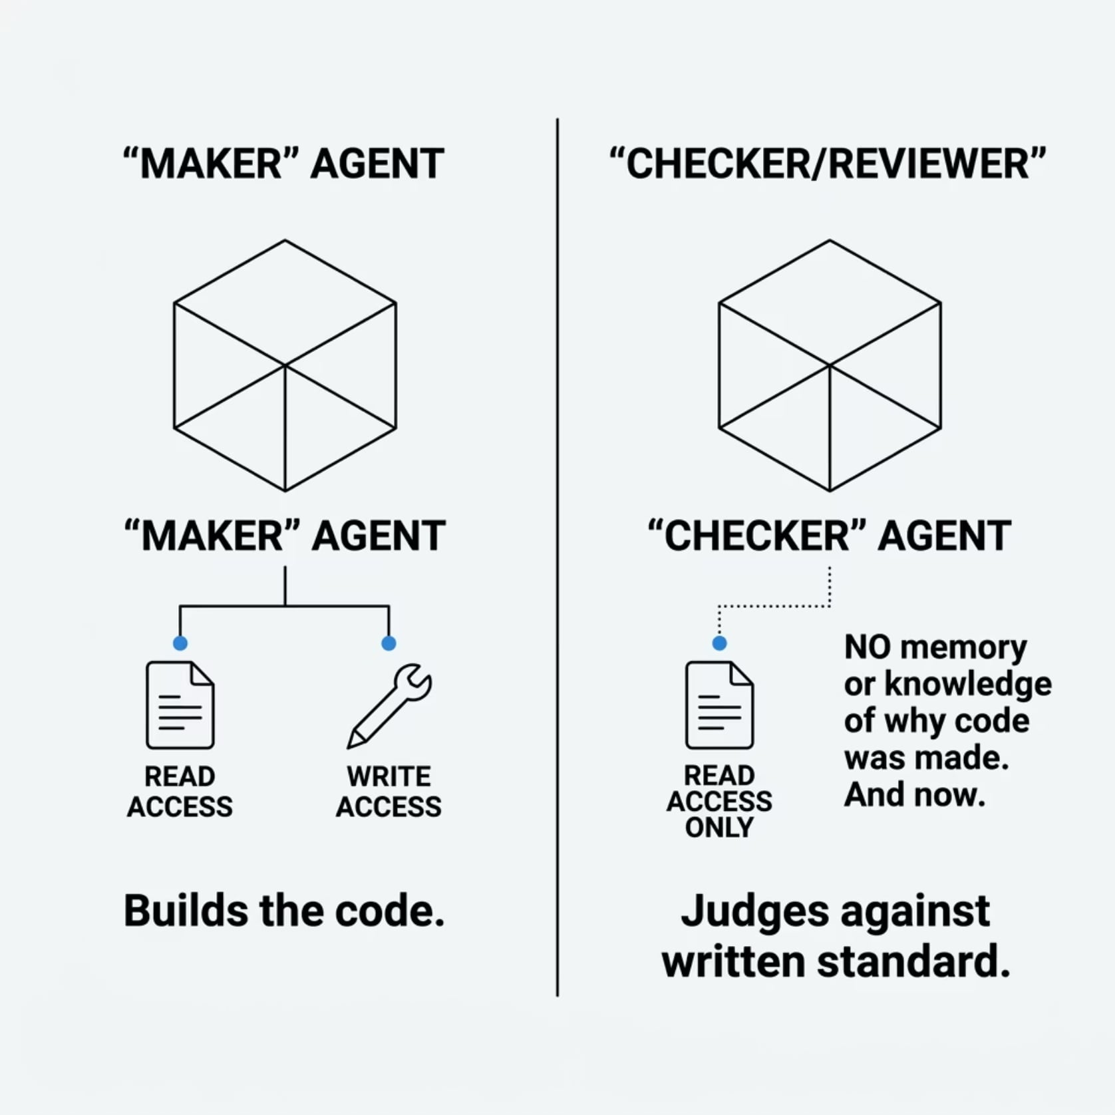
QUALITY CONTROL
Never Let the Maker Be the Checker
A reviewer agent with only Read tools — it literally cannot edit.
Fresh eyes, no memory of why the code is that way, judging only against your written standard.
Constraint by architecture beats constraint by politeness.

Slide 19


EXERCISE 3
🛠 Exercise 3 — Delegation
Part A
Part B
Part C
Make your agent argue both sides
4 parallel subagents, one per view — overlapping timers, batch finishes in the slowest one's time
reviewer-template.md → the audit
Done = a violations table from an agent that fixed nothing. Watch the screen for the parallel launch.

Slide 20
MCP — giving the agent hands (and eyes)
Model Context Protocol — the USB-C of AI
Skills teach
MCP connects
One standard plug between any agent and any tool.
A server exposes a menu of tools; the agent calls them by name.
The agent learns how: "here is how we style charts"
The agent gains access: browsers, databases, Notion, GitHub — called by name.
Tonight's server: Playwright — a real browser the agent can navigate, click, and read.

Slide 21
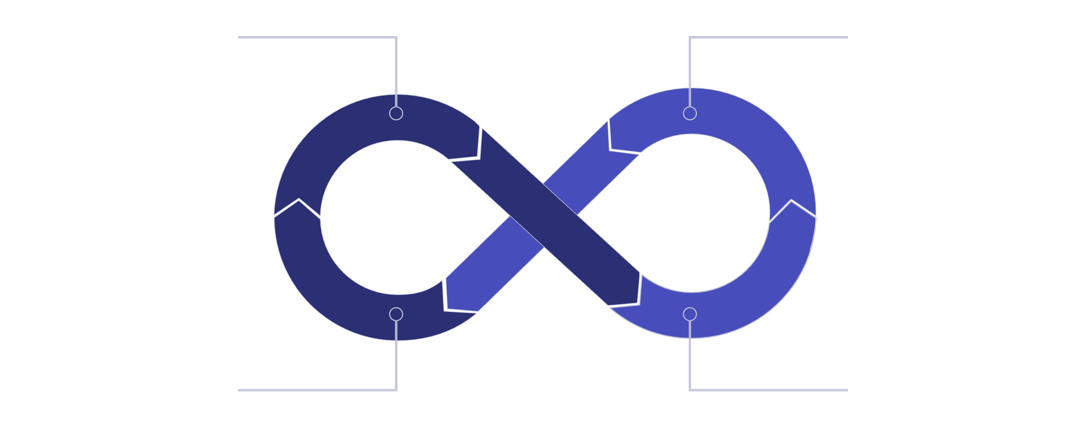
The loop: how agents become reliable
Produce
Verify
Verify Again
Fix Failed
One attempt
A loop with checks
~80% right — good, but not reliable enough for production.
Converges toward reliable. Each cycle catches what slipped through.
The catch
Always set a retry cap
The agent rises exactly to the standard of your verifier — never above it.
A loop without a stop condition is a bill without a ceiling.

Slide 22
EXERCISE 4
Self-Verification (demo-first)
What you'll watch
Following live
verify → sabotage → the loop catches it → fix → PASS
Then saved as /check-dashboard — one word, forever.
Requires Playwright MCP set up — a 150 MB download.
Tonight in the room: watch the demo
Tonight at home: do it yourself

Slide 23
Evals — is any of this actually working?
A rubric = your promises, made gradeable
Verifier
Eval
Checkable criteria + evidence + verdicts.
Judges the work: "Is this change ok?"
Judges the worker: "Is my whole setup good — and improving?"
Include one criterion that FAILS on purpose — a rubric that only measures what you already built is a mirror, not an instrument.

Slide 24
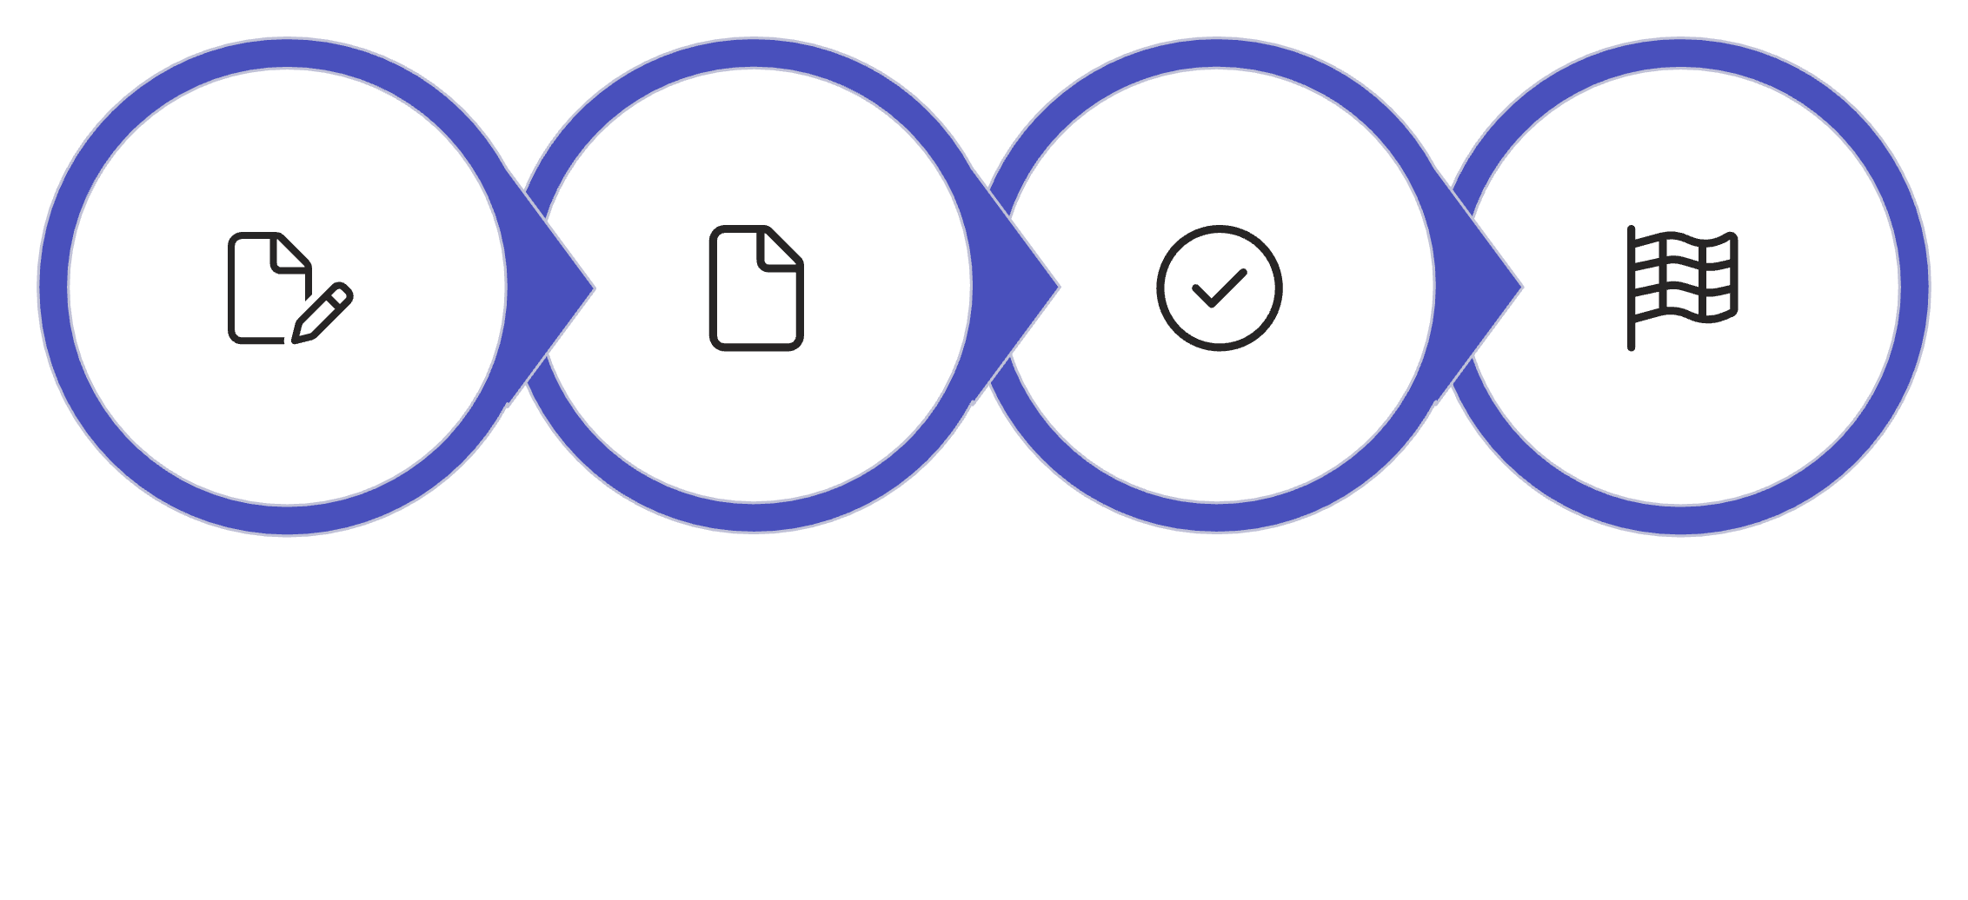
EXERCISE 5
Evaluation (the finale)
Open workshop.html
Fill rubric-template.md
Fresh session grades
Done: scorecard
The template
The rule
Done means
rubric-template.md: 3 given + 4 yours + 1 aspirational + 1 judgment
A fresh session grades your dashboard — and fixes nothing.
Your scorecard: everything promised delivered, next milestone named.

Slide 25
Agents forget everything overnight. Leave them a note.
README
CLAUDE.md
MEMORY.md
Is
The brochure
The handbook
The shift-handover note
For
Humans
Every agent session
The next session
Changes
Rarely
Occasionally
Every session
Tonight's homework, one prompt: "Summarize this session into MEMORY.md."

Slide 26
What you actually learned tonight
01
02
The verifier loop = the mechanism
Loop engineering = designing the system around it
The core primitive that makes agents reliable.
Goal, verifier, memory, termination. The term is a month old — you'll see it on your feeds.
03
04
Long-running agents = that design, deployed unattended
Prompt → context → loop engineering
You practiced all three tonight.
The natural endpoint of everything you built tonight.

Slide 27

How far do you let it run?
Where the value is today
1
1. Watch every step
Most professional value today lives at rungs 2–3.
Each rung up needs the guardrails from the rung below. You built those tonight.
2
2. Auto-approve safe actions
3. Task-level autonomy
3
An agent can only run as long as your guardrails can hold.
"Show me at the end"
4. Background agents
4
Overnight runs, PRs in the morning

Slide 28
Thank you 💛
workshop.html · solutions.html · github.com/pyladiesams/building-with-coding-agents-jul2026
Recording on YouTube.
This workshop was built with the methods it teaches — every exercise dry-run by an agent, every failure folded back into the materials.
@pyladiesams · @Fan-shiyu

