Slide 1
BIM 105: Lab 2 Intro
Bayes’ Formula and Estimating Population Sizes

Slide 2
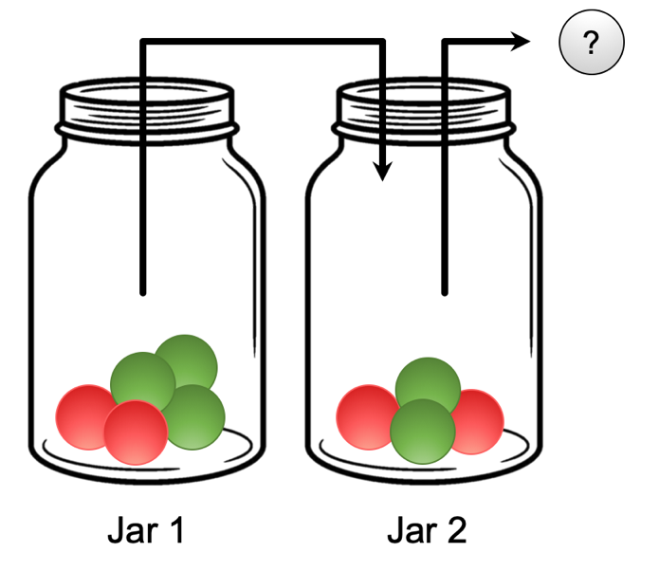
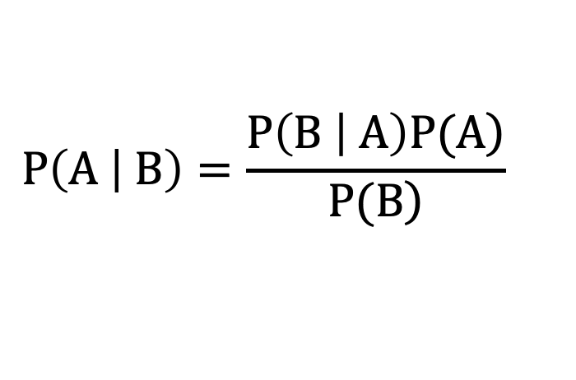
Jar Example (warm-up)
Bayes’ Formula (Bayes’ Rule)
$$P\left(A | B\right)=\frac{\left.P\left(B | A\right)P(A\right)}{\left.P(B\right)}$$

Slide 3

Estimating Population Size with Animal Tagging

Slide 4

Estimating Population Size with Animal Tagging

Slide 5
Estimating Population Size with Animal Tagging

Slide 6

Estimating Population Size with Animal Tagging
Capture and tag some of the population

Slide 7
Estimating Population Size with Animal Tagging
Capture and count tags in second sample

Slide 8
Estimating Population Size with Animal Tagging
“Mark-recapture” experiment (using fish as example)
Collect some fish and mark/tag them [first capture]
Release fish back into population, and wait for population to mix
Collect fish and count proportion tagged [second capture]
Under assumption of complete mixing, proportion of tagged animals in second capture should be equal to the proportion of tagged animals in total population
$$\frac{1 tagged fish in second capture}{6 total fish in second capture}≈\frac{4 tagged fish in total population}{x fish in total population} ⟹x=24$$

Slide 9
Estimating Population Size with Animal Tagging
“Mark-recapture” experiment (using fish as example)
Consider extreme cases:
No tagged fish in second capture: Population is somewhat large
All fish in second capture are tagged: Nearly all of population was tagged in first capture/tag (somewhat small population)

Slide 10
Estimating Population Size with Animal Tagging
“Mark-recapture” experiment (using fish as example)
Collect fish and count proportion tagged [second capture]
Is it better to sample without replacement or with replacement? Does it make a difference?
We use simulations to explore this – think about your expectations beforehand

Slide 11
Lab Procedures
Follow along lab prompt and answer questions using MATLAB
Template MATLAB answer script provided on Canvas
Template is filled in with code snippets to save you some time
“mark_recapture_prob.m” also on Canvas
Helpful function used at some points in the lab
Download and make sure it’s in the same location as your answer script in order to use it
Question 8: Answer code is provided in template script, but you still need to discuss results

Slide 12
Estimating Population Size with Animal Tagging

