Slide 1
During the global COVID-19 pandemic in Spring 2020, college engineering classes shifted suddenly in teaching modality from in-person, to online instruction
Was engineering-related self-efficacy and outcome expectations impacted during this period?
Our Motivation

Slide 2
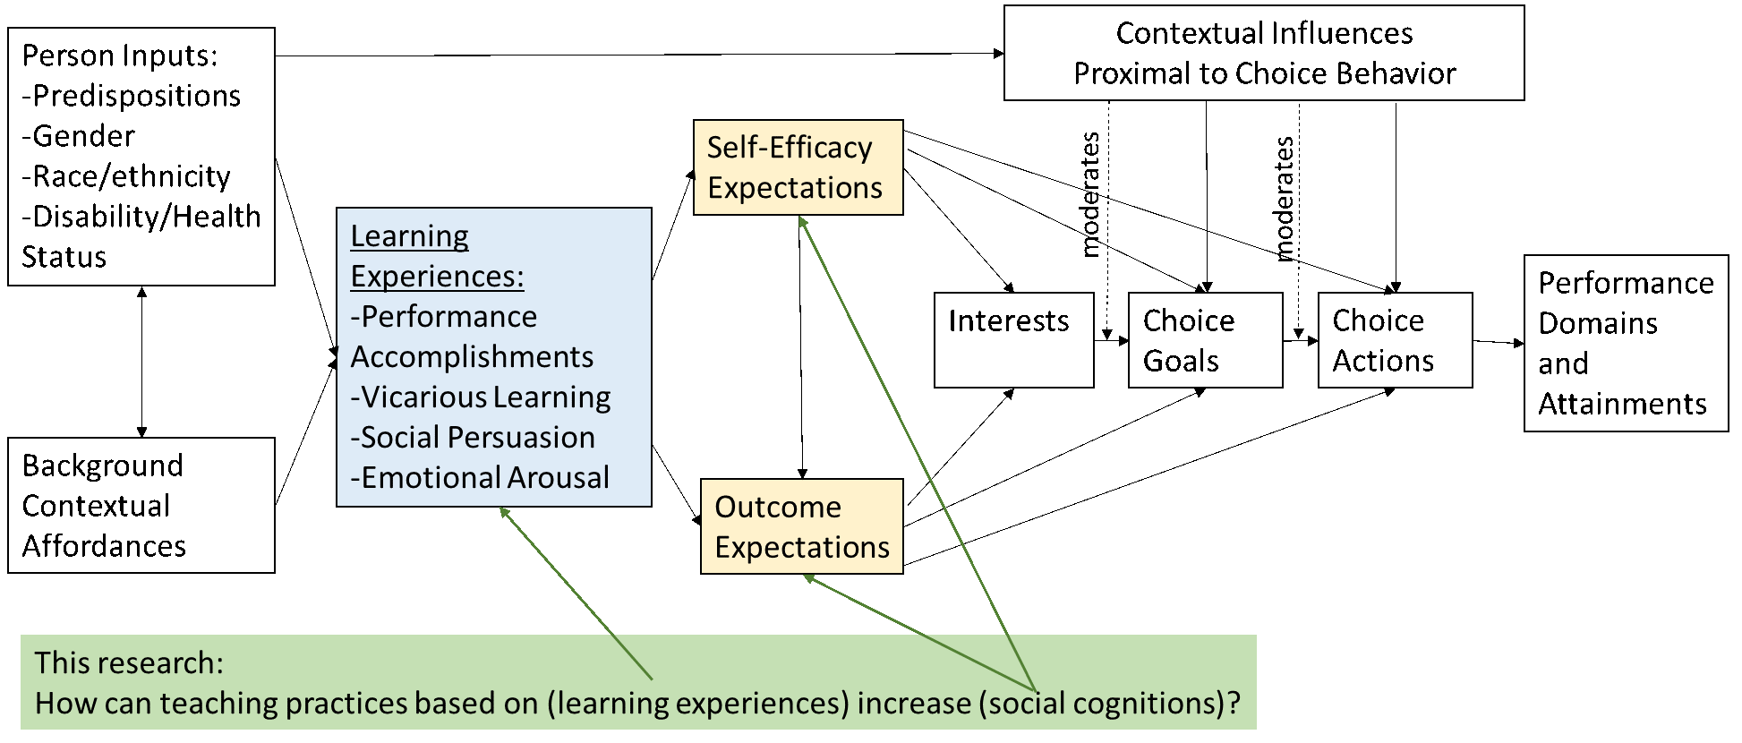
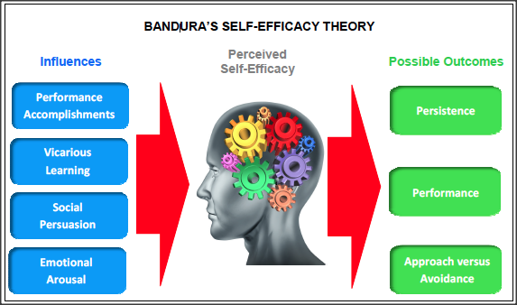
A Little Background
Social Cognitive Career Theory (SCCT; Lent, Brown, and Hackett, 1994; 2000) consists of three interlocking models that explain the development of career-related interests, choice goals, and performance. SCCTs core components include the variables of self-efficacy (i.e., confidence in one’s ability to successfully perform a domain-specific task), outcome expectations (i.e., anticipated outcomes of a particular behavior), interests (i.e., patterns of likes and dislikes for career activities), and goals (i.e., determination for a particular activity or outcome).
Bandura’s (1977; 1986) social cognitive theory is at the core of SCCT in that the social cognitions of self-efficacy and outcome expectations are the key mechanisms through which individuals develop career-related interests and goals.
Overview of SCCT model (based on Lent et al. 1994)
Relationship between self-efficacy and outcomes (https://www.ovpconsulting.com/weekly/2018/11/16/086p3teoj8d0dbvuwbt51sh7qkc63c

Slide 3
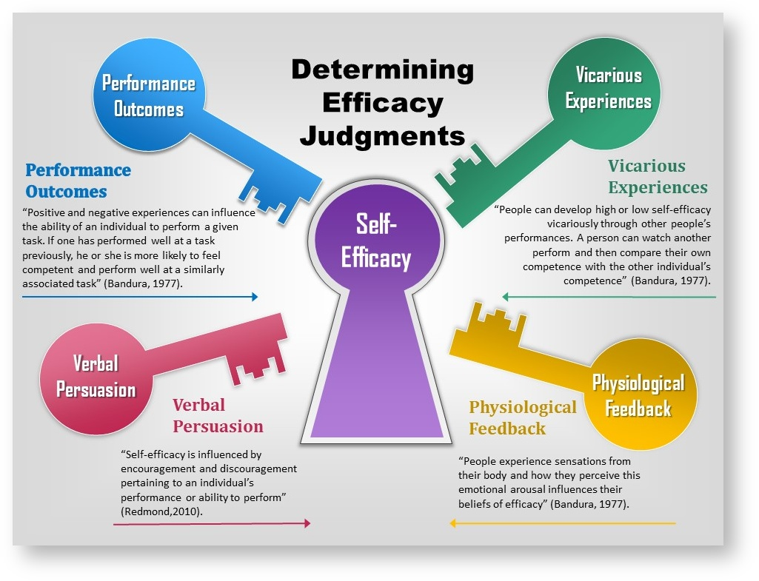
Self-Efficacy An individual’s belief in their ability to plan and complete a specific task (Bandura 1977). Hypothesized to relate to avoiding or approaching certain career options, the quality of performance, and their persistence when faced with obstacles
Outcome Expectations Expected outcomes and anticipated consequences for engaging in a particular behavior
Sources of Self-efficacy (https://www.simplypsychology.org/self-efficacy.html)
The Connection - Social cognitions of self-efficacy and outcome expectations are significant predictors of choice goals and actions in STEM fields - Social cognitions may also support engineering persistence (staying in the engineering major or continuing the engineering degree through perceived challenges)

Slide 4

Our Question
How would students social cognitions be impacted by the sudden shifts in teaching instruction during Spring 2020?

Slide 5

What We Did
- Administered surveys at 3 time points (beginning of the semester, just after shutdown, and end of semester) during the during the 16-week academic spring semester of 2020 - Sample size: Over 200 students in 8 engineering courses

Slide 6
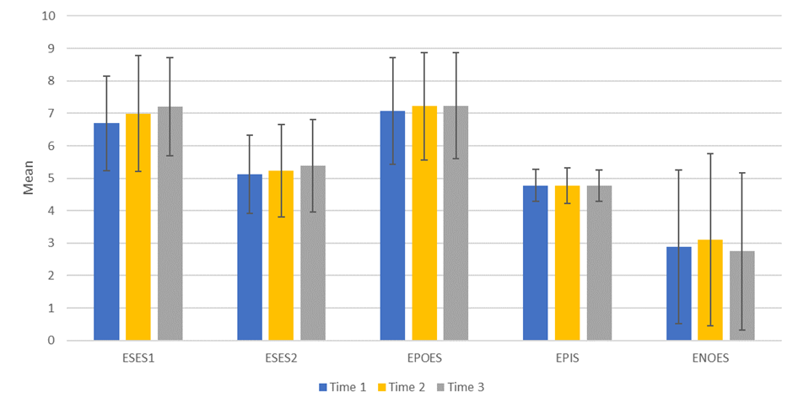
What We Found
Results demonstrated a statistically significant increase in engineering self-efficacy scores on the two utilized measures between Time 1 and Time 3 but not between the other time points in the overall results. Although the increase was statistically significant (p < 0.01; p < 0.5) the magnitude of the increase was marginal (only 7%-8% increase in the mean score).
Students’ perceptions of positive and negative outcome expectations and persistence intentions did not change greatly.
Despite the abrupt transition online to remote education, students increased in their confidence in their ability to succeed in their engineering coursework (self-efficacy), and for the most part still intend to major and find employment in engineering (persistence).

Slide 7
Next Steps
Formation of Faculty Learning Community to improve teaching practices. Future study will look at if changes in teaching practices and impact the social cognitions.
Engineering Faculty Learning Community
This learning community is part of a NSF funded study to evaluate the effect of changes in teaching practices on student social cognitions. Project Goals:
To increase the participation of women in engineering through enhanced social cognitions which have been linked to career outcomes.
To create a learning community comprised of engineering faculty to learn about social cognitive based teaching practices.
To support faculty in designing and implementing these teaching practices.
To assess the effectiveness of social cognitive based teaching practices on engineering students’ self-efficacy and outcome expectations.

Slide 8
Questions – Please contact us!
Research Team
Sarah Orton, Associate Professor, Civil and Environmental Engineering ortons@missouri.edu
Rose Marra, Professor, School of Information Science & Learning Technologies rmarra@missouri.edu
Lisa Y. Flores, Professor, Department of Educational, School & Counseling Psychology floresly@missouri.edu
Fan Yu, PhD student, School of Information Science & Learning Technologies fyu@mail.missouri.com
Johanna Milord, PhD student, Department of Educational, School & Counseling Psychology milordj@mail.missouri.edu

Slide 9
Acknowledgement
This work is supported by the National Science Foundation under Grant No.1926480. The authors gratefully acknowledge the financial support from the National Science Foundation. The opinions, findings, and conclusions or recommendations expressed in this paper are those of the authors and do not necessarily reflect the views of the sponsor.

