Slide 1
Computer Architecture Experiment
Topic 5. Dynamically Scheduled Pipelines using Scoreboarding
浙江大学计算机学院
2021年11月
Notes:
同学们好，今天我们讲一下实验5，这个实验主要是实现一个简单的浮点数流水线

Slide 2
Outline
Experiment Purpose
Experiment Task
Basic Principle
Operating Procedures
Checkpoints

Slide 3
Experiment Purpose
Understand the principle of piplines that support multicycle operations.
Master the design methods of piplines that support multicycle operations.
Master verification methods of pipelined CPU supporting multicycle operations.

Slide 4
Experiment Task
Redesign the pipelines with IF/ID/FU/WB stages and FU stage supporting multicycle operations.
Redesign of CPU Controller.
Verify the Pipelined CPU with program and observe the execution of program.

Slide 5
Notes:
这是整个系统的结构图
浮点数流水线中分成了4个stage, IF/ID/FU/WB
IF阶段取指令，ID阶段decode, FU阶段进行计算，计算单元有branch, 整数的，浮点乘法，浮点除法，load/store memory的。
最后，writeback

Slide 6
Control Unit
// IF
output reg_IF_en, branch_ctrl,
// ID
output reg_ID_en, reg_ID_flush,
output[2:0] ImmSel,
output ALU_en, MEM_en, MUL_en, DIV_en, JUMP_en,
// FU
output[3:0] JUMP_op,
output[3:0] ALU_op,
output ALUSrcA,
output ALUSrcB,
output MEM_we,
// WB
output reg[2:0] write_sel,
output reg[4:0] rd_ctrl,
output reg reg_write
input clk,
input rst,
input[31:0] inst,
input valid_ID,
input ALU_done,
input MEM_done,
input MUL_done,
input DIV_done,
input JUMP_done,
input cmp_res_FU,
Notes:
然后我们来看一些关键单元的代码
首先是ctrl unit,这个control unit贯穿全局
需要控制IF的stall和下一条指令的选择
控制ID的stall，flush, 立即数，根据指令类型判断计算所需要的计算单元，就是这里的ALU_en, MEM_en, MUL_en, DIV_en, JUMP_en
控制Fu阶段计算的操作数和操作类型
控制Wb阶段的写回，要不要写回，写回到什么寄存器，写回的数据数据：来自ALU,MEM, MUL, DIV, JUMP等
再看ctrl unit的输入，有指令，然后Fu计算完成之后，要给ctrl unit信号
[回到上一下ppt],然后再来看Fu阶段的这些计算单元

Slide 7
FU-ALU
reg[3:0] Control;
reg[31:0] A, B;
always@(posedge clk) begin
if(EN & ~state) begin // state == 0
A ...
B ...
Control ...
state <= 1;
end
else state <= 0;
end
...
module FU_ALU(
input clk, EN,
input[3:0] ALUControl,
input[31:0] ALUA, ALUB,
output[31:0] res,
output zero, overflow,
output finish
);
reg state;
assign finish = state == 1'b1;
initial begin
state = 0;
end
Notes:
首先来看ALU
整数计算单元
首先定义了一个state寄存器，用state寄存器来指示这个计算单元的占用状态和是否结束。
在ALU里面，两个操作数是A和B，执行的操作是由Control信号指定的
指令进入ALU单元进行计算，在初始状态，也就是这里的EN & ~state这里 (表明ALU使能，并且ALU空闲)，要对A，B，Control进行赋值，A要赋值为ALUA, B要赋值为ALUB，Control要赋值为ALU_Control
然后ALU就会计算出结果。
ALU计算是组合电路，立刻就能结束。同时，这个state转移到1，表明finish
在下一个时钟周期，state转移到0,表明ALU现在处于空闲状态

Slide 8
FU-Multiplier
module FU_mul(
input clk, EN,
input[31:0] A, B,
output[31:0] res,
output finish
);
reg[6:0] state;
assign finish = state[0] == 1'b1;
initial begin
state = 0;
end
reg[31:0] A_reg, B_reg;
always@(posedge clk) begin
if(EN & ~|state) begin
A_reg ...
B_reg ...
state <= 7'b100_0000;
end
else state <= {1'b0, state[6:1]};
end
wire[63:0] mulres;
multiplier mul(.CLK(clk),.A(A_reg),.B(B_reg),.P(mulres));
assign res = mulres[31:0];
endmodule
Notes:
在Multiplier里面，同理
浮点数乘法计算需要7个时钟周期
这里用了一个7位寄存器的state
进入计算时，state最高位被置位为1
然后每个时钟周期，把这个1向右移动一位，state最低位为1时计算结束

Slide 9
FU-Divider
always@(posedge clk) begin
if(EN & ~state) begin // state == 0
A_reg...
B_reg...
A_valid ...
B_valid ...
state ...
end
else if(res_valid) begin
A_valid ...
B_valid ...
state ...
end
end
divider div(.aclk(clk),
.s_axis_dividend_tvalid(A_valid),
.s_axis_dividend_tdata(A_reg),
.s_axis_divisor_tvalid(B_valid),
.s_axis_divisor_tdata(B_reg),
.m_axis_dout_tvalid(res_valid),
.m_axis_dout_tdata(divres)
);
assign res = divres[63:32];
endmodule
module FU_div(
input clk, EN,
input[31:0] A, B,
output[31:0] res,
output finish
);
wire res_valid;
wire[63:0] divres;
reg state;
assign finish = res_valid & state;
initial begin
state = 0;
end
reg A_valid, B_valid;
reg[31:0] A_reg, B_reg;
Notes:
然后是除法
FU-div里面state只有一位
因为这里divider计算结束时会发出res_valid信号

Slide 10
FU-Jump
module FU_jump(
input clk, EN, JALR,
input[2:0] cmp_ctrl,
input[31:0] rs1_data, rs2_data, imm, PC,
output[31:0] PC_jump, PC_wb,
output cmp_res, finish
);
reg state;
assign finish = state == 1'b1;
initial begin
state = 0;
end
reg JALR_reg;
reg[2:0] cmp_ctrl_reg;
reg[31:0] rs1_data_reg, rs2_data_reg, imm_reg, PC_reg;
always@(posedge clk) begin
if(EN & ~state) begin // state == 0
JALR_reg ...
cmp_ctrl_reg ...
rs1_data_reg ...
rs2_data_reg ...
imm_reg ...
PC_reg ...
state ...
end
else state <= 0;
end
cmp_32 cmp ... add_32 a ... add_32 b ...
Notes:
后面这几个都差不多，大家可以自己看一下

Slide 11
FU-Mem
always@(posedge clk) begin
if(EN & ~|state) begin
mem_w_reg ...
bhw_reg ...
rs1_data_reg ...
rs2_data_reg ...
imm_reg ...
state ...
end
else state ...
end
wire[31:0] addr;
add_32 add ...
RAM_B ram(.clka(clk),.addra(addr),.dina(rs2_data_reg),.wea(mem_w_reg),
.douta(mem_data),.mem_u_b_h_w(bhw_reg));
endmodule
module FU_mem(
input clk, EN, mem_w,
input[2:0] bhw,
input[31:0] rs1_data, rs2_data, imm,
output[31:0] mem_data,
output finish
);
reg[1:0] state;
assign finish = state[0] == 1'b1;
initial begin
state = 0;
end
reg mem_w_reg;
reg[2:0] bhw_reg;
reg[31:0] rs1_data_reg, rs2_data_reg, imm_reg;

Slide 12
Write Back
// WB
REG32 reg_WB_ALU(.clk(debug_clk),.rst(rst),.CE(FU_ALU_finish),.D(ALUout_FU),.Q(ALUout_WB));
REG32 reg_WB_mem(.clk(debug_clk),.rst(rst),.CE(FU_mem_finish),.D(mem_data_FU),.Q(mem_data_WB));
REG32 reg_WB_mul(.clk(debug_clk),.rst(rst),.CE(FU_mul_finish),.D(mulres_FU),.Q(mulres_WB));
REG32 reg_WB_div(.clk(debug_clk),.rst(rst),.CE(FU_div_finish),.D(divres_FU),.Q(divres_WB));
REG32 reg_WB_jump(.clk(debug_clk),.rst(rst),.CE(FU_jump_finish),.D(PC_wb_FU),.Q(PC_wb_WB));
MUX8T1_32 mux_DtR(... .o(wt_data_WB));
Regs register(...
.Wt_addr(rd_ctrl),.Wt_data(wt_data_WB),
...);
Notes:
最后是Writeback
Fu里面计算单元计算出来的结果会放到对应的寄存器，然后通过一个多路选择器写回寄存器

Slide 13
Pipelines resolving Data Hazards
Notes:
讲完这些之后，和之前的5-stage pipeline一样，在浮点数流水线里面，也要处理data hazard和control hazard
在这个实验里面，一条指令FU和WB都执行完了，他的下一条指令才能进入FU，这样就不会出现data hazard

Slide 14
Methods of resolving Control hazards
Predict-not-taken
Condition and Addr. Calculation in FU
Notes:
对于control hazard, 这个实验里面我们采用predict-not-taken, 和以前一样。
不一样的是，在这里，分支是在EXE阶段处理的，也就是FU-Jump处理的
在predict-not-taken的情况下，如果分支实际上take了，就需要kill两条指令
这个图可能不太对，Fu处理完就会flush

Slide 15
Predict Untaken
FU_Jump
FU_jump ju(.clk(debug_clk),.EN(FU_jump_EN),.finish(FU_jump_finish),
.JALR(Jump_ctrl[3]),.cmp_ctrl(Jump_ctrl[2:0]),.rs1_data(rs1_data_ID),.rs2_data(rs2_data_ID),
.imm(Imm_out_ID),.PC(PC_ID),.PC_jump(PC_jump_FU),.PC_wb(PC_wb_FU),
.cmp_res(cmp_res_FU));
Ctrl Unit
assign branch_ctrl = (B_in_FU & cmp_res_FU) | J_in_FU;
assign reg_ID_flush = branch_ctrl;
IF Stage
ID Stage
MUX2T1_32 mux_IF(
.I0(PC_4_IF),
.I1(PC_jump_FU),
.s(branch_ctrl),
.o(next_PC_IF)
);
else if(flush) begin
PCurrent_ID <= PCOUT;
IR_ID <= 32'h00000013;
valid <= 0;
end
Notes:
看一下代码
首先分支指令在FU_Jump，FU_jump判断分支是否会跳转，这个结果会存在cmp_res_FU
cmp_res_FU会传到ctrl unit,
如果是条件分支指令并且分支结果是会跳转，或者是无条件跳转的，branch_ctrl信号会置1，
If阶段，会根据branch_ctrl信号选择执行的下一条指令，Id阶段会进行flush

Slide 16
Instr. Mem.(1)
NO. | Instruction | Addr. | Label | ASM | Comment
0 | 00000013 | 0 | __start: | addi x0, x0, 0
1 | 00402103 | 4 |  | lw x2, 4(x0)
2 | 00802203 | 8 |  | lw x4, 8(x0)
3 | 004100b3 | C |  | add x1, x2, x4
4 | fff08193 | 10 |  | addi x3, x1, -1
5 | 00c02283 | 14 |  | lw x5, 12(x0)
6 | 01002303 | 18 |  | lw x6, 16(x0)
7 | 01402383 | 1C |  | lw x7, 20(x0)
8 | 40220433 | 20 |  | sub x8,x4,x2
9 | ffd50493 | 24 |  | addi x9,x10,-3
10 | 00520c63 | 28 |  | beq x4,x5,label0
11 | 00420a63 | 2C |  | beq x4,x4,label0
12 | 03000a13 | 30 |  | addi x20,x0,48
13 | 03400a13 | 34 |  | addi x20,x0,52
14 | 03800a13 | 38 |  | addi x20,x0,56

Slide 17
Instr. Mem.(2)
NO. | Instruction | Addr. | Label | ASM | Comment
15 | 03c00a13 | 3C |  | addi x20,x0,60
16 | 00004537 | 40 | label0: | lui x10,4
17 | 014005ef | 44 |  | jal x11,20
18 | 04800a13 | 48 |  | addi x20,x0,72
19 | 04c00a13 | 4C |  | addi x20,x0,76
20 | 05000a13 | 50 |  | addi x20,x0,80
21 | 05400a13 | 54 |  | addi x20,x0,84
22 | ffff0617 | 58 |  | auipc x12, 0xffff0
23 | 0223c6b3 | 5C |  | div x13, x7, x2
24 | 02520733 | 60 |  | mul x14, x4, x5
25 | 022687b3 | 64 |  | mul x15, x13, x2
26 | 00400813 | 68 |  | addi x16, x0, 4
27 | 000008e7 | 6C |  | jalr x17,0(x0)
Notes:
887 963=76/2=38
979-963=16

Slide 18
Data Mem.
NO. | Data | Addr. | Comment
0 | 000080BF | 0
1 | 00000008 | 4
2 | 00000010 | 8
3 | 00000014 | C
4 | FFFF0000 | 10
5 | 0FFF0000 | 14
6 | FF000F0F | 18
7 | F0F0F0F0 | 1C
8 | 00000000 | 20
9 | 00000000 | 24
10 | 00000000 | 28
11 | 00000000 | 2C
12 | 00000000 | 30
13 | 00000000 | 34
14 | 00000000 | 38
15 | 00000000 | 3C
NO. | Instruction | Addr. | Comment
16 | 00000000 | 40
17 | 00000000 | 44
18 | 00000000 | 48
19 | 00000000 | 4C
20 | A3000000 | 50
21 | 27000000 | 54
22 | 79000000 | 58
23 | 15100000 | 5C
24 | 00000000 | 60
25 | 00000000 | 64
26 | 00000000 | 68
27 | 00000000 | 6C
28 | 00000000 | 70
29 | 00000000 | 74
30 | 00000000 | 78
31 | 00000000 | 7C

Slide 19
Test Bench
RV32core core(
.debug_en(1'b0),
.debug_step(1'b0),
.debug_addr(7'b0),
.debug_data(),
.clk(clk),
.rst(rst),
.interrupter(1'b0)
);
initial begin
clk = 0;
rst = 1;
#2 rst = 0;
end
always #1 clk = ~clk;
00000013
00402103
00802203
004100b3
fff08093
00c02283
01002303
01402383
402200b3
ffd50093
00520c63
00420a63
00000013
00000013
00000013
00000013
000040b7
00c000ef
00000013
00000013
00000013
00000013
ffff0097
0223c433
025204b3
022404b3
00400113
000000e7

Slide 20
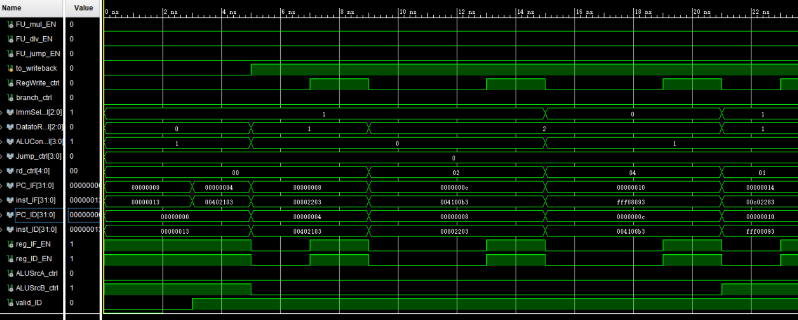
Simulation (1)

Slide 21
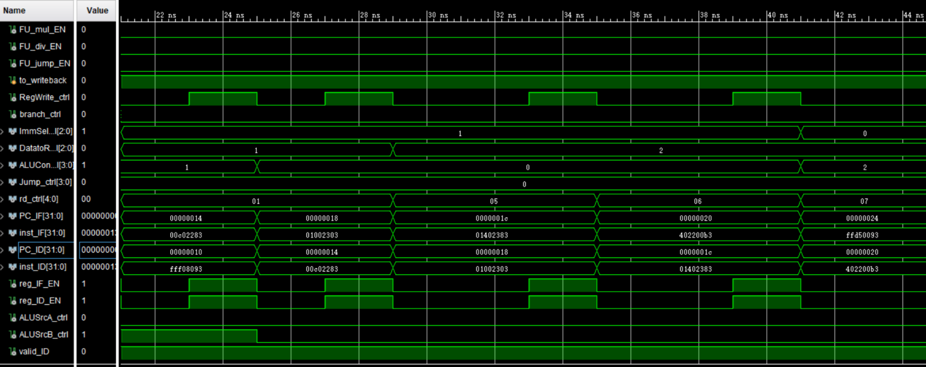
Simulation (2)

Slide 22
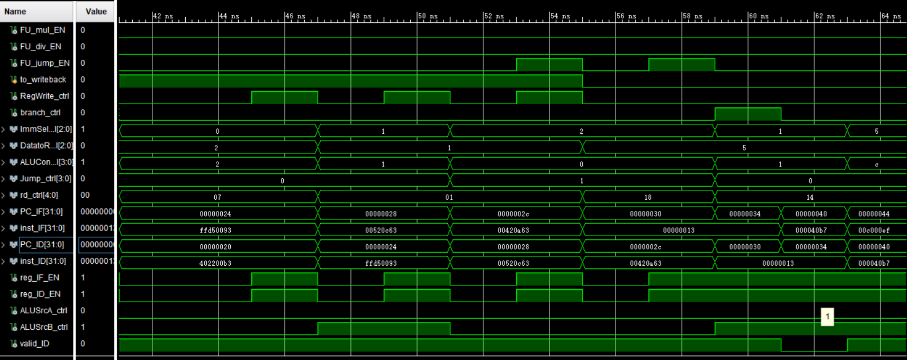
Simulation (3)

Slide 23
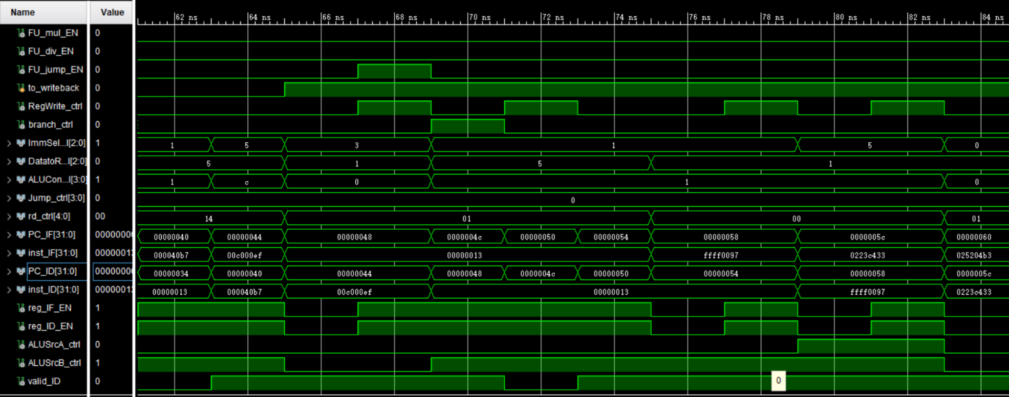
Simulation (4)
IF
ID

Slide 24
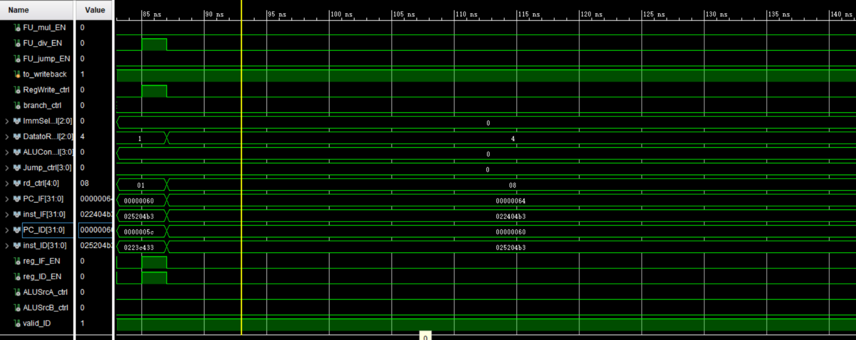
Simulation (5)
ID
FU

Slide 25
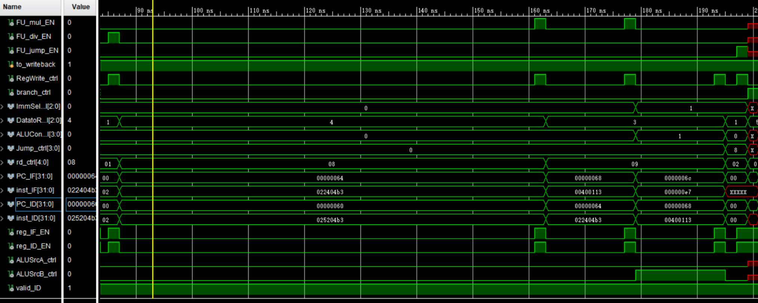
Simulation (6)
Next FU EN
WB

Slide 26
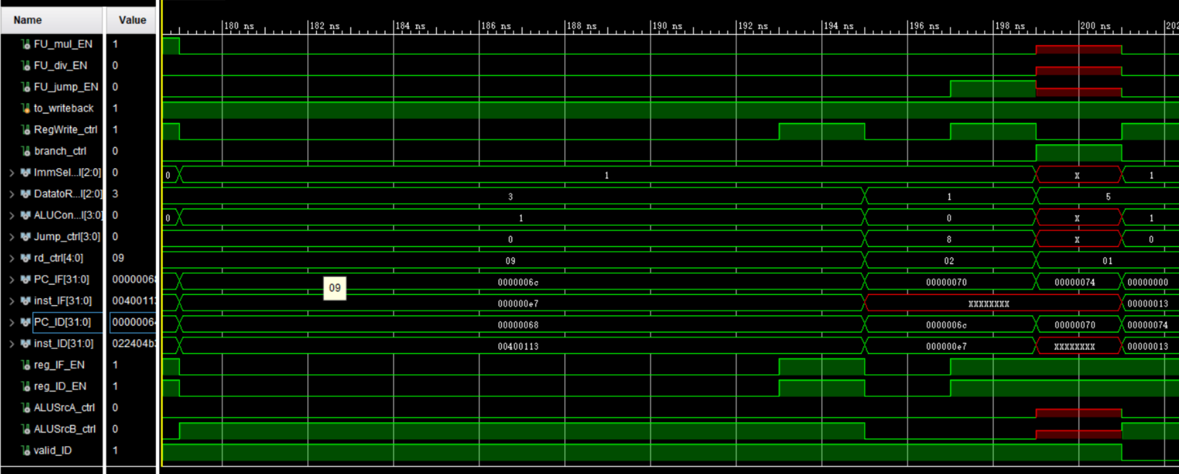
Simulation (7)

Slide 27
Checkpoints
CP 1:
Waveform Simulation of the Pipelined CPU with the verification program
CP 2:
FPGA Implementation of the Pipelined CPU with the verification program

Slide 28
Thanks!

