Slide 1
Computer Architecture Experiment
Topic 3. Cache Design
浙江大学计算机学院
2021年11月
Notes:
大家好，今天我们讲一下实验三，接下来两个实验是将cache接入到我们的流水线CPU。
这个分两步：一个是我们今天讲的，写一个cache
下一个实验会将这个cache接到我们的流水线CPU上
我们这个实验的任务就是设计和验证cache, 只需要仿真

Slide 2
Outline
Experiment Purpose
Experiment Task
Basic Principle
Operating Procedures
Checkpoints

Slide 3
Experiment Purpose
Understand Cache Line.
Understand the principle of Cache Management Unit (CMU) and State Machine of CMU.
Master the design methods of CMU.
Master the design methods of Cache Line.
master verification methods of Cache Line.

Slide 4
Experiment Task
Design of Cache Line and CMU.
Verify the Cache Line and CMU.
Observe the Waveform of Simulation.

Slide 5
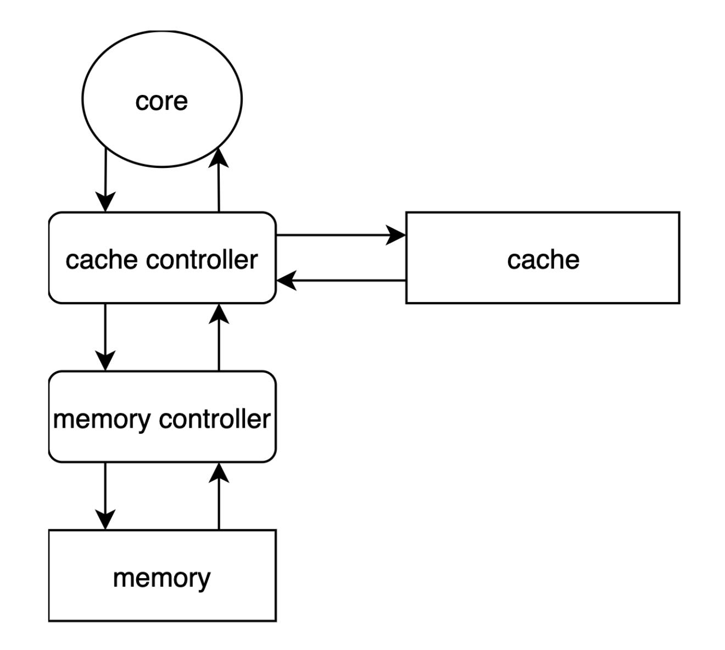
Single Core
Notes:
首先我们看一下单核处理器的core和memory hierarchy的结构。
以load指令为例
core发起一个load指令，cache controller接受到load指令后，去查询cache,
如果cache hit了，就把cache中的数据返回给core
如果cache miss了，cache中有空间的话
cache controller会向memory发起请求
memory controller接受到请求后，从memory中取数据发送给cache controller,
cache controller将数据写到cache
然后让core再次发起load指令
可以看到cache在这个过程中，就是手cache controller指挥的，cache controller发起load, store, cache去查找数据，找到了就传数据，写数据，并告诉cache controller 是一个cache hit, 如果找不到数据，就告诉cache controller是一个cache miss, 并设置一些和miss处理相关的一些信息。
我们这次实验只是实现这个cache

Slide 6
Cache Config
64 cache lines
2-way set associative
4 words per cache line
Write Back
Write Allocate
LRU Replacement Policy
Notes:
我们要实验的cache
是一个二路组关联的，
每个cacheline存放的数据位4个words
写策略是write back 和 write allocate
替换策略是LRU

Slide 7
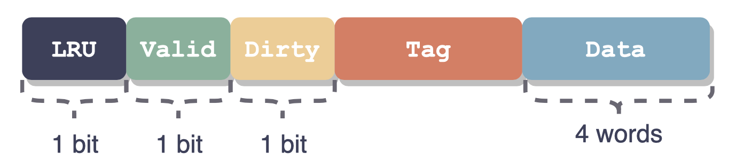
Cache Line
Notes:
首先看一下一个cache line的组成，
在这个实验里呢，我们是有LRU, valid, dirty这些位，
LRU是在cache数据替换时替换哪一个set的数据
valid
dirty
这里Data有4个words

Slide 8
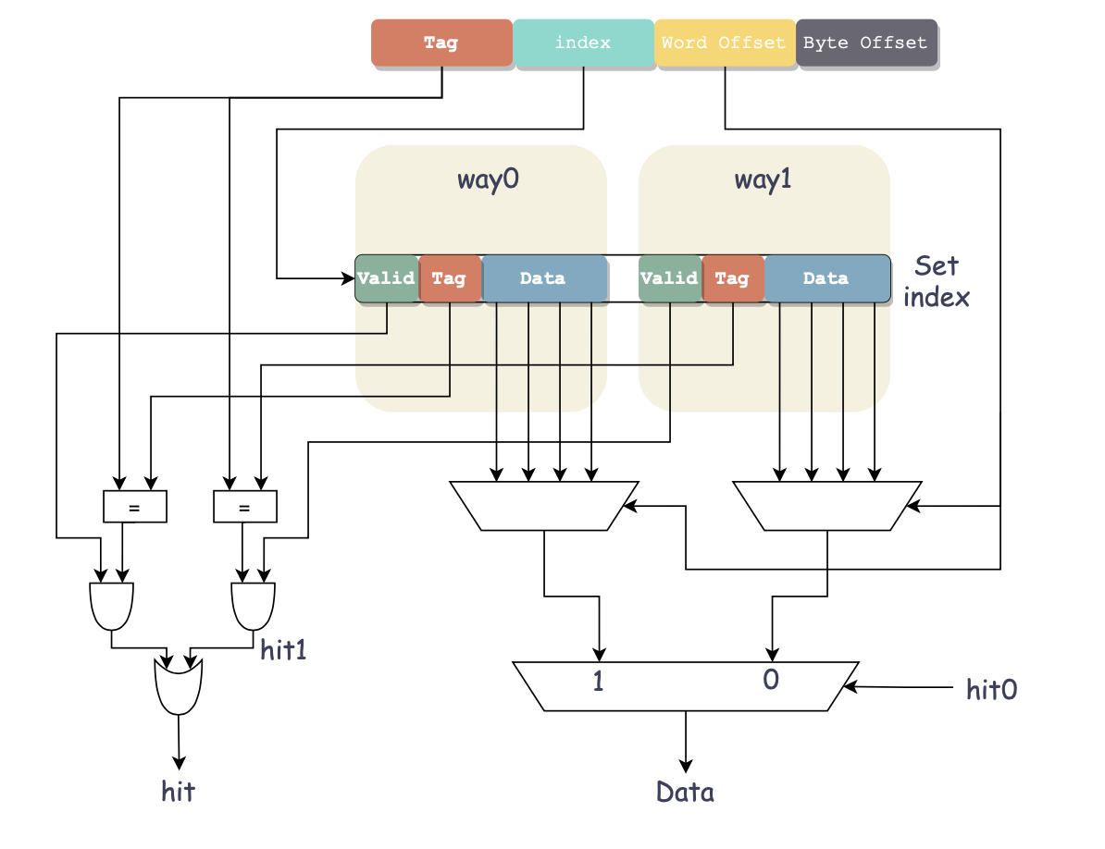
Access Cache
Notes:
ok, 然后看一下从cache的访问过程
byte offset是字节偏移, word offset是word偏移
我们的一个cache line里面放的数据是4个word, 实际传给core是传一个word, 这个offset表明是哪一个word
index是用来索引的，一个index对应了cache中的一个set
根据index确定cache里面的一个set, 根据word offset确定Data中的某一位，根据tag和valid信息确定哪一个way的数据

Slide 9
Input and output Signals of Cache Line
module cache (
input wire clk, // clock
input wire rst, // reset
input wire [ADDR_BITS-1:0] addr, // address
input wire load, // read refreshes recent bit
input wire store, // set valid to 1 and reset dirty to 0
input wire edit, // set dirty to 1
input wire invalid, // reset valid to 0
input wire [2:0] u_b_h_w, // select signed or not & data width
// please refer to definition of LB, LH, LW, LBU, LHU in RV32I Instruction Set
input wire [31:0] din, // data write in
output reg hit = 0, // hit or not
output reg [31:0] dout = 0, // data read out
output reg valid = 0, // valid bit
output reg dirty = 0, // dirty bit
output reg [TAG_BITS-1:0] tag = 0 // tag bits
);
lb | 000
lh | 001
lw | 010
lbu | 100
lhu | 101
Notes:
然后接下来，讲一下代码
要注意一下这个代码里面edit是写的意思，store是replace的意思
u_b_h_w表示load byte还是load word, load half word这些
然后这里会输出一个tag也是为了做cache replace

Slide 10
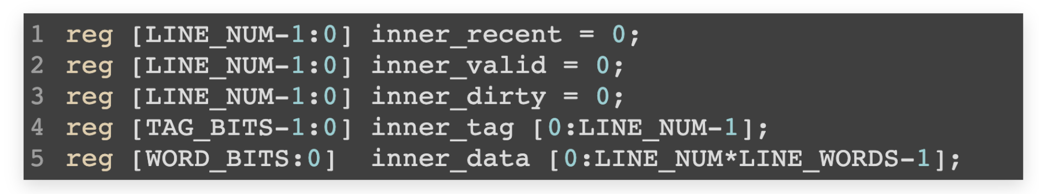
Cache Line Memory
32 sets; 64 cache lines
set 𝑖 way 0: 𝑖×2+0
set 𝑖 way 1: 𝑖×2+1
set 𝑖 way 𝑗 word 𝑘: 𝑖×8+𝑗×4+𝑘
inner_recent[{i, 1'b0}]
inner_recent[{i, 1'b1}]
Notes:
然后是这些cacheline怎么存
我们的cache是2路组关联的，容量是64个cache line, 32个set
这里每个cacheline的各个field分开存储，数组大小是64
数组0, 1是set 0的信息，2, 3是set 2的信息，…
做个拼接

Slide 11
Address
Bytes of word = 4, WORD_BYTES_WIDTH = 2
Words of line = 4, LINE_WORDS_WIDTH = 2
Tag bits = 23
Address bits = 32
Ways = 2
LINE_INDEX_WIDTH = ADDR_BITS - TAG_BITS - LINE_WORDS_WIDTH - WORD_BYTES_WIDTH = ?
Line Number = ?
Notes:
6
2^6 = 32

Slide 12
Simulation Example(1)
// init
32'd10: begin
load <= 0;
store <= 1;
edit <= 0;
din <= 32'h11111111;
addr <= 32'h00000004;
end
32'd11: begin
addr <= 32'h0000000C;
end
32'd12: begin
addr <= 32'h00000010;
end
32'd13: begin
addr <= 32'h00000014;
end
// read miss
32'd14: begin
load <= 1;
store <= 0;
edit <= 0;
u_b_h_w <= 3'b010;
din <= 0;
addr <= 32'h00000020;
end
// read hit
32'd15: begin
u_b_h_w <= 3'b010;
addr <= 32'h00000010;
end

Slide 13
Simulation Example(2)
// write miss
32'd16: begin
load <= 0;
store <= 0;
edit <= 1;
u_b_h_w <= 3'b010;
din <= 32'h22222222;
addr <= 32'h000000024;
end
// write hit
32'd17: begin
u_b_h_w <= 3'b010;
addr <= 32'h00000014;
end
// read line 0 of set 0, set recent bit
32'd18: begin
load <= 1;
store <= 0;
edit <= 0;
u_b_h_w <= 3'b010;
din <= 0;
addr <= 32'h00000004;
end
// store to line 1 of set 0 due to line 0 recent
32'd19: begin
load <= 0;
store <= 1;
edit <= 0;
u_b_h_w <= 3'b010;
din <= 32'h33333333;
addr <= 32'h00000204;
end

Slide 14
Simulation Example(3)
// edit line 1 of set 0, set dirty & recent
32'd20: begin
load <= 0;
store <= 0;
edit <= 1;
u_b_h_w <= 3'b010;
din <= 32'h44444444;
addr <= 32'h00000204;
end
// read line 0 of set 0, set recent bit
32'd21: begin
load <= 1;
store <= 0;
edit <= 0;
u_b_h_w <= 3'b010;
din <= 0;
addr <= 32'h00000004;
end
// read miss, tag mismatch. output tag (of line 1), valid and dirty == 1
32'd22: begin
load <= 1;
store <= 0;
edit <= 0;
u_b_h_w <= 3'b010;
din <= 32'h0;
addr <= 32'h00000404;
end
// auto replace line 1 of set 0
32'd23: begin
load <= 0;
store <= 1;
edit <= 0;
u_b_h_w <= 3'b010;
din <= 32'h55555555;
addr <= 32'h00000404;
end

Slide 15
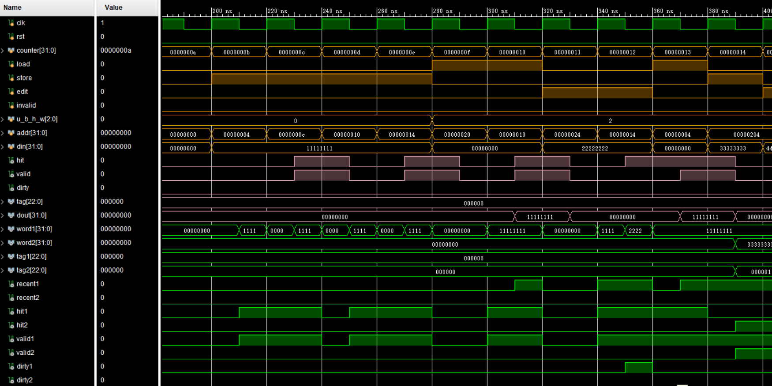
Simulation Example(1)
Load miss
Load hit

Slide 16
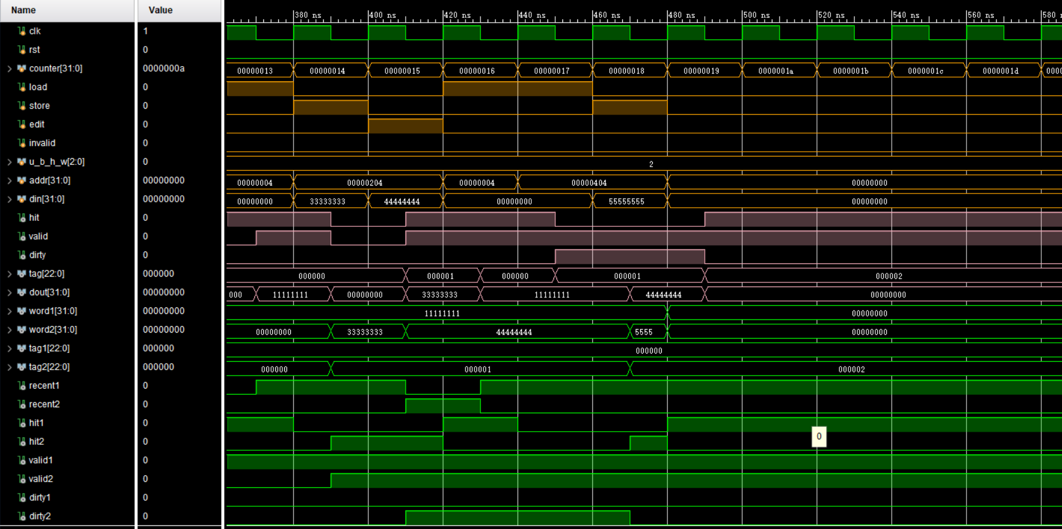
Simulation Example(2)

Slide 17
Simulation
Write Simulation Code yourself
cache initialization
read
miss
hit
write
miss
hit

Slide 18
Checkpoints
CP1:
Waveform Simulation of Cache Line.

Slide 19
Thanks!

