Slide 1
LLM RAG

Slide 2
Dataset
Dataset | FAQ | Finance | Insurance
Data Type | Mapping Q-A | PDF files | PDF files
Data Count | 616 | 1035 | 643
Noted:
Data Cleaning (from Slack): repeating same page
=> insurance/85.pdf vs insurance/48.pdf
Table Data
=> Yes
Image/Figure Data
=> No

Slide 3
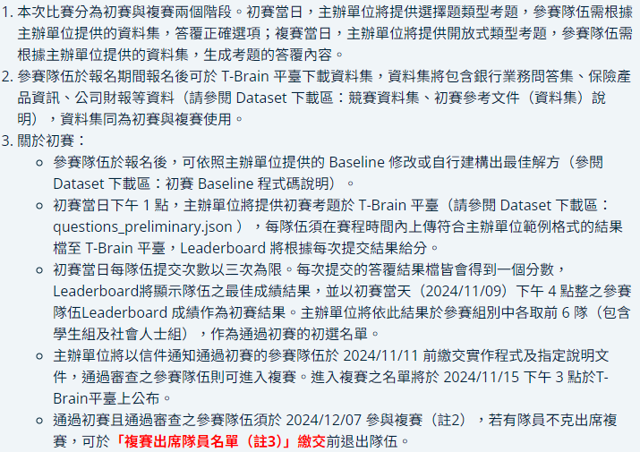
Preliminary rule
?

Slide 4
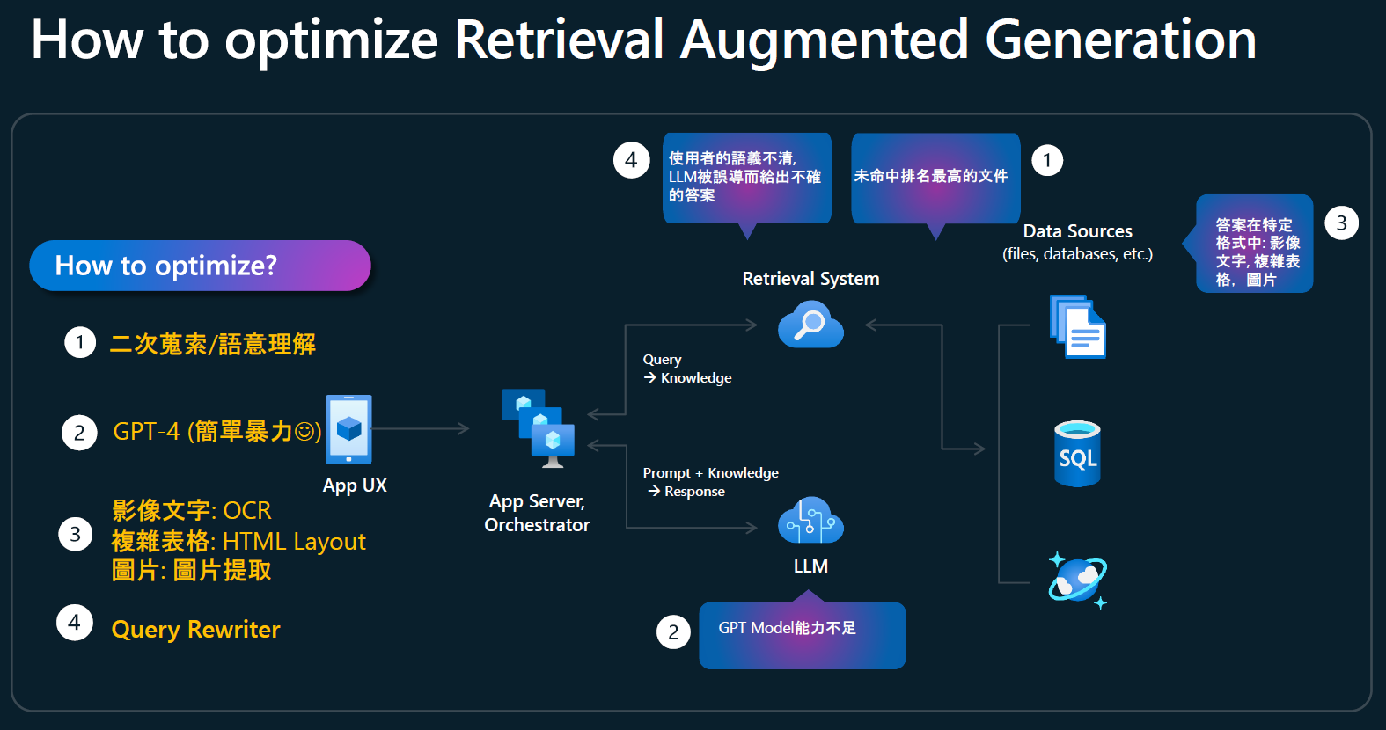
Approach

Slide 5
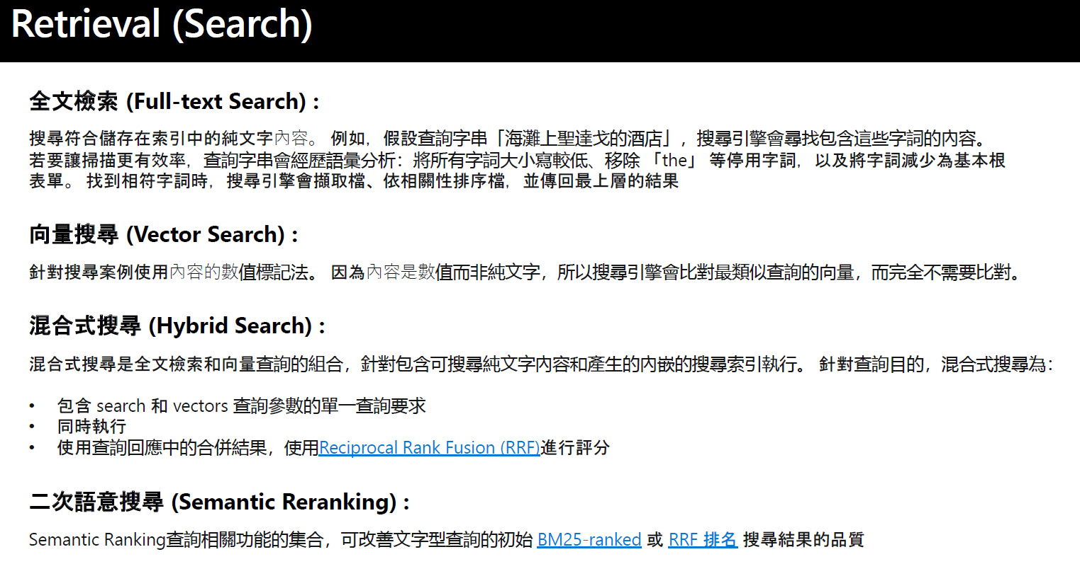
Approach

Slide 6
Approach
Chunking
Sematic Chucking
Vector Database
FAISS
Chroma
Retrieval (Search) Approach
Hybrid Search
Vector Search
Other Enhancement Methods
Reciprocal Rank Fusion

