Slide 1
Image Segmentation
Loop

Slide 2
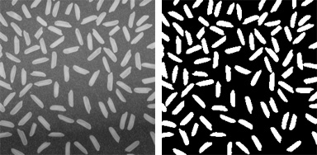
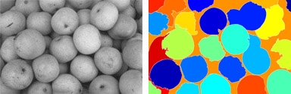
Introduction
image segmentation is the process of partitioning a digital image into multiple segments (sets of pixels, also known as super-pixels).
Segmentation subdivides an image into its constituent regions or objects

Slide 3
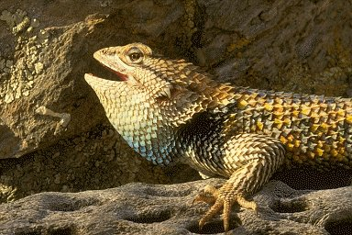
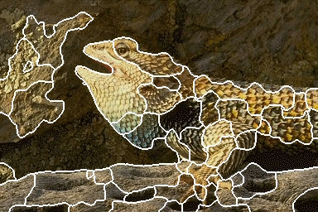
Introduction

Slide 4
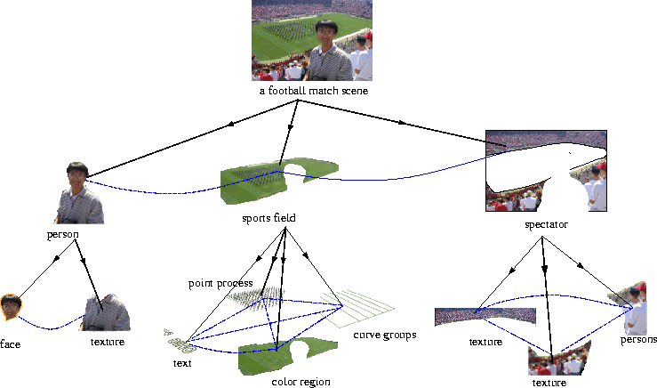
Introduction

Slide 5
Introduction
Segmentation algorithms for monochrome images generally are based on one of two basic categories dealing with properties of intensity values: similarity and discontinuity.
Thresholding Method
Watershed Method

Slide 6
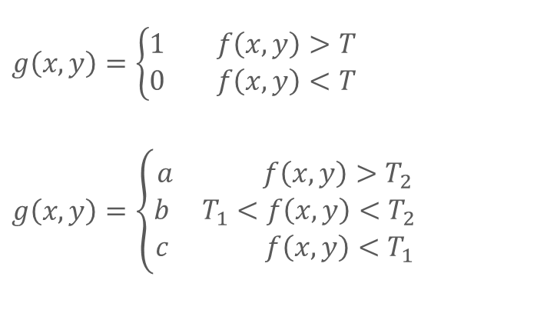
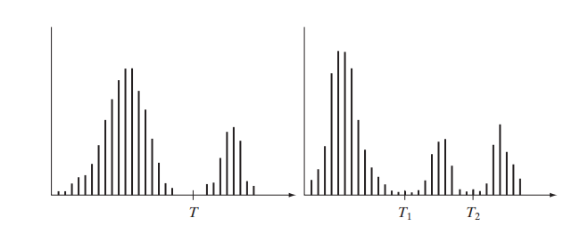
Thresholde Method
The Histogram

Slide 7
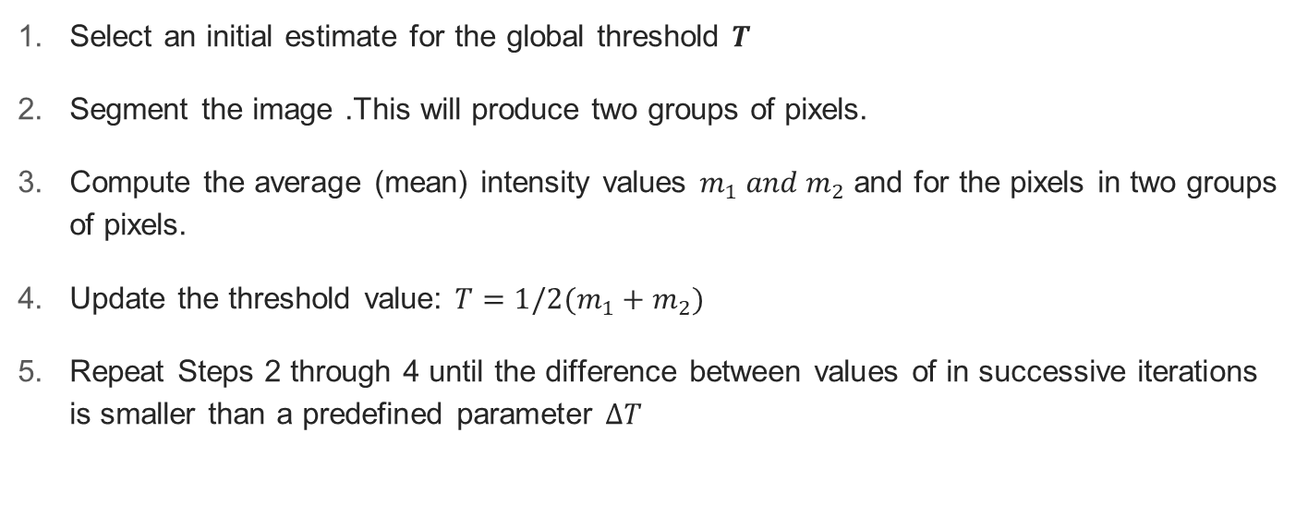
Global Thresholding

Slide 8
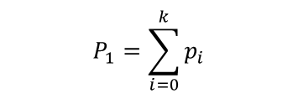

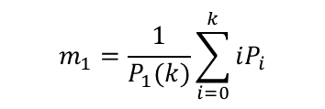
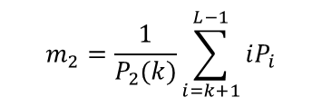
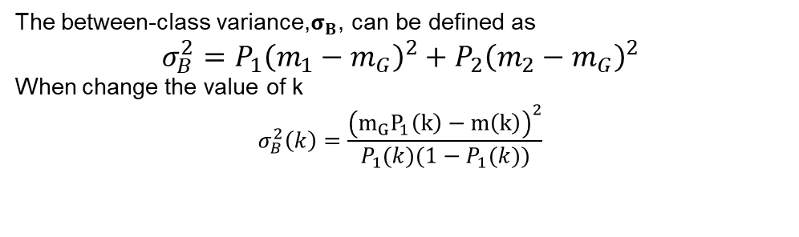
Global Thresholding
Otsu's method

Slide 9
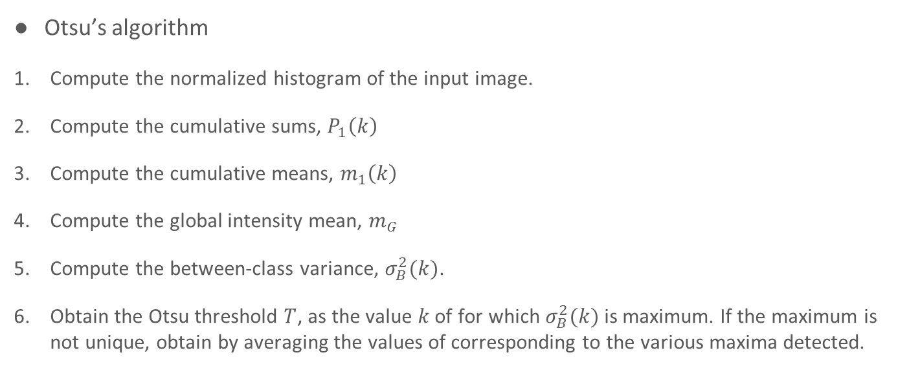
Global Thresholding

Slide 10
Problem

Slide 11
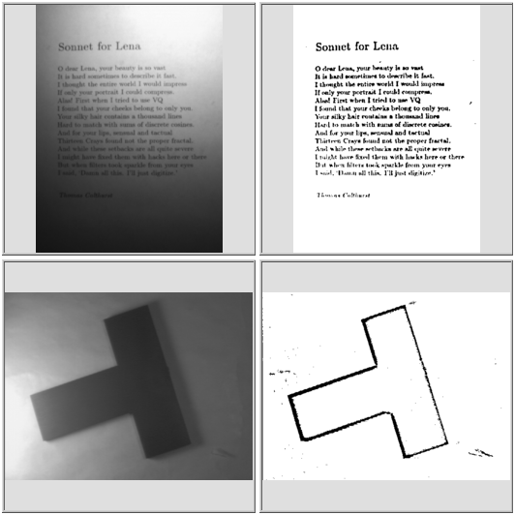
Problem
How?

Slide 12
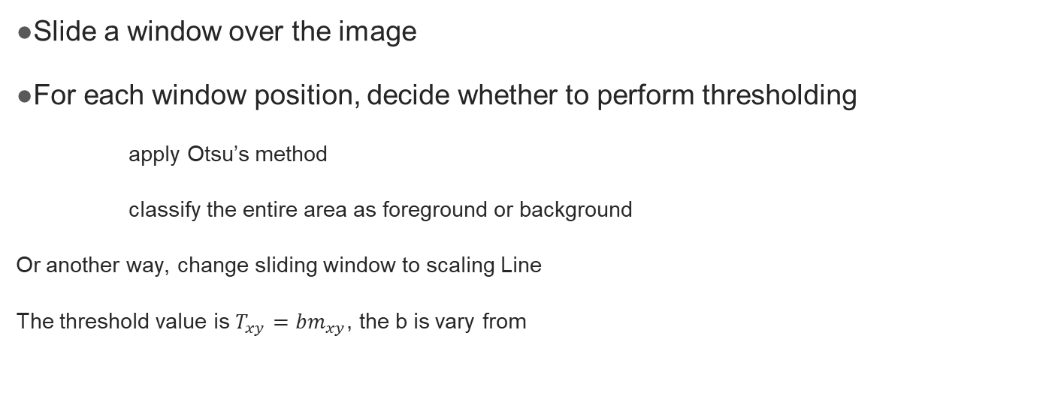
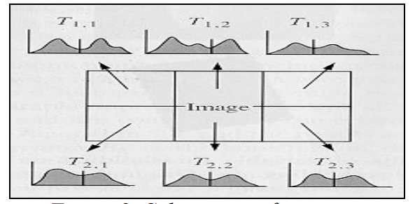

Locally adaptive thresholding

Slide 13

Multiple Thresholds
Single threshold is rarely sufficient for the whole image, similar to one threshold

Slide 14
Morphological Watersheds
treating an image as a height field or landscape, regions where the rain would flow into the same lake
Start flooding from local minima, and label ridges

Slide 15
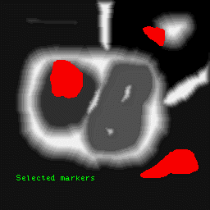

Morphological Watersheds
Marker-controlled watershed
flood this surface from its minima

Slide 16
Key Algorithm(you must know)
OTSU
Multiple Thresholds

Slide 17
Reference
https://cn.mathworks.com/discovery/image-segmentation.html
https://en.wikipedia.org/wiki/Image_segmentation
https://en.wikipedia.org/wiki/Otsu%27s_method
https://en.wikipedia.org/wiki/Watershed_(image_processing)

