Slide 1
Representing Rotations

Slide 2
Orientation Representation
orientation

Slide 3
Interpolation
O₁
O _{1.5}
O₂

Slide 4
Concatenation
O₁
O₂

Slide 5
3-D Transformations
Translate, scale, or rotate a point P to P’
P’=P+T
P’=SP
P’=RP
How to treat these transformations in a unified way?
P’ = MP
Representing P in the homogeneous coordinate
M can be used for animation, viewing, or modeling

Slide 6
Homogeneous Coordinate
In graphics, we use homogeneous coordinate for transformation
4x4 matrix can represent translation, scaling, and rotation and other transformations
Typically, when transforming a point in 3D space, we set w = 1

Slide 7
Translation
New point in 3D space
Point in 3D space
Transformation matrix

Slide 8
Scaling

Slide 9
Rotation
X axis
Y axis
Z axis

Slide 10
Compounding Transformations
Transformations can be treated as a series of matrix multiplications
rotation, scaling
translation

Slide 11
Two Ways of Interpreting a Rotation Matrix
Rotating a vector

Slide 12
Two Ways of Interpreting a Rotation Matrix
Rotating a coordinate
Transformation that maps from coordinate 1 to coordinate 0
Axes of coordinate 1 represented in coordinate 0
Notes:
x_bar, y_bar, u_bar, v_bar and V are vectors defined in the global coordinate (x_bar, y_bar)
(x^0, y^0) are the coordinates of V in the global coordinate (coordinate 0)
(x^1, y^1) are the coordinates of V in the local coordinate (coordinate 1)
V can be considered as a vector that can be represented in the local or global coordinate.

Slide 13
Rotation Matrix
Rows/columns of matrix must be orthonormal
Unit length and orthogonal
Numerical errors cause a nonorthonomral matrix when a series of rotations apply
How to interpolate between matrices?
Interpolating the components of two matrices doesn’t maintain the orthonormality
The generated matrix is not a rotation matrix

Slide 14
Interpolate Rotation Matrix?
The halfway matrix you get by linearly interpolating each entry is
Not a rotation matrix any more!
90º z-axis
-90º z-axis

Slide 15
Representing 3D rotations
Rotation Matrix
Fixed Angle
Euler Angle
Axis angle
Quaternion

Slide 16
Fixed Angle Representation
Ordered triple of rotations about global axes
Any triple can be used that doesn’t repeat an axis immediately, e.g., x-y-z is fine, so is x-y-x. But x-x-z is not.
Y
e.g., x-y-z order
Z
X

Slide 17
Fixed Angle Representation
(0,90,0) in x-y-z order
(90,45,90) in x-y-z order
Y
Y
(0,90,0)
X
X
Z
Z
Y
Y
(90,45,90)
(90,45,0)
(90,0,0)
X
X
Z
Z

Slide 18
Interpolation Problem in Fixed Angle
The rotation from (0,90,0) to (90,45,90) is a 45-degree x-axis rotation
Directly interpolating between (0,90,0) and (90,45,90) produces a halfway orientation (45, 67.5, 45)
Desired halfway orientation is (90, 22.5, 90)
Y
Y
Y
X
X
X
Z
(0,0,0)
Z
(0,90,0)
Z
(90,45,90)

Slide 19
Euler Angle
Ordered triple of rotations about local axes
As with fixed angles, any triple can be used that doesn’t immediately repeat an axis, e.g., x-y-z, is fine, so is x-y-x. But x-x-z is not.
Euler angle ordering is equivalent to reverse ordering in fixed angles
Y
y
Z
z
x
X

Slide 20
Fixed Angle vs. Euler Angle
Fixed angle: (90,45,90) in x-y-z order
Euler angle: (90,45,90) in z’-y’-x’ order
Y
Y
X
X
Z
Z
Y
Y
y’
X
x’
X
Z
Z

Slide 21
Fixed Angle vs. Euler Angle
Fixed angle: (90,45,90) in x-y-z order
Euler angle: (90,45,90) in z’-y’-x’ order
Y
Y
(90,0,0)
X
X
Z
Z
Y
Y
x’
(90,0,0)
X
y’
X
Z
Z

Slide 22
Fixed Angle vs. Euler Angle
Fixed angle: (90,45,90) in x-y-z order
Euler angle: (90,45,90) in z’-y’-x’ order
Y
Y
(90,45,0)
X
X
Z
Z
Y
Y
x’
(90,45,0)
X
y’
X
Z
Z

Slide 23
Fixed Angle vs. Euler Angle
Fixed angle: (90,45,90) in x-y-z order
Euler angle: (90,45,90) in z’-y’-x’ order
Y
Y
(90,45,90)
X
X
Z
Z
Y
Y
x’
(90,45,90)
y’
X
X
Z
Z

Slide 24
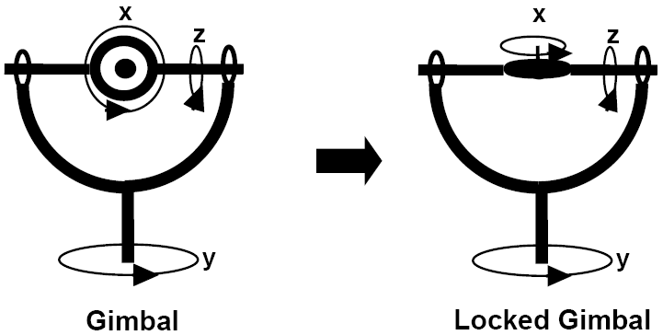
Gimbal Lock
A gimbal is a mechanical device allowing the rotation of an object in multiple dimensions
Gimbal lock occurs when two of the rotation axes align

Slide 25
Gimbal Lock
Gimbal lock is a basic problem with 3D representations using fixed or Euler angles
http://www.anticz.com/eularqua.htm

Slide 26
Axis Angle Representation
Euler’s rotation theorem
Any 3-D rotation can be described by 4 parameters
Rotate about by
(A_{x},A_{y},A_{z},θ)
Α
Y
θ
X
Z

Slide 27
Axis Angle Interpolation
Interpolate axis and angle separately
Y
Z
X

Slide 28
Axis Angle vs. Quaternion
Axis angle
Can interpolate the axis and angle separately
No gimbal lock
Cannot compose rotations efficiently
Quaternion
Good interpolation
No gimbal lock
Can be composed

Slide 29
Quaternion
4-tuple of real numbers
q=(s,x,y,z) or [s,v]
s is a scalar; v is a vector
Same information as axis/angle but in a different form
A=(A_{x},A_{y},A_{z})
Y
θ
X
Z

Slide 30
Quaternion Math
Addition
Multiplication
Multiplication is associative but not commutative

Slide 31
Quaternion Math (cont.)
A point in space is represented as [0, x, y, z]
Multiplicative identity
Inverse
ILE5030 Computer Animation and Special Effects 11S

Slide 32
Quaternion Rotation
To rotate a vector v using quaternion
Represent the vector as [0, v]
Represent the rotation as a quaternion q
q and –q represent the same orientation
ILE5030 Computer Animation and Special Effects 11S

Slide 33
Why q and –q represent same rotation?
Consider two axis angles that represent the same rotation

Slide 34
Compose Rotations
Prove by yourself that
ILE5030 Computer Animation and Special Effects 11S

Slide 35
Summary of Rotation Representations
Rotation Matrix
orthornormal columns/rows
bad for interpolation
Fixed Angle
rotate about global axes
bad for interpolation, gimbal lock
Euler Angle
rotate about local axes
same problem as fixed angle

Slide 36
Summary of Rotation Representations
Axis angle
rotate about A by θ , (A_{x},A_{y},A_{z},θ)
good interpolation, no gimbal lock
bad for compounding rotations
Quaternion
similar to axis angle but in different form
q=[s,v]
good for compounding rotations

Slide 37
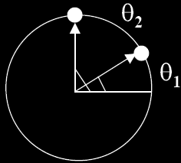
Visualizing Rotations
View rotations as points lying on an n-D sphere
Interpolating rotation means moving on n-D sphere
How about 3-angle rotation (quaternion)?
1-angle rotation
unit circle in 2D space
2-angle rotation
unit sphere in 3D space

Slide 38
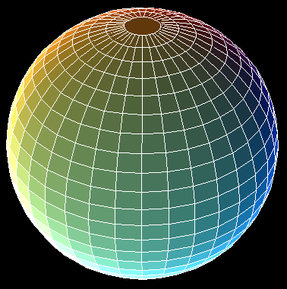
Quaternion Interpolation
A quaternion is a point on a 4D unit sphere
Unit quaternion: q=(s,x,y,z), ||q|| = 1
Interpolating rotations means moving on 4D sphere

Slide 39
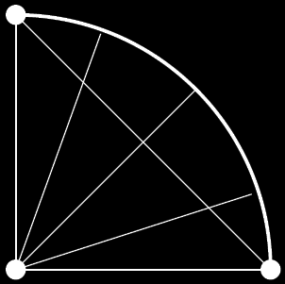
Linear Interpolation
Linear interpolation generates unequal spacing of points after projecting to circle

Slide 40
Spherical Linear Interpolation (slerp)
Want equal increment along arc connecting two quaternions on the spherical surface
Normalize to regain unit quaternion

Slide 41
Proof of Slerp Equation
It can be proved that
P
A
B
θ
Ω

Slide 42
Proof of Slerp Equation (cont.)
P
A
B
θ
Ω

Slide 43
Two equations for Two unknowns

Slide 44
Slerp: Pick Shortest Path
Recall that q and –q represent the same rotation
Slerp can go the LONG way!
Have to go the short way

Slide 45
Useful Analogies
Euclidean Space
Position
Linear interpolation
4D Spherical Space
Orientation
Spherical linear interpolation
(slerp)

Slide 46
What if there are multiple segments?
As linear interpolation in Euclidean space, we can have first order discontinuity
Need a cubic curve interpolation to maintain first order continuity in Euclidean space
Similarly, slerp can have 1st order discontinuity
We also need a cubic curve interpolation in 4D spherical space for 1st order continuity

Slide 47
Bezier Interpolation in Euclidean Space
-1
3
-3
1
P1 P2 P3 P4
3
-6
3
0
p(u) = [u3 u2 u 1]
-3
3
3
0
1
0
0
0
p’(0) = 3(p2-p1), p’(1)=3(p4-p3)
P1
P2
P3
P4

Slide 48
Bezier Interpolation in Euclidean Space
Colinearity of the control points at either side of
an endpoint guarantees the 1st order continuity
p’(0) = 3(p2-p1), P’(1)=3(p4-p3)
P1
P2
P3
P4

Slide 49
Bezier Interpolation of Quaternions
Bezier interpolation on 4D sphere?
How are control points generated?
How are cubic splines defined?
Control points are automatically generated as it is not intuitive to manually adjust them on a 4D sphere
Construct Bezier curves by iteratively linear interpolation → applying slerp
Let’s first see how to do the above two procedures in Euclidean space

Slide 50
Generating Collinear Control Points
-1
3
-3
1
p_{n}
a_{n} b_{n+1} p_{n+1}
3
-6
3
0
p(u) = [u³ u² u 1]
-3
3
3
0
1
0
0
0
p_{n}
a_{n}
p_{n+2}
p_{n-1}
b_{n+1}
p_{n+1}
a_{n+1}
1

Slide 51
De Casteljau Construction of Bézier Curve
Constructing Bezier curve by multiple linear interpolation
u=1/3
p(1/3)

Slide 52
De Casteljau Construction of Bézier Curve
from www.wikipedia.org

Slide 53
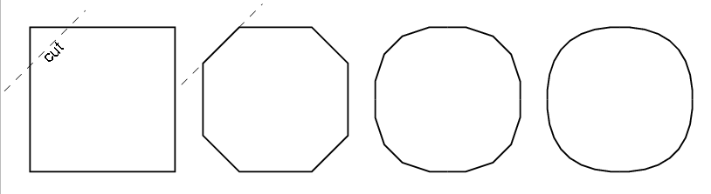
Geometric Intuition for Bézier Curves
By repeatedly cutting the corners off a polygon, we approach a smooth curve
This is called subdivision!

Slide 54
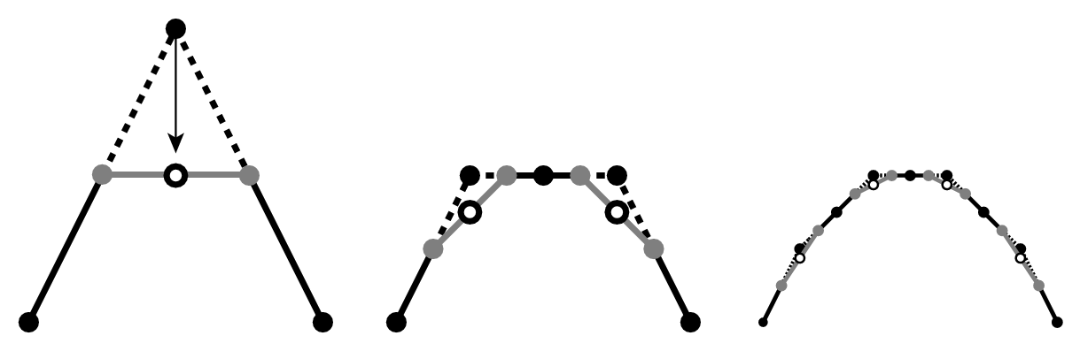
Subdivision Scheme
Defines a curve by breaking a simpler curve into smaller pieces
The limit curve (obtained by subdividing infinitely many times) will be a smooth curve

Slide 55
Subdivision Rule
The above rule can be generalized
Regrouping terms gives the quadratic Bézier

Slide 56
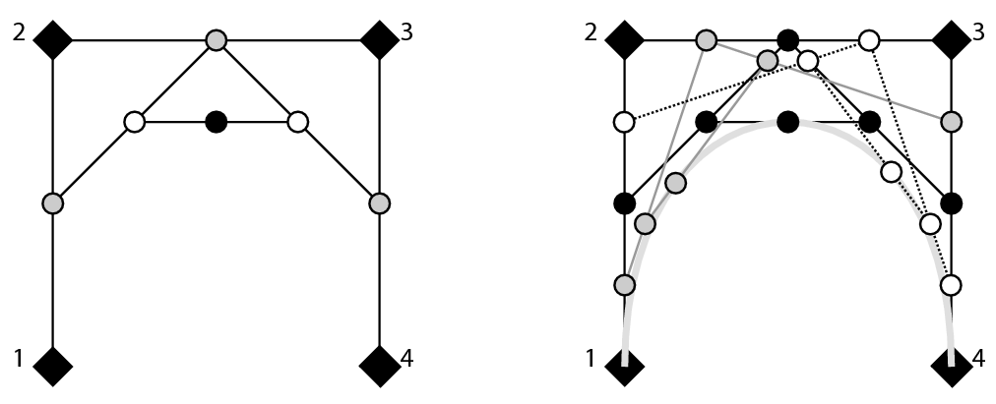
De Casteljau Algorithm
Constructs Bezier curve using a sequence of linear interpolation
u=1/3
p(1/3)

Slide 57
Bezier Interpolation of Quaternions
Automatically generating interior (spherical) control point
q’_{n-1}
1
b _{n}
q _{n}
a _{n}
q _{n+1}
Bisect the span
q _{n-1}
Double the arc

Slide 58
De Casteljau Construction on 4D Sphere
u=1/3
P(1/3)

