Slide 1
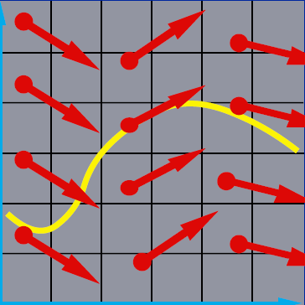
Differential Equation Basics
x₂
x₁
Witkin and Baraff’s course notes in SIGGRAPH’01: Physically-based modeling
http://www.cs.cmu.edu/~baraff/sigcourse/

Slide 2
Physics-based Simulation
A procedure that generates a sequence of the states of a system based on physics laws
x_{i}
Newtonian laws
elastic forces
wind
gravity
friction
…
x_{i}
x_{i+1}
x_{i+1}= x_{i}+ △x
△x

Slide 3
Outline
Differential equation basics (this class)
Implicit methods (next class )

Slide 4
Differential Equations
Differential equation describes the relation between an unknown function and its derivatives
Solving a differential equation is to find a function that satisfies the relation
Numerical solution of differential equations is based on finite-dimensional approximation

Slide 5
Ordinary Differential Equations
Ordinary differential equation (ODE)
All derivatives are with respect to single independent variable, usually representing time
Known function
Unknown function that evaluates the state given time
Time derivative of the unknown function
*We’ll show that a higher ODE can be transformed into this 1st order system soon!

Slide 6
Higher-Order ODEs
Order of ODE determined by highest-order derivative of solution function appearing in ODE
Equations with higher derivatives can be transformed into equivalent first-order system

Slide 7
Higher-Order ODEs (cont.)
Given k-th order ODE
Define
Original ODE equivalent to first order system

Slide 8
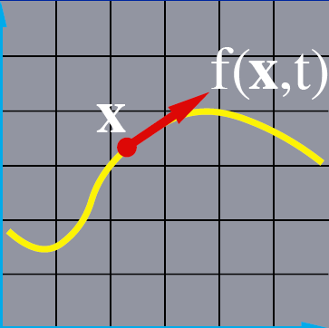
Visualizing Solution of ODE
x₂
x₁

Slide 9
Vector Field
The differential equation defines a vector field over x
x₂
Think of this vector field as the sea, and the velocity of current at different places and time is defined by f(x,t)
x₁

Slide 10
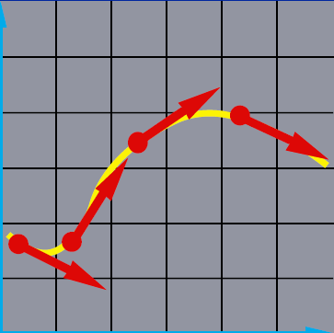
Integral Curves
Pick a starting point, and follow the vectors
x₂
Release a ball at any starting point and let it drift following the current. The trajectory swept out by the ball is an integral curve
x₁

Slide 11
Initial Value Problem
Given the starting point, follow the integral curve
x₂
Where the ball is carried depends on where we initially drop it, but once dropped, all future motion is determined by f(x,t)
x₁

Slide 12
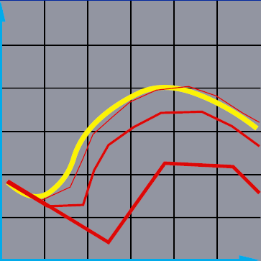
Numerical Solution of ODEs
Instead of true integral curve, numerical solution follow a polygonal path
Each leg is obtained by evaluating the derivative at discrete time steps
Bigger steps, bigger errors
x₂
x₁

Slide 13
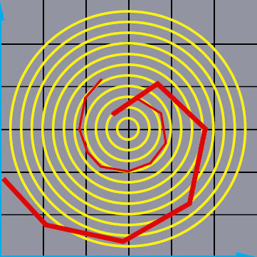
Issue I: Inaccuracy
Error turns x(t) from a circle into the spiral of your choice!
x₂
x₁

Slide 14
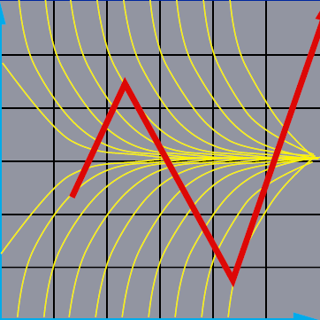
Issue II: Instability
x₂
x₁

Slide 15
Euler’s Method
Simplest numerical solution method
Bigger time steps, bigger errors
x₂
x₁

Slide 16
Euler’s Method (cont.)
Solves ODE using one-term Taylor-series
O(h²):
2nd order accurate

Slide 17
Drawbacks of Euler’s Method
Inaccuracy
Inefficiency
Need to use small time-steps to avoid divergence
Example: http://heath.cs.illinois.edu/iem/ode/eulrmthd/
Improvement using the midpoint method
Slope at midpoint is used

Slide 18
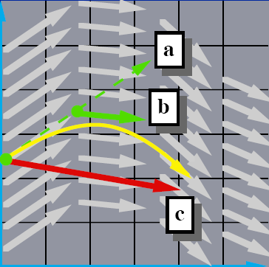
The Midpoint Method
Compute an Euler step
Evaluate f at the midpoint
Take a step using the midpoint value
x₂
x₁

Slide 19
Accuracy of the Midpoint Method is O(h³)
Solves ODE using two-term Taylor-series
Approximating f’ by Taylor-series

Slide 20
Accuracy of the Midpoint Method (cont.)

Slide 21
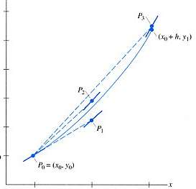
Runge-Kutta 4th Order Method
Using a weighted average of slopes obtained at four points

Slide 22
Adaptive Step Size
Ideally, we want to choose h as large as possible, but not so large as to cause big error or instability
We can vary h as we march forward in time

Slide 23
Adaptive Step Size for Euler’s Method
Estimate x_{a} by taking a full Euler step
Estimate x_{b} by taking two half Euler steps
Error estimate: e = |x_{a} - x_{b}| is bounded by O(h²)
x_{a} and x_{b} differ from the true value of x(t_{a}+h) by O(h²)

Slide 24
Adaptive Step Size for Euler’s Method
What is optimal h if we want to have an error of as much as ε, and the current error is e?

Slide 25
Take Home Message
x₂
Don’t use Euler’s method
Inaccuracy
Inefficiency (or unstable)
Do use adaptive step size or implicit method
Read Witkin and Baraff’s course notes in SIGGRAPH’01: Physics-based modeling
x₁

