Slide 1
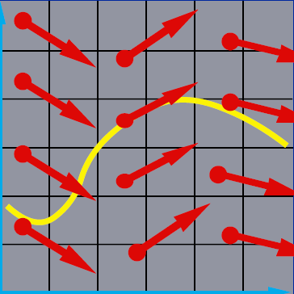
Differential Equation Basics (2)
x₂
x₁

Slide 2
Outline
Stability of ODE
Propagation error
Stiff system
Implicit method

Slide 3
Stability of Analytic Solution of ODE
Stable if solutions resulting from perturbations of initial value remain close to original solution
Unstable if solutions resulting perturbations diverges away from original solution without bound
Neutrally stable if solutions resulting from perturbations are neither stable or unstable

Slide 4
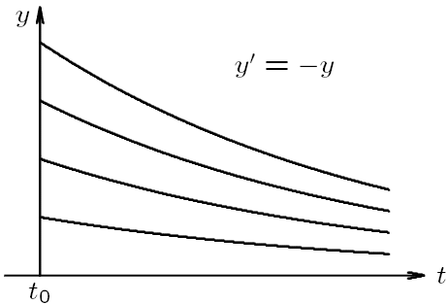
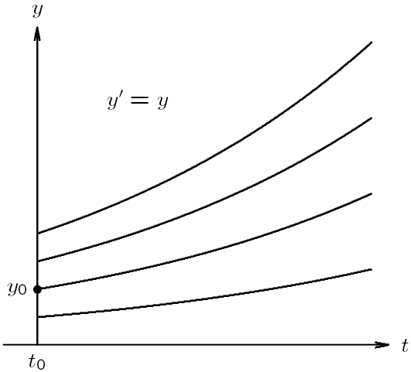
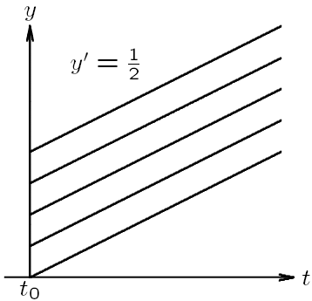
Example: Stability of ODE
Stable
Unstable
Neutrally
stable

Slide 5
Stability of Numerical Solution of ODE
Numerical solution is stable if small perturbations do not cause resulting numerical solutions to diverge from each other without bound
Divergence of numerical solutions could be caused by instability of analytical solution to ODE, but can also be due to numerical method itself, even when solutions to ODE is stable

Slide 6
Determining Stability and Accuracy
Simple approach to determining stability and accuracy of numerical method is to apply it to scalar ODE x’=Ax, where A is (possibly complex) constant
For a given numerical method, we can
Determine stability by characterizing growth of numerical solution
Determine accuracy by comparing exact and numerical solutions

Slide 7
Example: Euler’s Method
Applying Euler’s method to x’=Ax using fixed step size h, we have
If Re(A) < 0, exact solution is stable
Numerical solution is also stable if
If A<0 and is real, we must have h<-2/A for Euler’s method to be stable

Slide 8
Propagated Error
Error made early in the process will also affect the late computations—the early error will be propagated
Propagated error analysis is not easy
We only analyze the propagated error for Euler’s method here

Slide 9
Propagated Error—Euler’s method
Numerical solution by Euler’s method
Analytic solution using Taylor series
Notes:
The last two equations are obtained from taking MVT to f(x)

Slide 10
Propagated Error—Euler’s method

Slide 11
Propagated Error—Euler’s method
Global error is the sum of propagated error and local error
Truncation error at each step is propagated to every later step with a growth factor (1+hK) each time!

Slide 12
Propagated Error—Euler’s method
Error does not grow if
This can be generated to higher-order case
Error does not grow if the norm of all eigenvalues of (I+hJ_{f}) less than 1
Jacobian of f:

Slide 13
Stability of Numerical Methods for ODEs
In general, growth factor depends on
Numerical method, which determines form of growth factor
Step size h
ODE, which determines Jacobian J_{f}

Slide 14
Stiff Equations
Let’s consider a simple ODE x’=-kx
k can be viewed as a stiffness constant
Some Physics: Spring-Damper System
Damper system
Spring force
Damping force: reduce the amplitude of oscillation

Slide 15
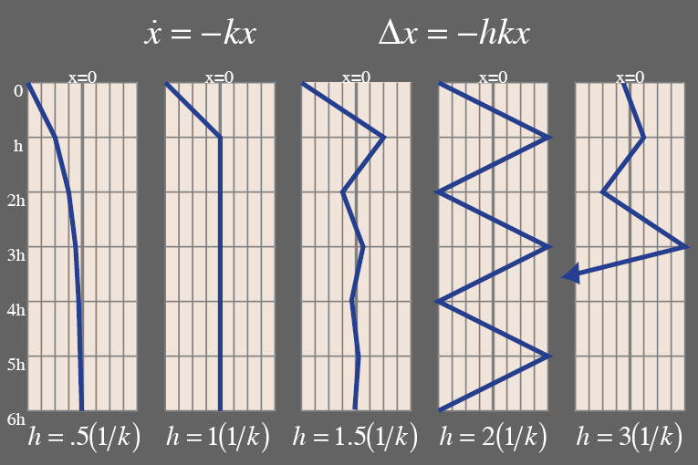
Step size of Euler’s method is limited by k
If h > 2/k, explode!
For a big k, h needs to be very small!
For convergence:

Slide 16
Stiff Equations
In more complex system, step size is limited by the largest k. One stiff spring can screw it up for everyone else
Systems that have some big k’s mixed in are called stiff systems
Remedy to stiff equations
Using small step size → very inefficient
Implicit methods

Slide 17
Implicit Method
Euler’s method is explicit in that it uses only information at time t_{n} to advance solution to time t_{n+1}
Larger stability region can be achieved using information at time t_{n+1}, which makes method implicit
y=f(t): y is an explicit function of t f(y,t)=0: y is an implicit function of t

Slide 18
Backward Euler Method
Explicit Euler Method
Implicit (Backward) Euler Method
Example: x’=-kx
In this case,
stable for any h > 0

Slide 19
Implicit Euler Method:
We must evaluate f with x_{n+1} before we know its value
Therefore, we need to solve algebraic equation to determine x_{n+1}
Root finding
Approximate f by

Slide 20
Example: Backward Euler Method
http://heath.cs.illinois.edu/iem/ode/backeulr/
Read the course note on the E3 course web

Slide 21
Example: solving a kth-order ODE
Convert to a system of 1st-order equations
Implicit method

Slide 22
Convert to a system of 1st-order ODE
Given k-th order ODE
Define
Original ODE equivalent to first order system

Slide 23
Example: kth-order ODE

