Slide 1
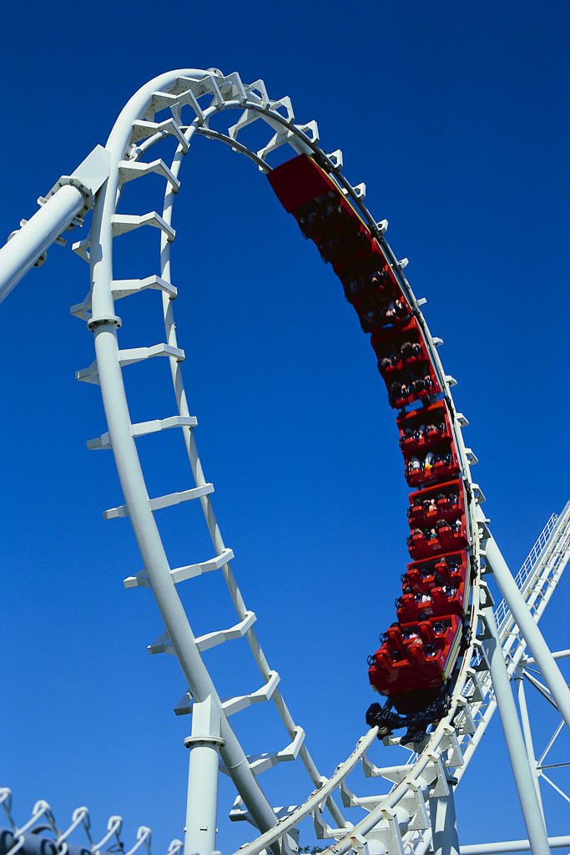
Constraint Particles

Slide 2
Outline
Constraint force
Single implicit constraint
Multiple implicit constraint
Parametric constraint

Slide 3
A Simple Example
A bead on a wire
The bead can slide freely along the wire but cannot come off it
How do we simulate the motion of the bead when arbitrary forces applied to it

Slide 4
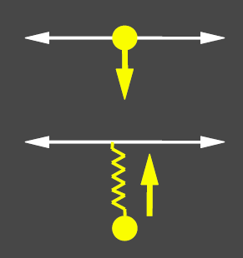
Penalty Constraints
Why not use a spring to hold the bead on the wire?
Problems:
Weak spring won’t do the job
Strong springs results in stiff systems

Slide 5
Constraint Force
What is legal acceleration?
Depends on both n and v
Compute such that the net force only generates legal acceleration
n
f
v
a
a

Slide 6
Constraint Force
Need to compute constraint forces that cancel the illegal applied forces
Need to know what legal acceleration is

Slide 7
Constraint force
Single implicit constraint
Multiple implicit constraint
Parametric constraint

Slide 8
Constraints
Implicit
Parametric
x
θ
r

Slide 9
Legal Acceleration
What is the legal position?
What is the legal velocity
What is the legal acceleration?
inner product
assume unit circle

Slide 10
Legal Conditions
If we start with legal position and velocity
We only need ensure the legal acceleration

Slide 11
Constraint Force
Use the legal condition to compute the constraint force
Substitute with

Slide 12
Constraint Force
We have one equation and two variables
Need one more condition to solve the constraint force

Slide 13
Virtual Work
Constraint force is passive—no energy gain or loss
Kinetic energy of the system
which is virtual work done by f and
Make sure does no work for every legal velocity
set of legal velocity

Slide 14
Virtual Work
The virtual work condition can be rewritten as
Substituting for in
Notes:
Since x*x’ = 0 and f*x’ = 0 → f is parallel to x → f = lamda * x

Slide 15
Geometric Interpretation
Constraint force
If the system is at rest
Only the tangent component of the applied force is kept
Normal component of the applied force

Slide 16
Constraint force
Single implicit constraint
Multiple implicit constraint
Parametric constraint

Slide 17
Generalization to Particle System
We know how to simulate a bead on a wire now
Apply the same idea, we can create a constrained particle system

Slide 18
Constraint Particles
Particles: each particle represents a point in the phase space
Forces: each force affects the acceleration of certain particles
Constraints:
Each is a function C_{i}(x₁,x₂,…)
Legal state: C_{i}(x₁,x₂,…) = 0, for all i
Constraint force: linear combination of constraint gradients

Slide 19
Motion Equation in General Case
For a system of n particles

Slide 20
Constraint Equation in General Case
System of constraint equation
To compute the legal acceleration: Let we can get
Jacobian
Constraint forces

Slide 21
Principle of Virtual Work
To ensure the constraint force does not produce work
All vectors satisfy the condition can be expressed as
vector

Slide 22
Two Conditions for Constraint Forces
Legal acceleration
Principle of virtual work
Constraint forces obtained by solving the linear system

Slide 23
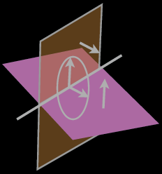
Constraint Gradients (cont.)
Normal of C₁:
Normal of C_{m} :

Slide 24
Constraint Gradients (cont.)
Legal states: the intersection of two planes
Normal of legal states
Constraint forces are aligned with the normal of legal states
Work done by constraint forces is zero
Notes:
Constraint forces are linear combination of the normals of hypersurfaces!

Slide 25
Impress your friends
The requirement that constraints not add or remove energy is called the Principle of Virtual Work
The λ’s are called Lagrangain Multipliers

Slide 26
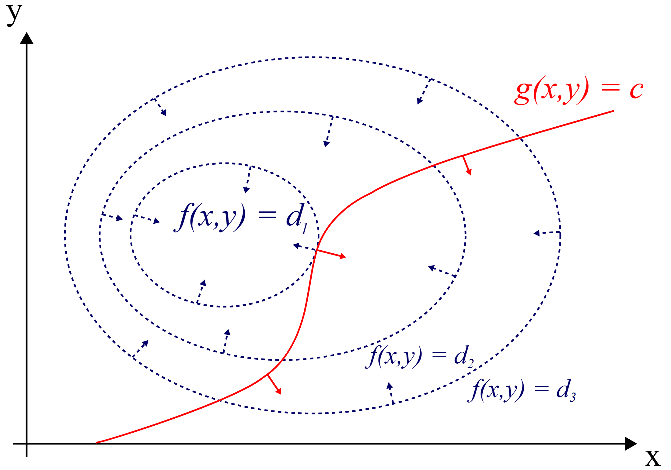
Side Note on Lagrange Multiplier
Finds the local maxima/minima of a function subject to equality constraints
Maximize f(x,y)
Sub. to g(x,y)=0
Notes:
The red line shows the constraint g(x, y) = c. The blue lines are contours of f(x, y). The point where the red line tangentially touches a blue contour is the maximum of f(x, y), since d₁ > d₂.

Slide 27
Constraints
Implicit
Parametric
x
θ
r

Slide 28
Parametric Constraints
Constraint is always met exactly
1 degree of freedom:
Solve for
x
θ
r

Slide 29
Parametric Constraints
Constraint is always met exactly
x
T
θ
r
Multiply both sides by T
virtual work principle

Slide 30
Lagrangian Dynamics
See Witkin & Baraff’s note for generalization to a system of n-particles using parametric constraints
This type of method is called Lagrangian Dynamics
Instead of working on unconstrained q
We work on a constrained space u and solve for through the parametric function
Generalized coordinate

Slide 31
Parametric Constraints
Advantages
Fewer degrees of freedom
Constraints are always met
Disadvantages
Hard to find a parametric function that captures the desired constraints
Hard to combine constraints

