Slide 1
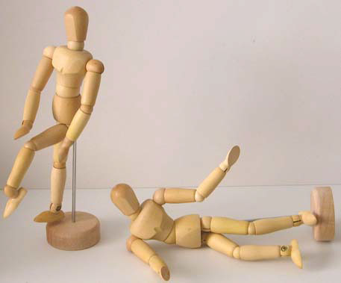
Kinematics

Slide 2
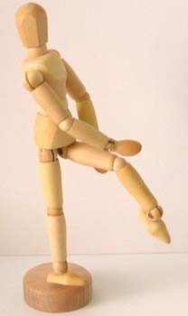
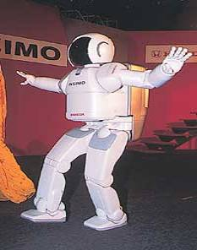
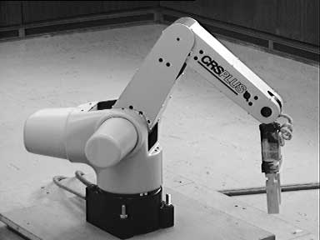
Kinematics
The branch of mechanics concerned with the motions of objects without regard to the forces that cause the motion
Why kinematics?
Hierarchical articulated model
Posing a character

Slide 3
Degrees of Freedom (DOF)
The minimum number of coordinates required to specify completely the motion of an object
yaw
roll
pitch
6 DOF: x, y, z, raw, pitch, yaw

Slide 4
Degrees of Freedom in Human Model
Root: 3 translational DOF + 3 rotational DOF
Rotational joints are commonly used
Each joint can have up to 3 DOF
Shoulder: 3 DOF
Wrist: 2 DOF
Knee: 1 DOF
3 DOF
1 DOF

Slide 5
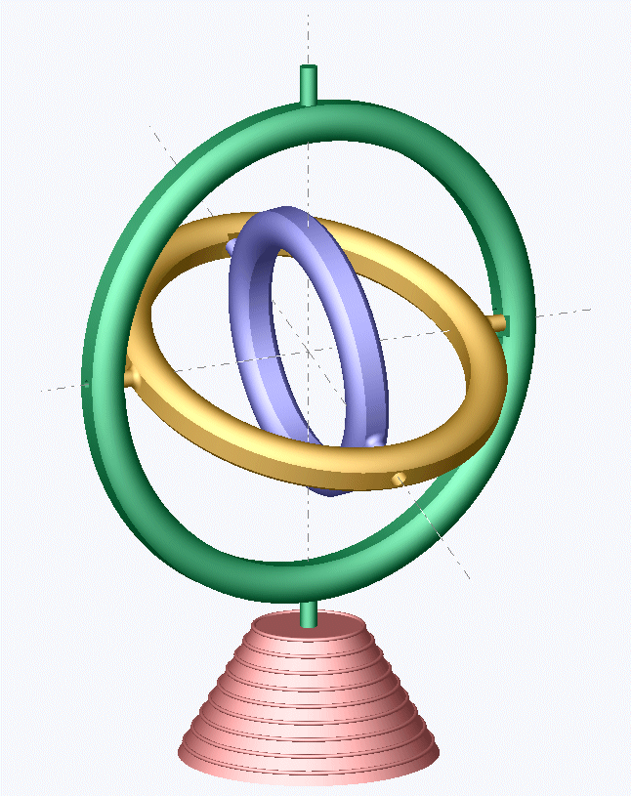
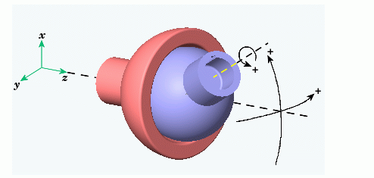
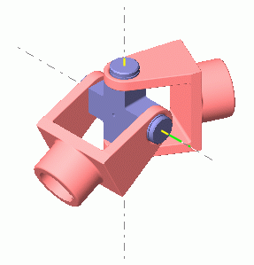
Revolute Joints
3 DOF joint
gimbal
ball and socket
2 DOF joint
universal

Slide 6
Hierarchical Articulated Model
Represent an articulated figure as a series of links connected by joints
Enforce limb connectivity in a tree-like structure
root

Slide 7
Joint Space vs. Cartesian Space
Joint space
space formed by joint angles
position all joints—fine level control
Cartesian space
3D space
specify environment interactions

Slide 8
Forward and Inverse Kinematics
Forward kinematics
mapping from joint space to cartesian space
Inverse kinematics
mapping from cartesian space to joint space
Forward Kinematics
Inverse Kinematics

Slide 9
Forward and Inverse Kinematics (cont.)
Forward kinematics
rendering
Inverse kinematics
good for specifying environment interaction
good for controlling a character—fewer parameters

Slide 10

Notations
: vector represented in coordinate frame i
: global position of the origin of coordinate frame i (global position of the ith joint)
: rotation matrix that transforms a vector from coordinate frame i to coordinate frame j, i.e.,
$${}_{i}^{}T$$

Slide 11






Forward Kinematics
$${}_{0}^{i}{R=\left[\begin{matrix}{}_{i}^{}X & {}_{i}^{}Y & {}_{i}^{}Z\end{matrix}\right]}$$
$${}_{i}^{}Z$$
$${}_{i}^{}Y$$
$$V_{i}$$
$${}_{i}^{}X$$
$${}_{i+1}^{}T={}_{0}^{1}R\left\{{}_{1}^{2}R⋯{}_{i−2}^{i−1}R\left({}_{i−1}^{i}RV_{i}+V_{i−1}\right)+V_{i−2}]⋯{]+V}_{1}\right\}$$
$${}_{i+1}^{}T={}_{0}^{i}RV_{i}+{}_{i}^{}T$$

Slide 12
Forward Kinematics by Composing Transformations
End Effector
Relative rotation from the local coordinate of parent link to
the local coordinate of the child link
Notes:
Moving local coordinate along the joint-link chain.

Slide 13
With simplified notations
?
End Effector
Base

Slide 14
Acclaim Format
Skeletal animation file format including
.ASF: Skeleton file
.AMC: Motion file
All information in ASF file is specified with respect to the global coordinate, while all information in AMC file is specified with respect to the local coordinate.

Slide 15
ASF File
Describes the local frame of each bone of a neutral (zero) pose in the global coordinate, e.g. Euler angle in xyz order,
We need to compute the relative transformation and the unit-length bone direction vector in local coordinate
begin
id 2
name lfemur
direction 0.342 -0.939 0
length 7.113
axis 0 0 20 XYZ
dof rx ry rz
limits (-160.0 20.0)
(-70.0 70.0)
(-60.0 70.0)
end

Slide 16
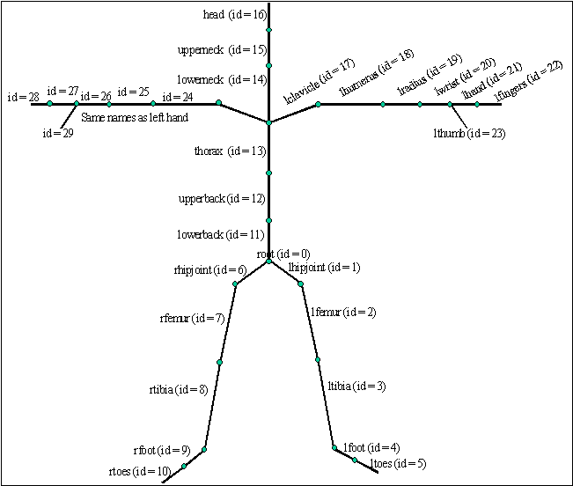

Slide 17
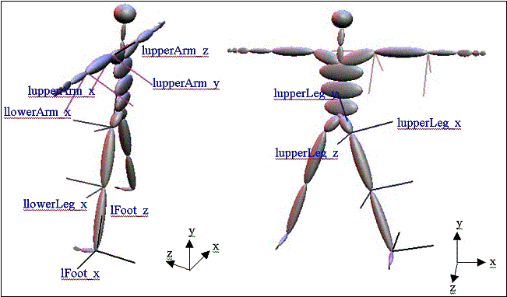

Slide 18
AMC File
#!OML:ASF F:\VICON\USERDATA\INSTALL\rory3\rory3.ASF
:FULLY-SPECIFIED
:DEGREES
1
root 3.1294 17.6906 0.576147 -69.7364 88.7134 -68.7451
lowerback 5.37529 -0.419929 3.55267
upperback -1.47894 -0.3644 -1.32457
thorax -4.58452 -0.299522 -3.33877
lowerneck -3.64552 -5.65816 -4.72229
upperneck 4.19034 -7.74441 9.40555
head 2.64463 -3.6745 3.67041
rclavicle 1.2921e-015 1.55052e-014
rhumerus -39.2113 -25.8219 -71.2854
rradius 20.028
rwrist 28.2698
rhand -0.838087 16.263
rfingers 7.12502
rthumb 24.7874 -12.1506
lclavicle 1.2921e-015 1.55052e-014
lhumerus -35.6109 24.573 71.3578
lradius 16.6086
lwrist 15.9001
lhand -12.5773 10.6855
lfingers 7.12502
lthumb 13.5007 40.2279
rfemur 1.2602 0.329943 20.7559
rtibia 13.9379
rfoot -15.3822 -1.1112
rtoes -8.02936
lfemur 3.52626 0.806532 -14.1882
ltibia 8.14895
lfoot -11.1811 0.939771
ltoes -6.61339

Slide 19





Forward Kinematics in ASF/AMC
begin
id 2
name lfemur
direction 0.342 -0.939 0
length 7.113
axis 0 0 20 XYZ
dof rx ry rz
limits (-160.0 20.0)
(-70.0 70.0)
(-60.0 70.0)
end
$${}_{i}^{}T={}_{0}^{i−1}RV_{i−1}+{}_{i−1}^{}T$$
$${}_{i}^{}Z$$
$$V_{i}$$
$${}_{i}^{}Y$$
$${}_{i}^{}X$$

Slide 20
Inverse Kinematics
End Effector=P
Base

Slide 21
Redundancy in IK
Our example
2 equations (constraints)
3 unknowns
Multiple solutions exist!
This is not uncommon!
see how you can move your elbow while keeping your finger touching your nose

Slide 22
Other problems in IK
Infinite solutions

Slide 23
Other problems in IK
No solutions

Slide 24
Why Is IK hard?
Redundancy
Natural motion
joint limits
minimum jerk
style?
Singularities
ill-conditioned matrix
shown later

Slide 25
Solving Inverse Kinematics
Analytic method
Inverse-Jacobian method
Optimization-based method
Example-based method

Slide 26
Analytic Method
θ₂
L2
L1
Goal
θ₁
(X,Y)

Slide 27
Analytic Method (cont.)
L2
180- θ₂
L1
(X,Y)
θ₁
θ_{T}
Y
X

Slide 28
Cosine Law
C
A
α
B

Slide 29
Analytic Method
L2
L1
180- θ₂
(X,Y)
θ₁
θ_{T}
Y
X

Slide 30
Inverse-Jacobian method
When linkage is complicated
Iteratively change the joint angles to approach the goal position and orientation

Slide 31
Jacobian
Jacobian is the n by m matrix relating differential changes of θ to differential changes of p (dp)
Jacobian maps velocities in joint space to velocities in cartesian space

Slide 32
Kinematic Interpretation of Jacobian

Slide 33
Example: Jacobian for a 2D arm
Let’s say we have a simple 2D robot arm with two 1-DOF rotational joints:
• p=[p_{x} p_{y}]
θ₂
θ₁

Slide 34
Jacobian for a 2D arm
The Jacobian matrix J(θ) shows how each component of p varies with respect to each joint angle

Slide 35
Jacobian for a 2D arm
Consider what would happen if we increased θ₁ by a small amount. What would happen to p ?
•
θ₁

Slide 36
Jacobian for a 2D arm
What if we increased θ₂ by a small amount?
•
θ₂

Slide 37
Jacobian for a 2D arm
•
θ₂
θ₁

Slide 38
Computing Jacobian analytically
A simple example:
You can imagine how computing Jacobian gets ugly when there are multiple joints!

Slide 39
Computing Jacobian geometrically
Instead of computing Jacobian analytically, we can take a geometric approach to compute it
Let’s say we are just concerned with the end effector position p for now.
This also implies that the Jacobian will be an 3×N matrix where N is the number of DOFs
For each DOF of a joint, we analyze how p would change if the DOF changes

Slide 40
Rotational DOFs
Let’s consider a 1-DOF rotational joint first
We want to know how the global position p will change if we rotate around the axis.
•
unit-length rotation
axis vector
θ₁

Slide 41
Rotational DOFs
•
a_{i}: unit length rotation axis in world space
r_{i}: position of joint pivot in world space
p: end effector position in world space
•

Slide 42
3-DOF Rotational Joints
Once we have each axis in world space, each one will get a column in the Jacobian matrix
At this point, it is essentially handled as three 1-DOF joints, so we can use the same formula for computing the derivative as we did earlier:
We repeat this for each of the three axes

Slide 43
Iterative IK Using Inverse Jacobian
P
P+dP
P_{goal}
Linearize about θ_{k} locally
Small increments

Slide 44
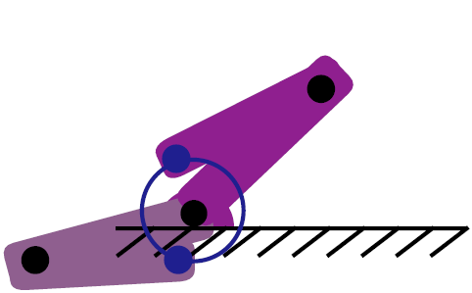
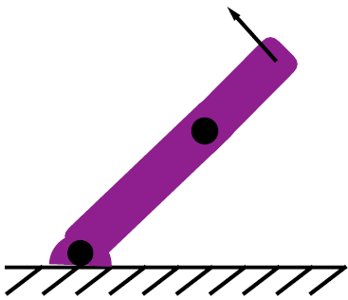
Jacobian may not be invertible!
Non-square matrix
pseudo inverse
Singularity
causes infinite joint velocities
occurs when any cannot achieve that is not perpendicular to the arm

Slide 45
Remedy to Singularity Problem
Add redundancy
add more joints to the original joint chain
(more DOFs are added)
Jacobian matrix is not square
Use pseudo inverse of Jacobian!

Slide 46
Pseudo Inverse of the Jacobian

Slide 47
Adding more control to IK
Pseudo inverse computes one of many possible solutions that minimize joint angle velocities
IK using pseudo inverse Jacobian may not provide natural poses
A control term can be added to the pseudo inverse Jacobian solution
The control term should not add anything to the velocities, that is
control term

Slide 48
Control Term Adds Zero Linear Velocities
A solution of this form
When put into this formula
Like this
After some manipulation, you can show that …
…it doesn’t affect the desired configuration
But it can be used to bias
The solution vector

Slide 49
Null space
The control term C is in the null space of J
The null space of J is the set of vectors which have no influence on the constraints

Slide 50
Utility of Null Space
The null space can be used to reach secondary goals
Or to find natural pose / control stiffness of joints

Slide 51
Optimization-based Method
Formulate IK as an nonlinear optimization problem
Example
Objective function
Constraint
Iterative algorithm
Nonlinear programming method by Zhao & Badler, TOG 1994

Slide 52
Objective Function
“distance” from the end effector to the goal position/orientation
Function of joint angles : G(θ)
Goal
distance
End Effector
Base

Slide 53
Objective Function
Position Goal
Orientation Goal
Position/Orientation Goal
weighted sum

Slide 54
Nonlinear Optimization
Constrained nonlinear optimization problem
Solution
standard numerical techniques
MATLAB or other optimization packages
usually a local minimum
depends on initial condition
limb coordination
joint limits

Slide 55
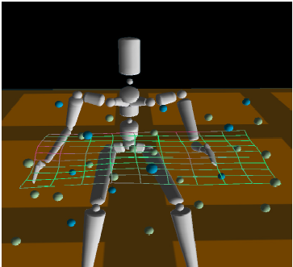
Example-based Method
Utilize motion database to assist IK solving
IK using interpolation
Rose et al., “Artist-directed IK using radial basis function interpolation,” Eurographics’01

Slide 56
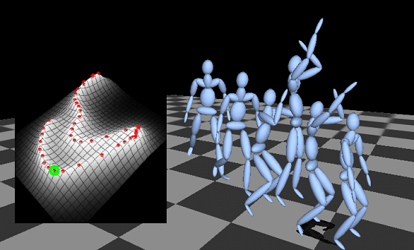
Example-based Method (cont.)
IK using constructed statistical model
Grochow et al., “Style-based inverse kinematics,” SIGGRAPH’04
Provide the most likely pose based on given constraints

Slide 57
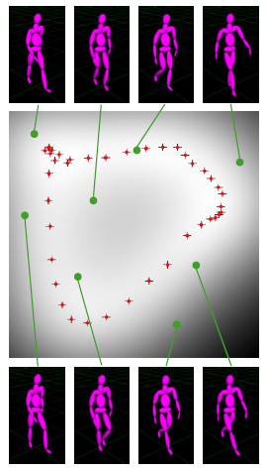
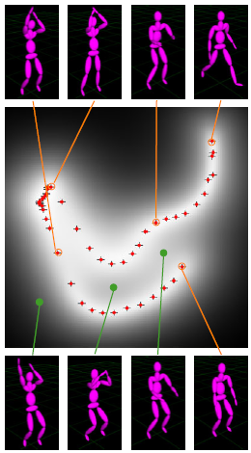
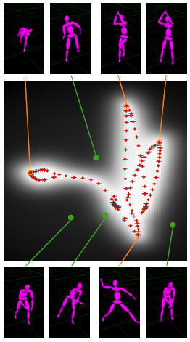
Example-based Method (cont.)
Constructed pose space (training, extrapolated)

Slide 58
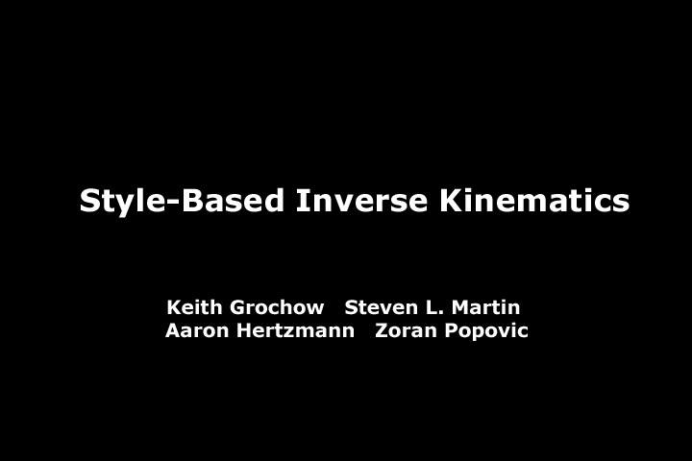
Videos
“Style-based inverse kinematics”

Slide 59
References
Zhao and Badler, "Inverse kinematics positioning using nonlinear programming for highly articulated figures," ACM TOG 1994.
Rose et al., “Artist-directed IK using radial basis function interpolation,” Eurographics’01
Keith Grochow, Steven L. Martin, Aaron Hertzmann and Zoran Popovic , "Style-based inverse kinematics," SIGGRAPH'04.

