Slide 1
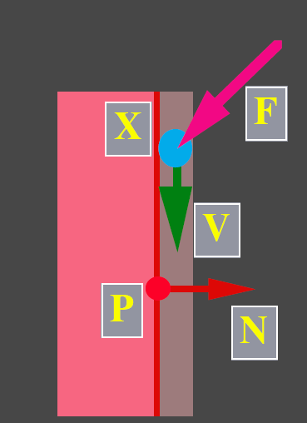
Particle System

Slide 2
Particles
Particles are objects modeled as point masses
Particle properties:
mass
position
velocity
force accumulator
age, lifespan
rendering properties
etc.

Slide 3
Particles (cont.)
Particles respond to forces
We represent this using differential equations
phase space
2nd order ODE
1st order ODEs

Slide 4
Particle Systems
Particle systems are collections of particles
Particle systems can represent:
fire
smoke/clouds
water
cloth
soft bodies
flocks/crowds

Slide 5
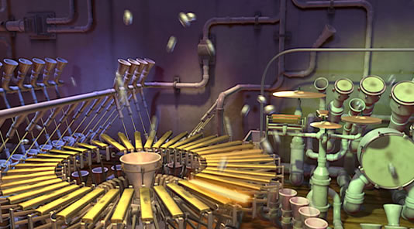
Example Videos
Particle Dreams by Karl Sims (1988)
Pipe Dream by Wayne Lytle (Animusic,2001)

Slide 6
Particle Systems
Separate the data structures and integration
Particle System
state
particles
time
send data as
6n vectors
Solver
state
state/derivatives
derivatives
Particle
x
v
f
m
x
v
f
m
x
v
f
m
x
v
f
m

Slide 7
Spatial Forces
Forces that depend on nearby particles within a local region
Gravity, Lennard-Jones and electric potentials
Spatial data structures can optimize computations

Slide 8
Unary Forces
Forces that only depend on 1 particle
f_{drag}
v
Gravity
Viscous Drag
Wind Fields
f = mg
f = -k_{d}v
f = kv_{wind}

Slide 9
n-ary Forces
Forces that depend on n particles
Example: binary forces—spring and damper
Springs

Slide 10
Spring Force
If particle is located farther than the rest position, the spring force needs to pull it back
If the particle is located nearer than the rest position, the spring force needs to push it away
Combine two cases:

Slide 11
Damper Force
If two particles are departing, the damper force needs to pull them back
If two particles are approaching, the damper force needs to push them away
Combine two cases:

Slide 12
Notes on Damping Forces
According to the law of energy conservation, a particle system consists of only masses and springs keep bouncing from each other after external forces disappear
Damping/viscous drag force resist motion, making a particle system gradually come to rest in the absence of external forces

Slide 13
Notes on Damping Forces (cont.)
It is highly recommended that at least a small amount of damping is applied to each particle
Excessive damping, however, makes a particle appear that floating in molasses (energy dissipates out too quickly, not responsive)

Slide 14
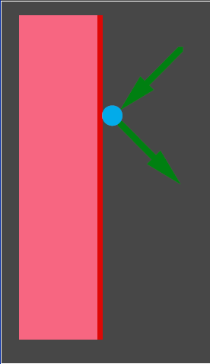
Collision Detection and Response
Later class: rigid body collision and contact
For now, just simple point-plane collisions

Slide 15
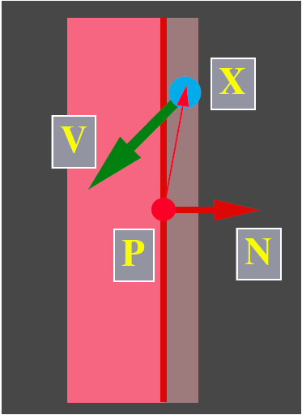
Collision Detection
Determine when a particle has collided
Close to the wall
Heading in

Slide 16
Collision Response
What should we do when a particle has collided (or penetrated)?
The correct thing to do is rollback the simulation to the exact point of contact
A less accurate but easier alternative is to just modify positions and velocities

Slide 17
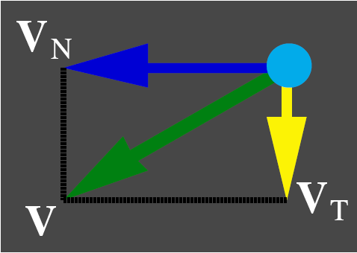
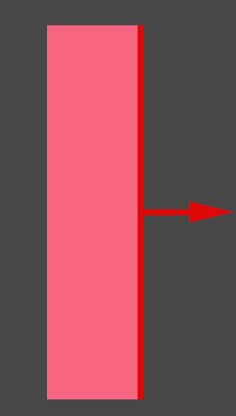

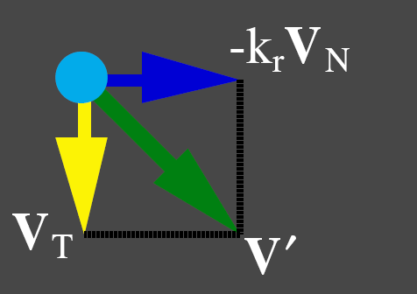
Collision Response
Assume no friction…
Before
After
coefficient of restitution
Notes:
Restitution: 恢復係數

Slide 18

Contact Conditions
On the wall
Moving along the wall
A force f, e.g., gravity, pushes the particle into the wall
Notes:
If a particle is on the collision surface, with zero normal velocity, then it is in contact

Slide 19
Contact Forces
When the particle is on the collision surface a contact force resists penetration
Contact forces do not resist leaving the surface
Simple friction can be modeled

Slide 20
Implementation
Solver Interface
System
Solver
GetDim
6
x
v
f
m
Get/Set State
x
v
Deriv Eval
v
f/m

Slide 21
Implementation (cont.)
Solver Interface
System
Solver
GetDim
6n
particles
Get/Set State
x₁
v₁
x₂
v₂
x_{n}
v_{n}
n
time
Deriv Eval
v₁
f₁/m₁
v₂
f₂/m₂
v_{n}
f_{n}/m_{n}

Slide 22
Physics Engine for Dynamics Simulation
Open Dynamics Engine (ODE)
Free software
Havok
Commercial software
“Reactor” in 3ds MAX
Bullet
PhysX
developed by Ageia, then acquired by Nvidia

