Slide 1
Rigid Body Dynamics
z₀
r_{0i}
R(t)
y₀
x(t)
x₀

Slide 2
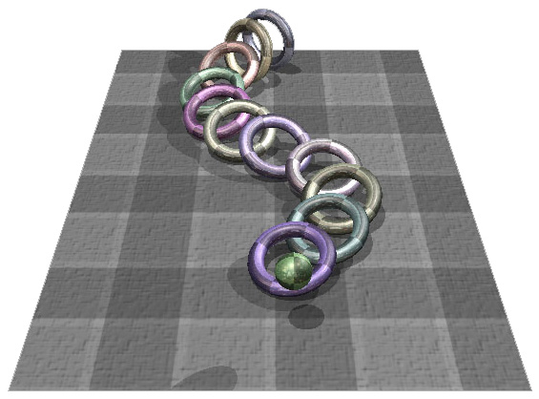
Rigid Body Simulation
Once we consider an object with spatial extent, particle system simulation is no longer sufficient

Slide 3
Problems
Unconstrained system
No contact
Constrained system
Collision detection and contact

Slide 4
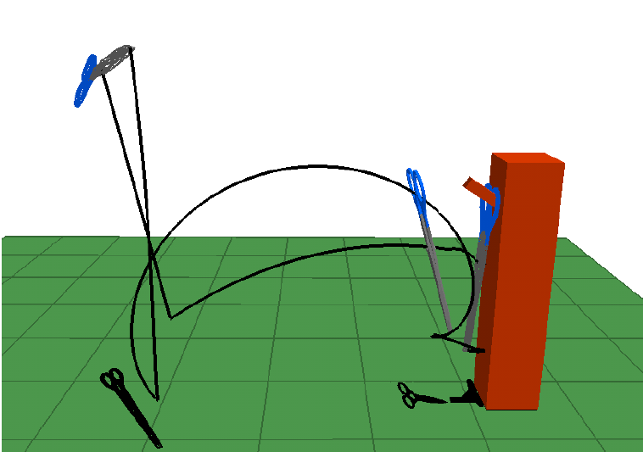
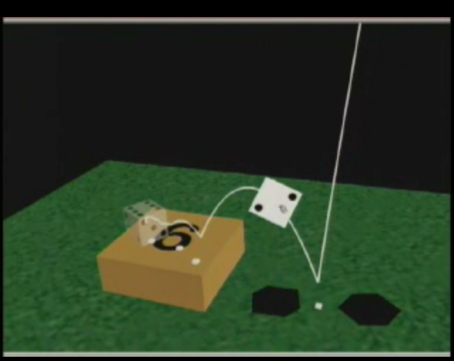
Problems
Computational efficiency is important!
Controllable is desired!
Jovan Popović, Steven M. Seitz, Michael Erdmann, Zoran Popović, Andrew Witkin “Interactive Manipulation of Rigid Body Simulations,” SIGGRAPH 2000

Slide 5
Rigid Body Concepts
Translation
Position
Linear velocity
Mass
Linear momentum
Force
Rotation
Orientation
Angular velocity
Inertia tensor
Angular momentum
Torque

Slide 6
Outline
Position and orientation
Linear and angular velocity
Mass and inertia
Force and torque

Slide 7
Particle State
x(t)
v(t)
f(t)

Slide 8
Rigid Body State
x(t)
v(t)
f(t)

Slide 9
Position and Orientation
Translation of the body
from the origin of the world coordinate
Rotation of the body
x(t)
v(t)
f(t)

Slide 10
Body Space
A fixed and unchanged space where the shape of a rigid body is defined
The geometric center of the rigid body lies at the origin of the body space
Also called object space or local space
z₀
r_{0i}
y₀
x₀

Slide 11
Position and Orientation
Body Space
World Space
z₀
z₀
r_{0i}
r_{0i}
R(t)
y₀
y₀
x(t)
x₀
x₀

Slide 12
Position and Orientation
Use x(t) and R(t) to transform the body space into world space
The world coordinate of an arbitrary point r_{0i} on the body
z₀
r_{0i}
R(t)
y₀
x(t)
x₀

Slide 13
Position and Orientation
Assume the rigid body has uniform density, what is the physical meaning of x(t)?
Center of mass over time
What is the physical meaning of R(t)?

Slide 14
Position and Orientation
Consider the x-axis in body space, (1, 0, 0), what is the direction of this vector in world space at time t?
R(t) represents the directions of x, y, z axes of the body space in world space at time t
first column of R

Slide 15
Position and Orientation
So x(t) and R(t) define the position and the orientation of the body at time t
Next we needed to define how the position and orientation change over time

Slide 16
Linear Velocity and Angular Velocity
Linear Velocity
Since x(t) is the position of the center of mass in world space, is the velocity of the center of mass in world space
Angular Velocity
If we fix the position of the COM in space
then any movement is due to the body spinning about some axis that passes through the COM
Otherwise, the COM would itself be moving

Slide 17
Angular Velocity
We describe that spin as a vector ω(t)
Linear position and velocity are related by
How are angular position (orientation) and velocity related?

Slide 18
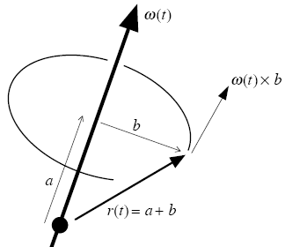
Angular Velocity
How are R(t) and ω(t) related?
Consider a vector r(t) at time t specified in world space, how do we represent in terms of ω(t)?

Slide 19
Angular Velocity
Given the physical meaning of R(t), what does each column change over time?
This expression is too cumbersome, we can use a trick to simplify it

Slide 20
Angular Velocity
Consider two 3 by 1 vectors: a and b, the cross product of them is
Given a, we can define a matrix a* such that

Slide 21
Angular Velocity

Slide 22
Perspective of Particles
Imagine a rigid body is composed of a large number of small particles
the particles are indexed from 1 to N
each particle has a constant location r_{0i} in body space
the location of i-th particle in world space at time t is

Slide 23
Velocity of a particle
linear component
angular component

Slide 24
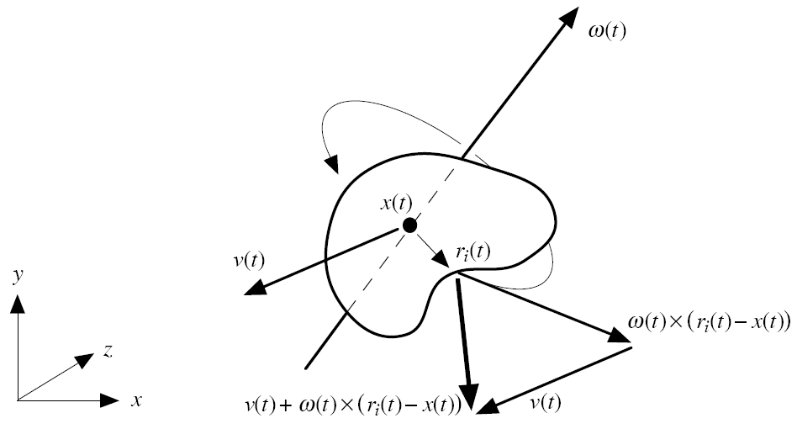
Velocity of a particle

Slide 25
Position and orientation
Linear and angular velocity
Mass and inertia
Force and torque

Slide 26
Mass
The mass of the i-th particle is m_{i}, the mass is
The center of mass defined in world space is
What about the COM in body space?

Slide 27
Inertia Tensor
Inertia tensor describes how the mass of a rigid body is distributed relative to the center of mass
I(t) depends on the orientation of a body, but not the translation
For an actual implementation, we replace the finite sum with the integrals over a body’s volume in world space

Slide 28
Inertia Tensor
Inertia tensors vary in world space over time
But are constant in body space
Precompute the integral part in body space to save time

Slide 29
Derivation

Slide 30
Inertia Tensor in Body Space
Use the facts that
We can obtain
scalar
For details, see page G14 of Baraff and Witkin’s course notes

Slide 31
Position and orientation
Linear and angular velocity
Mass and inertia
Force and torque

Slide 32
Net Force
f₁(t)
z₀
f₂(t)
y₀
x(t)
v(t)
f_{i}(t)
x₀

Slide 33
Net Torque
f₁(t)
p₁
f₂(t)
p₂
x(t)
p₃
v(t)
f₃(t)

Slide 34
Rigid Body Equation of Motion
Mv(t) : Linear momentum
I(t) ω(t) : Angular momentum

Slide 35
Some Implementation Issues
Use quaternion to represent orientation
See the appendix of the course notes
Use Green’s Theorem to compute inertia tensor
Paper Brian Mirtich, “Fast and Accurate Computation of Polyhedral Mass Properties,” Journal of Graphics Tools, 1996
C code http://www.cs.berkeley.edu/~jfc/mirtich/massProps.html

Slide 36
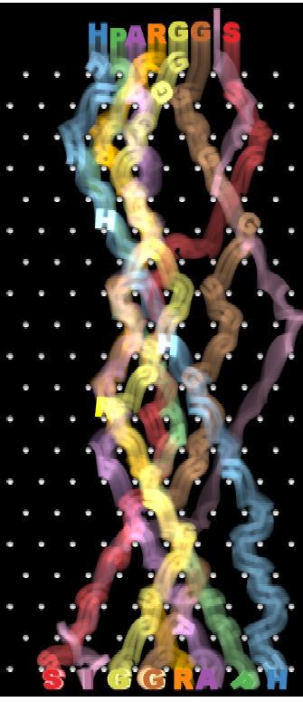
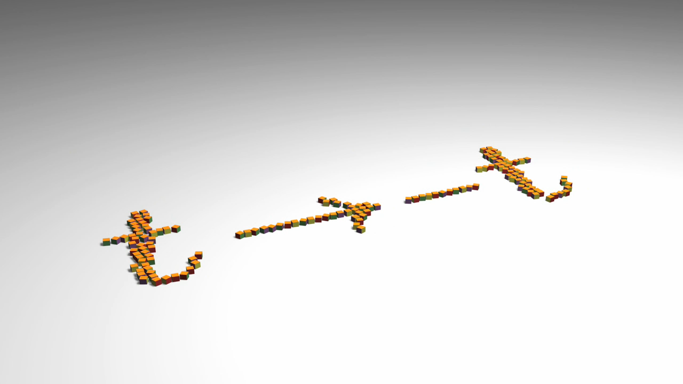
Some examples
Christopher Twigg & Doug James
“Backwards Steps in Rigid Body Simulation,” SiGGRAPH’08
“Many-Worlds Browsing for Control of Multibody Dynamics,” SIGGRAPH’06

Slide 37
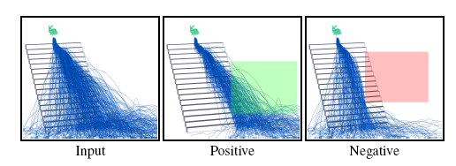
Many-Worlds Browsing

Slide 38
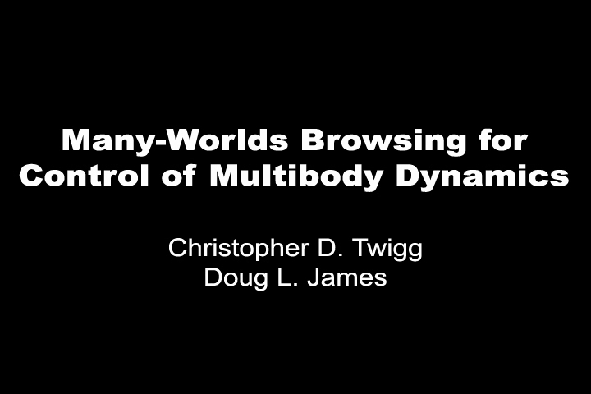
Many-Worlds Browsing

Slide 39
Further Reference
SIGGRAPH 2008 course: Real-time Physics
state-of-the-art methods
rigid and deformable solids, smoke and fluid simulation
http://www.matthiasmueller.info/realtimephysics/index.html
Interactive Simulation of Rigid Body Dynamics in Computer Graphics
CGF, 2014

