Slide 1
PG_activate = 0
(inactivte 链表)
PG_activate = 1
(activte 链表)
lru_cache_add()
移动到 activate 链表
lru_cache_add_active_or_unevictable()
3
2
2
4
PG_reference=0
PG_reference=1
PG_reference=0
PG_reference=1
1
1
2
5
移动到 inactivate 链表
1
SetPageReferenced(page)
2
ClearPageReferenced(page)
3
activate_page(page)
4
mark_page_accessed(struct page *page)
5
deactivate_file_page(struct page *page)

Slide 2
直接页面回收流程
异步回收流程(每个NUMA节点一个)
在内存分配时判断低于水位值后，wake_all_kswapds唤醒内核线程
__alloc_pages_nodemask
Buddy分配器的核心
慢速分配路径
_alloc_pages_slowpath
balance_pgdat
balance_pgdat
页面回收后，并尝试分配内存
_alloc_pages_direct_reclaim
kswapd_shrink_node()
_perform__reclaim
shrink_node()
shrink_slab()
try_to_free_pages
do_try_to_free_pages
shrink_node_memcg()
shrink_zones()
shrink_list()
shrink_active_list()
shrink_inactive_list()
shrink_page_list()

Slide 3
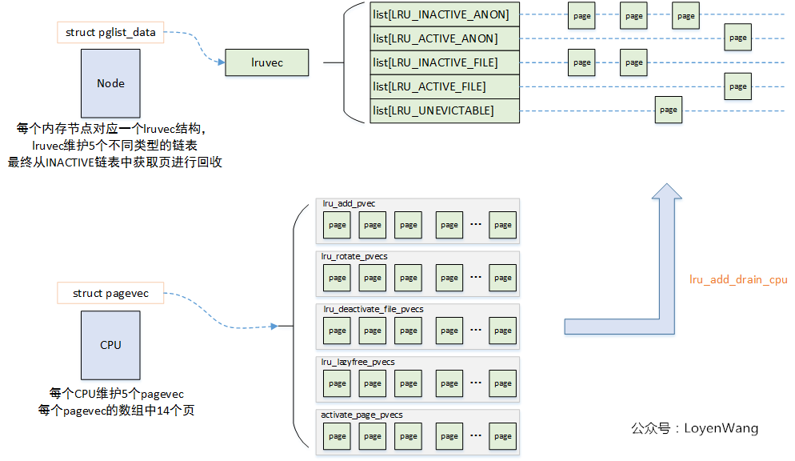
15

Slide 4
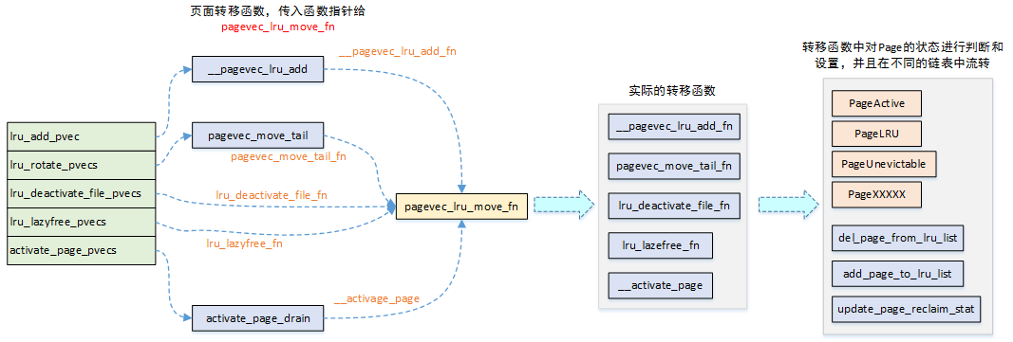

Slide 5
页面转移函数，传入指针给
pagevec_lru_move_fn
__pagevec_lru_add
CPU5种缓存
lru_add_pvec
lru_rotate_pvecs
lru_deactivate_file_pvecs
lru_lazyfree_pvecs
activate_page_pvecs

Slide 6
