Slide 1
Full Connected
Vectorization
synthesizes global information and simplifies it to a 1D vector with redundant parameters.
feature map
Map space
Global Average Pooling
greatly reduces the network parameters, has good spatial structure expressiveness and anti-fit.
feature map

Slide 2
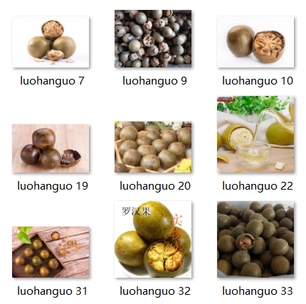
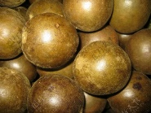
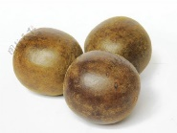
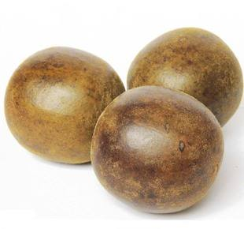
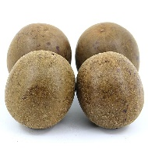
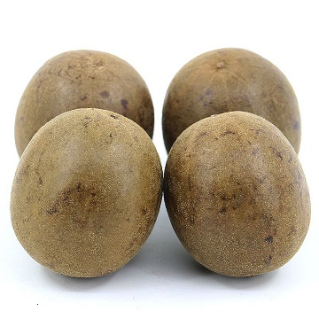

Dataset
Network query fetch
Delete invalid pictures
Normalization and standardization
Improved CNN
Conv + BN
1 2 3
4 5 6
7 8 9
Conv + Max Pooling
Conv + BN + Max Pooling
Input(256x256x3)
Three interleaved network structures
Conv
GAP
FC

Slide 3

