Slide 1
Layne’s Challenge Informational

Slide 2
It’s Super Fun!
We always have fun

Slide 3
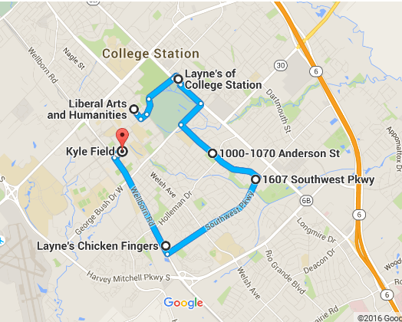
Main Goal
Plan the Layne’s Challenge
You would be surprised how many details and decisions and man hours it takes to pull off the Layne’s Challenge
Explain Layne’s Challenge

Slide 4
The Real Goal
Leave behind an event and charity for future Aggies to enjoy

Slide 5
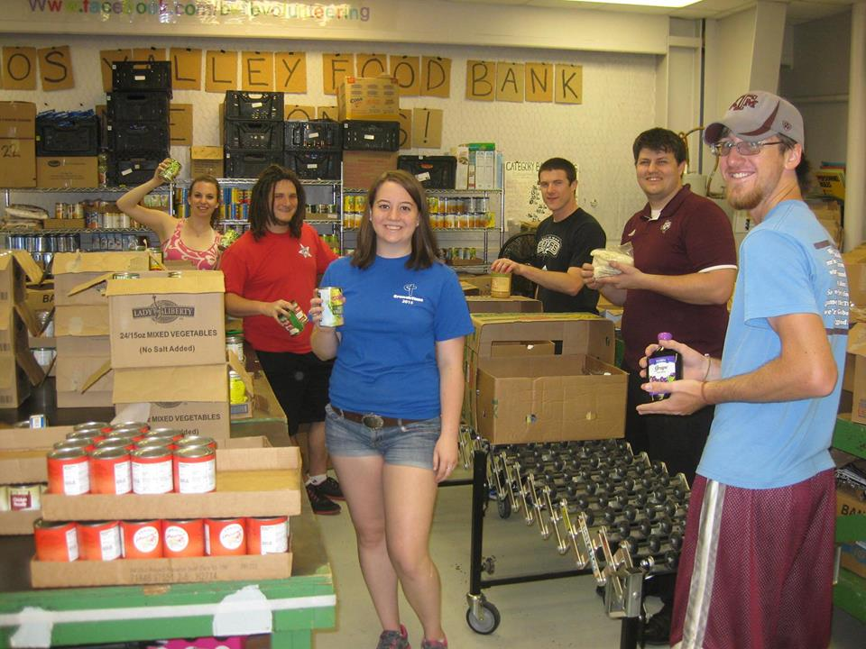
Service
Over the past 2 years we raised $2800 for the Brazos Valley Food Bank
Hope to volunteer at the food bank this semester

Slide 6
Young Organization
We are still trying to figure out what we are doing
Transforming with our members

Slide 7
Meetings
1. Team Building Exercise
2. Discuss important stuff
3. Decide what team members need to do before the next meeting
We meet Thursdays at 8 PM
Currently in Blocker, hoping to move elsewhere

