Slide 1
Underwater image restoration
Zhang Qiqi
2016.11.21

Slide 2
CONTENT
Basic concepts of PSF
PSF on the high speed imaging system
PSF on the underwater imaging system
Plan of future work

Slide 3
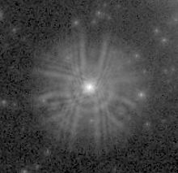

Basic concepts of PSF
点扩散函数（point spread function）
点光源：当面元的光振动为单位脉冲即$δ（x）、δ（y）时，将该$面元称为点光源。
点扩散函数：成像系统对点光源的响应
PSF的物理意义：在不考虑加性噪声影响的情况下，一个点光源通过成像系统后形成的扩散图像。

Slide 4
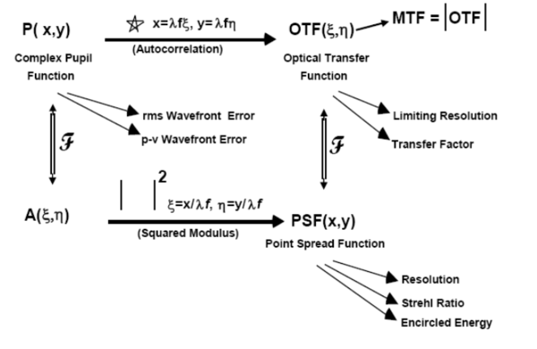
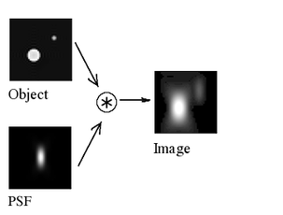
Basic concepts of PSF
point spread function

Slide 5
PSF on the high speed imaging system^{[1]}
The image recoreded on the imaging sensor can be formulated as the sequential convolutions of diffraction, defoucs,and digital sampling with the object :
In the fourier domain:
[1] Bichuan Shen, C.H. Chen, Guoyu Wang, “Study of point spread function and optical transfer function in blind deconvolution.” Pattern Recognition and Computer Vision, 2009.

Slide 6
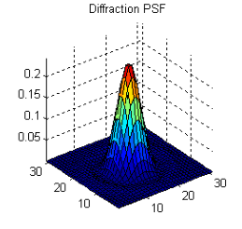
PSF on the high speed imaging system
The PSF of the diffraction limit
：光的波长
D：透镜的直径
：透镜到像平面的距离
r ：极坐标中的距离
：一阶贝塞尔函数

Slide 7
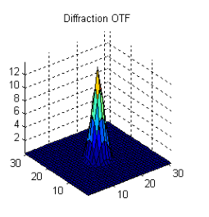
PSF on the high speed imaging system
The PSF of the diffraction limit
in the fourier domain:

Slide 8
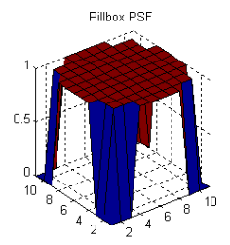
PSF on the high speed imaging system
The PSF of the defoucs
It can be expressed as a pillbox function:
otherwise

Slide 9
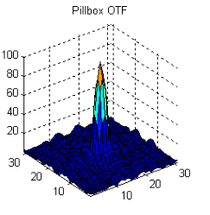
PSF on the high speed imaging system
The PSF of the defoucs
in the fourier domain:
Airy function

Slide 10
PSF on the high speed imaging system
The sampling kernel averaging over the pixel size of
in the fourier domain:
otherwise

Slide 11
PSF on the high speed imaging system
The total PSF can be assumed as a two-dimensional Gaussian function:
in the fourier domain:

Slide 12
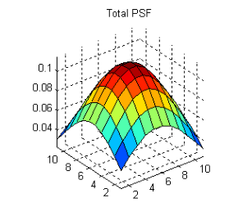
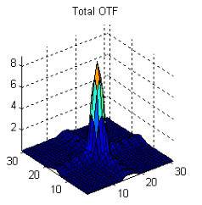
PSF on the high speed imaging system

Slide 13
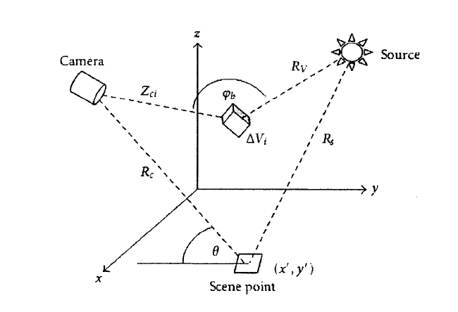

Underwater imaging system
Classical underwater imaging model
$E_{T}=E_{d}+E_{f}+E_{b}$
${ E}_{T}：相机$接受到的信号
$E_{d}$：直接传输部分
$E_{f}：$前向散射部分
$E_{b}：$后向散射部分
Jaffe-McGlamery模型^{[1][2]}
[1] B. L. McGlamery. “A computer model for underwater camera systems.” Ocean Optics, 1980.
[2] J.S. Jaffe. “Computer modeling and the design of optimal underwater imaging systems.” IEEE Journal of Oceanic Engineering, 1990.

Slide 14
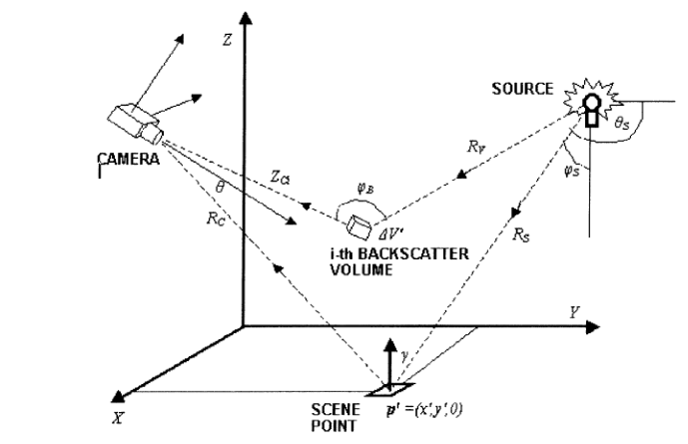

Underwater imaging system
Scattering fuction
The irradiance incident on the scance at p:
: 极角的函数，表示从光源传递到透镜上半球壳的辐照度
$$b(θ_{s},φ_{s})$$

Slide 15

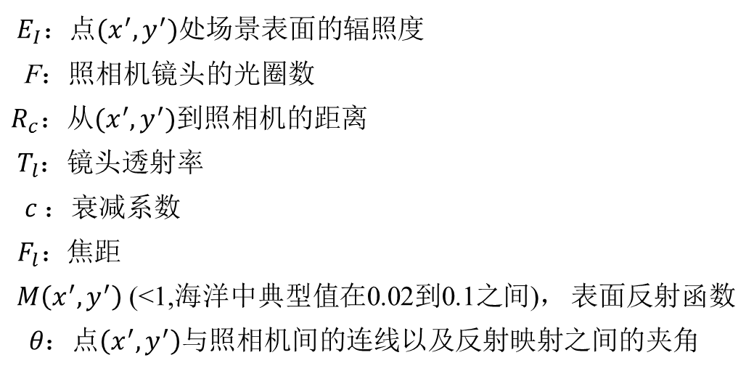
Underwater imaging system
Direct component
$E_{d}(x,y)=E_{I}(x^{′},y^{′}) exp⁡(−cR_{c})\frac{M(x^{′},y^{′})}{4F}T_{l}\cos{{}_{}^{4}{{θ\left[\frac{R_{c}−F_{l}}{R_{c}}\right]}^{2}}}$
${ E}_{I}：$点$(x^{′},y^{′})$处场景表面的辐照度
F：照相机镜头的光圈数
$R_{c}：$从$(x^{′},y^{′})$到照相机的距离
$T_{l}$：镜头透射率
$c ：$衰减系数
$F_{l}：$焦距
$M\left(x^{′},y^{′}\right)$ (<1,海洋中典型值在0.02到0.1之间)， 表面反射函数
$θ：$点$\left(x^{′},y^{′}\right)$与照相机间的连线以及反射映射之间的夹角

Slide 16
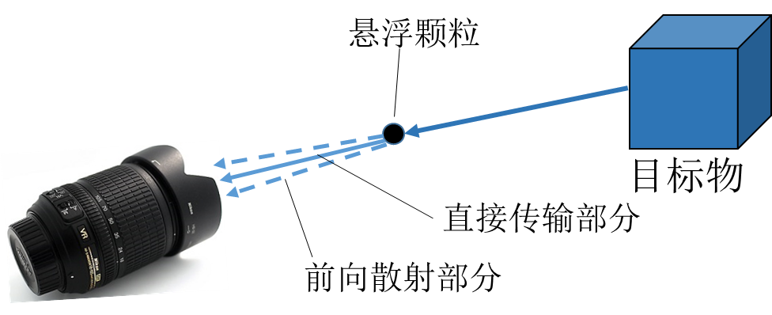

Underwater imaging system
Forwardscatter component
$$E_{f}(x,y)=E_{d}(x,y)∗g(x,y,R_{c},G,c,B)$$
$g\left(x,y,R_{c},G,c,B\right)=\left[\exp\left(−GR_{c}\right)−exp⁡(−cR_{c})\right]F^{−1}\left\{exp⁡(−BR_{c}w)\right\}$
G：经验系数,且|G|<|c|
B： 由经验决定的阻尼函数
w：随机频率

Slide 17
Underwater imaging system
Backscatter component
The irradiance on a differential volume is :

Slide 18
Underwater imaging system
Backscatter component
The resulting radiant intensity scattered to the
camera by is:
The direct component:

Slide 19
Underwater imaging system
The function of degraded image：
In the frequency domain ：
the system response is expressed as a direct product of the optical system itself and the medium:
In the spatial domain:

Slide 20
Underwater imaging system
The Fourier transfer of h(x,y):
(1)
(1) can be reduced to a one-dimensional Hankel intrgral:
(2)

Slide 21
Underwater imaging system
MTF of the medium:
DTF of the seawater :
phase function:
W. H. Wells, “Theory of Small Angle Scattering.” North Atlantic Treaty Organization, 1973.

Slide 22
Restorate burred image by using PSF
deconvolution

Slide 23
Restorate burred image by using PSF
deconvolution

Slide 24
Restorate burred image by using PSF
Inverse filter^{[1]}
[1] E. Trucco and A. Olmos, “Self-tuning underwater image restoration.” IEEE Journal of Oceanic Engineering, 2006.

Slide 25
Restorate burred image by using PSF
Wiener deconvolution^{[1]}
the transfer fuction of Wiener filter:
the spectrum of the restored image:
[1] Z. Liu, Y. Yu, K. Zhang, and H. Huang, “Underwater image transmission and blurred image restoration.” Optical
Engineering, 2001.

Slide 26
Plan of future work
Find codes associated with the PSF of underwater
Learn knowledge about dark channel prior

Slide 27
Thanks

