Slide 1
Game Management and E-Commerce System

Slide 2
MEMBERS
Phan Trần Thanh Huy - ITCSIU22056
Nguyễn Đình Khánh Ngân - ITCSIU22236
Bùi Công Vinh - ITCSIU22165

Slide 3
INTRODUCTION TOPIC
This project aims to create an innovative game management platform that seamlessly integrates modern e-commerce functionalities to enhance the gaming experience.
The platform will provide comprehensive tools for managing games, user profiles. Moreover, it will feature a marketplace where users and developers can freely buy, and sell games.
By blending efficient game management with dynamic e-commerce capabilities, this system aspires to transform how gamers and developers interact within the gaming ecosystem.

Slide 4
NOVELTY
This project introduces a groundbreaking approach to game management and distribution by providing users with the flexibility to purchase either the fully playable digital version of a game or the source code.
For gamers, the platform delivers a seamless and user-friendly experience for accessing and managing their favorite games.
For developers, it opens up opportunities for learning, customization, and reusability, offering a developer-friendly environment that encourages code sharing, modding, and creative development.
By bridging the gap between end-users and creators, this system revolutionizes the traditional game distribution model, empowering all stakeholders in the gaming industry.

Slide 5
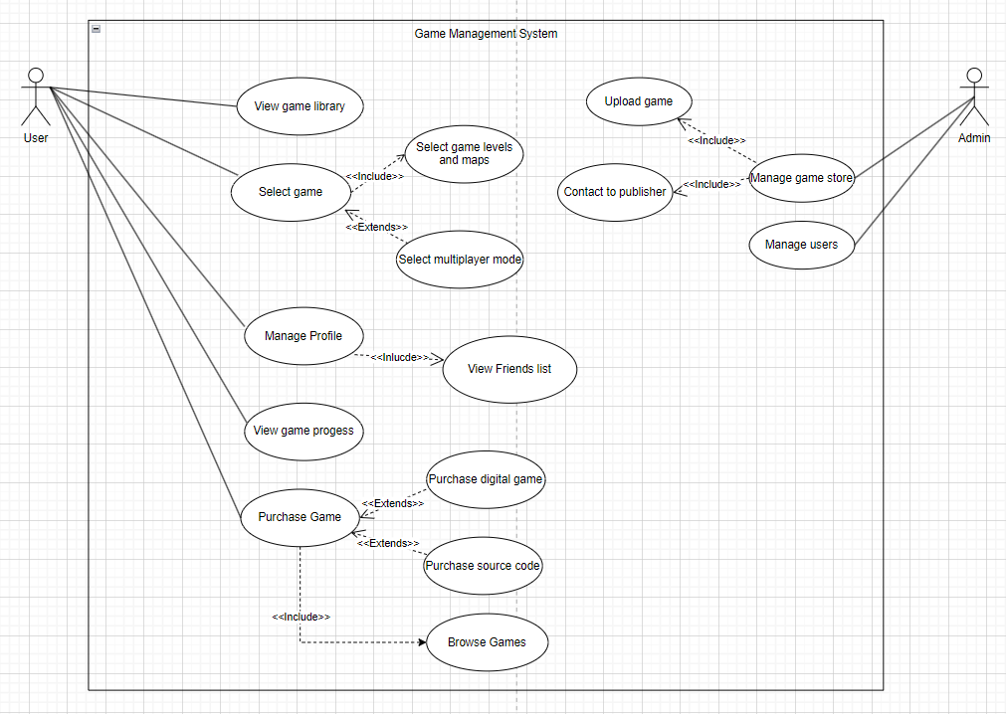
Use Case Diagram

Slide 6
Thank you!
GAME MANAGEMENT AND E-COMMERCE SYSTEM
Phan Trần Thanh Huy - ITCSIU22056
Nguyễn Đình Khánh Ngân - ITCSIU22236
Bùi Công Vinh - ITCSIU22165

