Slide 1
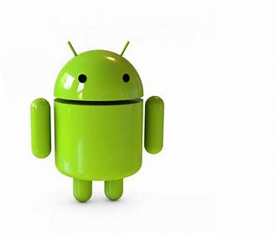
Android
Android Development

Slide 2
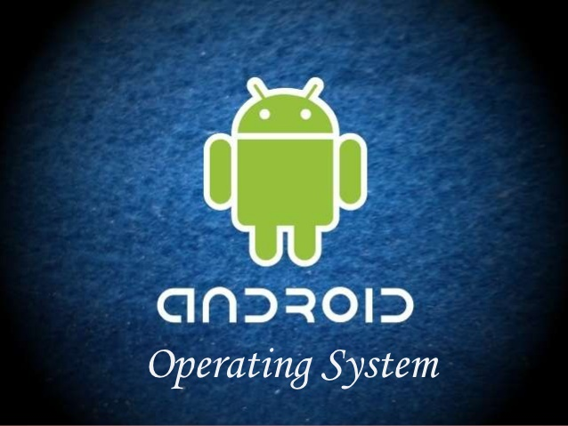
INTRODUCTION
ORIGIN OF ANDROID
FEATURES OF ANDROID
VERSIONS OF ANDROID
SOFTWARE FEATURES
HARDWARE FEATURES

Slide 3
INTRODUCTION
Android is Linux based operating system for mobile devices.
Android is developed specifically for applications
There are more than 3,500,000 apps in Android market
Android is an open source
Notes:
Android is “open” in a variety of ways. For one thing, the Android operating system is based on code from the “Android Open Source Project,” or AOSP. It’s open-source, so people can take that source code and create custom operating systems from it.

Slide 4
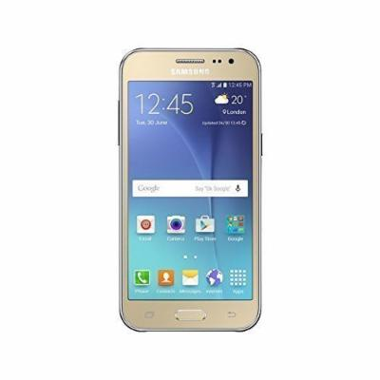
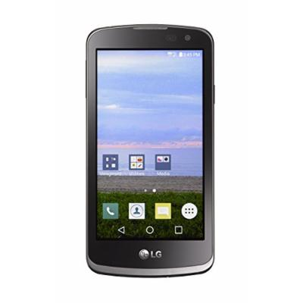
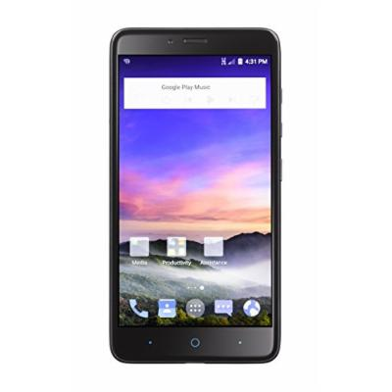
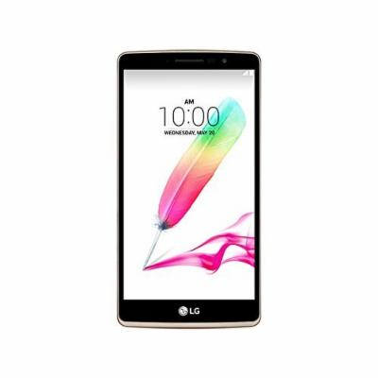
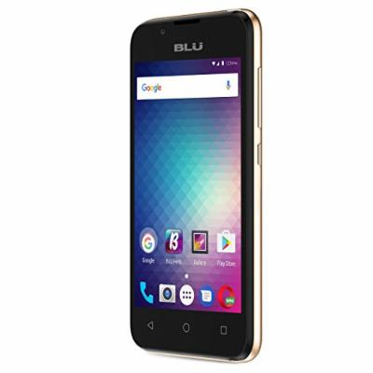
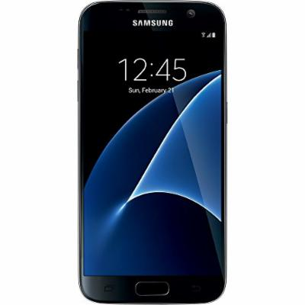
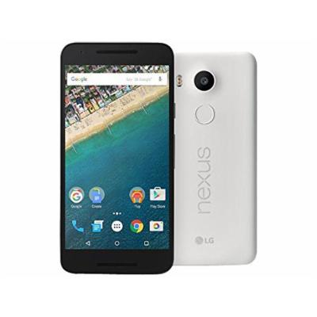


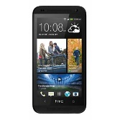
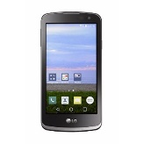

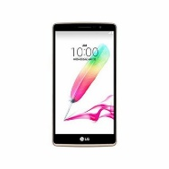


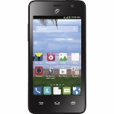
SMART PHONES
LG Nexus 5X H791 32GB Memory Unlocked GSM Smart Phone, 5.2" Quartz White | Samsung Galaxy J2 SM-J200H/DS DUOS Dual SIM Unlocked GSM Android Smartphone 4.7"... | HTC Desire 610 8GB Unlocked GSM 4G LTE Quad-Core Android 4.4 Smartphone - Black ...
Total Wireless LG Rebel 4G LTE Prepaid Smartphone | TracFone ZTE MAX DUO 4G LTE CDMA Prepaid Smartphone | LG G4 Stylus H540 Dual Sim Gold (FACTORY
TracFone ZTE Paragon 4G LTE Android Prepaid Smartphone | BLU Advance 4.0 L3 -Unlocked Dual Sim Smartphone -Gold | TracFone Samsung Galaxy S7 4G LTE Prepaid Smartphone

Slide 5
ORIGIN OF ANDROID
Android was founded in Palo Alto, California in October 2003 by Andy Rubin, Rich Miner, Nick Sears and Chris White who work at “Google” to develop.
Android was purchased by the GOOGLE in AUGUST, 2005 for 50 million $.
The Open handset alliance, a consortium of 84 technology and mobile companies comprising Google, HTC, Sony, Dell, Intel, Motorola, Qualcomm, Texas Instruments, Samsung Electronics, LG Electronics, T-Mobile, and many others was formed – 5 November 2007.
Android Beta was released -12 November 2007 by this consortium

Slide 6
Features of Android
Android can run multiple apps at the same time
Also support optimized graphics VGA, 2D graphics and 3D graphics
Android has better app market
Android lets you change your setting faster
It gives you more options to fit your budget
Android keeps information visible on your home screen
Android also supports java applications

Slide 7
VERSIONS OF ANDROID
Cupcake (1.5),
Donut (1.6),
Éclair (2.0, 2.1),
Froyo (2.2),
Gingerbread (2.3),
Honeycomb (3.0, 3.1, 3.2),
Ice Cream Sandwich (4.0),
Jelly Bean (4.1, 4.2, 4.3),
Kit Kat (4.4),
Lollipop (5.0, 5.1),
Marshmallow (6.0),
Nougat (7.0, 7.1),
Oreo (8.0).

Slide 8
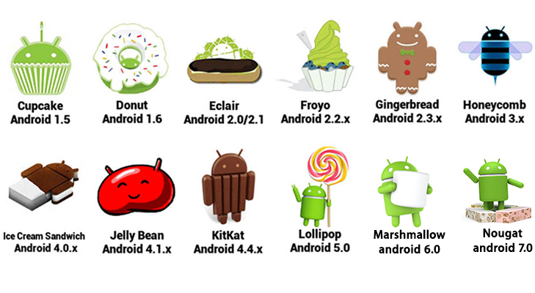

Slide 9
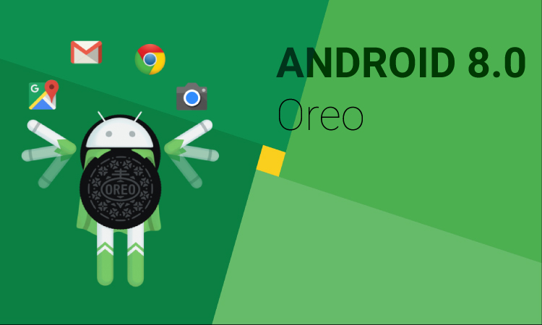

Slide 10
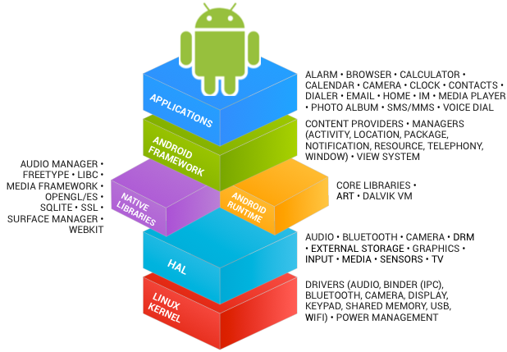
The Android Software Architecture
Linux kernel
HAL (standard interface for hardware)
Libraries
Since Android 5.0 Lollipop system, the Dalvik VM has been officially replaced by a new runtime called ART (Android RunTime).
Application layer
Application framework

Slide 12
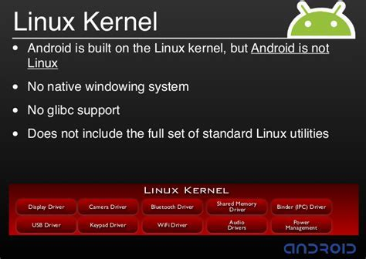
LINUX KERNEL
Device drivers
Memory management
Process management
Networking

Slide 13
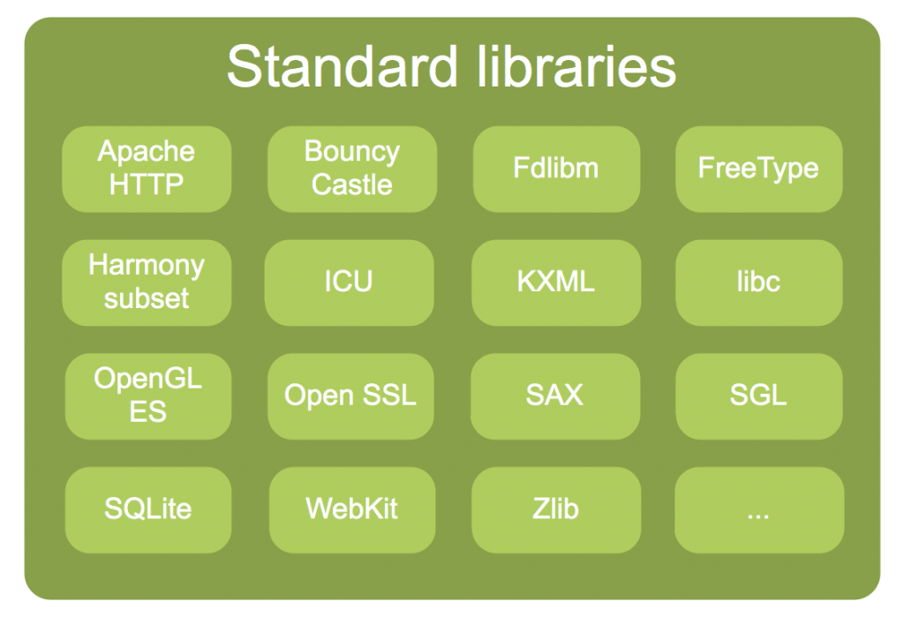
LIBRARIES
C/C++ libraries
Interface through Java
Surface manager- Handling UI Windows
2D and 3D graphic
Media codes, SQLite, Browser engine

Slide 14
ANDROID RUNTIME (ART)
Dalvik used Just-In-Time (JIT) approach in which the compilation was done on demand. All the dex files were converted into their respective native representations only when it was needed.
ART uses the Ahead-Of-Time (AOT) approach, in which the dex files were compiled before they were demanded.
This itself massively improves the performance and battery life of any Android device.

Slide 15
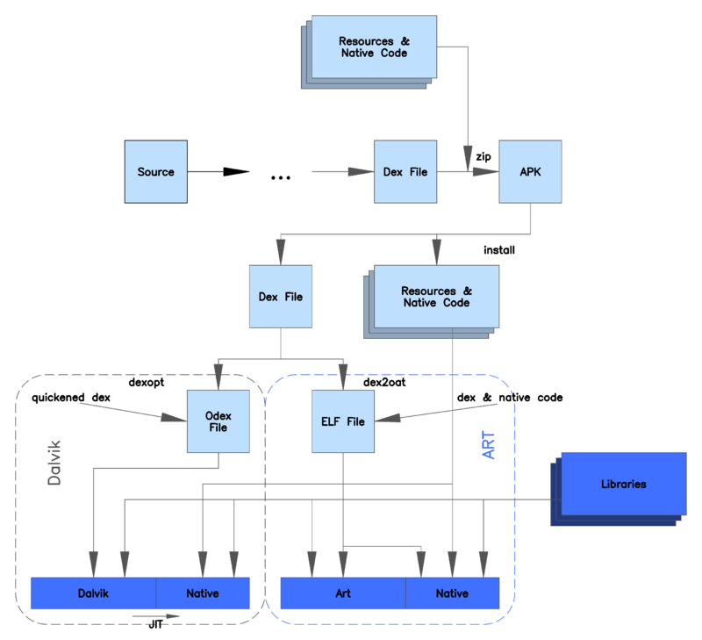

Slide 16
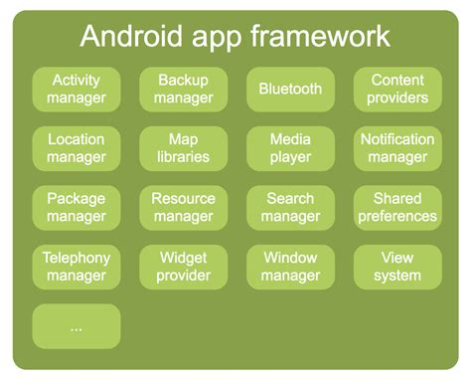
Application Framework
Activity manager- manages application life cycle
Android provides a set of core applications:
Email Client
SMS Program
Calendar
Maps
Browser
Contacts. Etc.

Slide 17
Application Framework (cont.)
All applications are written using the Java language
APIs
Data Structures
Utilities
File Access
Graphics
Etc.

Slide 18
SOFTWARE FEATURES
Integrated browser based on the open source Web Kit engine
SQLite for relational data storage
Media support for common audio, video, and still image formats
Dalvik Virtual Machine /ART optimized for mobile devices
Notes:
WebKit is the web browser engine used by Safari, Mail, App Store, and many other apps on macOS, iOS, and Linux.

Slide 19
HARDWARE FEATURES
Cellular networking: GSM, EDGE, #G
LAN: Bluetooth, and Wi-Fi
Graphics Hardware Acceleration
Camera, GPS and COMPASS
Touch screen and accelerometer for motion sensing

Slide 20
TECHNIQUES FOR SAVING DATA
SQLite Databases: relational database library for sorting and managing complex data
Files: you can create, write, and read files from the local storage or external media (SD Cards)

Slide 21
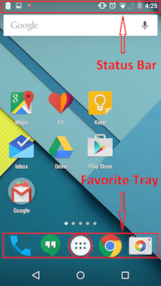
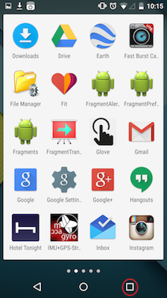
Standard UI Screens
Home screen
All app screens

Slide 22
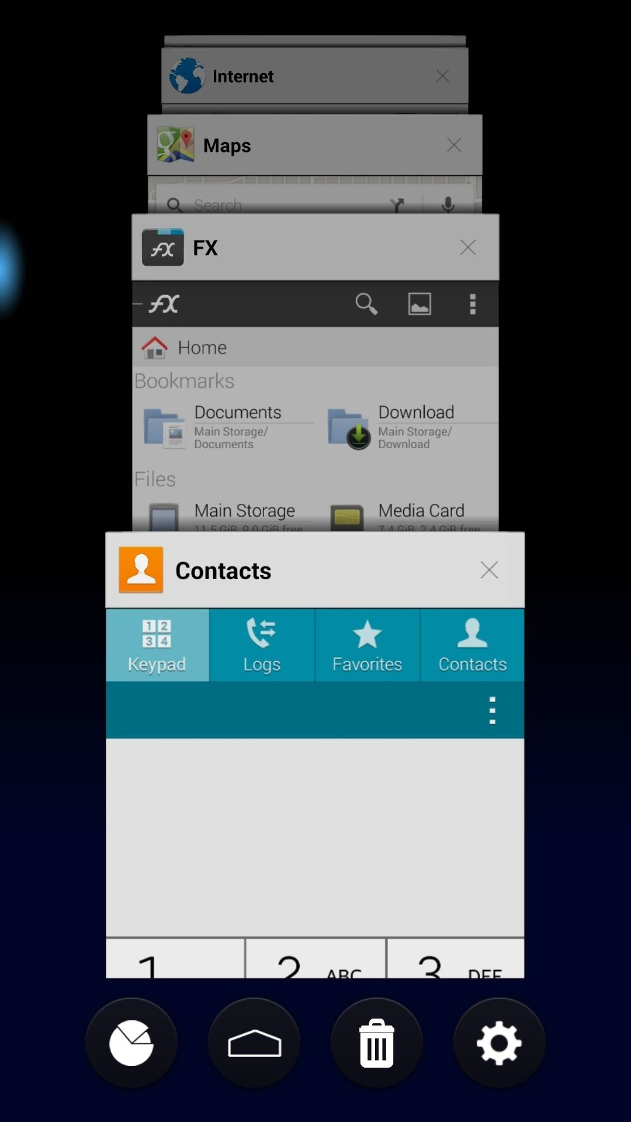
Standard UI Screens
Home screen
Recent apps screen

Slide 23
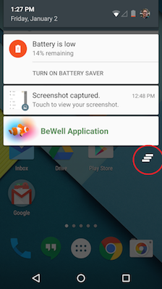
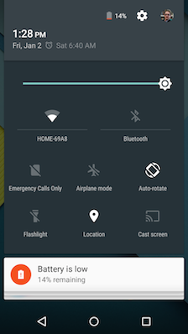
Standard UI Screens
Status bar and notification screen
Recent apps screen
If you drag the notification shade further
down, you will see a menu with many
quick toggle buttons to change settings.
You can also adjust the screen light here.

Slide 24
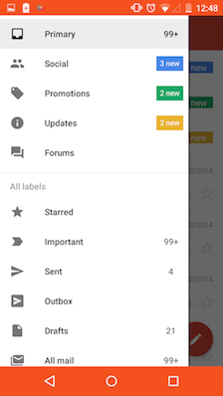
Standard UI Screens
Gmail UI

Slide 25
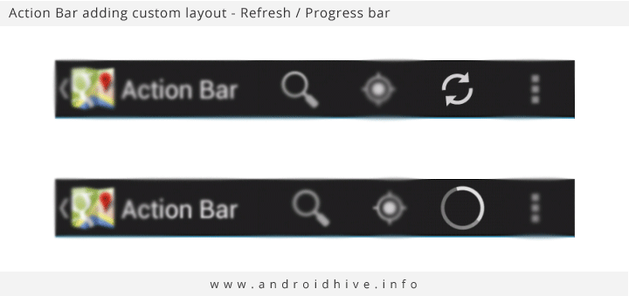
Standard UI Screens
Action Bar
The action bar is configurable from app to app and provides a semi-standard way to build out a simple and clean app UI to handle user action and app navigation.

