Slide 1
The Modern Software Developer
CS146S
Stanford University, Fall 2025
Mihail Eric
themodernsoftware.dev

Slide 2
To MCP and Beyond
themodernsoftware.dev

Slide 3
Why
背景
LLMs have vast (but static) world knowledge that only updates when we retrain
To build fully autonomous systems we need robust ways to feed dynamic data in
What’s the weather today
Who’s president
What’s the price of Bitcoin
Who’s the narrator in Nike’s latest ad campaign
RAG and tool-calling are the best answer we have today
检索增强生成（RAG）：从外部知识库（如数据库、文档）中实时检索相关信息，并将其提供给LLM，作为生成答案的依据。
工具调用（Tool-Calling）：让LLM具备调用外部工具、API或函数的能力（例如调用天气API、查询数据库、执行计算），从而获取实时信息或执行具体操作。
themodernsoftware.dev

Slide 4
Basics
Model Context Protocol（MCP）（模型上下文协议）
Open protocol that allows systems to provide context to AI models in a manner generalizable across integrations
In English: standard format for exposing tools to LLMs
History: in the distant past pre-November 2024 when MCP was introduced…
themodernsoftware.dev
Notes:
Recall what we did in the last class, this was like the pre-MCP days. The APIs were pretty well-formatted so getting the LLM to use them wasn’t super challenging.

Slide 5

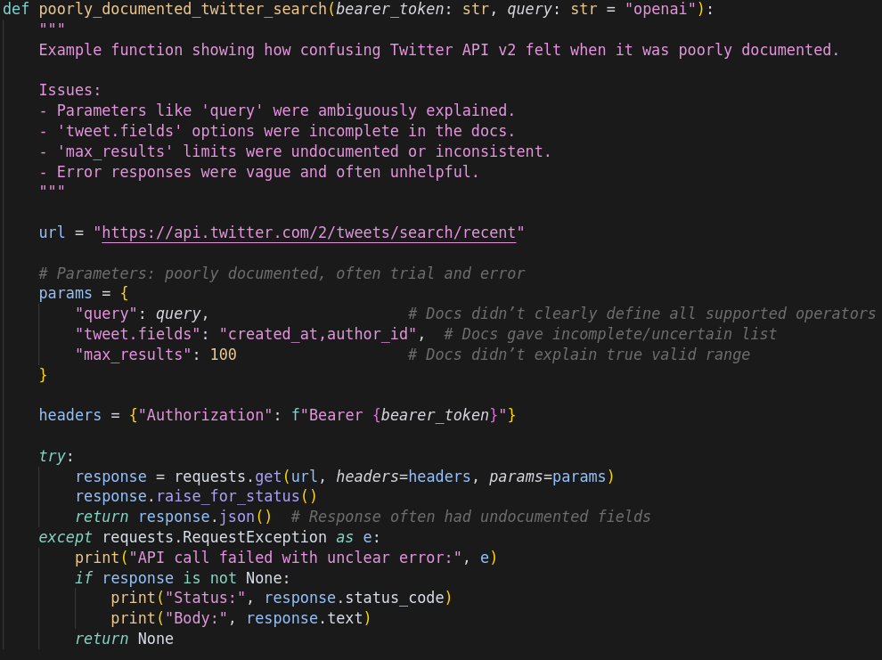

Imagine integrating with a questionable 3rd party API
What APIs do you expose?
????
LLM 无法自动、可靠地理解这个 API 能做什么以及如何调用它
MCP 提供了一个标准的、机器可读的协议
themodernsoftware.dev
Notes:
You want to enable your LLM to access a 3rd party API
But think of all the things that could be challenging:
Poor documentation
Inconsistent data exchange formats
Authentication
Error handling
The onus is on your to interpret all of those factors for this API

Slide 6

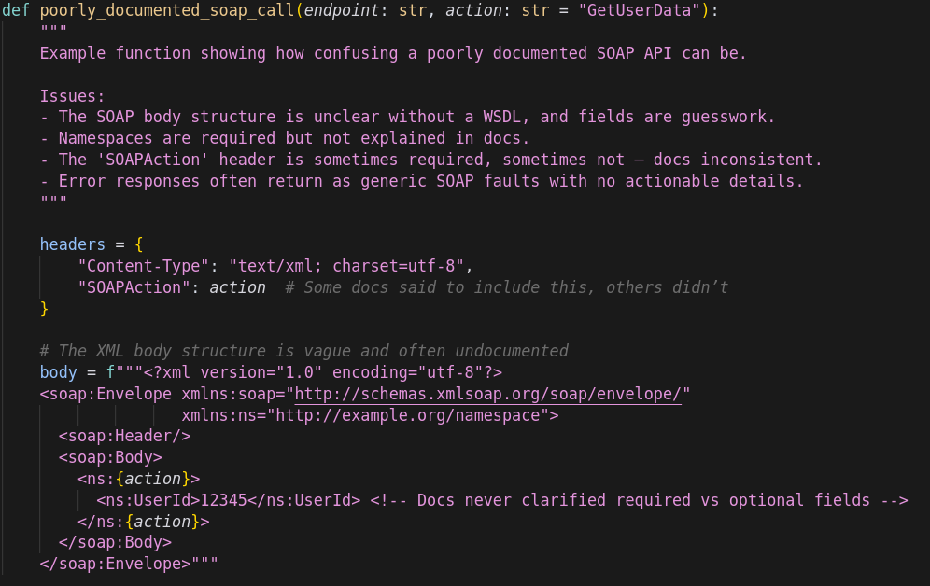

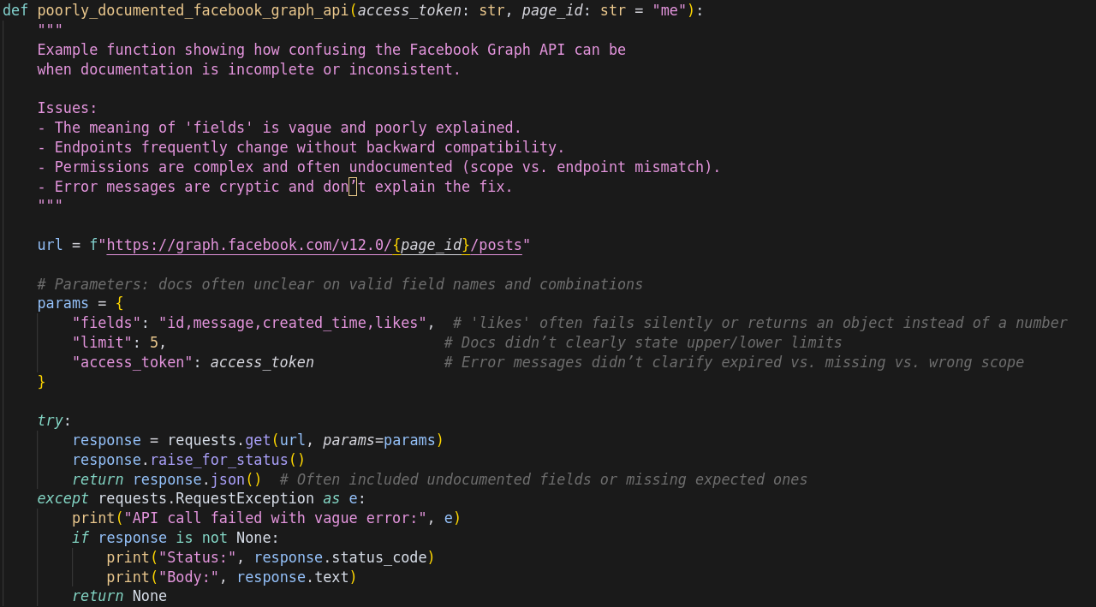
Now many APIs
大语言模型（LLM）在集成多个异构 API 时面临的挑战
理解困难
集成困难
????
????
????
MCP 通过定义统一的协议，让任何工具、服务或平台都可以封装成一个MCP智能体
themodernsoftware.dev
Notes:
Now imagine having to do that for 100s of APIs

Slide 7
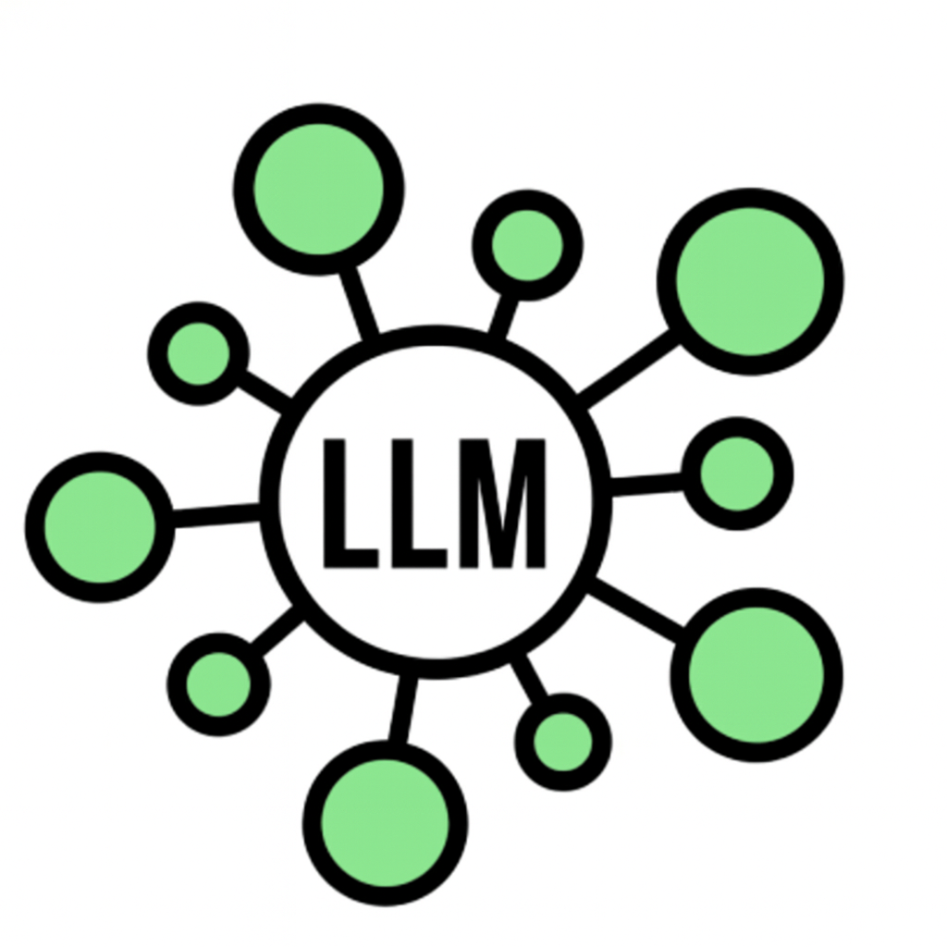

Now many LLM apps
MCP可以大大降低这种复杂性，将a*b变成a+b
themodernsoftware.dev
Notes:
Now imagine integrating many LLM apps
It’s a mess: NxM connectors across LLM apps and API integration points

Slide 8
MCP A Bit Deeper 深入了解MCP
Terminology
Host: Cursor, Claude Desktop(主机)：最终用户直接交互的应用程序
MCP Client: Library embedded on host (stateful session per server) (客户端)：嵌入在主机中的一个程序库
MCP Server: Lightweight wrapper in front of a tool(服务器)：位于某个具体工具前方的轻量级包装程序。
Tool: Callable function (could be data source, API)（工具）
Flow 能力发现->自我描述->上下文注入->智能调用->执行操作
Client calls tools/list to MCP server (what can you do?)
Server returns JSON describing each tool (name, summary, JSON schema)
Host injects that JSON into model’s context
User prompt triggers model, emitting a structured tool call
MCP server executes and conversation resumes
MCP provides stdio and SSE transport layer
themodernsoftware.dev

Slide 9

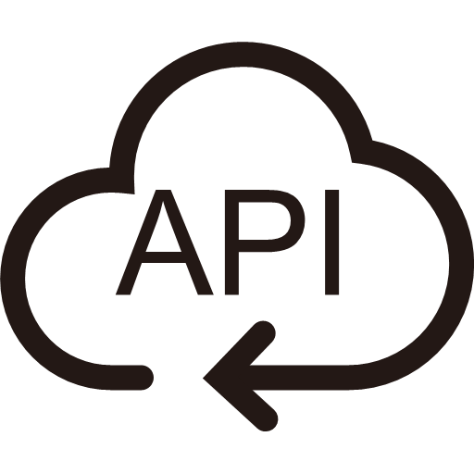






具体工作流程演示
MCP client 客户端
MCP server
服务器
2
Summarize my emails from Jack
Get tools
1
Ask query
5
4
用户
Send response
Call function for tool and get response
3
Send query and pick tool with params
themodernsoftware.dev

Slide 10
Limitations局限性
Agents don’t handle many tools very well today 多工具协同的处理能力尚不成熟
APIs eat up your context window quickly
传统API设计会消耗宝贵的上下文窗口
Design APIs to be AI-native rather that rigid 专门为AI的使用方式设计API
themodernsoftware.dev
Notes:
Discuss Cursor hard limit on # of tools

Slide 11
Questions?
themodernsoftware.dev
Notes:
Discuss Cursor hard limit on # of tools

