Slide 1
Structured Writing for Professionals
English 170 Stanford University, Fall 2025
Mihail Eric

Slide 2
The Modern Software Developer
CS146S
Stanford University, Fall 2025
Mihail Eric

Slide 3
Introduction and How LLMs are Made

Slide 4
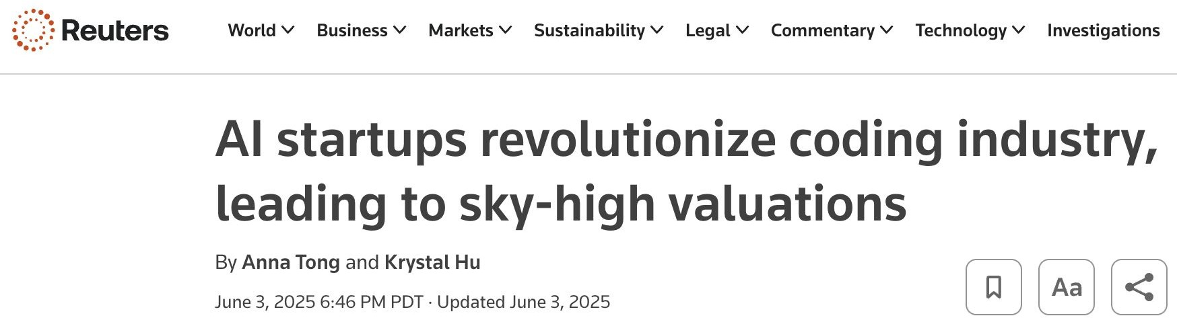

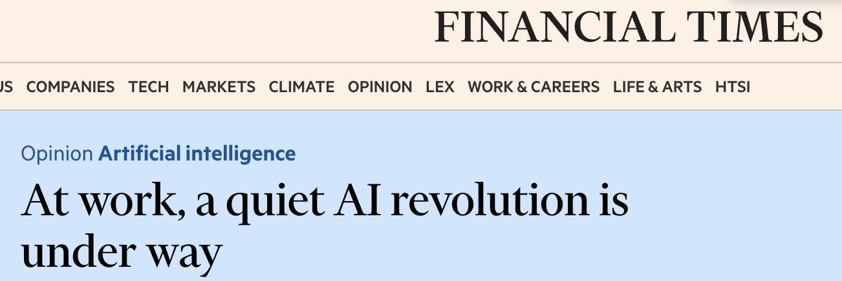
State of the World: 2025
Meta的扎克伯格承诺投入数千亿美元用
于人工智能数据中心，以推动超级智能的
发展

Slide 5
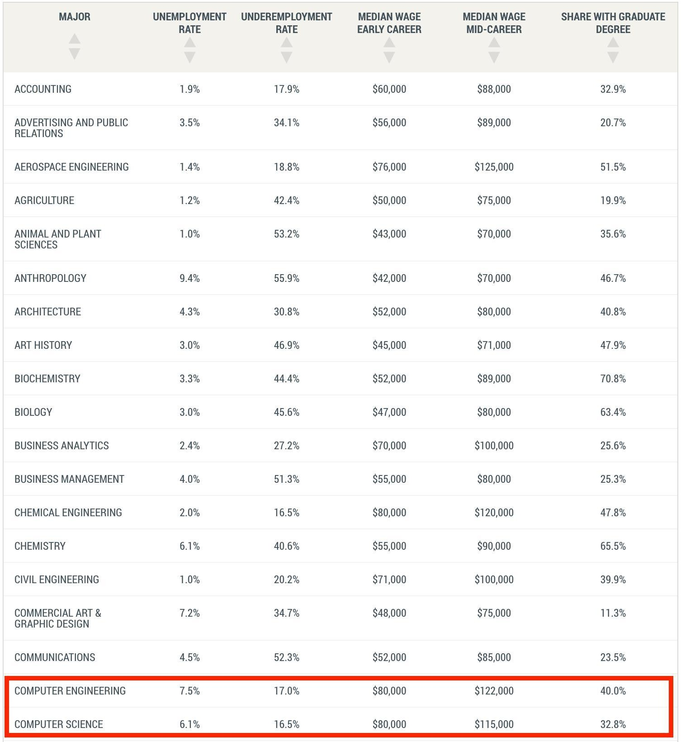
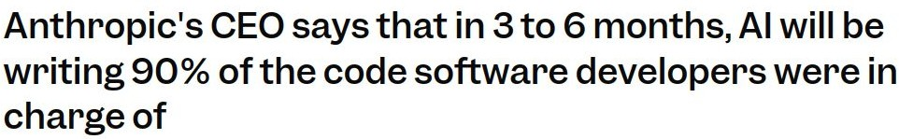

Bad News
- Windsurf team
Anthropic的首席执行官表示，在3到6个月内，人工智能将编写90 %原本由软件开发人员负责的代码。
谷歌首席科学家预测，人工智能在一年内可能达到初级程序员的水平。

Slide 6
Good News
Software developers have the potential to be more productive than they have ever been in history
With AI coding an engineer can pick up tech stacks and tools at an unprecedented pace
You won’t be replaced by AI. You’ll be replaced by a competent engineer who knows how to use AI.
软件开发人员有望达到历史上从未有过的高效水平。
借助人工智能编程，工程师能够以前所未有的速度掌握技术栈和工具。
你不会被人工智能取代。你会被一个懂得如何使用人工智能的合格工程师取代。

Slide 7
The Modern Software Developer

Slide 8
This is not the “vibe coding” class

Slide 9
10 weeks in 2 slides

Slide 10
The Takeaway
Human-agent engineering
Focus on the skills that are not yet replaced by AI systems
Business understanding
Become the tech lead
LLMs are only as good as you are
Good context leads to good code
If you can’t understand your codebase, neither will an LLM
人工智能体工程：
专注于尚未被人工智能系统替代的技能
业务理解
成为技术负责人
LLM的能力取决于你自身的水平
良好的上下文会产生优质的代码
如果你无法理解自己的代码库，LLM也同样做不到

Slide 11
The Takeaway
Read and review a lot of code
Learn to discern good from bad, wrong software
Have good taste
Experiment aggressively
There are no established software patterns yet
Everyone is still ﬁguring it out
This class will introduce many workﬂows and tools - ﬁgure out what works for you
大量阅读并审查代码
学会辨别软件的好坏与对错
有良好的鉴赏能力
积极尝试
目前还没有成熟的软件模式
所有人仍在摸索中
本课程将介绍许多工作流程和工具

Slide 12





Course Logistics
课程安排，一些关于作者的介绍
A bit about me
Stanford undergrad/grad
Head of AI at a stealth startup in the sales space
Built ﬁrst LLMs at Amazon Alexa
Founded and sold an ML education startup
Founded a YC-backed AI coding company
1 awesome CA
Febie Lin

Slide 13
Course Logistics
https://themodernsoftware.dev
Lectures
Mon/Fri 8:30-9:20 am
Deliverables
9 assignments (1x/week) focusing on lecture material practice
https://github.com/mihail911/modern-software-dev-assignments
1 ﬁnal open-ended project in which you will exercise AI coding principles we cover
Grading
80/15/5 breakdown for project/assignments/participation
Something pretty awesome
Guest lectures from founders leading top AI developer startups today
$100s of millions raised, billions in valuation
Don’t miss these talks!

Slide 14
How LLMs Work in 5 Slides (For Engineers)

Slide 15

Basics
LLMs (large language models) are autoregressive models for next-token prediction
LLM（大型语言模型）是用于下一个token预测的自回归模型

Slide 16


Basics
0.3 | the
0.6 | idx
0.1 | cat
Get probability distribution over most likely next token
获取最可能的下一个标记的概
率分布
Transformers layers (12-96+) using self-attention mechanism (Viswani et. al. 2017)
使用自注意力机制（Viswani等人，2017年）的Transformer
层（12-96+个）
Embedding layer
Convert tokens into ﬁxed-dimensional numerical vectors (~1-3K dimensions)
将标记转换为固定维度的数值
向量（约1-3K维度）
a
for
loop
for
Tokenize inputs using ﬁxed vocabulary
使用固定词汇表对输入进行分
词

Slide 17
Training Process
自监督预训练
在各种通常为开放的数据源上，向模型传授语言概念
许多标记
公开资源库
编写for循环
Stage 1
Self-supervised pretraining
Teach the model notion of language on a variety of often public data sources
100s of billions to trillion+ tokens (language and code)
Common Crawl, Wikipedia, StackExchange, Public Github repos
Write a for loop → that could be used in a piece of code
Stage 2
Supervised ﬁnetuning
Teach model to follow instructions
High-quality, curated prompt-response pairs (“what is the capital of Croatia” -> “Zagreb is the capital”)
Tens of thousands to 100s of thousands of pairs
Write a for loop → ok here’s a for loop…
Stage 3
Preferencing tuning
Align model outputs with human preferences (helpfulness, correctness, readability)
Collect pairs of outputs for same prompt and train reward model to predict preferred output
Tens of thousands to 100s of thousands of human-labeled comparisons
Write a for loop → for idx in range(10):
监督微调
教模型遵循指令
高质量、精心筛选的提示-响应对
偏好调优
使模型输出与人类偏好保持一致
收集针对相同提示的输出对，并训练奖励模型来预测更优的输出

Slide 18
Training Process
Reasoning models
Extend training with chain-of-thought reasoning traces
Tool-use integration
Get human preferences on reasoning steps
Reinforcement learning to learn how to evaluate reasoning traces, backtrack, etc
Size
GPT-3/Claude 3.5 Sonnet - 175B parameters
LLaMA 3.1 - 405B parameters
GPT-4 - 1.8T (reported)
推理模型
通过思维链推理轨迹扩展训练
工具使用整合
获取人类对推理步骤的偏好
强化学习，用于学习如何评估推理轨迹、回溯等

Slide 19
In practice
局限性：
幻觉：生成不存在/过时的API（通过强大的上下文
设计来缓解）
上下文窗口限制
延迟
成本
Strengths
Expert-level code completion
Code understanding
Code ﬁxing
Limitations
Hallucinations
Generating non-existent/out-of-date APIs (mitigated with robust context engineering)
Context window limits
~100-200K tokens but not all are created equal
Latency
Seconds to minutes per request depending on task (plan and delegate accordingly)
Cost
$1-3 per million input tokens, $10+ per million output tokens for best models
优势：
专家级代码补全
代码理解
代码修复

Slide 20
Questions?

